Slide 1

Watermarking: Where To?
Scott Aaronson (UT Austin)
Simons Workshop on Alignment, Trust, Watermarking, and Copyright Issues in LLMs
Berkeley, CA, October 17, 2024

Slide 2
Review of LLM Watermarking
Idea: Add a hidden statistical signal to LLM outputs, to make it easier to prove that they came from an LLM
Exploits the fact that most LLM generation is already probabilistic
Uses: Catching academic cheaters, bot-generated propaganda and spam, etc … but also, identifying LLM output to exclude from future training data!
History: I started advocating this in Summer 2022, shortly after joining OpenAI’s Alignment team. Many others, at UMD, Berkeley, Stanford, DeepMind, etc. have since taken the idea much further (you’ll hear from some of them!).

Slide 3
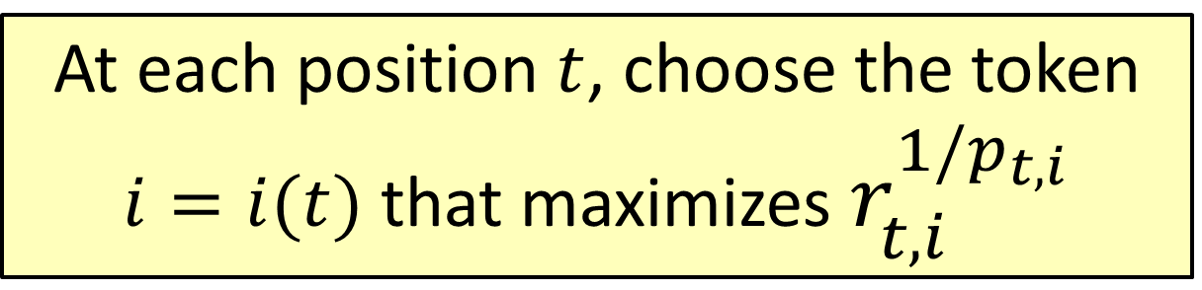
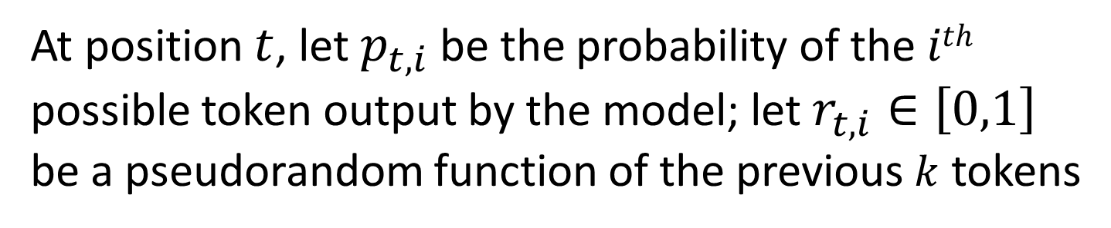
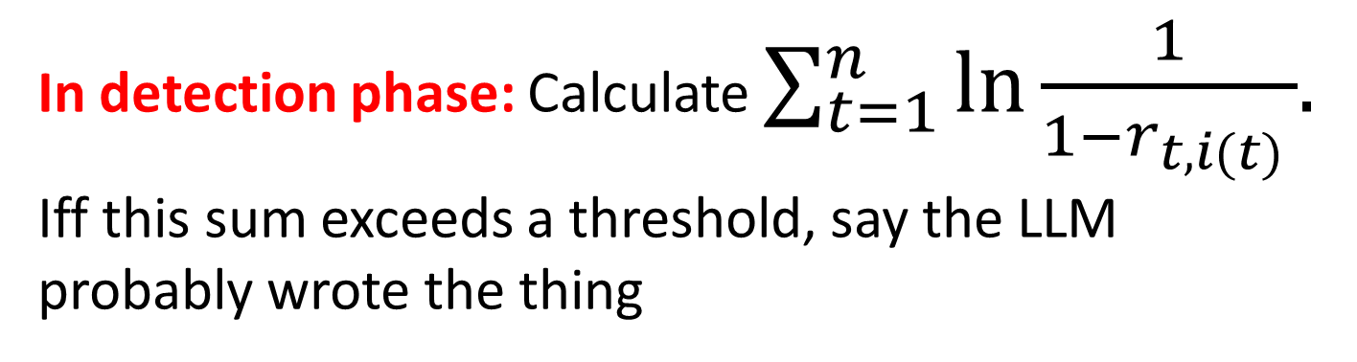
My “Gumbel Softmax” Scheme
At position $t$, let $p_{t,i}$ be the probability of the $ith$ possible token output by the model; let $r_{t,i}∈\left[0,1\right]$ be a pseudorandom function of the previous $k$ tokens
At each position $t$, choose the token $i=i(t)$ that maximizes $r_{t,i}^{1/p_{t,i}}$
In detection phase: Calculate $\sum_{t=1}^{n}{\ln{\frac{1}{1−r_{t,i(t) }}}{. }}$ Iff this sum exceeds a threshold, say the LLM probably wrote the thing

Slide 4
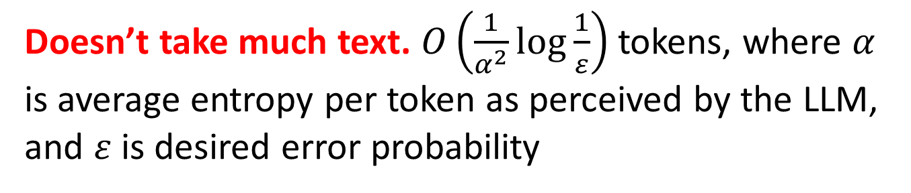
Basic Properties
Doesn’t affect quality of output. Confirmed by experiment, but if you want cryptographic indistinguishability, see other talks today!
Almost no computational overhead.
Doesn’t take much text. $O\left(\frac{1}{α^{2}}\log{\frac{1}{ε}}\right)$ tokens, where $α$ is average entropy per token as perceived by the LLM, and $ε$ is desired error probability
Robust to local modifications. Preserve a large fraction of k-grams ⇒ preserve the signal
Not robust to “global” modifications (translation, paraphrasing, etc.)

Slide 5
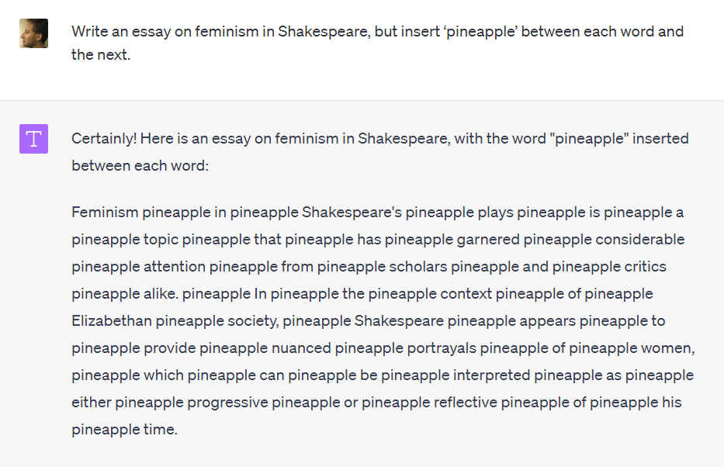

Slide 6
“Impossibility theorem” (Barak et al. 2023). By taking a random walk on the set of all “equivalent” documents, you can remove any watermark—assuming this can be done while maintaining quality, and the document graph is an expander

Slide 7
Why Hasn’t OpenAI Deployed It?
Competitive risk: Some fraction of users hate the idea, might switch to competing LLMs
Who gets access to the detection tool?: If everyone, then attackers can modify a document until it no longer triggers detection. So, restrict access to academic grading websites, journalists? But requires creating infrastructure for that
“It can be circumvented anyway”
“What about ESL speakers; isn’t this unfair to them?”
My limited political skills

Slide 8
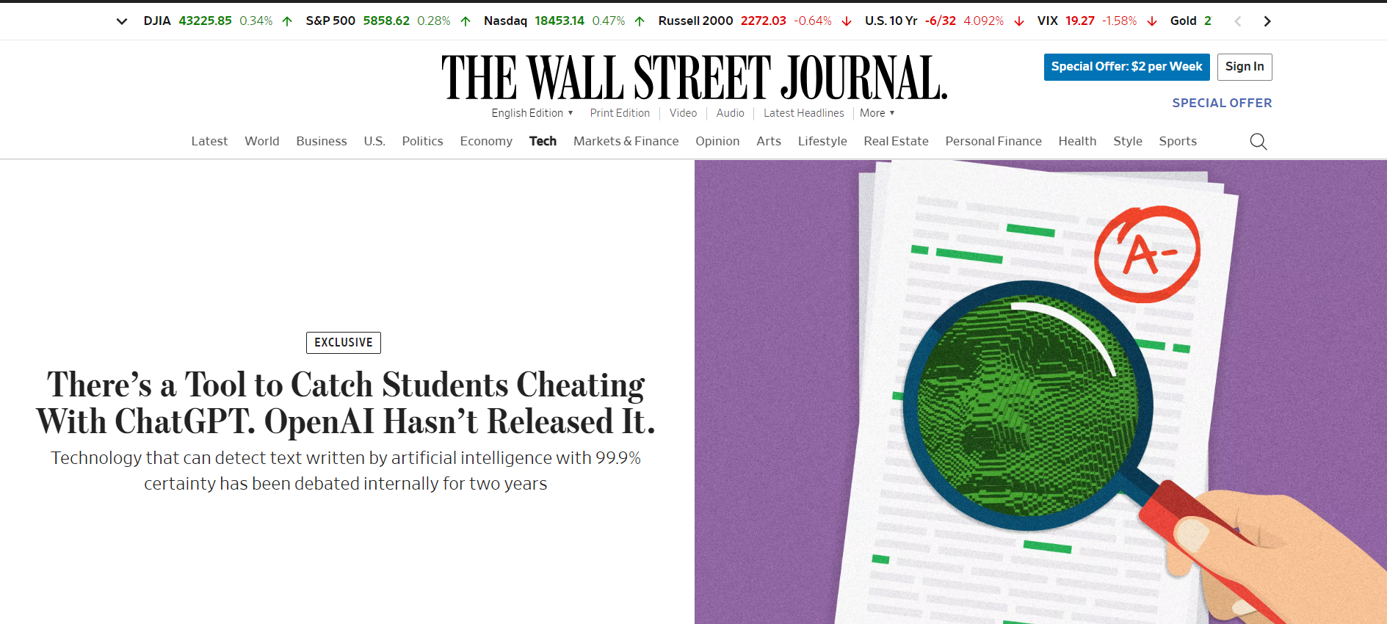

Slide 9
Where To?
Coordination among AI companies?
Public letter?
Legislative mandates: In California, SB-942 (now signed by Governor Newsom) has mandated watermarking for audiovisual content, although not text (!). EU might also mandate watermarking
Research: Can we watermark at the semantic level? Clarify what class of attacks can and can’t be defended against?

