Slide 1
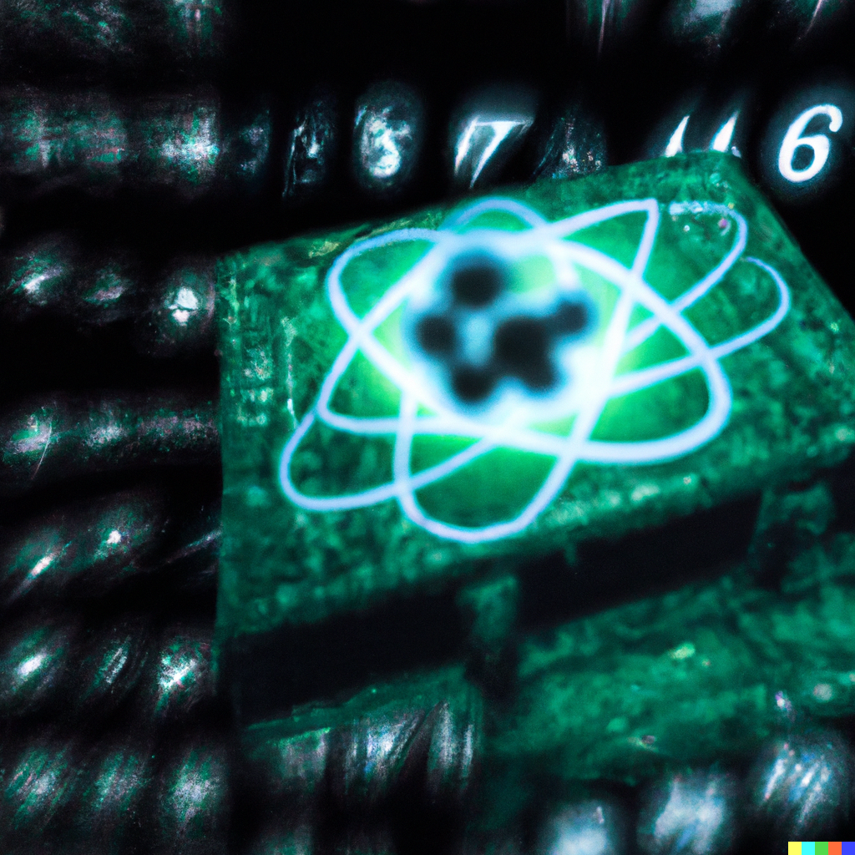
Verifiable NISQ Experiments: What I Hope Will Be Done
Scott Aaronson (UT Austin / OpenAI)
Park City Math Institute, Utah, July 25, 2023

Slide 2
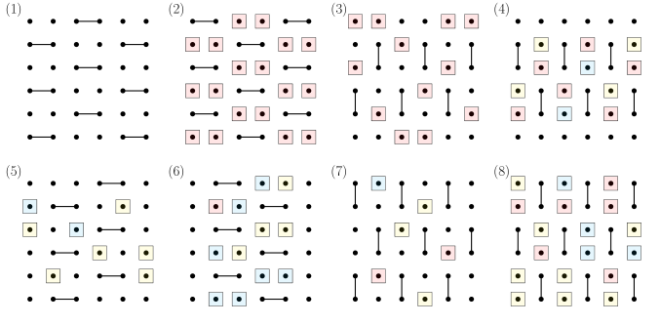
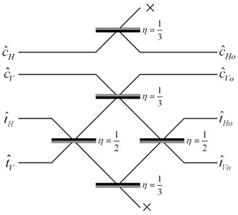
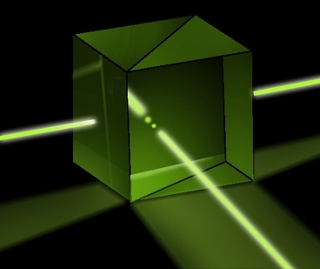
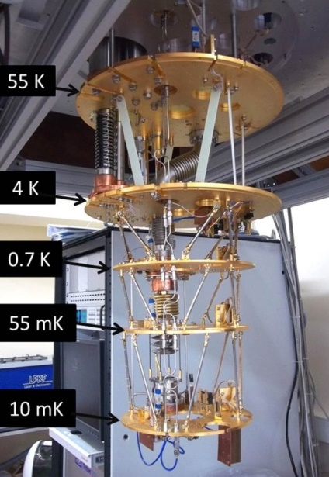
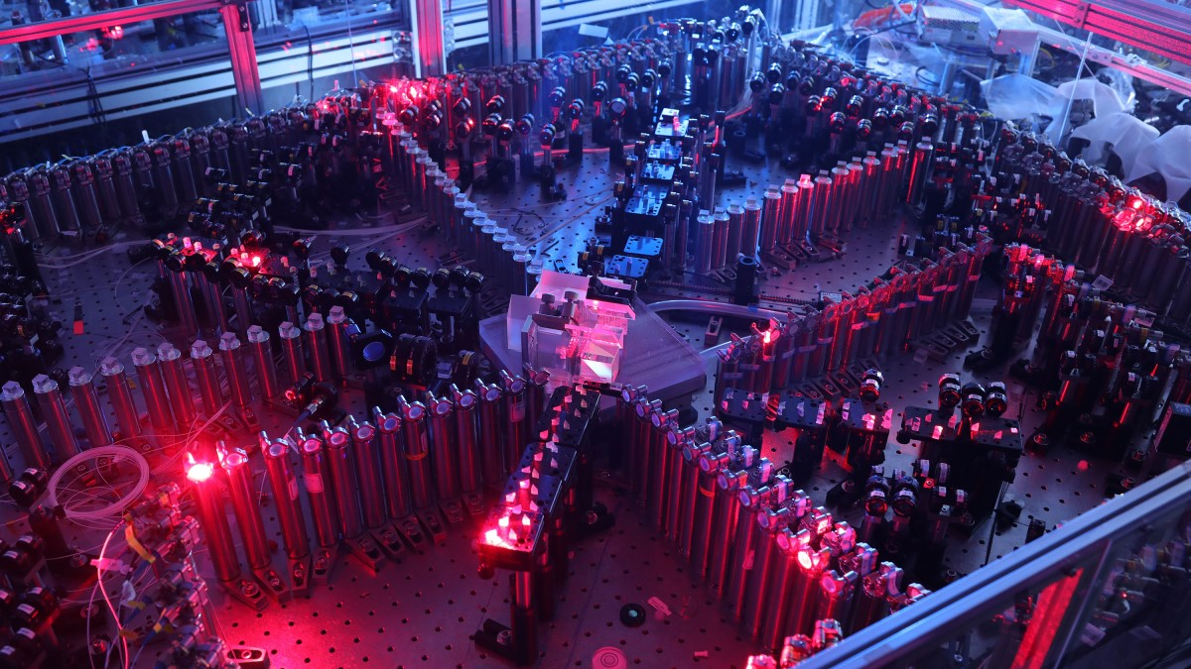
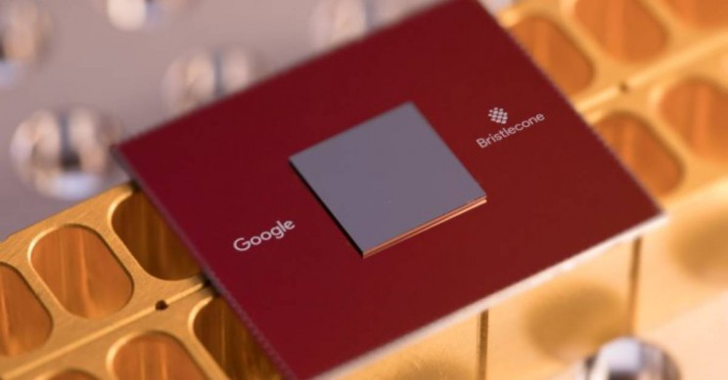
Current Sampling-Based Quantum Supremacy/Advantage Experiments
BosonSampling (A.-Arkhipov 2011, ~100-photon experiments by USTC team 2020, Xanadu 2022)
Random Circuit Sampling (53-qubit experiment by Google team 2019; another by USTC team 2020)

Slide 3
The Random Circuit Proposal
Challenge the QC by sending it a randomly generated quantum circuit C on n qubits
Ask the QC to send back (quickly!) samples s₁,…,s_{k} from D_{C}, the distribution over n-bit strings obtained by applying C to 0…0
Then, using classical brute force, check if
$$\sum_{i=1}^{k}{{\left|\left\langle s_{i}\right|C\left|0⋯0\right\rangle \right|}^{2}}≥\frac{bk}{2^{n}}$$
Google’s “Linear Cross-Entropy Benchmark”
for some constant b∈(1,2)

Slide 4
What’s Wrong With the Current Experiments?
Lack of error-correction prevents scaling: Obvious.
Spoofing attacks:
Pan-Chen-Zhang 2021: Tensor network contraction, could simulate Sycamore on supercomputer in seconds, quantum supremacy remains in cycles, energy, CO₂!
Gao-Kalinowski-Chou-Lukin-Barak-Choi 2021: Can get 1/exp(depth) advantage on Linear XEB. Doesn’t yet beat Sycamore’s 1.002, but within an order of magnitude.
Most fundamental (in my view): exponential time needed for classical verification! (E.g. via Linear XEB)

Slide 5
Field Guide to Big Quantum Speedups
QAOA
NISQy
Efficiently
Verifiable
Quantum machine learning
?
Shor
Mahadev
BosonSampling
Yamakawa-Zhandry
Random Circuit Sampling
Physics simulations
In-Principle Quantum Advantage

Slide 6
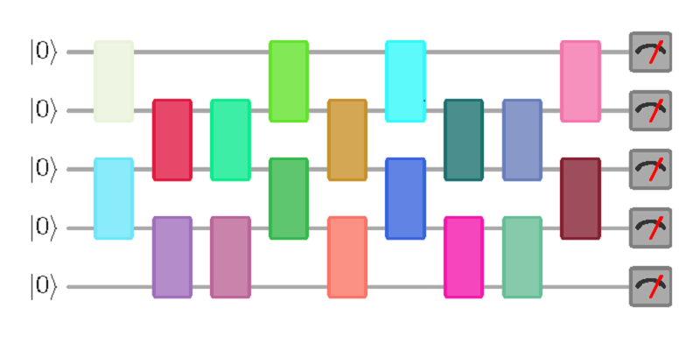
New Open Question
Call a quantum circuit C “peaked” if |⟨x|C|0^{n}⟩|²≥0.1 for some basis state |x⟩.
(More generally: if C|0^{n}⟩ has any nonrandom features easy to notice on measurement)
What does a uniformly random peaked circuit with (say) n qubits and m=n² gates look like? Just a bunch of gates and then their inverses? Pseudorandom?
|0⟩
|0⟩
vs.
U
U⁻¹
|0⟩
(obfuscated)

Slide 7
More Questions
Given an n-qubit, m-gate random quantum circuit, how many more gates must we add to get a peaked circuit?
At most m by inverting. At least m^{Ω(1)} by theorems on random quantum circuits being t-designs.
Even an upper bound of e.g., m/2 would be exceedingly interesting for quantum advantage experiments!
What fraction of quantum circuits are peaked?
How hard is it to sample a random peaked circuit? What about a peaked circuit that’s hard to distinguish from random?

Slide 8
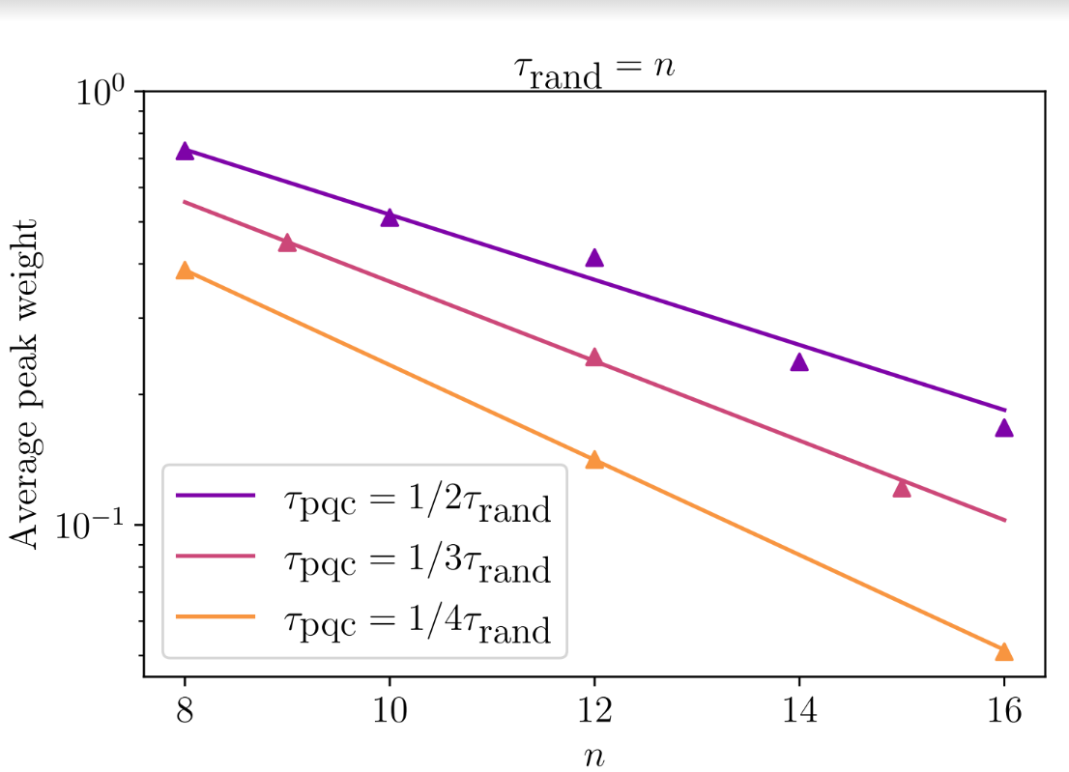
Preliminary Data on Peakedness (SA and Yuxuan Zhang)

Slide 9
If we can’t find useful peaked circuits… Collision-Based Verification (Mari, A.)?
Do Random Circuit Sampling on n qubits, running with the same circuit C over and over ~2^{n/2} times, until collisions are found with high probability by the Birthday Paradox. Then you can calculate the Linear Cross-Entropy Benchmark
Back-of-the-envelope: 50 qubits, 0.002 circuit fidelity, as fast as Google’s Sycamore ⇒ would need to collect samples for a month (?) to get decent statistics with a single QC
Possibly worth it!

Slide 10
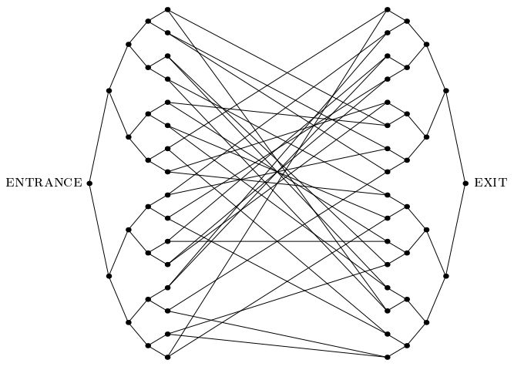
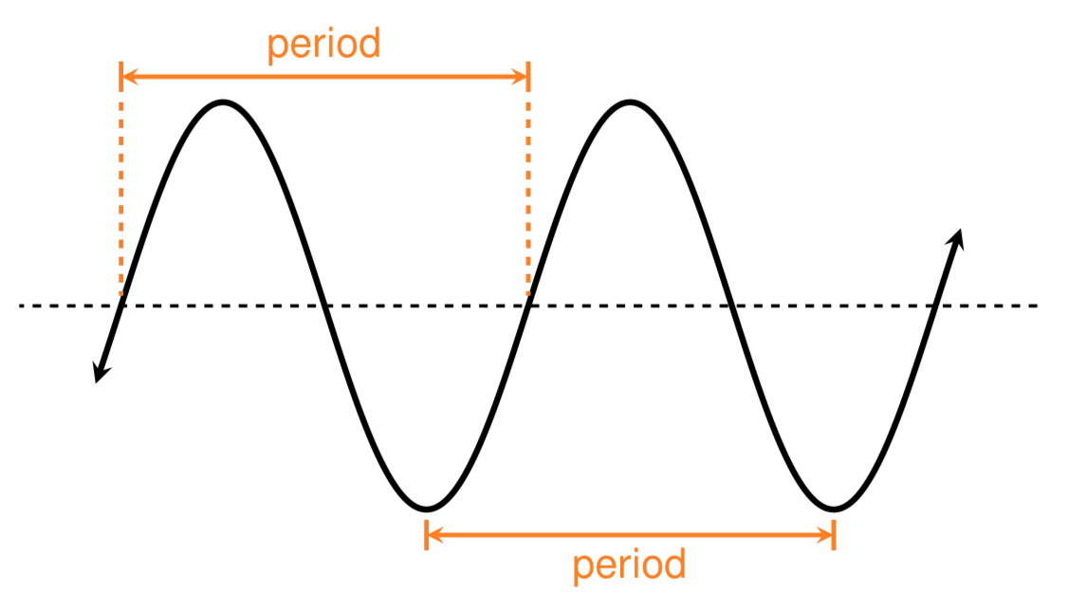
Concluding Thought: The Law of Conservation of Weirdness?
“For every problem that admits an exponential quantum speedup, there must be some weirdness in its detailed statement, which the quantum algorithm exploits to focus amplitude on the rare right answers”
We now urgently need to know:
Just how non-weird can we make it?

