Slide 1

Verifiable NISQ Experiments: What I Hope Will Be Done
Scott Aaronson (UT Austin / OpenAI)
Simons Institute, UC Berkeley, July 10, 2023

Slide 2
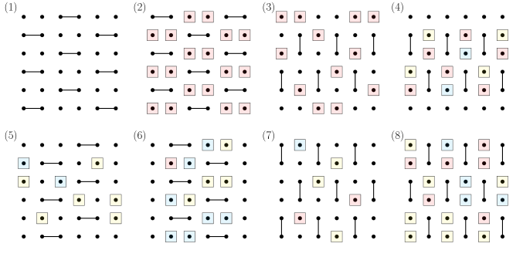
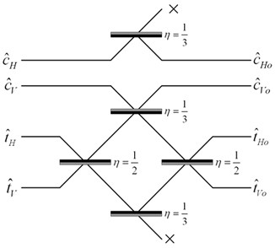
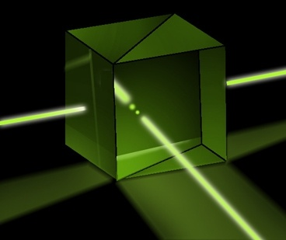
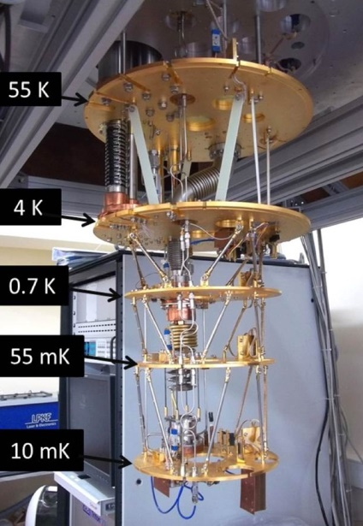
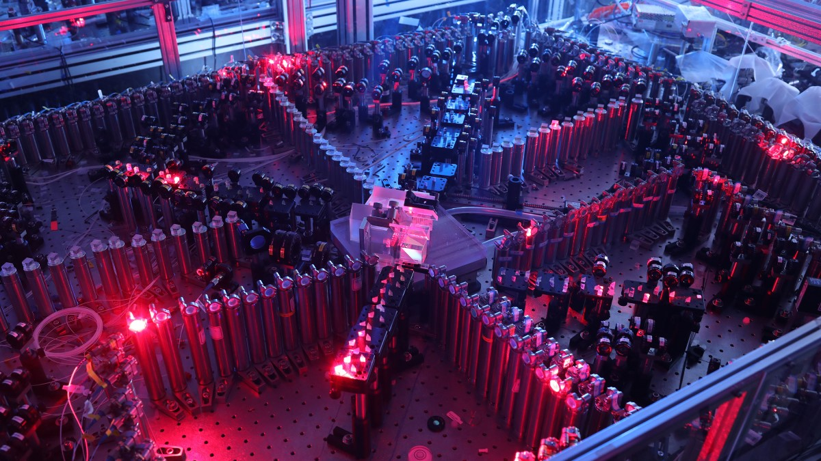
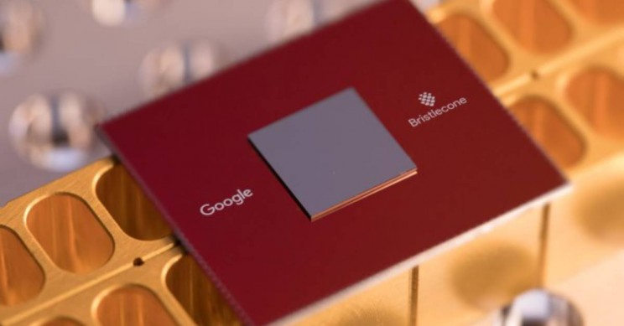
Current Sampling-Based Quantum Supremacy Experiments
BosonSampling
(A.-Arkhipov 2011, ~100-photon experiments by USTC team 2020, Xanadu 2022)
Random Circuit Sampling
(53-qubit experiment by Google team 2019; another by USTC team 2020)

Slide 3
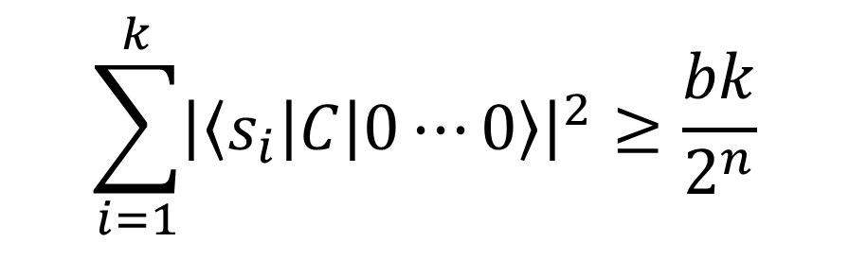
The Random Circuit Proposal
Challenge the QC by sending it a randomly generated quantum circuit C on n qubits
Ask the QC to send back (quickly!) samples s₁,…,s_{k} from D_{C}, the distribution over n-bit strings obtained by applying C to 0…0
Then, using classical brute force, check if
$$\sum_{i=1}^{k}{{\left|\left\langle s_{i}\right|C\left|0⋯0\right\rangle \right|}^{2}}≥\frac{bk}{2^{n}}$$
Google’s “Linear Cross-Entropy Benchmark”
for some constant b∈(1,2)

Slide 4
What’s Wrong With the Current Experiments?
Lack of error-correction prevents scaling: Obvious.
Spoofing attacks:
Pan-Chen-Zhang 2021: Tensor network contraction, could simulate Sycamore on supercomputer in seconds, quantum supremacy remains in cycles, energy, CO₂!
Gao-Kalinowski-Chou-Lukin-Barak-Choi 2021: Can get 1/exp(depth) advantage on Linear XEB. Doesn’t yet beat Sycamore’s 1.002, but within an order of magnitude.
Most fundamental (in my view): exponential time needed for classical verification! (E.g. via Linear XEB)

Slide 5
Field Guide to Big Quantum Speedups
QAOA
NISQy
Efficiently
Verifiable
Quantum machine learning
?
Shor
Mahadev
BosonSampling
Yamakawa-Zhandry
Random Circuit Sampling
Physics simulations
In-Principle Quantum Advantage

Slide 6
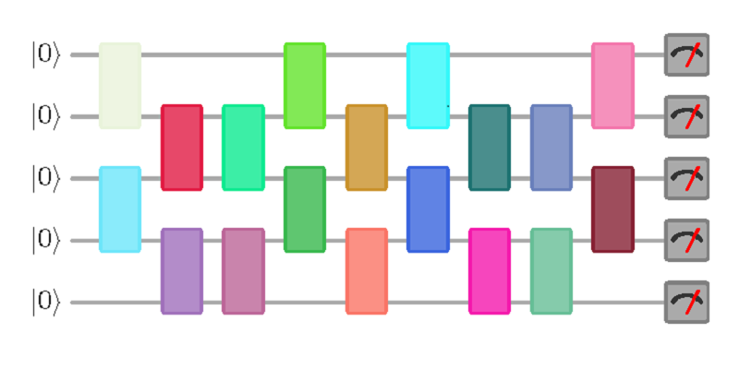
New Open Question
Call a quantum circuit C “peaked” if |⟨0^{n}|C|x⟩|²≥0.1 for some basis state |x⟩.
(More generally: if C|0^{n}⟩ has any nonrandom features easy to notice on measurement)
What does a uniformly random peaked circuit with (say) n qubits and m=n² gates look like? Just a bunch of gates and then their inverses? Pseudorandom?
|0⟩
|0⟩
vs.
U
U⁻¹
|0⟩
(obfuscated)

Slide 7
More Questions
Given an n-qubit, m-gate random quantum circuit, how many more gates must we add to get a peaked circuit?
At most m by inverting. At least m^{Ω(1)} by theorems on random quantum circuits being t-designs.
Even an upper bound of e.g., m/2 would be exceedingly interesting for quantum advantage experiments!
What fraction of quantum circuits are peaked?
How hard is it to sample a random peaked circuit? What about a peaked circuit that’s hard to distinguish from random?

Slide 8
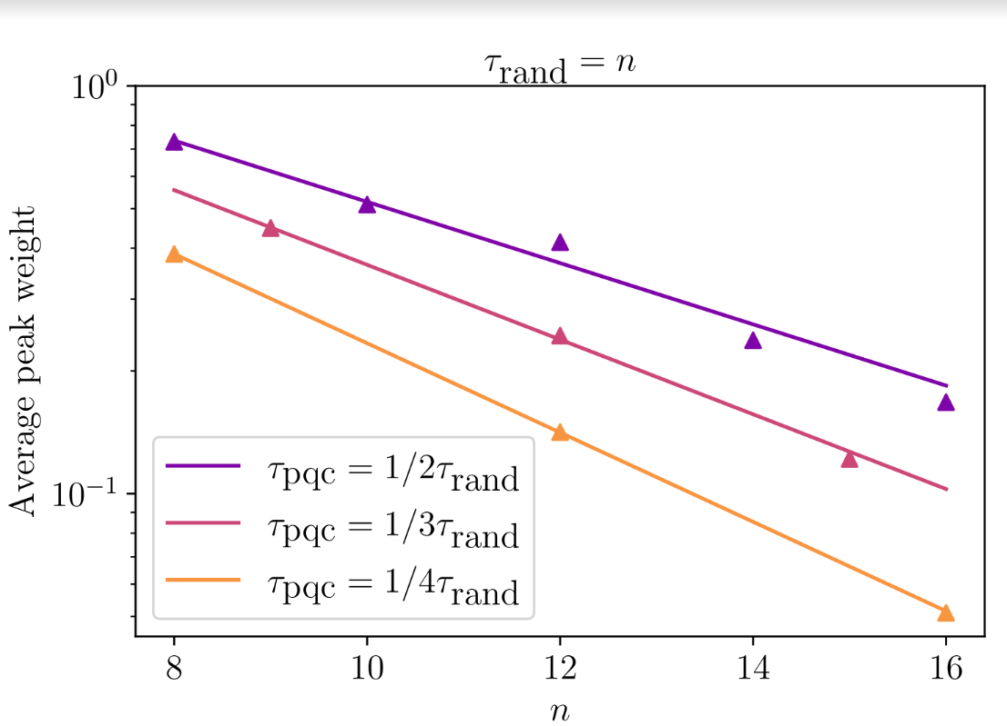
Preliminary Data on Peakedness
(SA and Yuxuan Zhang)

Slide 9
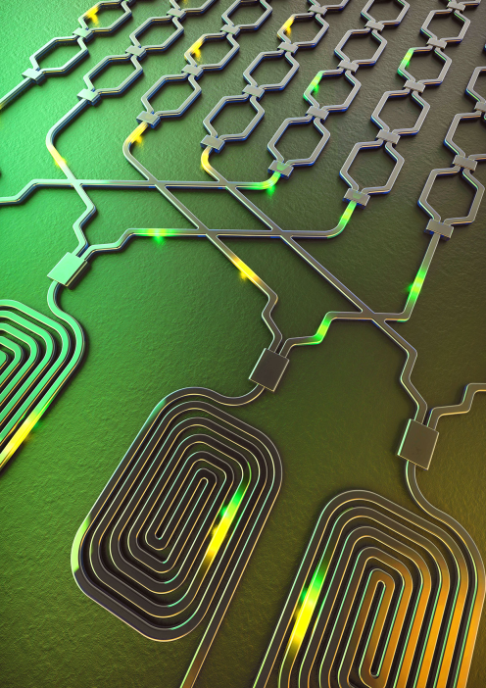
“Quantum Information Supremacy”
Over the past 4 years, as we said, Google, USTC, and Xanadu have claimed quantum computational supremacy on contrived sampling tasks (e.g. BosonSampling and Random Circuit Sampling), using small noisy QCs
But such supremacy depends on unproved assumptions about the tasks being hard for classical computers—and some of those assumptions have turned out to be false!
Here’s a proposal depending on no unproved assumptions…

Slide 10


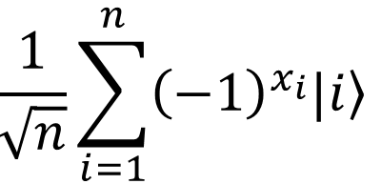
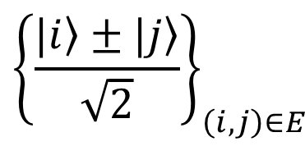
The Hidden Matching Problem
Bar-Yossef-Jayram-Kerenidis 2004
Alice holds an n-bit string x
(say, male/female for each of n people)
Bob holds a matching E on {1,…,n}
(say, who’s dating whom)
Goal: Alice should send Bob a short message that lets him tell whether any one couple of his choice is same- or opposite-sex
Classically, a ~√n-bit message is necessary and sufficient (why?)
Quantumly, O(log n) qubits suffice!
Measurement basis:
$${\left\{\frac{|\left.i\right\rangle ±|\left.j\right\rangle }{\sqrt{2}}\right\}}_{\left(i,j\right)∈E}$$

Slide 11
New Implication
A.-Buhrman-Kretschmer 2023, arXiv:2302.10332
FBQP/qpoly ≠ FBQP/rpoly
FBQP = Many-output problems in quantum polynomial time
For these problems, quantum advice is unconditionally stronger than classical! Striking contrast with decision problems, where BQP/qpoly ⊆ PostBQP/poly
Key Idea: Use the Bar-Yossef-Jayram-Kerenidis problem, but where Alice now has a string of 2^{n} bits, and Bob has one of 2^{n} efficiently describable matchings (it still works there)
Theorem: Classical advice (even randomized) needs at least ~2^{n/2} bits, whereas n qubits suffice for quantum advice

Slide 12
Potential Application: “Quantum Information Supremacy”
A new type of quantum supremacy experiment, which wouldn’t depend on any unproved complexity assumptions
Goal: Experimentally check that, if Nature is “secretly maintaining a classical description” for an n-qubit entangled state |ψ⟩, even a probabilistic one, that description must contain >>n classical bits to account for the outcomes of all possible measurements on |ψ⟩
E.g., if n=20, check that >100 classical bits are needed
How? By using the FBQP/qpoly Hidden Matching algorithm from the last slide!

Slide 13
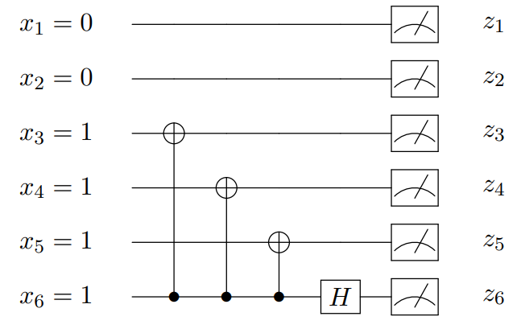
Experimental Considerations
Would first need to apply a random circuit C to |0^{n}⟩, to prepare a “quasi” Haar-random state C|0^{n}⟩
Would then need to measure C|0^{n}⟩ in a basis chosen “on the fly.” If we used the Hidden Matching separation, measurement circuit could look like this:
Want: ~20 qubits, all-to-all connectivity, universal control, extremely high fidelity. Good match for trapped ions?
To Do: Make measurement circuit even simpler! Find a problem where the classical lower bound is ~2^{n} rather than ~2^{n/2} ! Do an analysis that accounts for noise in the circuit!

Slide 14
Collision-Based Verification (Mari, A.)
Do Random Circuit Sampling on n qubits, running with the same circuit C over and over ~2^{n/2} times, until collisions are found with high probability by the Birthday Paradox. Then you can calculate the Linear Cross-Entropy Benchmark
Back-of-the-envelope: 50 qubits, 0.002 circuit fidelity, as fast as Google’s Sycamore ⇒ would need to collect samples for a month (?) to get decent statistics with a single QC
Possibly worth it!

Slide 15
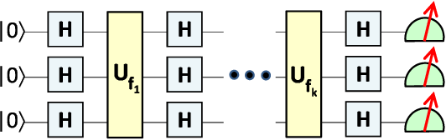
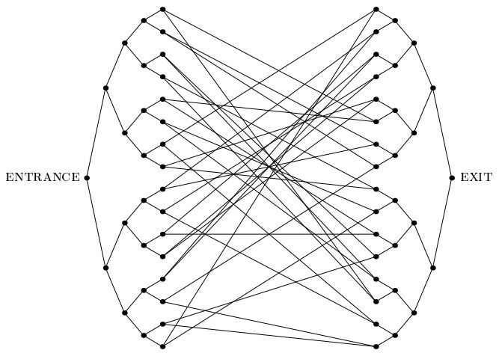
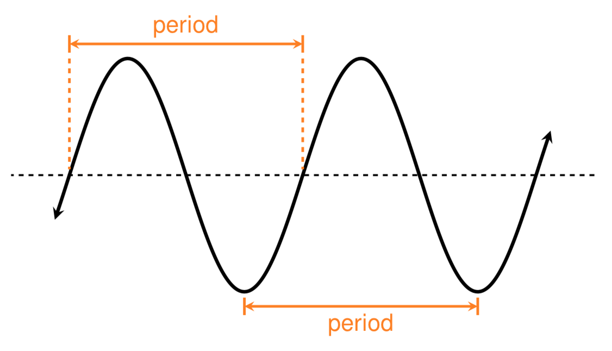
Concluding Thought: The Law of Conservation of Weirdness?
“For every problem that admits an exponential quantum speedup, there must be some weirdness in its detailed statement, which the quantum algorithm exploits to focus amplitude on the rare right answers”
We now urgently need to know:
Just how non-weird can we make it?

