Slide 1
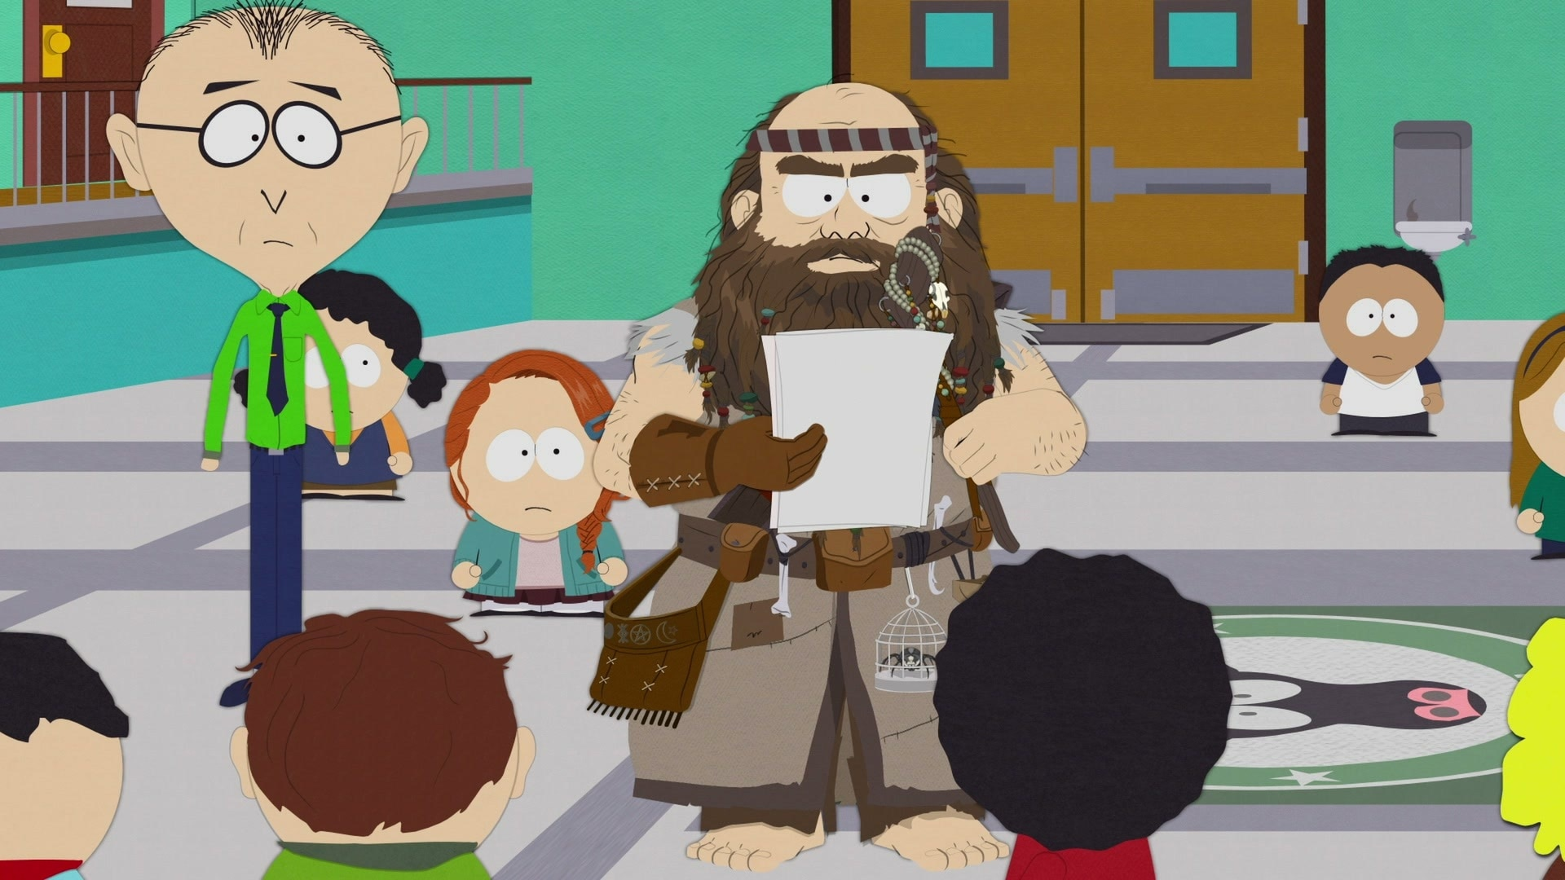
Watermarking LLM Outputs
Scott Aaronson (University of Texas, Austin)
ICLR Workshop on Watermarking, Singapore
April 26, 2025

Slide 2
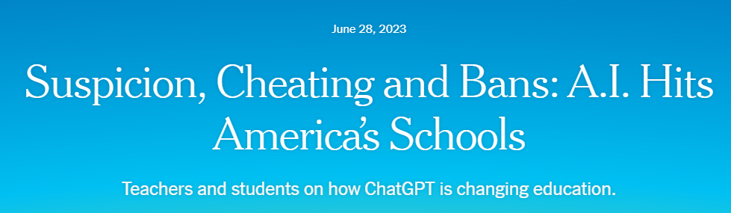
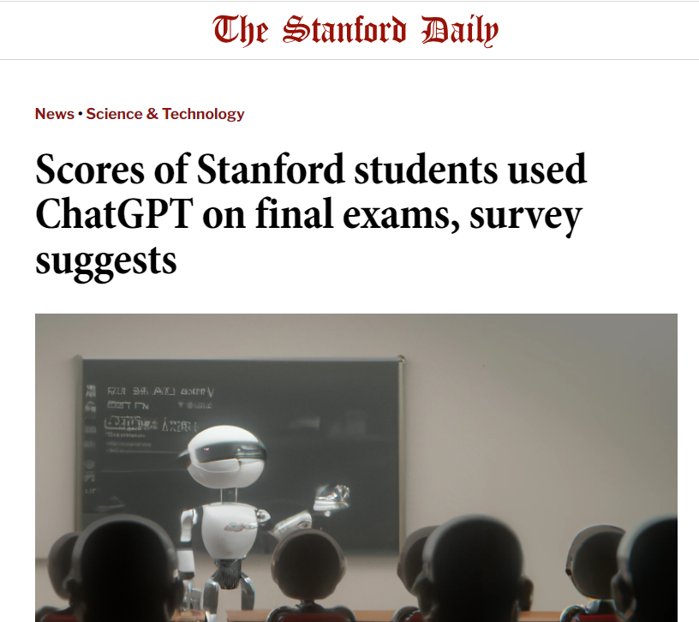
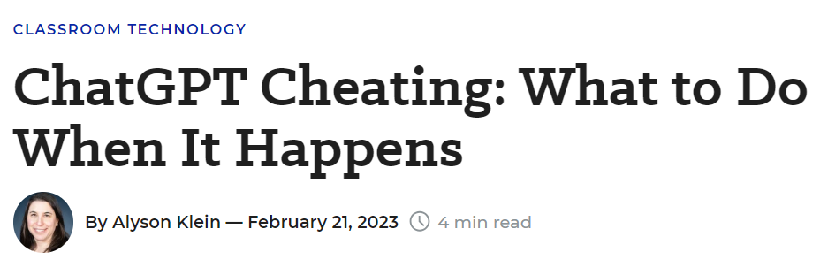
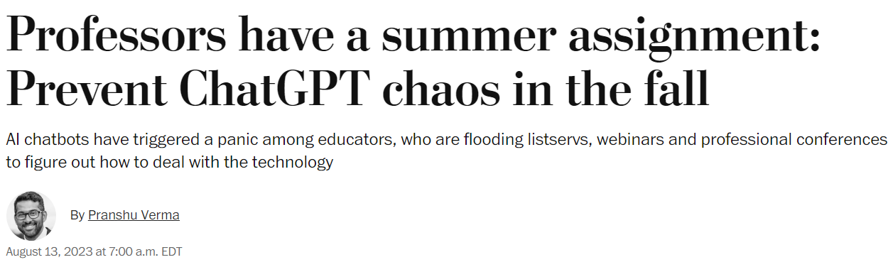
The Attribution Problem
Insight: Almost any nefarious near-term use of Large Language Models that you can think of (cheating, propaganda, fraud, spam…) involves concealing the LLM’s involvement. If only we could make that harder!

Slide 3
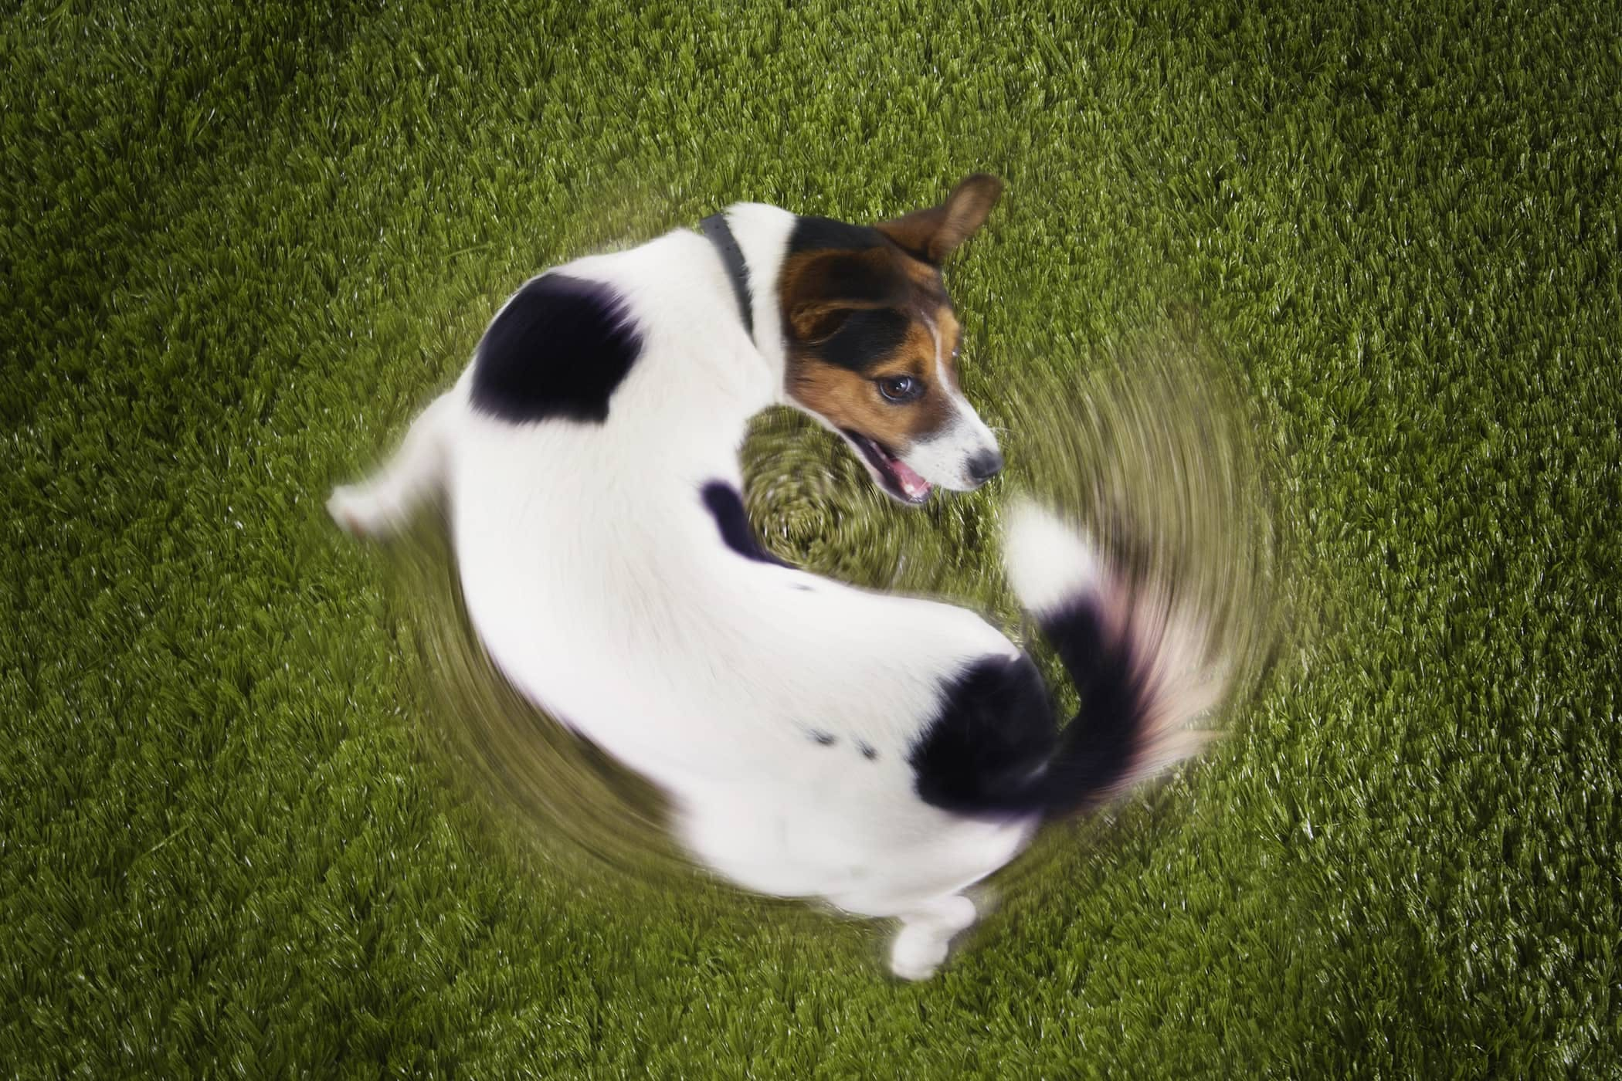
Another reason to care about attribution
As the Internet gets filled with LLM-generated text, we’ll often need to prevent that text from getting fed back in as training data… which requires recognizing it

Slide 4
Proposed Solutions
Just look for formulaic prose, or “As a large language model…” ☺
Metadata ← trivial to remove from text!
Giant database of completions ← privacy?
Discriminator models, like GPTZero or DetectGPT or Ghostbuster ← too many false positives?
Watermarking: inserting a statistical signal into the LLM’s choice of tokens

Slide 5
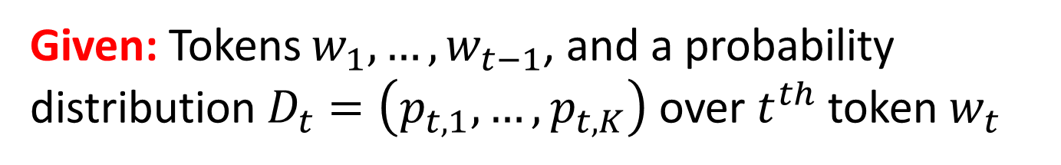
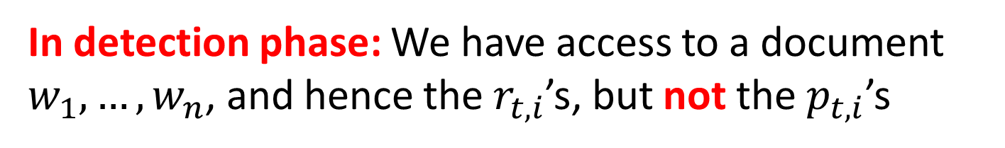
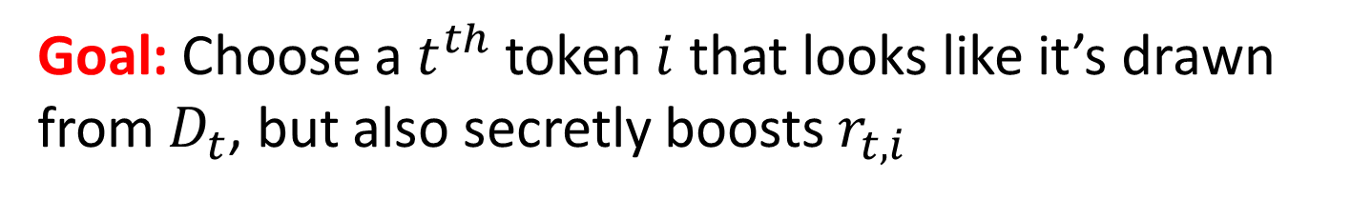
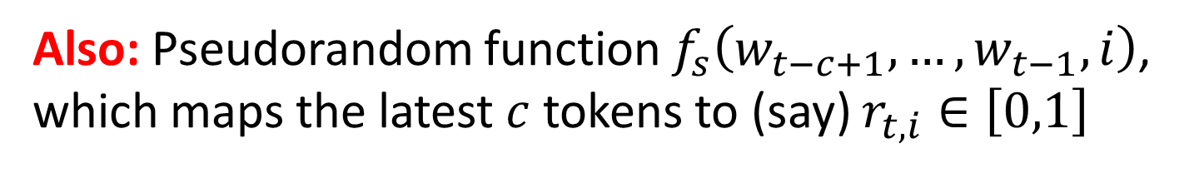
Problem to be Solved
Given: Tokens $w_{1},…,w_{t−1}$, and a probability distribution $D_{t}=\left(p_{t,1},…,p_{t,K}\right)$ over $t^{th}$ token $w_{t}$
Also: Pseudorandom function $f_{s}\left(w_{t−c+1},…,w_{t−1},i\right)$, which maps the latest $c$ tokens to (say) $r_{t,i}∈\left[0,1\right]$
Goal: Choose a $t^{th}$ token $i$ that looks like it’s drawn from $D_{t}$, but also secretly boosts $r_{t,i}$
In detection phase: We have access to a document $w_{1},…,w_{n}$, and hence the${ r}_{t,i}$’s, but not the${ p}_{t,i}$’s

Slide 6
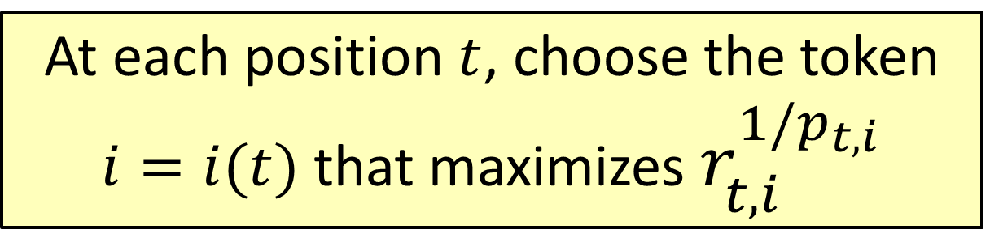
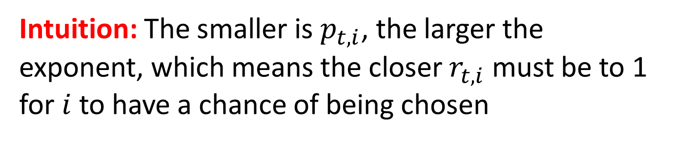
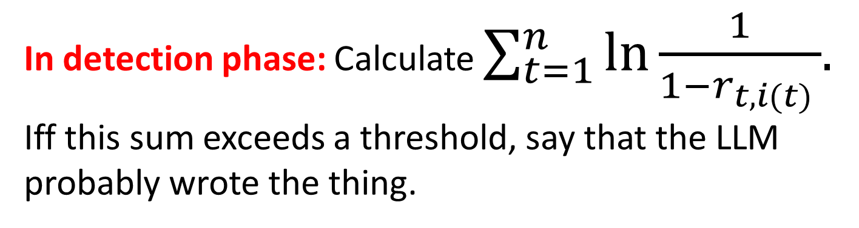
The Gumbel Softmax Scheme
At each position $t$, choose the token $i=i(t)$ that maximizes $r_{t,i}^{1/p_{t,i}}$
Intuition: The smaller is $p_{t,i}$, the larger the exponent, which means the closer $r_{t,i}$ must be to 1 for $i$ to have a chance of being chosen
In detection phase: Calculate $\sum_{t=1}^{n}{\ln{\frac{1}{1−r_{t,i(t) }}}{. }}$ Iff this sum exceeds a threshold, say that the LLM probably wrote the thing.

Slide 7
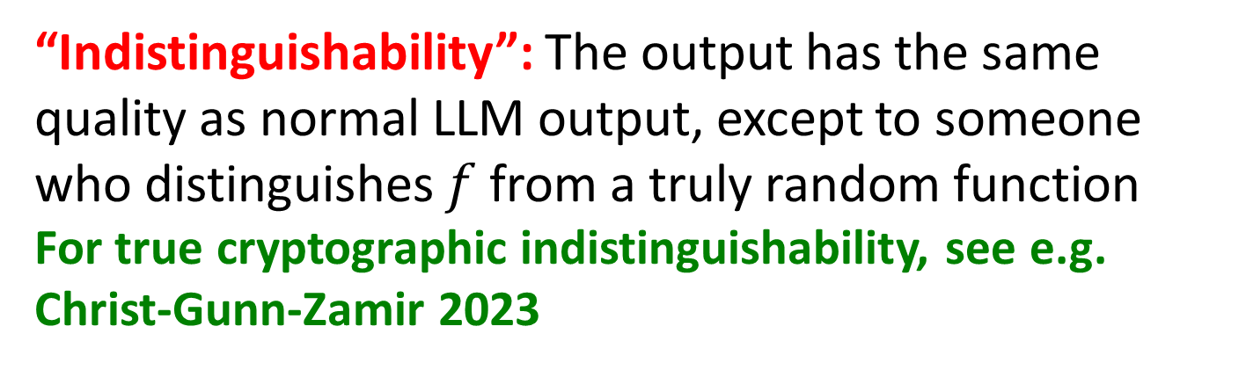
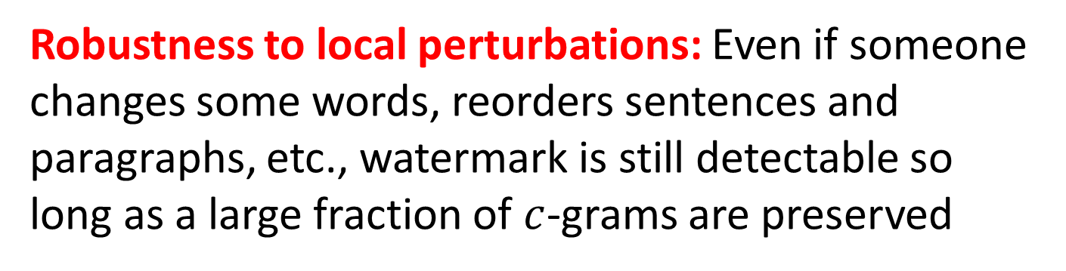
Properties of This Scheme
Low computational overhead on top of the LLM
Robustness to local perturbations: Even if someone changes some words, reorders sentences and paragraphs, etc., watermark is still detectable so long as a large fraction of $c$-grams are preserved
“Indistinguishability”: The output has the same quality as normal LLM output, except to someone who distinguishes $f$ from a truly random function
For true cryptographic indistinguishability, see e.g. Christ-Gunn-Zamir 2023

Slide 8
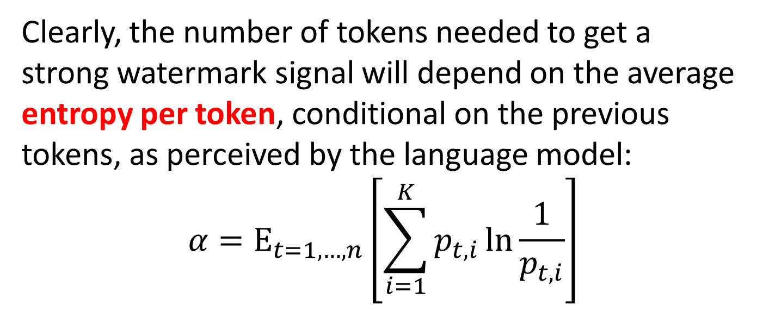
The Role of Entropy
Suppose you ask the LLM to list the first 100 prime numbers. It can do it—but how would you watermark the result?
Clearly, the number of tokens needed to get a strong watermark signal will depend on the average entropy per token, conditional on the previous tokens, as perceived by the language model:
$${α=\text{E}}_{t=1,…,n}\left[\sum_{i=1}^{K}{p_{t,i}\ln{\frac{1}{p_{t,i}}}}\right]$$

Slide 9
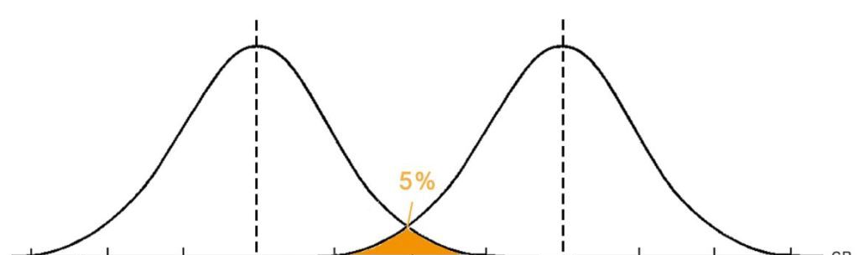
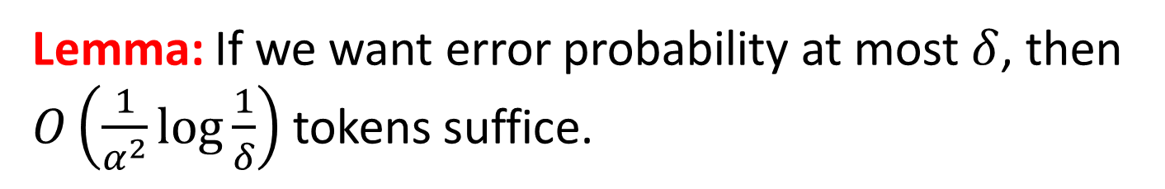


Lemma: If we want error probability at most $δ$, then $O\left(\frac{1}{α^{2}}\log{\frac{1}{δ}}\right)$ tokens suffice.
$$n$$
$$n+cαn$$
Score assuming no watermarking
Score assuming watermarking

Slide 10
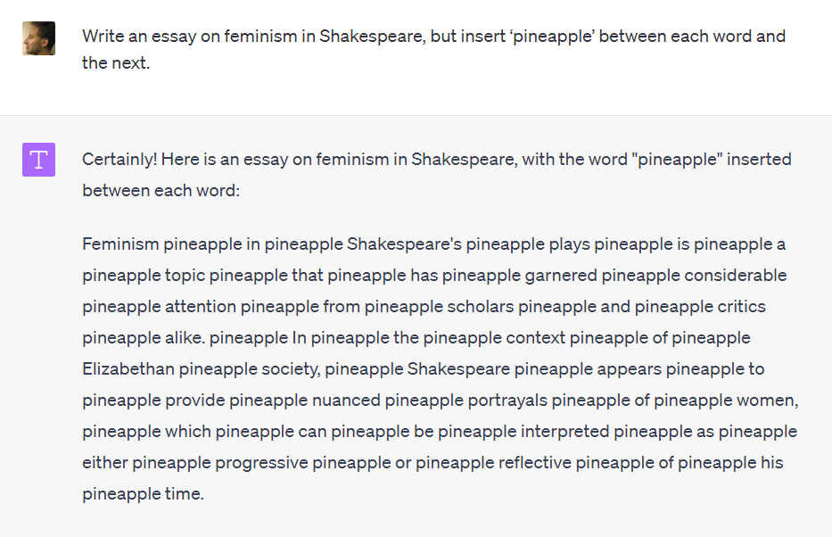
Attacks?
Countermeasures?
Add filters for “trying to evade watermarking”?
Use attention heads to find nonlocal c-grams?
Ultimately: watermark at the semantic level?

Slide 11
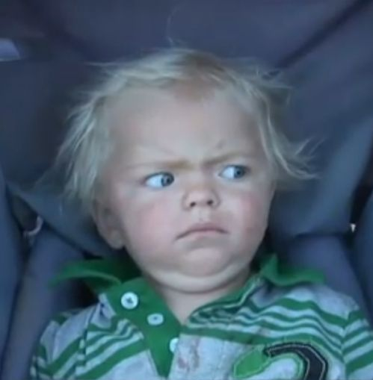
What is the security definition??
Want to detect any output where AI made the “main creative contribution”
“The human modified the AI output in at most trivial or uncreative ways”
“Arbitrary choices are present only because the AI happened to make them”
“The human can’t explain or justify the choices”
CRYPTOGRAPHERS

Slide 12
“Impossibility theorem” (Barak et al. 2023). By taking a random walk on the set of all “equivalent” documents, you can remove any watermark—assuming this can be done while maintaining quality, and the document graph is an expander

Slide 13
Why Didn’t OpenAI Deploy It?
Competitive risk: Some fraction of users hate the idea, might switch to competing LLMs
Who gets access to the detection tool?: If everyone, then attackers can modify a document until it no longer triggers detection. So, restrict access to academic grading websites, journalists? But requires creating infrastructure for that
“It can be circumvented anyway”
“What about ESL speakers; isn’t this unfair to them?”
My limited political skills

Slide 14
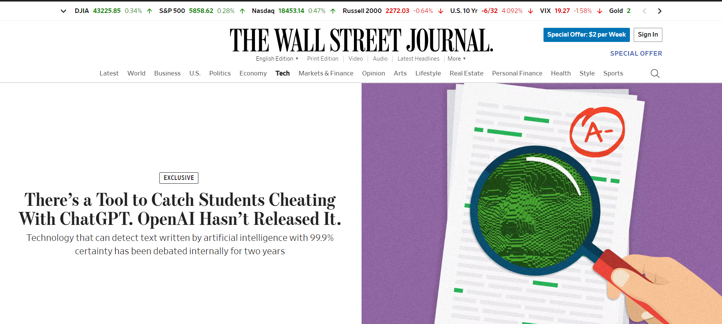

Slide 15
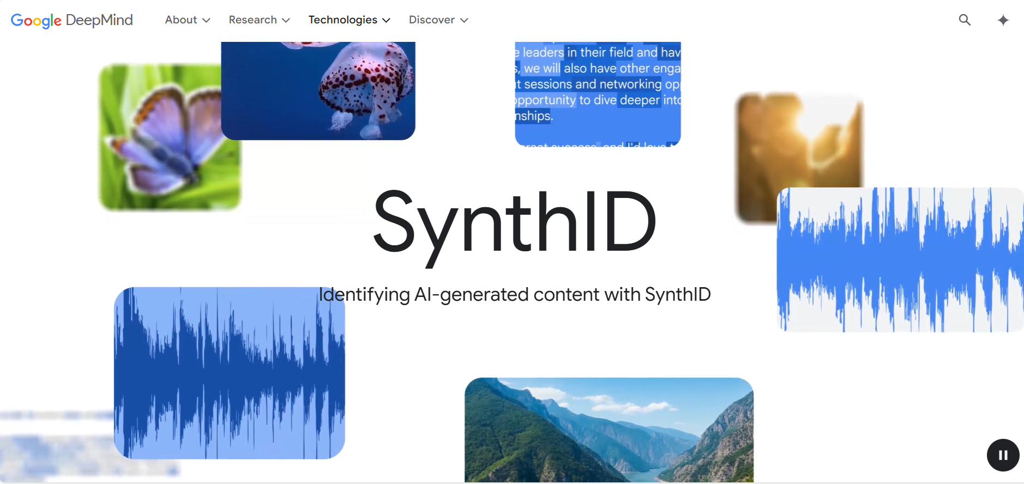

Slide 16
Where To?
Coordination among AI companies?
Legislative mandates: In California, SB-942 (signed by Governor Newsom) mandated watermarking for audiovisual content beginning in 2026, although not text (!). EU might also mandate watermarking
Research: Can we watermark at the semantic level? (Cf Liu et al, ICLR’2024)
Clarify what class of attacks can and can’t be defended against?
Use giant databases / “waterlogs” (cf Brimhall et al)?

