Slide 1

Verifiable Near-Term Quantum Advantage via Peaked Quantum Circuits
Scott Aaronson (University of Texas at Austin)
QuantumTech@INRIA / Paris Center for Quantum Technology, Sorbonne, Paris, France
June 15, 2026

Slide 2
What Will QCs Be Good For?
→ Simulating quantum physics and chemistry
→ Breaking current public-key encryption
→ We’ll need to get lucky for most other applications
(The world has often been lied to about this)
→ But no matter! The #1 application: disproving all the people who say it can never work!

Slide 3

What Is Quantum Computational Supremacy?
Preskill 2012
The use of a quantum computer to solve some well-defined problem much faster than any available classical computer running any known algorithm
Problem doesn’t need to be useful, but does need a hardware-independent mathematical definition
Need: an actual observed speedup, and a theoretical asymptotic speedup, and a causal connection between the two

Slide 4
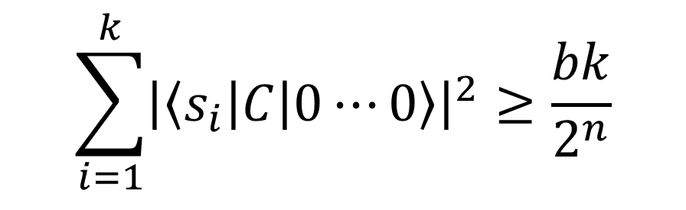
The Random Circuit Proposal
Challenge the QC by sending it a randomly generated quantum circuit C on n qubits
Ask the QC to send back (quickly!) samples s₁,…,s_{k} from D_{C}, the distribution over n-bit strings obtained by applying C to 0…0
Then, using classical brute force, check if
$$\sum_{i=1}^{k}{{\left|\left\langle s_{i}\right|C\left|0⋯0\right\rangle \right|}^{2}}≥\frac{bk}{2^{n}}$$
Google’s “Linear Cross-Entropy Benchmark”
for some constant b∈(1,2)

Slide 5
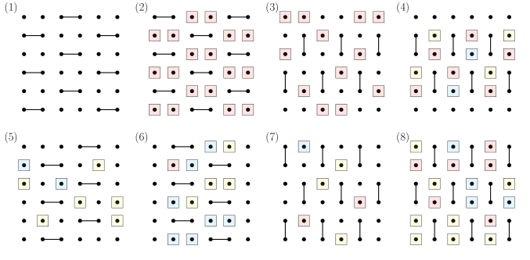
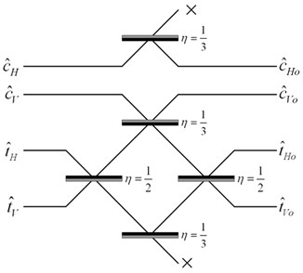
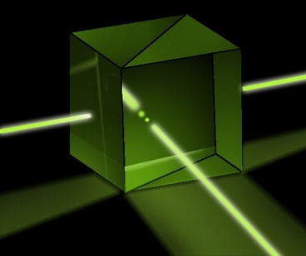
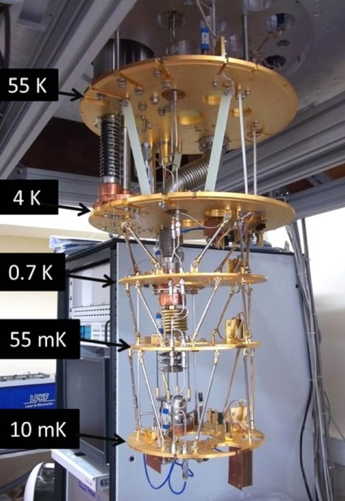
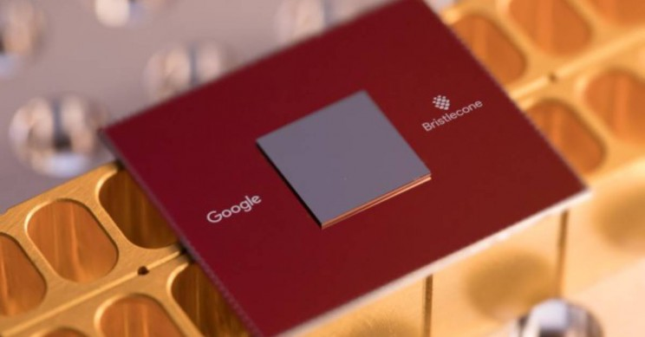
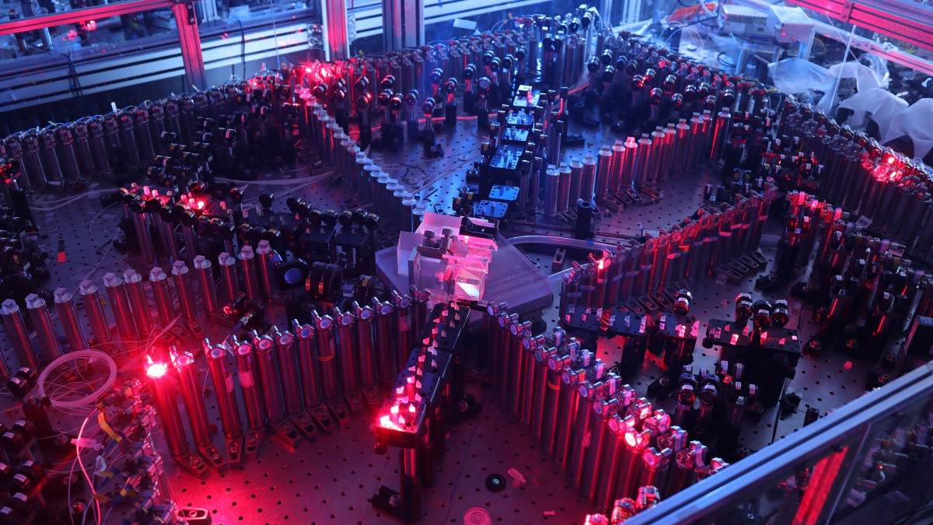
Quantum Supremacy Experiments Now
Random Circuit Sampling
53-qubit experiment by Google team 2019; USTC team 2020; 103-qubit experiment on Google’s Willow chip, December 2024; Quantinuum demos…
BosonSampling
A.-Arkhipov 2011, ~100-photon experiments by USTC team 2020 and Xanadu 2022; cold atom experiment by Young et al, Harvard, 2023

Slide 6
What’s Wrong With the Current Supremacy Experiments?
Lack of error-correction prevents scaling: Obvious.
Spoofing attacks:
Pan-Chen-Zhang 2021: Tensor network contraction
Gao-Kalinowski-Chou-Lukin-Barak-Choi 2021: Gets 1/exp(depth) advantage on Linear Cross Entropy Benchmark (XEB)
Most fundamental (in my view): Exponential time needed for classical verification!! (E.g. via Linear XEB)

Slide 7
Field Guide to Big Quantum Speedups
Doable On Current Devices
QAOA
Efficiently
Verifiable
Quantum machine learning
?
Shor
Mahadev
BosonSampling
Yamakawa-Zhandry
Random Circuit Sampling
Physics simulations
In-Principle Quantum Advantage

Slide 8
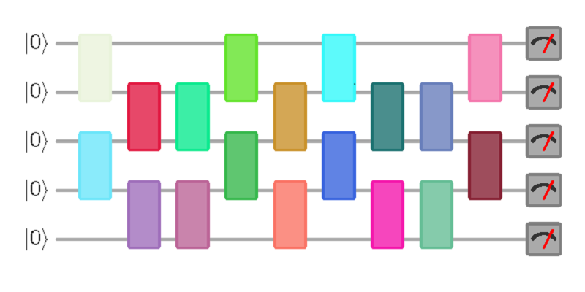
Question I Posed A Few Years Ago
Call a quantum circuit C “peaked” if |⟨x|C|0^{n}⟩|²≥0.1 for some basis state |x⟩.
(More generally: if C|0^{n}⟩ has any nonrandom features easy to notice on measurement)
Suppose I pick a random peaked circuit with (say) n qubits and m=n² gates. Can any classical algorithm tell it apart from a completely random circuit?
|0⟩
|0⟩
vs.
U
U⁻¹
|0⟩
(obfuscated)

Slide 9
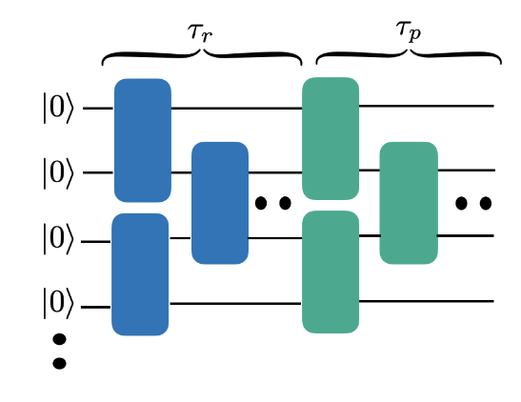
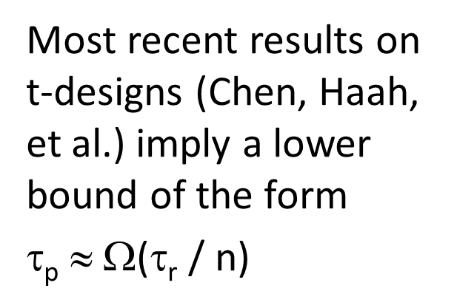
Numerical Investigation
SA + Yuxuan Zhang, arXiv:2404.14493
Since the original question is too expensive to study, we instead ask: Given an n-qubit quantum circuit C with τ_{r} random layers, how many more layers τ_{p} of our choice must we append to it, to get an overall peaked circuit?
Most recent results on t-designs (Chen, Haah, et al.) imply a lower bound of the form
τ_{p} $$ Ω(τ_{r} / n)

Slide 10
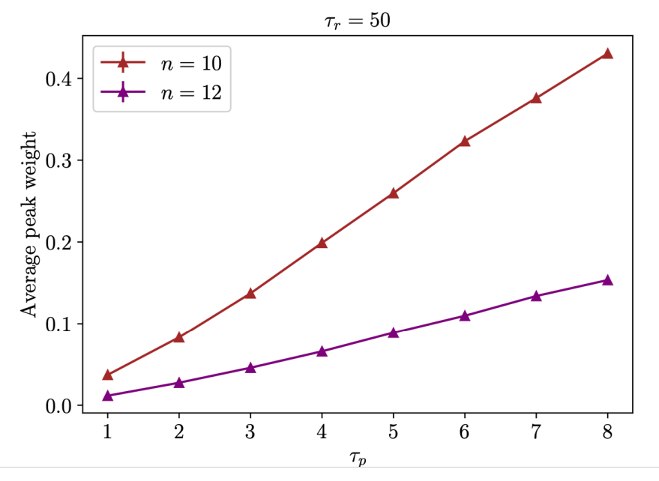
Data on Peakedness: It’s There!

Slide 11
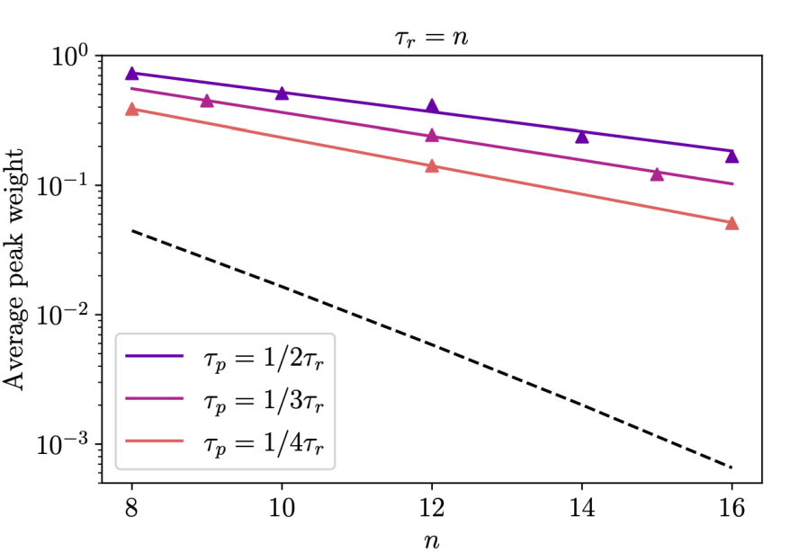
Output distributions look random except for the peak…

Slide 12
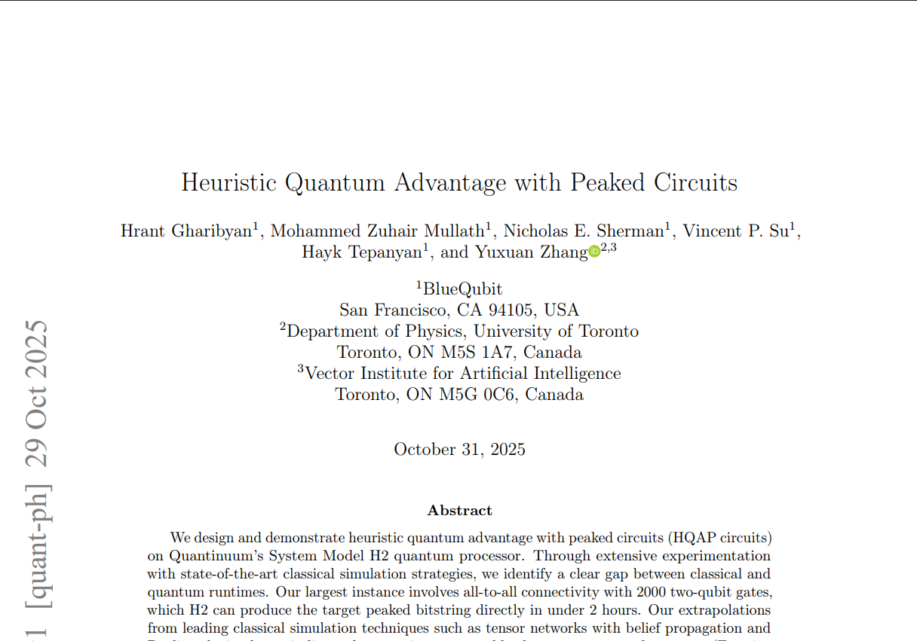
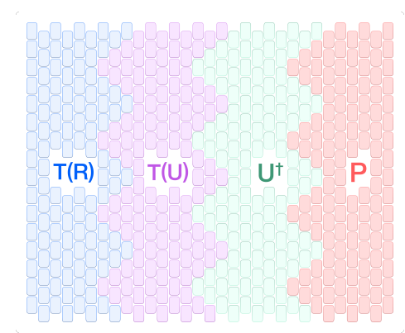
BlueQubit’s Obfuscated Peaked Circuit Demo
Kremer-Dupuis, arXiv:2604.21908: Bespoke classical break of some of BlueQubit’s circuits! But others are still standing

Slide 13
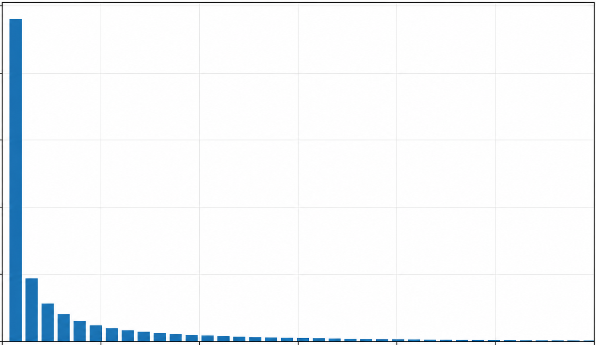
Summary
Via gradient descent, we were able to find quantum circuits that contain a highly peaked output, yet otherwise look totally random.
We still don’t understand what’s going on here!
Are these circuits really indistinguishable from random?
Why should they exist?
Can such circuits be found efficiently?

Slide 14
More Broadly
The next few years are “crunch time” for verifiable NISQ quantum advantage demos
“By default,” we’ll just continue doing OTOC measurements, condensed matter simulations, obfuscated peaked circuits, etc. until scalable fault-tolerant devices exist that can run Shor
Is something better possible? If so, could change the trajectory substantially. Basic theory questions still unresolved!

