Slide 1
New Results on Quantum Oracles
U
Scott Aaronson
(University of Texas at Austin)
Columbia University CS Department
October 10, 2025

Slide 2
The Plan
I’ll tell you about two brand-new results:
No black-box amplification procedure for QMA can achieve better than 1/exp(n) soundness error and 1/exp(exp(n)) completeness error (joint with Freek Witteveen and Phillip Harris)
We have PQP^{U} ⊆ PostBQP^{U} relative to quantum oracles that are closed under inverses or complex conjugation, but not all superoperator oracles (joint with Adam Bouland and Jordan Docter)
Both results involve: quantum oracles, low-degree rational functions, and some GPT-5 assistance!

Slide 3
Introducing Some of the Characters
PP = PQP = PostBQP
Thresholds / postselection
QMA
Quantum Merlin-Arthur
Classical Merlin, Quantum Arthur
QCMA
Merlin-Arthur
(Randomized NP)
MA
BQP
Quantum polytime
NP
BPP
Randomized polytime
P

Slide 4
Quantum Oracle
An infinite list of unitary transformations, U=(U_{n}), that a quantum algorithm gets to apply in black-box fashion
(Doesn’t make sense to give to a classical algorithm)
Generalizes classical oracles A:{0,1}*→{0,1}
Introduced by A.-Kuperberg 2006, who also showed that there’s a quantum oracle U such that QCMA^{U} ≠ QMA^{U}
(Giving a classical A such that QCMA^{A} ≠ QMA^{A} remains open!)
Whenever we provide U, should we also provide U⁻¹? U*? Controlled-U? A.-Kuperberg 2006 raised these questions without answering them; we’ll return to them later!
Cf. recent work by Tang and Wright (arXiv:2508.00055, arXiv:2507.23787), Zhandry (IACR 2025/1072)

Slide 5
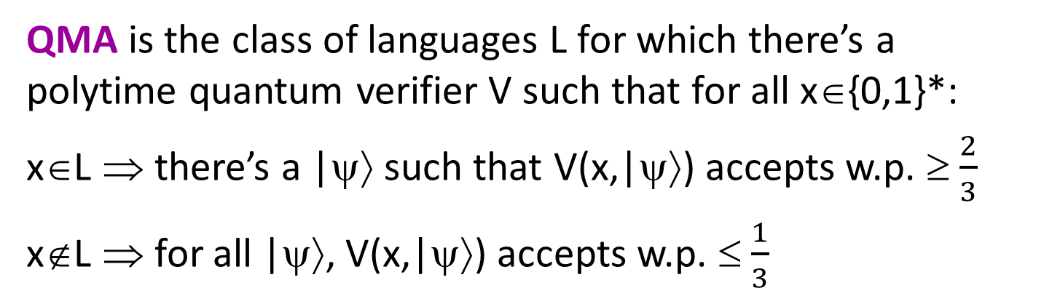
QMA Perfect Completeness Problem
QMA is the class of languages L for which there’s a polytime quantum verifier V such that for all x∈{0,1}*:
x∈L ⇒ there’s a |ψ⟩ such that V(x,|ψ⟩) accepts w.p. ≥ $\frac{2}{3}$
x∉L ⇒ for all |ψ⟩, V(x,|ψ⟩) accepts w.p. ≤ $\frac{1}{3}$
Reminder: MA₁ = MA
As usual, can amplify 2/3 and 1/3 to 1-2^{-poly(n)} and 2^{-poly(n)}
Also, QCMA₁ = QCMA
(Jordan et al. 2011)
QMA₁ is the same except that if x∈L, then V(x,|ψ⟩) must accept with probability 1
Warning: Gate-set dependent!
Clearly QMA₁ ⊆ QMA.
Longstanding open problem: Is this containment strict?

Slide 6
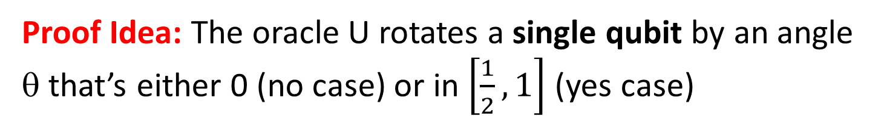
Theorem (A. 2009): There exists a quantum oracle U such that QMA^{U} ≠ QMA₁^{U}.
Proof Idea: The oracle U rotates a single qubit by an angle θ that’s either 0 (no case) or in $\left[\frac{1}{2},1\right]$ (yes case)
We can easily decide which in QMA^{U} and even BQP^{U}
But to decide in QMA₁^{U}, the acceptance probability would need to go like this:
1
Acceptance probability
0
0
½
1
θ

Slide 7
Why Is That A Problem?
Lemma: Suppose Arthur gets an m-qubit witness |ψ⟩ and makes T queries to U. Then his maximum acceptance probability can be written as λ_{max}(E(θ)), where E(θ) is a 2^{m}×2^{m} Hermitian matrix, each of whose entries is a degree-2T polynomial in cos(θ) and sin(θ).
Proof Sketch: Follows the polynomial method (Beals et al. 1998). Treating Arthur’s amplitudes as polynomials in U’s entries, cos(θ) and sin(θ), each query raises degree by 1.
We can then form Arthur’s measurement operator, E=E(θ), doubling the degree from T to 2T.
Merlin’s job: Maximize ⟨ψ|E|ψ⟩ over all witnesses |ψ⟩.

Slide 8
1
λ_{max}(E(θ))
0
0
½
1
θ
Could this be the maximum of finitely many real analytic functions λ₁(θ),…, λ_{N}(θ)? No way!
At least one λ_{j}(θ) must flatline at 1 in a finite interval, but then, being analytic, must be 1 across the whole range

Slide 9

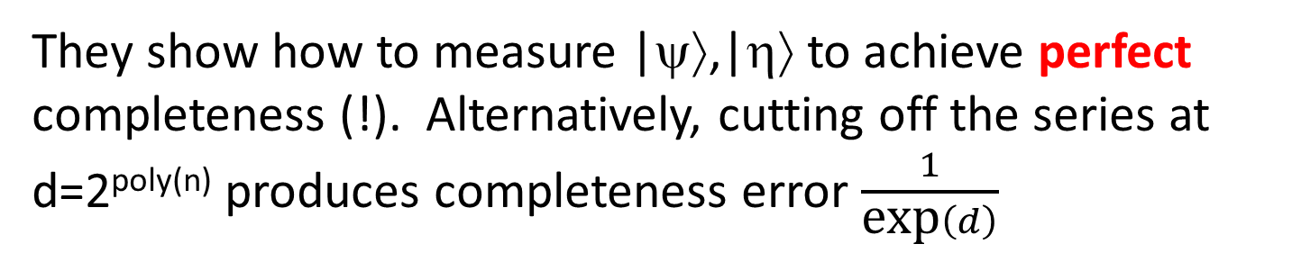
Blockbuster Result from June
Theorem (Jeffery-Witteveen, arXiv:2506.15551): QMA can be amplified to completeness error 1/exp(exp(n))
Rough Idea: Suppose Arthur accepts with maximum probability p>½. Then in addition to the witness |ψ⟩ accepted with probability p, Merlin provides a state |η⟩ that encodes p via an infinite decreasing geometric series:
$$|\left.η\right\rangle ≔\sqrt{1−γ^{2}}\sum_{d=1}^{∞}{γ^{d}|\left.d\right\rangle , γ≔\frac{1−p}{p}}$$
They show how to measure |ψ⟩,|η⟩ to achieve perfect completeness (!). Alternatively, cutting off the series at d=2^{poly(n)} produces completeness error $\frac{1}{\text{exp}\left(d\right)}$

Slide 10
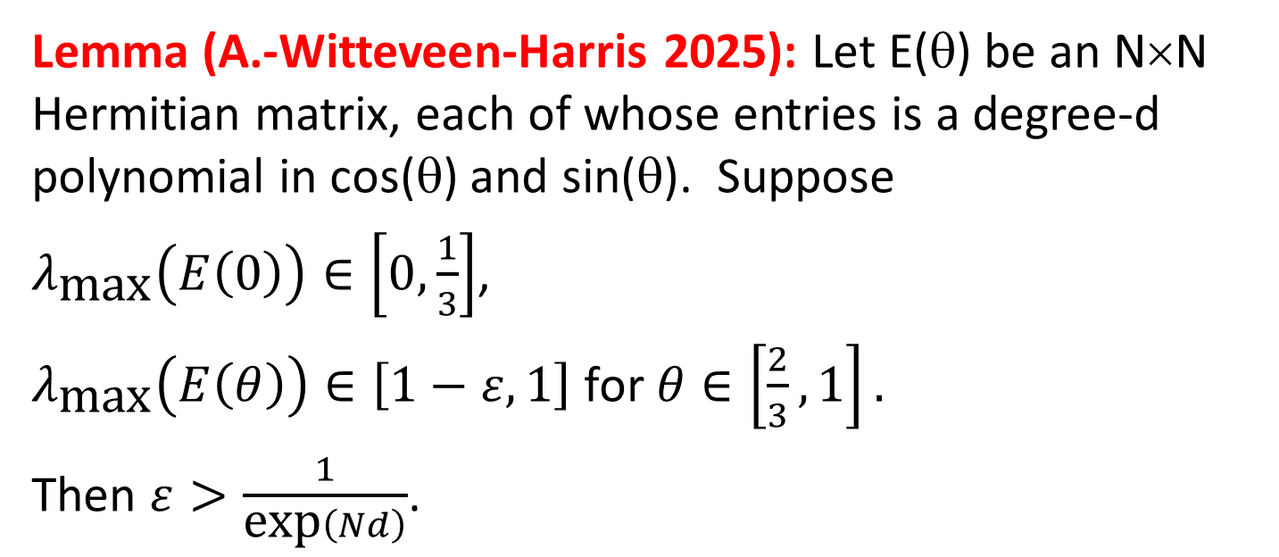
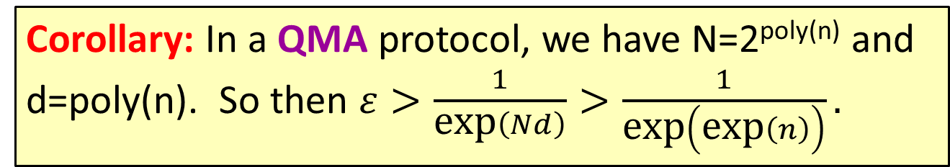
Why It’s Optimal:
Making My 2009 Oracle Separation Quantitative
Lemma (A.-Witteveen-Harris 2025): Let E(θ) be an N×N Hermitian matrix, each of whose entries is a degree-d polynomial in cos(θ) and sin(θ). Suppose
$λ_{\text{max}}\left(E\left(0\right)\right)∈\left[0,\frac{1}{3}\right]$,
$λ_{\text{max}}\left(E\left(θ\right)\right)∈\left[1−ε,1\right]$ for $θ∈\left[\frac{2}{3},1\right].$
Then $ε>\frac{1}{\text{exp}\left(Nd\right)}$.
1
1-ε
Corollary: In a QMA protocol, we have N=2^{poly(n)} and d=poly(n). So then $ε>\frac{1}{\text{exp}\left(Nd\right)}>\frac{1}{\text{exp}\left(\text{exp}\left(n\right)\right)}.$
1/3
0

Slide 11
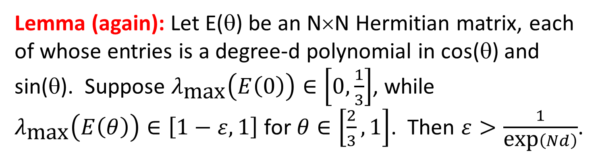
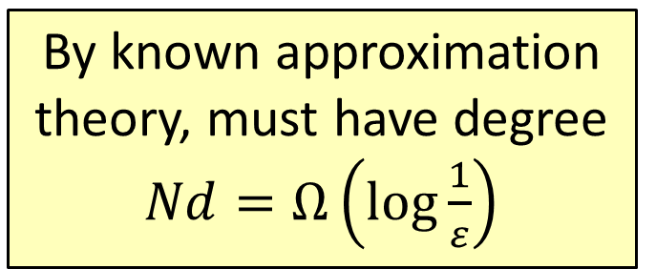
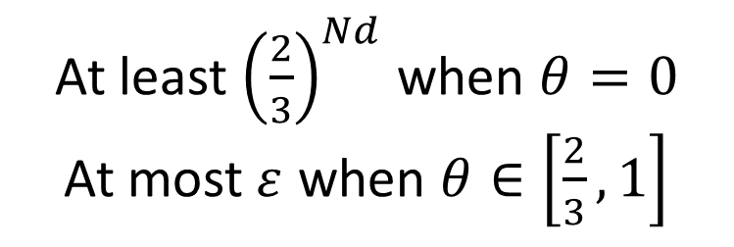
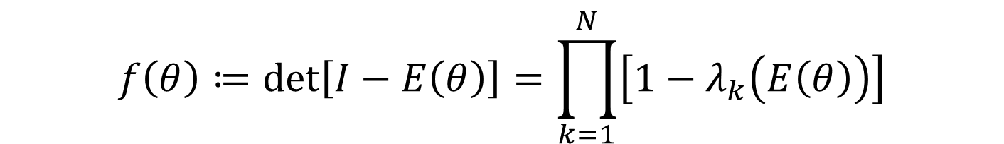
Lemma (again): Let E(θ) be an N×N Hermitian matrix, each of whose entries is a degree-d polynomial in cos(θ) and sin(θ). Suppose $λ_{\text{max}}\left(E\left(0\right)\right)∈\left[0,\frac{1}{3}\right]$, while
$λ_{\text{max}}\left(E\left(θ\right)\right)∈\left[1−ε,1\right]$ for $θ∈\left[\frac{2}{3},1\right]$. Then $ε>\frac{1}{\text{exp}\left(Nd\right)}$.
Proof Idea: Consider
$$f\left(θ\right)≔\text{det}\left[I−E\left(θ\right)\right]=\prod_{k=1}^{N}{\left[1−λ_{k}\left(E\left(θ\right)\right)\right]}$$
GPT5-Thinking suggested
Tr[(I-E(θ))⁻¹], works but worse!
Polynomial in cos(θ), sin(θ) of degree O(Nd)
By known approximation theory, must have degree $Nd=Ω\left(\log{\frac{1}{ε}}\right)$
At least ${\left(\frac{2}{3}\right)}^{Nd}$ when $θ=0$
At most$ε$ when $θ∈\left[\frac{2}{3},1\right]$

Slide 12

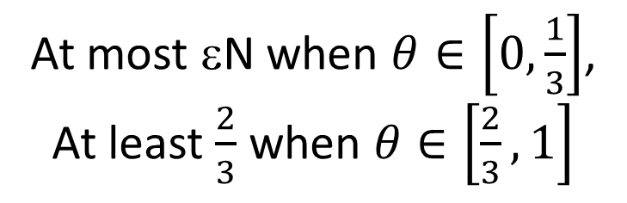
Why Soundness Error Is Different
Now we can instead consider the function
$$\text{Tr}\left[E\left(θ\right)\right]=\sum_{k=1}^{N}{λ_{k}\left(E\left(θ\right)\right)}$$
Polynomial in cos(θ), sin(θ) of degree O(d)
At most εN when $θ∈\left[0,\frac{1}{3}\right]$,
At least $\frac{2}{3}$ when $θ∈\left[\frac{2}{3},1\right]$
Implies $d=Ω\left(\log{\frac{1}{ε}}\right)$, with no N dependence!

Slide 13
A Puzzle
QMA ⊆ PP is believed to be strict.
Yet the “approximation theory object of QMA” (largest eigenvalues of poly(n)-degree, exp(n)×exp(n) Hermitian matrices) can be more powerful than the “approximation theory object of PP” (poly(n)-degree rational functions). For example, in amplification of completeness error. What gives??
Resolution: The QMA ⊆ PP simulation computes only a crude estimate of the largest eigenvalue. If you want more precise information, then indeed PreciseQMA = PSPACE (Fefferman-Lin, arXiv:1604.01384) is more powerful than PP

Slide 14
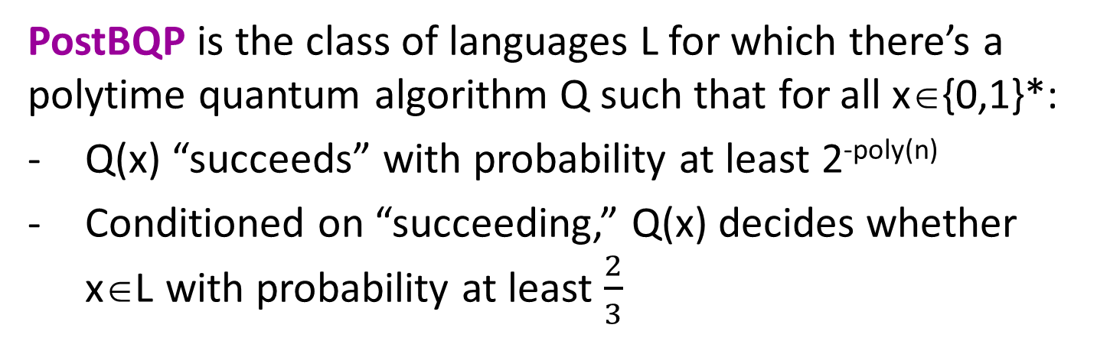
The Power of Postselection
PostBQP is the class of languages L for which there’s a polytime quantum algorithm Q such that for all x∈{0,1}*:
Q(x) “succeeds” with probability at least 2^{-poly(n)}
Conditioned on “succeeding,” Q(x) decides whether x∈L with probability at least $\frac{2}{3}$
PP is the class of languages L for which there’s a polytime algorithm A such that for all x∈{0,1}*:
If x∈L then Pr[A(x) accepts] > ½ + 2^{-poly(n)}
If x∉L then Pr[A(x) accepts] < ½ - 2^{-poly(n)}
Theorem (A. 2004): PostBQP = PP.
To prove PostBQP ⊆ PP: Almost the same as BQP ⊆ PP

Slide 15

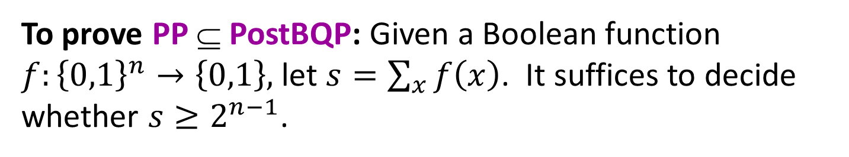



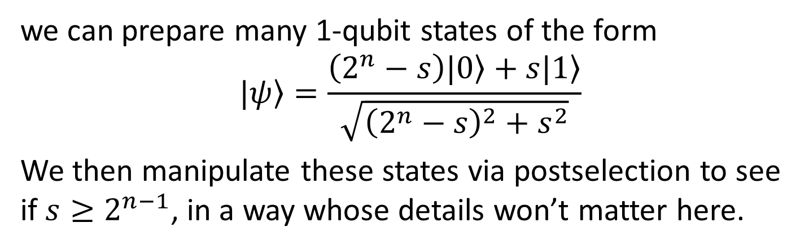

To prove PP ⊆ PostBQP: Given a Boolean function $f:{\left\{0,1\right\}}^{n}→\left\{0,1\right\},$ let $s=\sum_{x}{f\left(x\right)}$. It suffices to decide whether $s≥2^{n−1}$.
Using the circuit
|0⟩
H
H
|0⟩
$$⋮$$
$$⋮$$
$$⋮$$
$$⋮$$
$$⋮$$
f
|0⟩
H
H
|0⟩
|0⟩
|ψ⟩
we can prepare many 1-qubit states of the form
$$|\left.ψ\right\rangle =\frac{\left(2^{n}−s\right)|\left.0\right\rangle +s|\left.1\right\rangle }{\sqrt{{\left(2^{n}−s\right)}^{2}+s^{2}}}$$
We then manipulate these states via postselection to see if $s≥2^{n−1}$, in a way whose details won’t matter here.

Slide 16
Does PostBQP = PP Relativize?
It’s not hard to see that PostBQP^{A} = PP^{A} for all classical oracles A.
On the other hand, let PQP be the same as PP except with quantum algorithms.
Then PQP = PP = PostBQP.
But PQP^{U} ⊆ PostBQP^{U} for all quantum oracles U is far from obvious!
(The other direction, PostBQP^{U} ⊆ PQP^{U} for all U, is not hard)

Slide 17
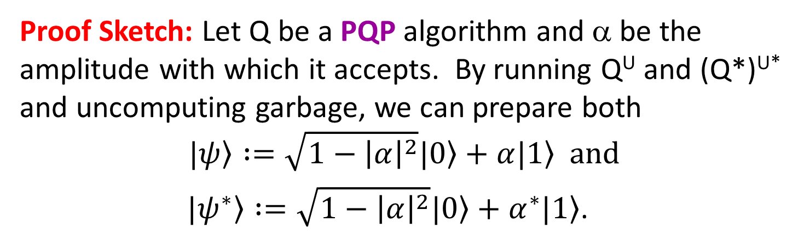
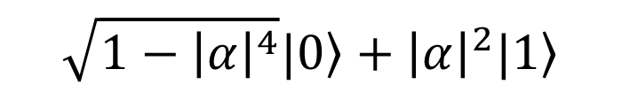
Theorem (A., Bouland, Docter 2025): If U is closed under complex conjugation, then PQP^{U} ⊆ PostBQP^{U}.
Proof Sketch: Let Q be a PQP algorithm and α be the amplitude with which it accepts. By running Q^{U} and (Q*)^{U*} and uncomputing garbage, we can prepare both
$$\left.|ψ\right\rangle :=\sqrt{1−{\left|α\right|}^{2}}\left.|0\right\rangle +\left.α|1\right\rangle \text{and}$$
$\left.|ψ^{∗}\right\rangle :=\sqrt{1−{\left|α\right|}^{2}}\left.|0\right\rangle +\left.α^{∗}|1\right\rangle$.
We then run
We can feed these into the usual PostBQP = PP algorithm!
|ψ⟩
H
|0⟩
|ψ*⟩
H
|0⟩
|0⟩
$$\sqrt{1−{\left|α\right|}^{4}}\left.|0\right\rangle +\left.{\left|α\right|}^{2}|1\right\rangle$$

Slide 18
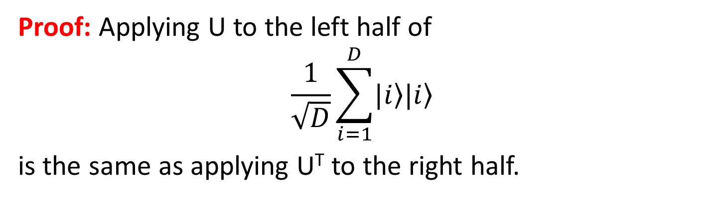
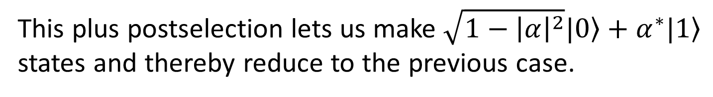
Corollary: If U is closed under inverses, then PQP^{U} ⊆ PostBQP^{U}.
Proof: Applying U to the left half of
$$\frac{1}{\sqrt{D}}\sum_{i=1}^{D}{\left.|i\right\rangle \left.|i\right\rangle }$$
is the same as applying U^{T} to the right half.
So, applying U⁻¹ to the left half is the same as applying U* to the right half.
This plus postselection lets us make $\sqrt{1−{\left|α\right|}^{2}}\left.|0\right\rangle +\left.α^{∗}|1\right\rangle$ states and thereby reduce to the previous case.

Slide 19
Quantum Oracle Separation
(Work In Progress)
Our Goal (A., Bouland, Docter 2025): There exists a quantum oracle U such that PQP^{U} ⊄ PostBQP^{U}.
Note: By the previous, this U needs to be complex, with no inverses or conjugates provided!
And 1-qubit U’s don’t work either! Intuitively,
$$\left(\begin{matrix}a & b \\ {e^{iθ}b}^{∗} & {−e^{iθ}a}^{∗}\end{matrix}\right)$$
needs to give away a* and b* in order to be unitary
We Have: There exists a superoperator oracle S such that PQP^{S} ⊄ PostBQP^{S}.

Slide 20
Conclusions and Open Problems
QMA and PostBQP still have surprises after all these years
Jeffery-Witteveen QMA amplification is black-box optimal
The availability of inverses, etc. can help in showing that complexity class containments quantumly relativize!
Does QMA = QMA₁ in the real world?
Is PQP^{U} ⊆ PostBQP^{U} relative to all O(1)-dimensional U?
AI is now a useful partner in quantum complexity theory research (I don’t think this was true a year ago)

