Slide 1
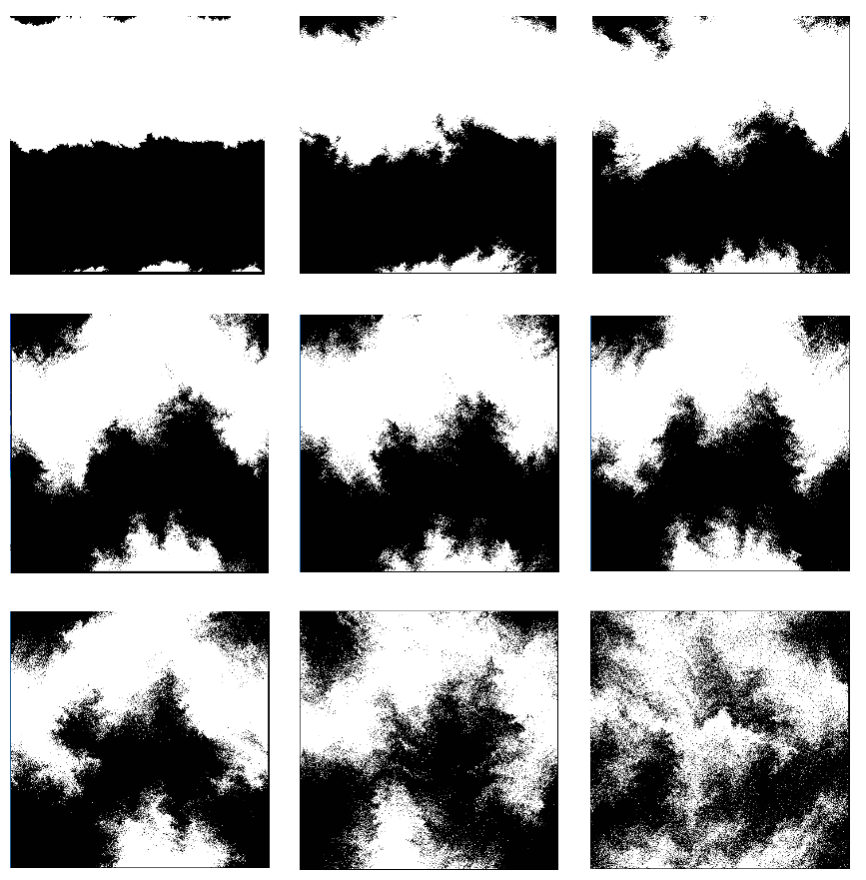
Complexity and Thermodynamics
Scott Aaronson (UT Austin)
Stochastic Thermodynamics & CS Theory Workshop
October 27, 2026
Notes:
ZOOM THRU ZOOM THRU Thanks so much for inviting me! When I typed “quantum computer” into Google Image Search, that’s the first picture that came up. That’s apparently what they look like. (I should warn you that I’m a theorist rather than an engineer.)

Slide 2
NP-hard
All NP problems are efficiently reducible to these
Hamilton cycle
Steiner tree
Graph 3-coloring
Satisfiability
Maximum clique
…
NP-complete
Matrix permanent
Halting problem
…
NP
Efficiently verifiable
Factoring
Graph isomorphism
…
Graph connectivity
Primality testing
Matrix determinant
Linear programming
…
P
Efficiently solvable
Notes:
Here’s a rough map of the world. At the bottom is P, which includes everything we know how to solve quickly with today’s computers. Containing it is NP, the class of problems where we could recognize an answer if we saw it, and at the top of NP is this huge family of NP-complete problems. There are plenty of problems that are even harder than NP-complete – one famous example is the halting problem, to determine whether a given computer program will ever stop running. Very interestingly, there are also problems believed to be intermediate between P and NP-complete. One example is factoring. These intermediate problems are extremely important for quantum computing, as we’ll see later, and they’re also important for cryptography.

Slide 3
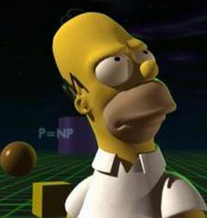

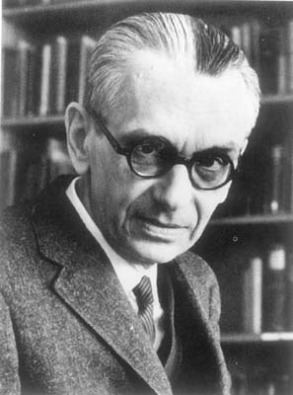
Does P=NP?
The (literally) $1,000,000 question
If there actually were a machine with [running time] ~Kn (or even only with ~Kn²), this would have consequences of the greatest magnitude.
—Gödel to von Neumann, 1956
Notes:
The big question is whether P=NP. Literally a million dollar question – if you solve it, you get a million dollars from the Clay Math Institute.
In my opinion, it’s the most important of all 7 Clay problems – since if P=NP, then probably you could not only solve that one problem, but also the other six. For you would simply program your computer to find the proofs for you.
I should mention, because of this blog I write, I get claims to solve the P vs. NP problem in my inbox every other week or so. The most recent *relatively-serious* claim was this summer, when this guy Vinay Deolalikar got all over the news claiming to have proved P!=NP. I was on vacation, but eventually it got to the point where I said, listen, if he’s right, I’ll supplement his million-dollar prize by $200,000. I took a lot of flak for that, but in case you’re wondering, the end result was I didn’t have to pay. This is still an open problem, one of the hardest and most profound open problems in mathematics.

Slide 4
P vs. NP and the Second Law
Ongoing joint work with Gülce Kardes and Harrison Hartle
Old Idea (Seth Lloyd, others): If P=NP, that could have implications for thermodynamics
Maybe it could mean that you could actually build a machine to “reverse the Second Law,” by reducing it to a computational problem and solving it!

Slide 5
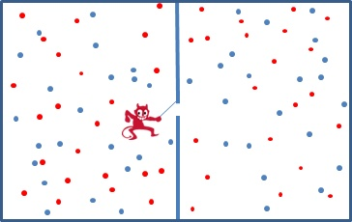
Maxwell’s Demon
Usual story (Szilard, Landauer, Bennett): Entropy doesn’t disappear, it just goes into the demon’s memory

Slide 6
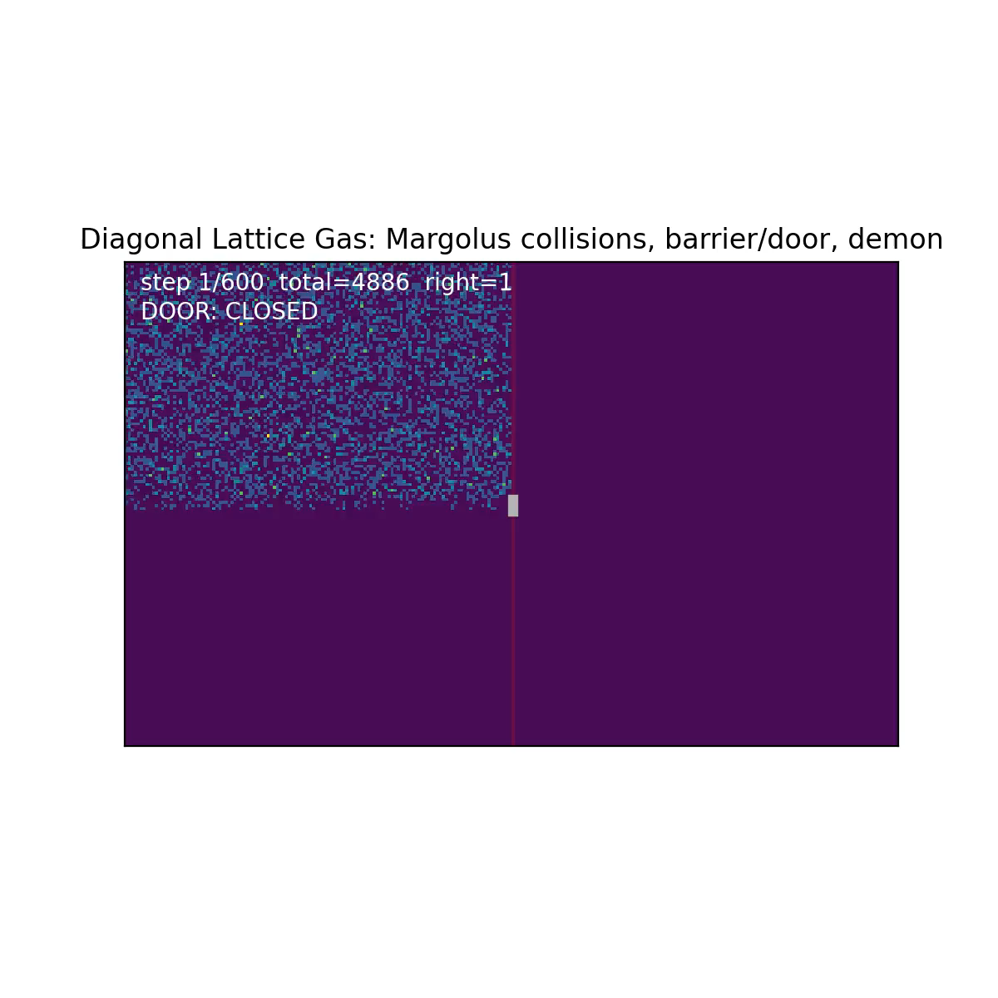
But what if the Demon could efficiently uncompute the contents of its memory, leaving only a small seed?
This could work if:
We have classical, non-chaotic reversible dynamics
There are no pseudorandom generators (or P=NP)

Slide 7
Objections
“You haven’t broken the Second Law. You’ve merely shown that some apparent entropy was never real entropy in the first place, but only pseudoentropy!”
In real life, even if P=NP, either quantum mechanics or chaotic dynamics could prevent the Demon’s uncomputing strategy from working
Nevertheless, this example shows that the appearance of thermodynamic laws working as they should can be protected only by computational hardness

Slide 8
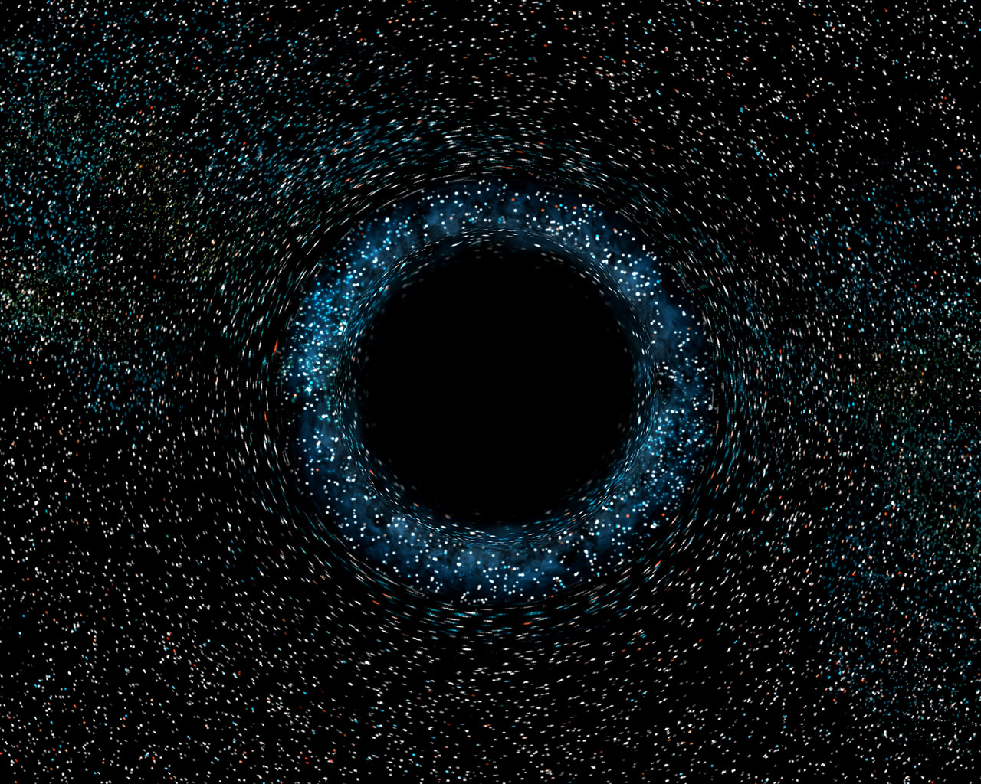


Even more dramatic: “Firewall Paradox”
Almheiri, Marolf, Polchinski, Sully 2012
From this month’s AI breakthroughs: Her task would become easy if P=PSPACE!
Harlow-Hayden 2013: Geometry of spacetime at the event horizon seems to be protected only by Alice’s task, of decoding patterns in the Hawking radiation, being exponentially hard even for QCs!

Slide 9
The Rise and Fall of “Complexity” in Closed Systems
Old joint work with Sean Carroll, Lauren Ouellette, Brent Werness, Varun Mohan, Katherine Li, finally being revised!

Slide 10
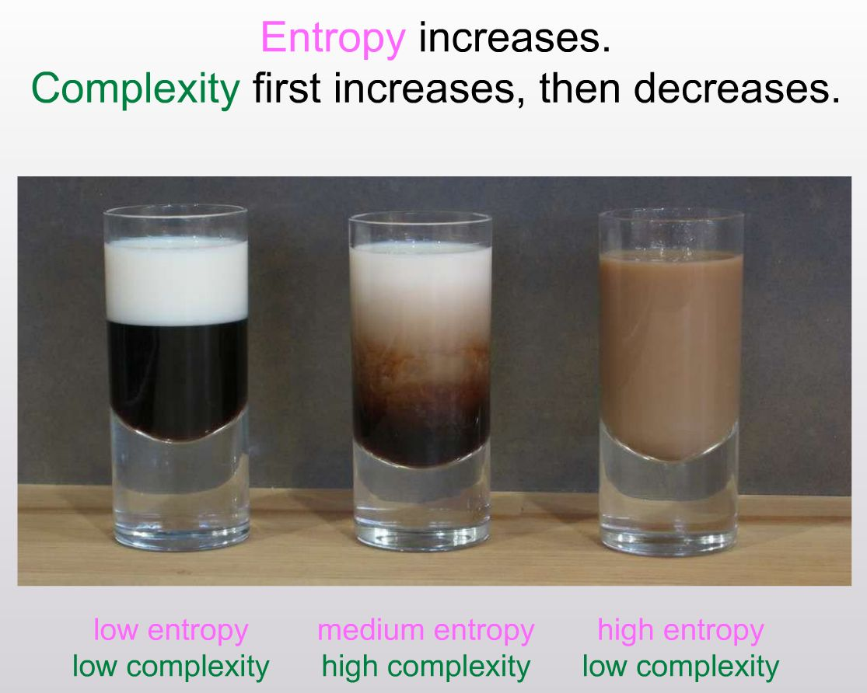

Slide 11
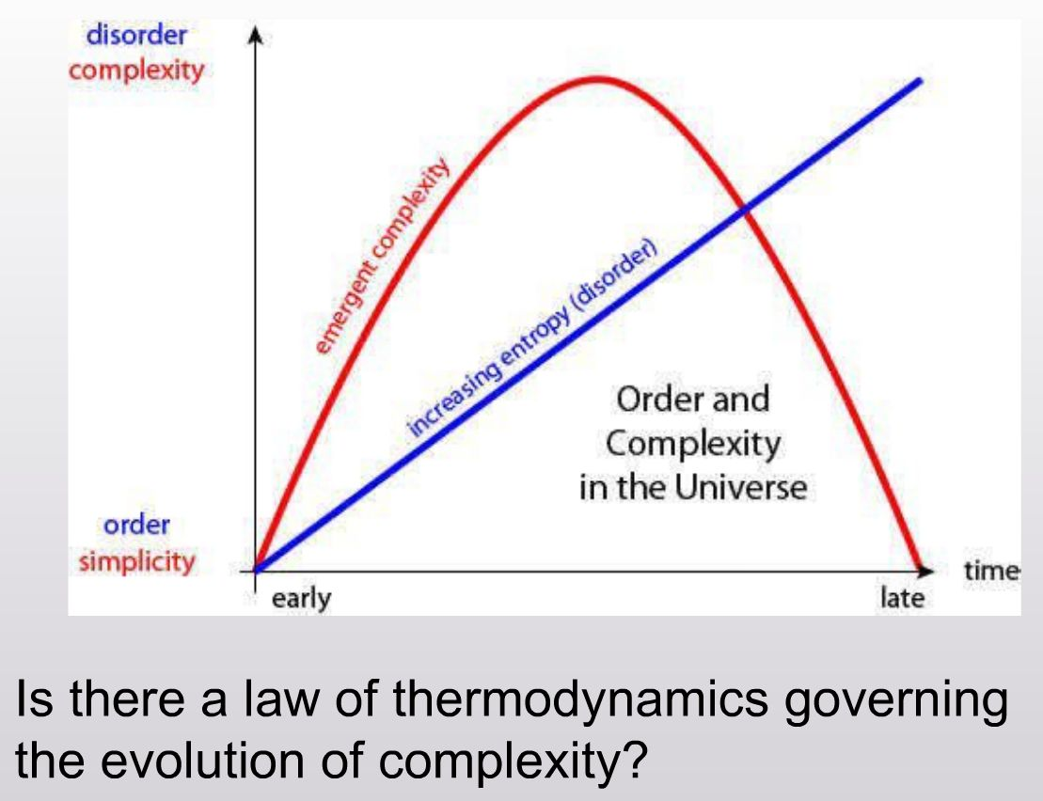

Slide 12
“The Tectonic Model of Coffee”
Seems to generate significant “complexity” at intermediate times—but how to define?

Slide 13
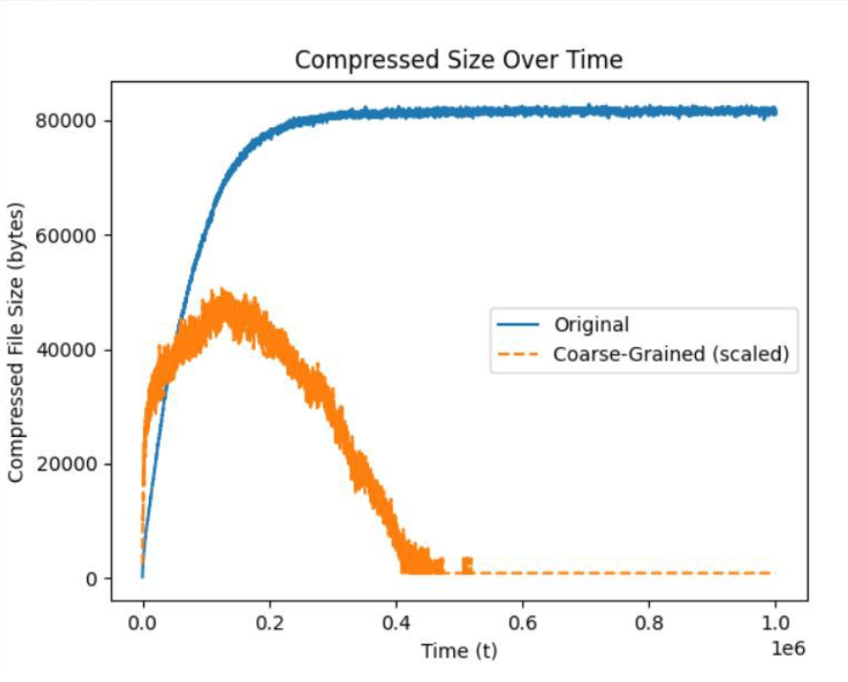
Our Choice: Coarse-Grained Entropy
We can even prove that n^{Ω(1)} coarse-grained entropy gets generated at some intermediate time

Slide 14
Why Is Computational Complexity Relevant Here?
Standard objection to coarse-grained entropy: Relies on a “human” choice of how to coarse-grain
Alternative: “Sophistication”
Let K be Kolmogorov complexity, of a string x∈{0,1}^{n} or a set S⊆{0,1}^{n}
Given x∈{0,1}^{n}, let Soph_{c}(x) be the minimum of K(S), over all S⊆{0,1}^{n} such that x∈S and K(S)+log₂|S|≤K(x)+c
  In a near-minimal program for x, the smallest number of bits that need to be “code” rather than “random data”

Slide 15
Problem: Soph_{c}(x) is tiny for typical states x of the coffee automaton! Why? Because we can let S be the ensemble of sampled states at time t; then x is almost certainly an incompressible element of S
Solution: Could use resource-bounded sophistication, e.g., minimal length of p in a minimal 2-part code consisting of (polytime program p outputting a constant-depth circuit C, input to C)
(Still seems hard to work with in practice though!)

Slide 16
Conclusions
Lots of interesting things to do at the intersection of computational complexity and thermodynamics!
Let’s do those things before AI does them first!

