Slide 1
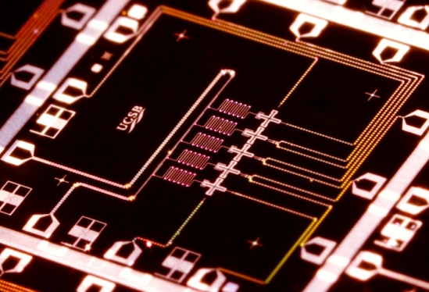
Complexity-Theoretic Foundations of Quantum Supremacy Experiments
PostBQP
PostBPP
Scott Aaronson (MIT→UT Austin)
Aspen Center for Physics, March 25, 2016
Joint work with Lijie Chen

Slide 2
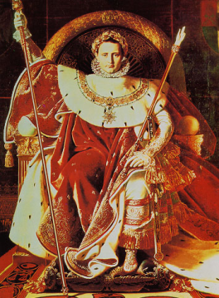
QUANTUM SUPREMACY
| ⟩
#1 Application of QC: Disprove the QC skeptics (and the Extended Church-Turing Thesis)!
Forget for now about applications. Just concentrate on certainty of a quantum speedup over the best classical algorithm for some task

Slide 3
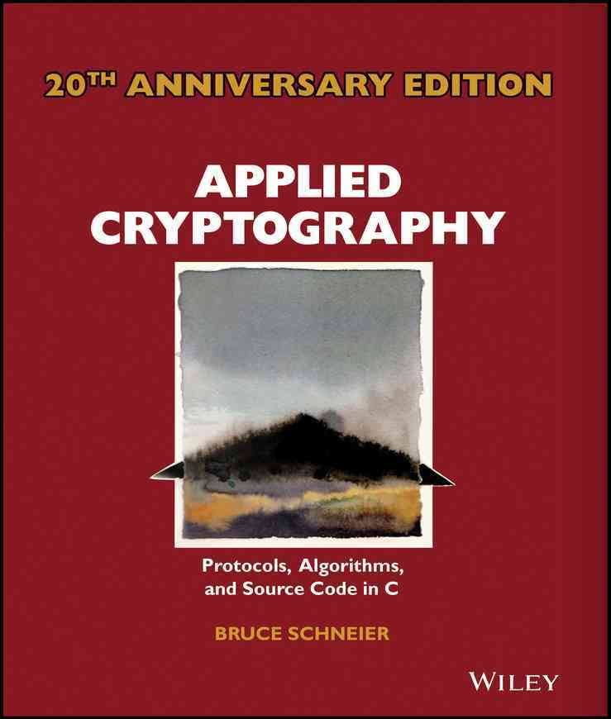
Physicists will need to think like applied cryptographers!
Define a clear task that your quantum device performs
Think hard about how your worst enemy would perform that task (or appear to…) using classical resources only
Closest historical analogue in physics: the Bell inequality
Publish benchmark challenges for classical skeptics
Isolate the cleanest possible hardness assumption that implies what you want
Leave a safety margin!
PostBQP: where we allow postselection on exponentially-unlikely measurement outcomes
PostBPP: Classical randomized subclass
Theorem (A. 2004): PostBQP = PP
PostBPP is in the polynomial hierarchy
PostBQP
PostBPP

Slide 4
The “Highbrow Approach”
A.-Arkhipov 2011, Bremner-Jozsa-Shepherd 2011
Consider sampling problems, where given an input x, we’re asked to output a sample (exactly or approximately) from a probability distribution D_{x} over n-bit strings
Compared to problems with a single valid output (like Factoring), sampling problems can be
Easier to solve with near-future quantum devices, and
Easier to argue are hard for classical computers!
(We “merely” give up on: practical applications, fast classical way to verify the result)
PostBQP: where we allow postselection on exponentially-unlikely measurement outcomes
PostBPP: Classical randomized subclass
Theorem (A. 2004): PostBQP = PP
PostBPP is in the polynomial hierarchy
PostBQP
PostBPP

Slide 5
BQP
The usual setting for quantum complexity theory
Factoring
BPP
Allowing postselection on exponentially-unlikely measurement outcomes makes separating quantum from classical easier!
Theorem (A. 2004): PostBQP=PP
Implies: If PostBPP=PostBQP, then the polynomial hierarchy collapses
Way stronger than any known consequence of BPP=BQP !
PostBQP
PostBPP
PostBQP: where we allow postselection on exponentially-unlikely measurement outcomes
PostBPP: Classical randomized subclass
Theorem (A. 2004): PostBQP = PP
PostBPP is in the polynomial hierarchy
PostBQP
PostBPP

Slide 6
Quantum vs. Classical Sampling
Observation: If quantum and classical exact sampling are polynomial-time equivalent, then PostBPP=PostBQP, and hence the polynomial hierarchy collapses
Quantum sampling tasks that can be shown hard this way:
BosonSampling [A.-Arkhipov 2011]
Constant-depth quantum circuits [Terhal-DiVincenzo 2003]
IQP [Bremner-Jozsa-Shepherd 2011] / FourierSampling [A. 2009]
One clean qubit [Fujii et al. 2014]
Stabilizer circuits with magic states [Jozsa-van den Nest 2014]
QAOA [Farhi-Harrow 2016]
PostBQP: where we allow postselection on exponentially-unlikely measurement outcomes
PostBPP: Classical randomized subclass
Theorem (A. 2004): PostBQP = PP
PostBPP is in the polynomial hierarchy
PostBQP
PostBPP

Slide 7
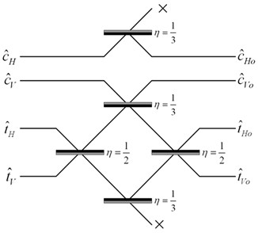
Case Study: BosonSampling
The Task: Sample a complex matrix, A∈C^{n×n}, with probability proportional to μ(A)|Per(A)|² (μ being the Gaussian measure)
Easy if you can build a network of beamsplitters and phaseshifters, input n identical photons, then measure the number of photons in each output mode
We showed: A fast classical algorithm would mean PH collapses. Even an approximate algorithm would mean permanents of i.i.d. Gaussians were approximable in BPP^{NP}
Experimentally demonstrated (sort of) with 6 photons! [O’Brien group, 2015] Lots of challenges scaling up

Slide 8
This Talk
In a few years, we might have dozens of high-quality qubits with controllable couplings, in superconducting and/or ion-trap architectures
Still won’t be enough for most QC applications. But should suffice for a quantum supremacy experiment!
Our duty as complexity theorists: Tell experimenters what they can do with their existing or planned hardware, how to verify it, and what can be said about the hardness of simulating it classically

Slide 9
The Random Quantum Circuit Proposal
Generate a quantum circuit C on n qubits in a √n×√n lattice, with d layers of random nearest-neighbor gates
Apply C to |0⟩^{⊗n} and measure. Repeat t times, to obtain samples x₁,…,x_{T} from {0,1}^{n}
Apply a statistical test to x₁,…,x_{T}
(taking classical exponential time, which is OK for n≈40)
Publish C. Challenge skeptics to generate samples passing the test in a reasonable amount of time

Slide 10
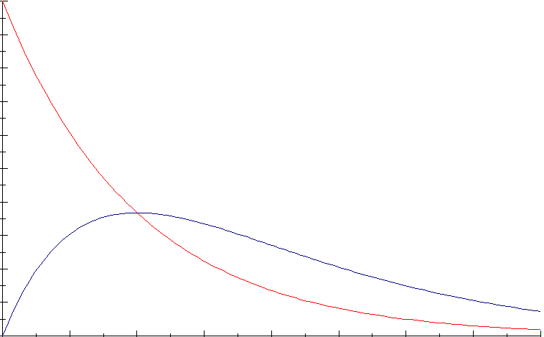
What statistical test should we use?
Simplest: Just check whether the histogram of probabilities of the observed x_{i}’s matches the theoretical prediction (assuming probabilities are exponentially distributed, as with a Haar-random state)
Theorem (Brandao-Harrow-Horodecki 2012): A random local circuit on √n×√n qubits produces nearly Gaussian amplitudes (hence nearly exponentially-distributed probabilities) after d=O(n) depth (right answer should be d=O(√n))

Slide 11
For any constants α and c∈(e^{-α},(1+α)e^{-α}) can also just check whether a ≥c fraction of x_{i}’s have
Theorem: A random quantum circuit, of any depth, will cause a ≥1-α/2 fraction of x_{i}’s (in expectation) to have
Provable by looking at the last gate only!
Distinguishable from classical random guessing’s e^{-α} fraction for all α≤1.59
Log-likelihood test doesn’t work with the hardness assumption we’ll adopt!

Slide 12
Our Strong Hardness Assumption
There’s no polynomial-time classical algorithm A such that, given a uniformly-random quantum circuit C with n qubits and m>>n gates,
Note: There is a polynomial-time classical algorithm that guesses with probability
(just expand ⟨0|^{⊗n}C|0⟩^{⊗n} out as a sum of 4^{m} terms, then sample a few random ones)

Slide 13
Theorem: Assume SHA. Then given as input a random quantum circuit C, with n qubits and m>>n gates, there’s no polynomial-time classical algorithm that even passes our statistical test for C-sampling (for α=ln 2, c=0.6) w.h.p.
Proof Sketch: Given a circuit C, first “hide” which amplitude we care about by applying a random XOR-mask to the outputs, producing a C’ such that
Now let A be a poly-time classical algorithm that passes the test for C’ with probability ≥0.99. Suppose A outputs samples x₁,…,x_{T}. Then if x_{i} =z for some i∈[T], guess that
Violates SHA!
Otherwise, guess that with probability

Slide 14
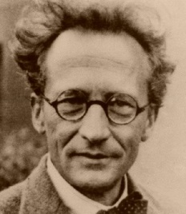
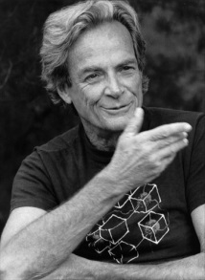
Time-Space Tradeoffs for Simulating Quantum Circuits
Given a general quantum circuit with n qubits and m>>n two-qubit gates, how should we simulate it classically?
“Schrödinger way”:
Store whole wavefunction
O(2^{n}) memory, O(m2^{n}) time
n=40, m=1000: Feasible but requires TB of RAM
“Feynman way”:
Sum over paths
O(m+n) memory, O(4^{m}) time
n=40, m=1000: Infeasible but requires little RAM
Best of both worlds?

Slide 15
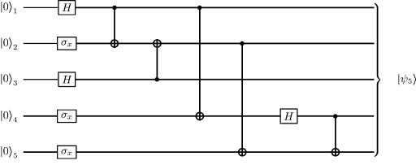
Theorem: Let C be a quantum circuit with n qubits and d layers of gates. Then we can compute each transition amplitude, ⟨x|C|y⟩, in d^{O(n)} time and poly(n,d) space.
C₂
C₁
Proof: Savitch’s Theorem! Recursively divide C into two chunks, C₁ and C₂, with d/2 layers each. Then
Evaluation time:

Slide 16
Comments
Time/Space Tradeoff: Starting with the “naïve, ~2^{n}-time and -memory Schrödinger simulation,” every time you halve the available memory, multiply the running time by the circuit depth d and you can still simulate
If the gates are nearest-neighbor on a √n×√n grid, can replace the d by d/√n, by switching to tensor networks when the depth is small enough
Is our d^{O(n)} algorithm optimal? Open problem! Related to L vs. NL
We don’t get a polytime algorithm to guess ⟨x|C|y⟩ with greater than 4^{-m} success probability (why not?)

Slide 17
A Different Approach: Fourier Sampling / IQP
Given a Boolean function
Let D_{f} be the distribution over {0,1}^{n} defined by
Trivial Quantum Algorithm:
|0⟩
H
H
Problem: Sample exactly or approximately from D_{f}
|0⟩
H
f
H
|0⟩
H
H

Slide 18
Classical Hardness of Fourier Sampling?
If f is given by an explicit circuit: “As usual,” any classical algorithm to sample D_{f} exactly would collapse PH
A classical algorithm to sample D_{f} within ε seems unlikely, but that takes a new assumption [Bremner-Montanaro-Shepherd 2015]
“SHA” is false, as it is for BosonSampling
If f is a black box: Any classical algorithm to sample D_{f} within ε requires Ω(2^{n}/n) queries to f [A.-Ambainis 2015]
Ω(2^{n}) queries for sufficiently small ε [A.-Chen 2016]
Even a FBPP^{PH} algorithm must make superpolynomially many queries to f [A. 2010]

Slide 19

SCOTT & LIJIE
A NEW KIND OF HARDNESS

Slide 20
Our Proposal
Compare complexity classes, relative to oracles A that are constrained to be in P/poly (i.e., black boxes that we can actually instantiate using small circuits)
Sample results:
There exists an A∈P/poly such that P^{A}≠NP^{A}
Implicit in Zhandry 2013: If PRFs exist, then there’s an A∈P/poly such that P^{A}≠BQP^{A}

Slide 21
FourierSampling with PRFs
Theorem: Suppose there’s a polynomial-time classical algorithm that passes a standard statistical test for FourierSampling f, whenever f∈P/poly. Also, suppose A accesses f only as a black box. Then all one-way functions can be inverted in time
Proof Sketch: If f were truly random, then no polytime classical algorithm could pass the FourierSampling test. So if we run the test and it passes, then we distinguished f from truly random. Running the test takes ~2^{n} time. From classical crypto [GGM’86,RR’93,HILL’97], if all PRFs (with size-n^{O(1)} seeds) can be distinguished from random in ~2^{n} time, then all OWFs can be inverted in time

Slide 22
Complexity Assumptions Needed?
Theorem: Suppose P=NP and PromiseBPP=PromiseBQP. Then PromiseBPP^{A}=PromiseBQP^{A} for all A∈P/poly.
Proof Sketch: Uses a new result in quantum query complexity [A.-BenDavid 2016]. Namely, for all partial Boolean functions f:S→{0,1} with S⊆{0,1}^{N},
(contrast with recent superquadratic separations for total functions!)
Set S of P/poly functions has 2^{poly(n)} size. Under strong enough complexity collapses, can explicitize [A.-BenDavid]
Analogously: Suppose P=NP and SampBPP=SampBQP. Then SampBPP^{A}=SampBQP^{A} for all A∈P/poly.

Slide 23
Non-Relativizing Techniques Will Be Needed for Strong Quantum Supremacy Theorems
Theorem (Fortnow-Rogers 1998): There’s an oracle relative to which P=BQP and yet PH is infinite.
Our Improvement: There’s an oracle relative to which SampBPP=SampBQP and yet PH is infinite.
Proof Sketch: Have one part of the oracle encode a PSPACE-complete language (collapsing SampBPP with SampBQP), while a second part encodes exponentially many random bits that each require an exponential search to find. This second part makes PH infinite by [Rossman-Servedio-Tan 2015], and doesn’t re-separate SampBPP and SampBQP by the BBBV lower bound

Slide 24
Conclusions
In the near future, we might be able to perform random quantum circuit and Fourier sampling with ~40 qubits
Central question: how do we verify that something classically hard was done?
  There’s no “direct physical signature” of quantum supremacy, because supremacy just means the nonexistence of a fast classical algorithm to do the same thing. That’s what makes complexity theory unavoidable!
As quantum computing theorists, we’d be urgently called upon to think about this, even if there were nothing theoretically interesting to say. But there is!

