Slide 1
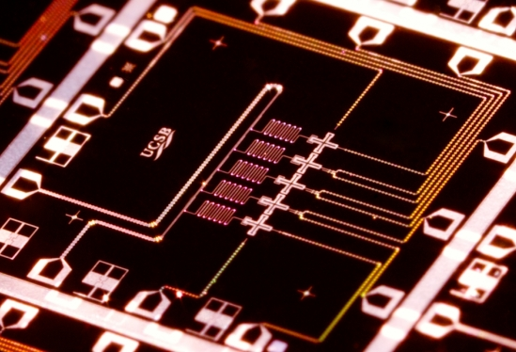
Quantum Supremacy
QSamp
Samp
Scott Aaronson (UT Austin)
UC Santa Barbara, May 26, 2017
Joint work with Lijie Chen (Tsinghua→MIT)
arXiv:1612.05903, CCC’17

Slide 2
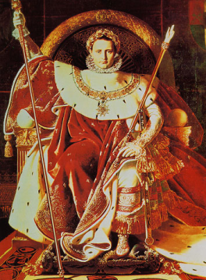
QUANTUM SUPREMACY
| ⟩
#1 Application of QC: Disprove the QC skeptics (and the Extended Church-Turing Thesis)!
Forget for now about applications. Just concentrate on certainty of a quantum speedup over the best classical algorithm for some task

Slide 3
The Sampling Approach Examples: BosonSampling (A.-Arkhipov 2011), FourierSampling/IQP (Bremner-Jozsa-Shepherd 2011), QAOA (Farhi et al.),…
Consider problems where the goal is to sample from a desired distribution over n-bit strings
Compared to problems with a single valid output (like Factoring), sampling problems can be
Easier to solve with near-future quantum devices, and
Easier to argue are hard for classical computers!
(We “merely” give up on: practical applications, fast classical way to verify the result)
PostBQP: where we allow postselection on exponentially-unlikely measurement outcomes
PostBPP: Classical randomized subclass
Theorem (A. 2004): PostBQP = PP
PostBPP is in the polynomial hierarchy
PostBQP
PostBPP

Slide 4
Simple Example: Fourier Sampling
|0⟩
H
H
|0⟩
H
f
H
Using the #P-hardness, one can show that if the quantum computer’s output distribution could be exactly sampled in classical polynomial time, then P^{#P}=BPP^{NP} and hence the polynomial hierarchy would collapse to the third level
|0⟩
H
H
Given a Boolean function
the above circuit samples each z∈{0,1}^{n} with probability
#P-hard to approximate, even for z=0…0

Slide 5
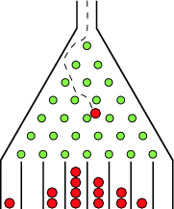
BosonSampling (A.-Arkhipov 2011)
A rudimentary type of quantum computing, involving only non-interacting photons
Classical counterpart: Galton’s Board
Replacing the balls by photons leads to famously counterintuitive phenomena, like the Hong-Ou-Mandel dip

Slide 6
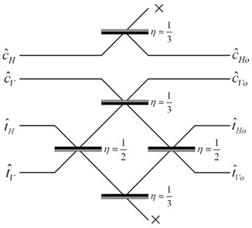
With n identical photons, transition amplitudes are given by permanents of n×n matrices
Central Theorem of BosonSampling: Suppose one can sample a linear-optical device’s output distribution in classical polynomial time, even to 1/n^{O(1)} error in variation distance. Then one can also estimate the permanent of a matrix of i.i.d. N(0,1) Gaussians in BPP^{NP}
Central Conjecture of BosonSampling: Gaussian permanent estimation is a #P-hard problem
If so, then fast classical simulation would collapse PH

Slide 7
Carolan et al. 2015: Demonstrated BosonSampling with 6 photons! Many optics groups are thinking about the challenges of scaling up to 20 or 30…
Meantime, though, in a few years, we might have ~50 high-quality qubits with controllable couplings, in superconducting (Google Santa Barbara) and/or trapped-ion setups
Still won’t be enough for most QC applications. But should suffice for a quantum supremacy experiment!
What exactly should the experimenters do, how should they verify it, and what can be said about the hardness of simulating it classically?

Slide 8
The Random Quantum Circuit Proposal
Generate a quantum circuit C on n qubits in a √n×√n lattice, with d layers of random nearest-neighbor gates
Apply C to |0⟩^{⊗n} and measure. Repeat T times, to obtain samples x₁,…,x_{T} from {0,1}^{n}
Apply a statistical test to x₁,…,x_{T} : check whether at least 2/3 of them have more the median probability (takes classical exponential time, which is OK for n≈40)
Publish C. Challenge skeptics to generate samples passing the test in a reasonable amount of time

Slide 9
Our Strong Hardness Assumption
There’s no polynomial-time classical algorithm A such that, given a uniformly-random quantum circuit C with n qubits and m>>n gates,
Note: There is a polynomial-time classical algorithm that guesses with probability
(just expand ⟨0|^{⊗n}C|0⟩^{⊗n} out as a sum of 4^{m} terms, then sample a few random ones)

Slide 10
Theorem: Assume SHA. Then given as input a random quantum circuit C, with n qubits and m>>n gates, there’s no polynomial-time classical algorithm that even passes our statistical test for C-sampling w.h.p.
Proof Sketch: Given a circuit C, first “hide” which amplitude we care about by applying a random XOR-mask to the outputs, producing a C’ such that
Now let A be a poly-time classical algorithm that passes the test for C’ with probability ≥0.99. Suppose A outputs samples x₁,…,x_{T}. Then if x_{i} =z for some i∈[T], guess that
Violates SHA!
Otherwise, guess that with probability

Slide 11
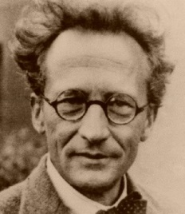
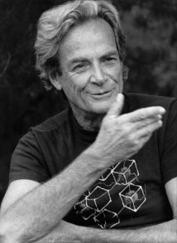
Time-Space Tradeoffs for Simulating Quantum Circuits
Given a general quantum circuit with n qubits and m>>n two-qubit gates, how should we simulate it classically?
“Schrödinger way”:
Store whole wavefunction
O(2^{n}) memory, O(m2^{n}) time
n=40, m=1000: Feasible but requires TB of RAM
“Feynman way”:
Sum over paths
O(m+n) memory, O(4^{m}) time
n=40, m=1000: Infeasible but requires little RAM
Best of both worlds?

Slide 12
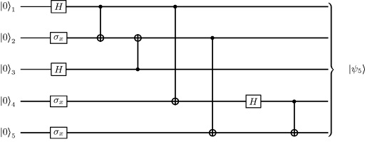
Theorem: Let C be a quantum circuit with n qubits and d layers of gates. Then we can compute each transition amplitude, ⟨x|C|y⟩, in d^{O(n)} time and poly(n,d) memory
C₂
C₁
Proof: Savitch’s Theorem! Recursively divide C into two chunks, C₁ and C₂, with d/2 layers each. Then
Can do better for nearest-neighbor circuits, or when more memory is available
This algorithm still doesn’t falsify the SHA! Why not?

Slide 13
Other Things We Showed
Any strong quantum supremacy theorem (“fast approximate classical sampling of this experiment would collapse the polynomial hierarchy”)—of the sort we sought for BosonSampling—will require non-relativizing techniques (It doesn’t hold in black-box generality; there’s an oracle that makes it false)
If one-way functions exist, then quantum supremacy is possible with efficiently computable (P/poly) oracles
If you want to prove quantum supremacy possible relative to efficiently computable oracles, then you’ll need to show either that it’s possible in the unrelativized world, or that NP⊄BQP

Slide 14
Summary
In the near future, we might be able to perform random quantum circuit sampling with ~50 qubits
Central question: how do we verify that something classically hard was done?
Quantum computing theorists would be urgently called upon to think about this, even if there were nothing theoretically interesting to say. But there is!

