Slide 1

Quantum Supremacy
Scott Aaronson (MIT→UT Austin)
Strachey Lecture, Oxford University
May 24, 2016

Slide 2
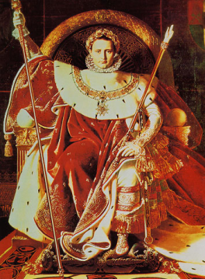
What this talk is about
| ⟩
“Quantum Supremacy”: A term that’s come into vogue in the past few years for quantum computing experiments—hopefully doable in the near future—that aim ”merely” to overthrow the Extended Church-Turing Thesis with as much certainty as possible, not to do anything of practical use

Slide 3
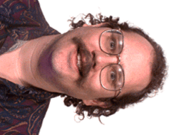
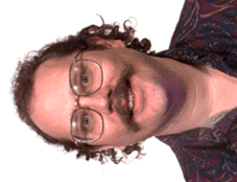
The Extended Church-Turing Thesis (ECT)
Everything feasibly computable in the physical world is feasibly computable by a (probabilistic) Turing machine
Shor’s Theorem (1994): Quantum Simulation has no efficient classical algorithm, unless Factoring does also

Slide 4
Quantum Mechanics in One Slide:
“Probability Theory with Minus Signs”
Probability Theory:
Quantum Mechanics:
Linear transformations that conserve 1-norm of probability vectors:
Stochastic matrices
Linear transformations that conserve 2-norm of amplitude vectors:
Unitary matrices
Notes:
So, let me first explain quantum mechanics in one slide. See, the physicists somehow convinced everyone that quantum mechanics is complicated and hard. The truth is, QM is unbelievably simple, once you take the physics out.
What is quantum mechanics IS, fundamentally, is a certain generalization of the laws of probability. In probability theory, you always represent your knowledge of a system using a vector of nonnegative real numbers, which sum to 1 and which are called probabilities. As the system changes, you update your knowledge by applying a linear transformation to the vector. The linear transformation has to preserve the 1-norm; matrices that do that are called stochastic matrices.
Quantum mechanics is almost the same, except now you represent your knowledge using a vector of complex numbers, called “amplitudes”. And instead of preserving the 1-norm of the vector, you preserve its 2-norm – which God or Nature seems to prefer over the 1-norm in every situation. Matrices that preserve 2-norm are called unitary matrices.

Slide 5
What is quantum computing?
In the 1980s, Feynman, Deutsch, and others noticed that quantum systems with n particles seemed to take ~2^{n} time to simulate—and had the idea of building a ‘quantum computer’ to overcome that problem
Not just a matter of trying all answers in parallel!
Exponentially many possible measurement outcomes, but you only see one, probabilistically!
Any hope for a speedup rides on the magic of interference between positive and negative contributions to an amplitude

Slide 6
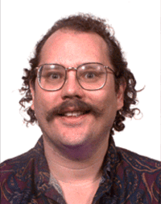

BQP (Bounded-Error Quantum Polynomial-Time): The class of problems solvable efficiently by a quantum computer, defined by Bernstein and Vazirani in 1993
Interesting
Shor 1994: Factoring integers is in BQP
NP-complete
P^{#P}
NP
Factoring
BQP
P

Slide 7
So quantum computers refute the ECT … what more proof could anyone want?
Building a scalable quantum computer is hard! After 20+ years, no fundamental obstacle has been found … but can’t we just refute the skeptics today?
  Can we “meet the experimentalists halfway,” and show computational hardness for quantum systems closer to what they’re actually working with?
Factoring might have a fast classical algorithm! At any rate, it’s an extremely “special” problem
  Wouldn’t it be great to show that if, quantum computers can be simulated classically, then (say) P=NP?

Slide 8
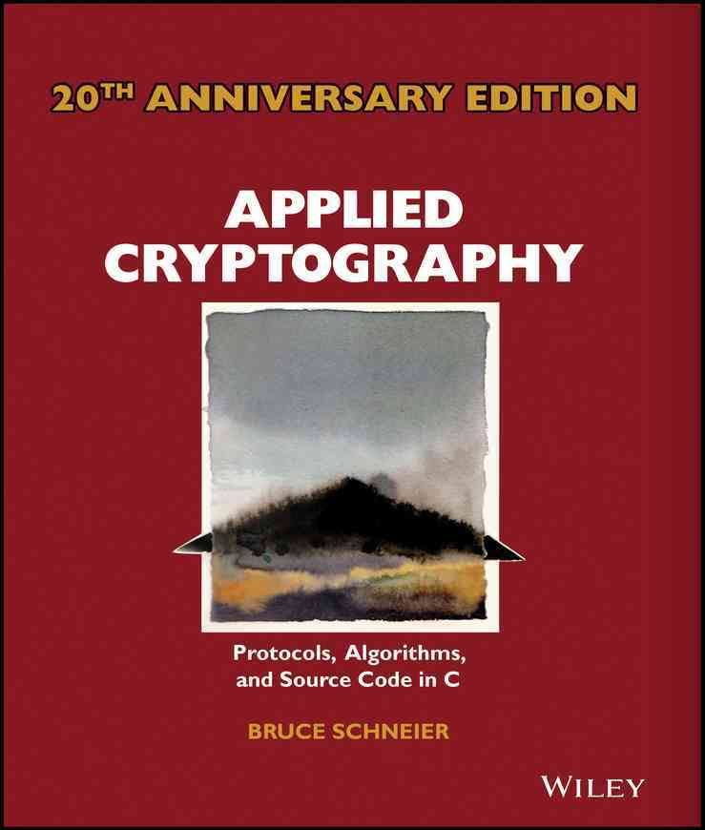
Motivates “Quantum Supremacy” … a.k.a., physicists learning to think like applied cryptographers!
Define a clear mathematical task that you can perform with quantum hardware of the near future
Think hard about how your worst enemy would perform that task (or appear to…) using classical resources only
Closest historical analogue in physics: the Bell inequality
Publish benchmark challenges for classical skeptics
Isolate the cleanest possible hardness assumption that implies what you want
Leave a safety margin!

Slide 9
The Sampling Approach
A.-Arkhipov 2011, Bremner-Jozsa-Shepherd 2011
Consider sampling problems, where given an input x, we’re asked to output a sample (exactly or approximately) from a probability distribution D_{x} over n-bit strings
Compared to problems with a single valid output (like Factoring), sampling problems can be
Easier to solve with near-future quantum devices, and
Easier to argue are hard for classical computers!
(We “merely” give up on: practical applications, fast classical way to verify the result)
PostBQP: where we allow postselection on exponentially-unlikely measurement outcomes
PostBPP: Classical randomized subclass
Theorem (A. 2004): PostBQP = PP
PostBPP is in the polynomial hierarchy
PostBQP
PostBPP

Slide 10
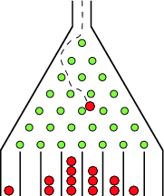
BosonSampling (A.-Arkhipov 2011)
A rudimentary type of quantum computing, involving only non-interacting photons
Classical counterpart: Galton’s Board
Replacing the balls by photons leads to famously counterintuitive phenomena, like the Hong-Ou-Mandel dip

Slide 11
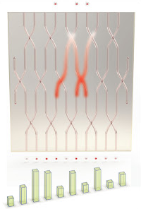
What’s going on? In general, we consider a network of beamsplitters, with n input “modes” (locations) and m>>n output modes
n identical photons enter, one per input mode
Assume for simplicity they all leave in different modes—there are possibilities
The beamsplitter network defines a column-orthonormal matrix A∈C^{m×n}, such that
where
n×n submatrix of A corresponding to S
is the matrix permanent (like the determinant, but without minus signs!)

Slide 12

So Can We Use Photons to Calculate Permanents—a #P-Complete Problem?
That sounds way too good to be true…
Explanation: If X is a submatrix of a unitary matrix, then |Per(X)|² will typically be exponentially small. So to get a reasonable estimate of |Per(X)|² for a given X, we’d generally need to repeat the optical experiment exponentially many times!

Slide 13
So Then, Why Is BosonSampling Classically Hard?
Sketch: Suppose there were a poly-time classical algorithm to sample the same distribution as the experiment. Then the probabilities—i.e., |Per(X)|² for X∈C^{n×n}—could be estimated using approximate counting (in BPP^{NP}). So P^{#P} would equal BPP^{NP}, collapsing the polynomial hierarchy to the third level!
Arguing that even a noisy BosonSampling device samples a classically-hard distribution is much more complicated…
Our Main Result: Suppose there’s a poly-time classical algorithm to sample a distribution even 1/poly(n)-close to the BosonSampling one in variation distance. Then there’s also a BPP^{NP} algorithm to estimate |Per(X)|², with high probability over a matrix X∈C^{n×n} of i.i.d. N(0,1) Gaussians
Our Main Conjecture: The above is already #P-hard.
(If so, then even a noisy simulation would collapse PH)

Slide 14
Verification
Obvious Difficulty: Supposing you do a BosonSampling experiment, how does a classical computer even verify the result?
Could do so by calculating |Per(X)|² for X’s corresponding to the output samples, and “seeing whether they’re anomalously large”
But this entails calculating permanents, which takes ~2^{n} time for n photons! Doesn’t that defeat the purpose?
Our Claim: Not necessarily. “Sweet spot” at n ≈ 30 or 40 photons

Slide 15
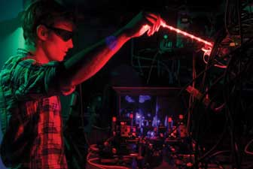
The Experimental Situation
Last summer, the group at Bristol reported BosonSampling with 6 photons (in a special case)—confirming experimentally that 6-photon amplitudes are indeed given by permanents of 6×6 complex matrices, just as quantum mechanics says
But scaling up to more photons is hard, because it seems to require deterministic single-photon sources
What might help: “Scattershot BosonSampling” (proposed by the group here at Oxford, esp. Steve Kolthammer)
But it’s worth considering whether BosonSampling-like ideas could be ported to other QC architectures, besides optics…

Slide 16
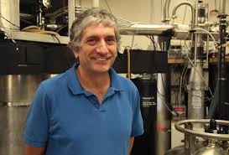
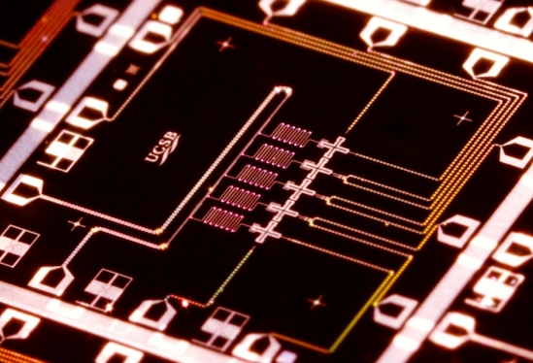
In a few years, we’re likely to have 40-50 high-quality qubits with controllable couplings, in superconducting or ion-trap architectures. (Way more exciting to me than 1000 lower-quality annealing qubits!)
John Martinis, Google
Still won’t be enough for most QC applications. But should suffice for a quantum supremacy experiment!
Our duty as theoretical computer scientists: Tell the experimenters what they can do with their existing or planned hardware, how to verify it, and what can be said about the hardness of simulating it classically

Slide 17
The Random Quantum Circuit Proposal
(Ongoing joint work with Lijie Chen)
Generate a quantum circuit C on n qubits in a √n×√n lattice, with d layers of random nearest-neighbor gates
Apply C to |0⟩^{⊗n} and measure. Repeat t times, to obtain samples x₁,…,x_{T} from {0,1}^{n}
Apply a statistical test to x₁,…,x_{T}
(taking classical exponential time, which is OK for n≈40)
Publish C. Challenge skeptics to generate samples passing the test in a reasonable amount of time

Slide 18
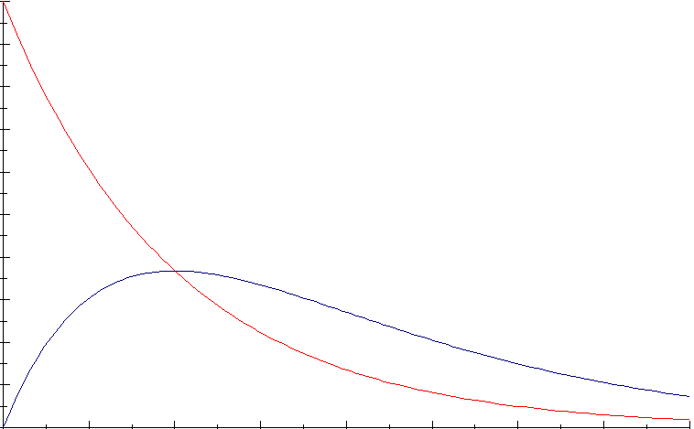
Verification of Outputs
Simplest: Just check whether the histogram of probabilities of the observed x_{i}’s matches the theoretical prediction (assuming probabilities are exponentially distributed, as with a Haar-random state)
Theorem (Brandao-Harrow-Horodecki 2012): A random local circuit on √n×√n qubits produces nearly Gaussian amplitudes (hence nearly exponentially-distributed probabilities) after d=O(n) depth (right answer should be d=O(√n))
For any constants α and c∈(e^{-α},(1+α)e^{-α}) can also just check whether a ≥c fraction of x_{i}’s have

Slide 19
To be more concrete, let’s do the following test…
Do an ≥0.6 fraction of the sampled x_{i}’s have

Slide 20
Our Strong Hardness Assumption
There’s no polynomial-time classical algorithm A such that, given a uniformly-random quantum circuit C with n qubits and m>>n gates,
Note: There is a polynomial-time classical algorithm that guesses with probability
(just expand ⟨0|^{⊗n}C|0⟩^{⊗n} out as a sum of 4^{m} terms, then sample a few random terms)

Slide 21
Theorem: Assume SHA. Then given as input a random quantum circuit C, with n qubits and m>>n gates, there’s no polynomial-time classical algorithm that even passes our statistical test for C-sampling with high probability
Proof Sketch: Given a circuit C, first “hide” which amplitude we care about by applying a random XOR-mask to the outputs, producing a C’ such that
Now let A be a poly-time classical algorithm that passes the test for C’ with probability ≥0.99. Suppose A outputs samples x₁,…,x_{T}. Then if x_{i} =z for some i∈[T], guess that
Violates SHA!
Otherwise, guess that with probability

Slide 22
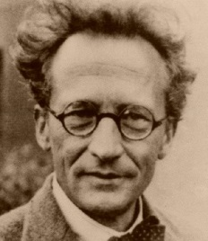
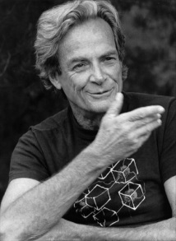
Time-Space Tradeoffs for Simulating Quantum Circuits
Given a general quantum circuit with n qubits and m>>n two-qubit gates, how should we simulate it classically?
“Schrödinger way”:
Store whole wavefunction
O(2^{n}) memory, O(m2^{n}) time
n=40, m=1000: Feasible but requires TB of RAM
“Feynman way”:
Sum over paths
O(m+n) memory, O(4^{m}) time
n=40, m=1000: Infeasible but requires little RAM
Best of both worlds?

Slide 23
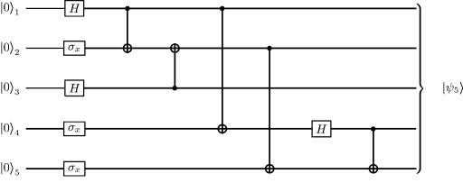
Theorem: Let C be a quantum circuit with n qubits and d layers of gates. Then we can compute each transition amplitude, ⟨x|C|y⟩, in d^{O(n)} time and poly(n,d) space.
C₂
C₁
Proof: Savitch’s Theorem! Recursively divide C into two chunks, C₁ and C₂, with d/2 layers each. Then
Evaluation time:

Slide 24
Comments
Time/Space Tradeoff: Starting with the “naïve, ~2^{n}-time and -memory Schrödinger simulation,” every time you halve the available memory, multiply the running time by the circuit depth d and you can still simulate
Is this d^{O(n)} algorithm optimal? Open problem! Related to L vs. NL
We don’t get a polytime algorithm to guess ⟨x|C|y⟩ with greater than 4^{-m} success probability (why not?)

Slide 25
A Different Approach: Fourier Sampling / IQP
Given a Boolean function
Let D_{f} be the distribution over {0,1}^{n} defined by
Trivial Quantum Algorithm:
|0⟩
H
H
Problem: Sample exactly or approximately from D_{f}
|0⟩
H
f
H
|0⟩
H
H

Slide 26
Classical Hardness of Fourier Sampling?
If f is a black box: Any classical algorithm to sample D_{f} within ε requires Ω(2^{n}/n) queries to f [A.-Ambainis 2015]
Ω(2^{n}) queries for sufficiently small ε [A.-Chen 2016]
Even a classical randomized algorithm with a PH oracle must make exponentially many queries to f [A. 2010]
If f is given by an explicit circuit: “As usual,” any classical algorithm to sample D_{f} exactly would collapse PH
A classical algorithm to sample D_{f} within ε seems unlikely, but that requires a new hardness assumption [Bremner-Montanaro-Shepherd 2015]
“SHA” is false, as it is for BosonSampling

Slide 27

Our Proposal:
Compare complexity classes, relative to black boxes that are constrained to lie in the class P/poly (i.e., black boxes that we can actually instantiate using small circuits)
SCOTT & LIJIE
A NEW KIND OF HARDNESS
Zhandry 2013: If pseudorandom functions exist, then there’s an A∈P/poly with P^{A}≠BQP^{A}
We show: Any such result must use some computational assumption

Slide 28
Suppose we do FourierSampling with a pseudorandom function f.
What can we say about the hardness of simulating the result classically?
Theorem: No polynomial-time classical algorithm, which accesses a cryptographic pseudorandom function f∈P/poly only as a black box, can do anything that passes a standard statistical test for FourierSampling f
Proof Sketch: No such algorithm could pass a test for FourierSampling a truly random function. So if we run the test and it passes, we distinguished f from truly random!

Slide 29
Conclusions
In the near future, we might be able to perform random quantum circuit and Fourier sampling with ~40 qubits
Central question: how do we verify that something classically hard was achieved?
  There’s no “direct physical signature” of quantum supremacy, because supremacy just means the nonexistence of a fast classical algorithm to do the same thing. This is what makes complexity theory unavoidable!
Quantum computing theorists would be urgently called upon to think about this, even if there were nothing theoretically interesting to say. But there is!

Slide 30
Open Problems (& Recent Progress)
BosonSampling with constant fraction of lost photons
  A.-Brod 2015: BosonSampling with constant number of lost photons is just as hard as perfect BosonSampling
Show that a collapse of quantum and classical approximate sampling would collapse the polynomial hierarchy
  A.-Chen 2016: Any proof of this would need to be non-relativizing
Give an efficient classical cryptographic scheme to verify the outputs of a BosonSampler or random quantum circuit sampler
  Shepherd & Bremner 2008: Proposal like this for Fourier Sampling

