Slide 1
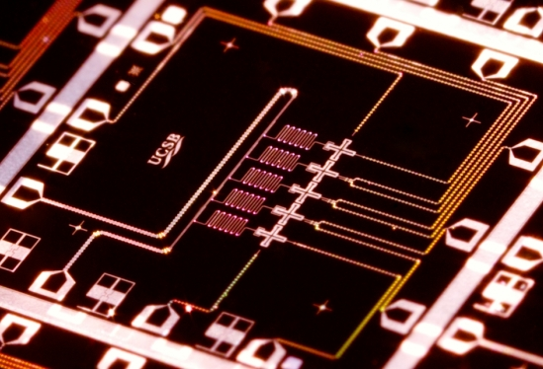
QUANTUM SUPREMACY
PostBQP
PostBPP
Scott Aaronson (MIT→UT Austin)
MSR, Redmond, July 15, 2016
Joint work with Lijie Chen

Slide 2
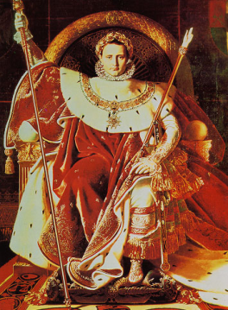
| ⟩
#1 Application of QC: Disprove the QC skeptics (and the Extended Church-Turing Thesis)!
Forget for now about applications. Just concentrate on certainty of a quantum speedup over the best classical algorithm for some task

Slide 3
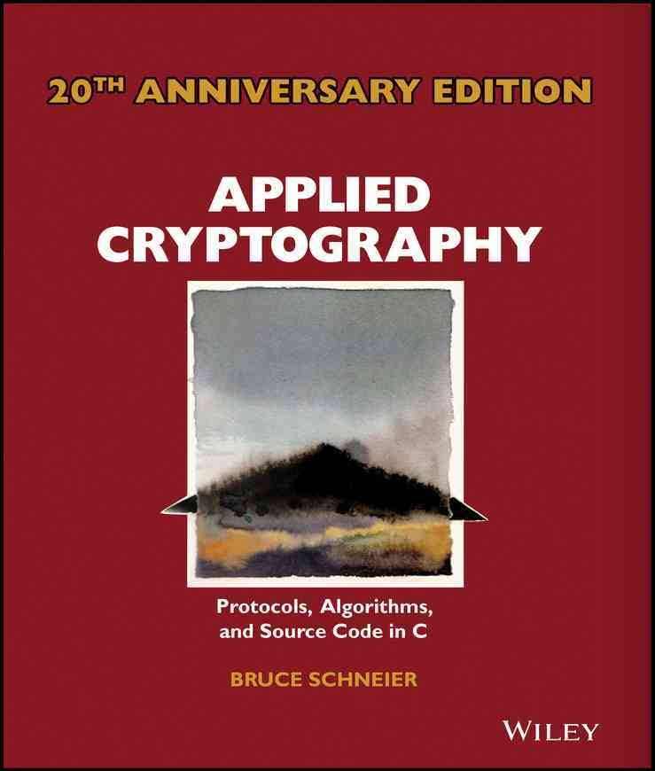
Physicists will need to think like applied cryptographers!
Define a clear task that your quantum device performs
Think hard about how your worst enemy would perform that task (or appear to…) using classical resources only Closest historical analogue in physics: the Bell inequality
Publish benchmark challenges for classical skeptics
Isolate the cleanest possible hardness assumption that implies what you want
Leave a safety margin!
PostBQP: where we allow postselection on exponentially-unlikely measurement outcomes
PostBPP: Classical randomized subclass
Theorem (A. 2004): PostBQP = PP
PostBPP is in the polynomial hierarchy
PostBQP
PostBPP

Slide 4
The Sampling Approach Examples: BosonSampling (A.-Arkhipov 2011), FourierSampling/IQP (Bremner-Jozsa-Shepherd 2011), QAOA, stabilizer circuits with magic states…
Consider sampling problems, where given an input x, we’re asked to output a sample (exactly or approximately) from a probability distribution D_{x} over n-bit strings
Compared to problems with a single valid output (like Factoring), sampling problems can be
Easier to solve with near-future quantum devices, and
Easier to argue are hard for classical computers!
(We “merely” give up on: practical applications, fast classical way to verify the result)
PostBQP: where we allow postselection on exponentially-unlikely measurement outcomes
PostBPP: Classical randomized subclass
Theorem (A. 2004): PostBQP = PP
PostBPP is in the polynomial hierarchy
PostBQP
PostBPP

Slide 5
This Talk
In a few years, we might have dozens of high-quality qubits with controllable couplings, in superconducting and/or ion-trap architectures
Still won’t be enough for most QC applications. But should suffice for a quantum supremacy experiment!
Our duty as complexity theorists: Tell experimenters what they can do with their existing or planned hardware, how to verify it, and what can be said about the hardness of simulating it classically

Slide 6
The Random Quantum Circuit Proposal
Generate a quantum circuit C on n qubits in a √n×√n lattice, with d layers of random nearest-neighbor gates
Apply C to |0⟩^{⊗n} and measure. Repeat t times, to obtain samples x₁,…,x_{T} from {0,1}^{n}
Apply a statistical test to x₁,…,x_{T} (taking classical exponential time, which is OK for n≈40)
Publish C. Challenge skeptics to generate samples passing the test in a reasonable amount of time

Slide 7
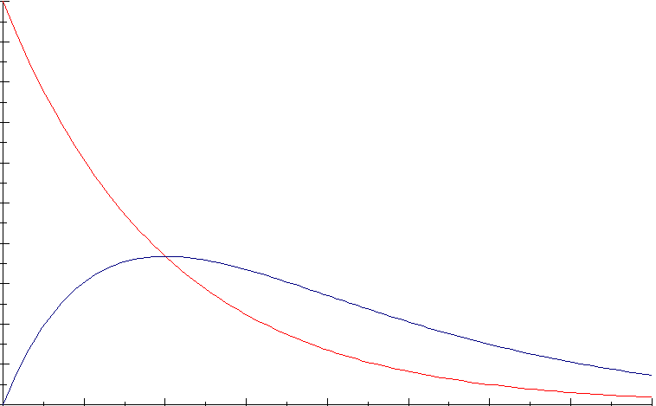
What statistical test should we use?
Simplest: Just check whether the histogram of probabilities of the observed x_{i}’s matches the theoretical prediction (assuming probabilities are exponentially distributed, as with a Haar-random state)
Theorem (Brandao-Harrow-Horodecki 2012): A random local circuit on √n×√n qubits produces nearly Gaussian amplitudes (hence nearly exponentially-distributed probabilities) after d=O(n) depth (right answer should be d=O(√n))

Slide 8
For constants α and c∈(e^{-α},(1+α)e^{-α}) can also just check whether a ≥c fraction of x_{i}’s have
Theorem: A random quantum circuit, of any depth, will cause a ≥1-α/2 fraction of x’s (in expectation) to have
Provable by looking at the last gate only!
Means: we just need to choose any α≤1.59, to produce a statistical test that distinguishes quantum from classical
Log-likelihood test doesn’t work with the hardness assumption we’ll adopt!

Slide 9
Our Strong Hardness Assumption
There’s no polynomial-time classical algorithm A such that, given a uniformly-random quantum circuit C with n qubits and m>>n gates,
Note: There is a polynomial-time classical algorithm that guesses with probability
(just expand ⟨0|^{⊗n}C|0⟩^{⊗n} out as a sum of 4^{m} terms, then sample a few random ones)

Slide 10
Theorem: Assume SHA. Then given as input a random quantum circuit C, with n qubits and m>>n gates, there’s no polynomial-time classical algorithm that even passes our statistical test for C-sampling (for α=ln 2, c=0.6) w.h.p.
Proof Sketch: Given a circuit C, first “hide” which amplitude we care about by applying a random XOR-mask to the outputs, producing a C’ such that
Now let A be a poly-time classical algorithm that passes the test for C’ with probability ≥0.99. Suppose A outputs samples x₁,…,x_{T}. Then if x_{i} =z for some i∈[T], guess that
Violates SHA!
Otherwise, guess that with probability

Slide 11
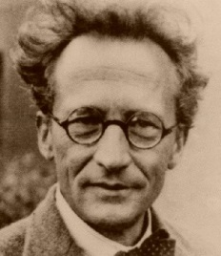
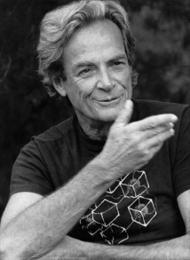
Time-Space Tradeoffs for Simulating Quantum Circuits
Given a general quantum circuit with n qubits and m>>n two-qubit gates, how should we simulate it classically?
“Schrödinger way”:
Store whole wavefunction
O(2^{n}) memory, O(m2^{n}) time
n=40, m=1000: Feasible but requires TB of RAM
“Feynman way”:
Sum over paths
O(m+n) memory, O(4^{m}) time
n=40, m=1000: Infeasible but requires little RAM
Best of both worlds?

Slide 12
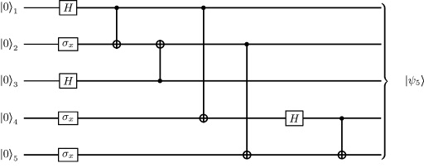
Theorem: Let C be a quantum circuit with n qubits and d layers of gates. Then we can compute each transition amplitude, ⟨x|C|y⟩, in d^{O(n)} time and poly(n,d) space.
C₂
C₁
Proof: Savitch’s Theorem! Recursively divide C into two chunks, C₁ and C₂, with d/2 layers each. Then
Evaluation time:

Slide 13
Comments
Time/Space Tradeoff: Starting with the “naïve, ~2^{n}-time and -memory Schrödinger simulation,” every time you halve the available memory, multiply the running time by the circuit depth d and you can still simulate
If the gates are nearest-neighbor on a √n×√n grid, can replace the d by d/√n, by switching to tensor networks when the depth is small enough
Is our d^{O(n)} algorithm optimal? Open problem! Related to L vs. NL
We don’t get a polytime algorithm to guess ⟨x|C|y⟩ with greater than 4^{-m} success probability (why not?)

Slide 14
Non-Relativizing Techniques Will Be Needed for Strong Quantum Supremacy Theorems
Theorem (Fortnow-Rogers 1998): There’s an oracle relative to which P=BQP and yet PH is infinite.
Our Improvement: There’s an oracle relative to which SampBPP=SampBQP and yet PH is infinite.
SampBPP: Class of distribution families {D_{n}}_{n} that can be approximately sampled by a polynomial-time randomized algorithm
SampBQP: Same but for quantum algorithms
“The sort of thing we conjecture holds for BosonSampling—i.e., fast approximate classical sampling collapses PH—doesn’t hold in complete black-box generality”

Slide 15
Theorem: There’s an oracle relative to which SampBPP=SampBQP and yet PH is infinite.
Proof Sketch: Have one part of the oracle encode a PSPACE-complete language (collapsing SampBPP with SampBQP), while a second part encodes exponentially many random bits that each require an exponential search to find. This second part makes PH infinite by [Rossman-Servedio-Tan 2015], and doesn’t re-separate SampBPP and SampBQP by the BBBV lower bound

Slide 16
Two More “Structural Supremacy Results”
Theorem: Suppose P=NP and SampBPP=SampBQP. Then SampBPP^{A}=SampBQP^{A} for all A∈P/poly.
(Even to prove a quantum supremacy theorem relative to an oracle, some computational assumption is needed—if we demand that the oracle be efficiently computable)
Theorem: Suppose that, for all f∈P/poly, there’s a polynomial-time classical algorithm that accesses f only as a black box, and passes a standard statistical test for sampling from f’s Fourier distribution. Then all one-way functions can be inverted in time
(With a modest computational assumption, one can indeed get quantum supremacy relative to an efficiently computable oracle)

Slide 17
Conclusions
In the near future, we might be able to perform random quantum circuit sampling with ~40 qubits
Central question: how do we verify that something classically hard was done?
There’s no “direct physical signature” of quantum supremacy, because supremacy just means the nonexistence of a fast classical algorithm to do the same thing. That’s what makes complexity theory unavoidable!
As quantum computing theorists, we’d be urgently called upon to think about this, even if there were nothing theoretically interesting to say. But there is!

