Slide 1
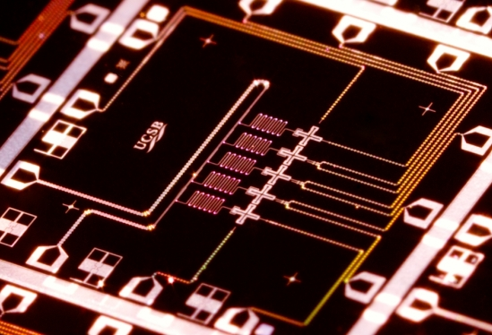
Complexity-Theoretic Foundations of Quantum Supremacy Experiments
QSamp
Samp
Scott Aaronson (UT Austin)
Banff, September 8, 2016
Joint work with Lijie Chen

Slide 2
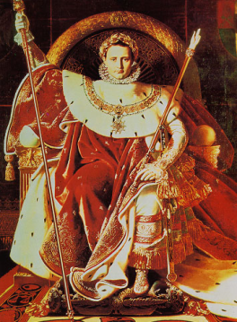
QUANTUM SUPREMACY
| ⟩
#1 Application of QC: Disprove the QC skeptics (and the Extended Church-Turing Thesis)!
Forget for now about applications. Just concentrate on certainty of a quantum speedup over the best classical algorithm for some task

Slide 3
The Sampling Approach Examples: BosonSampling (A.-Arkhipov 2011), FourierSampling/IQP (Bremner-Jozsa-Shepherd 2011), QAOA, stabilizer circuits with magic states…
Consider sampling problems, where given an input x, we’re asked to output a sample (exactly or approximately) from a probability distribution D_{x} over n-bit strings
Compared to problems with a single valid output (like Factoring), sampling problems can be
Easier to solve with near-future quantum devices, and
Easier to argue are hard for classical computers!
(We “merely” give up on: practical applications, fast classical way to verify the result)
PostBQP: where we allow postselection on exponentially-unlikely measurement outcomes
PostBPP: Classical randomized subclass
Theorem (A. 2004): PostBQP = PP
PostBPP is in the polynomial hierarchy
PostBQP
PostBPP

Slide 4
Underlying all the recent quantum supremacy ideas…
Samp: poly(n)-time samplable distribution families {D_{n}}_{n} QSamp: Same except we allow quantum sampling ApproxSamp: poly(n,1/ε) samplable distribution families ApproxQSamp
Theorem (easy): Samp = QSamp ⇒ PH collapses
Proof: It’s not hard to set up a quantum circuit C for which approximating (say) p=Pr[C outputs 0^{n}] is #P-complete. Suppose we could sample C’s output distribution classically. Then we could also estimate p in BPP^{NP} using approximate counting. So we’d have P^{#P}=BPP^{NP} which collapses PH.

Slide 5
Example: Fourier Sampling
|0⟩
H
H
|0⟩
H
f
H
|0⟩
H
H
Given a Boolean function
the above circuit samples each z∈{0,1}^{n} with probability
#P-complete to approximate, even for z=0…0

Slide 6
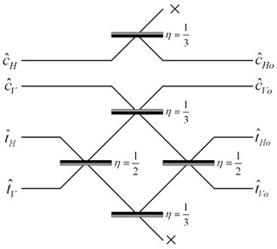
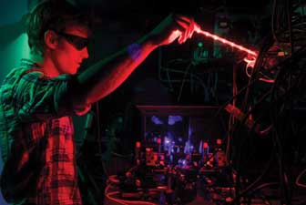
Central Theorem of BosonSampling: ApproxSamp = ApproxQSamp ⇒ one could estimate the permanent of a matrix of i.i.d. Gaussians in BPP^{NP} (and this even relativizes…)
Central Conjecture of BosonSampling: Gaussian permanent estimation is #P-complete
If so, then even ApproxSamp = ApproxQSamp would imply that PH collapses

Slide 7
This Talk
In a few years, we might have 40-50 high-quality qubits with controllable couplings, in superconducting and/or ion-trap architectures (e.g. from Martinis group at Google and Monroe group at Maryland/NIST)
Still won’t be enough for most QC applications. But should suffice for a quantum supremacy experiment!
Our duty as complexity theorists: Tell experimenters what they can do with their existing or planned hardware, how to verify it, and what can be said about the hardness of simulating it classically

Slide 8
The Random Quantum Circuit Proposal
Generate a quantum circuit C on n qubits in a √n×√n lattice, with d layers of random nearest-neighbor gates
Apply C to |0⟩^{⊗n} and measure. Repeat t times, to obtain samples x₁,…,x_{T} from {0,1}^{n}
Apply a statistical test to x₁,…,x_{T} (taking classical exponential time, which is OK for n≈40)
Publish C. Challenge skeptics to generate samples passing the test in a reasonable amount of time

Slide 9
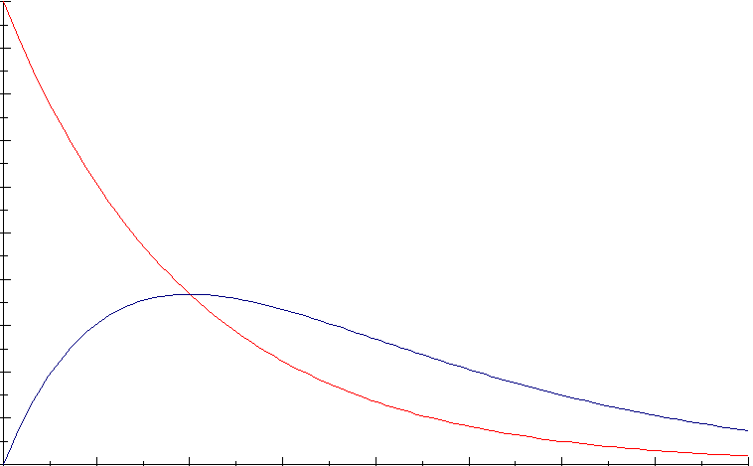
What statistical test should we use?
Simplest: Just check whether the histogram of probabilities of the observed x_{i}’s matches the theoretical prediction (assuming probabilities are exponentially distributed, as with a Haar-random state)
For constants α and c∈(e^{-α},(1+α)e^{-α}) can also just check whether a ≥c fraction of x_{i}’s have
Theorem (Brandao-Harrow-Horodecki 2012): A random local circuit on √n×√n qubits produces nearly Gaussian amplitudes (hence nearly exponentially-distributed probabilities) after d=O(n) depth (right answer should be d=O(√n))

Slide 10
Our Strong Hardness Assumption
There’s no polynomial-time classical algorithm A such that, given a uniformly-random quantum circuit C with n qubits and m>>n gates,
Note: There is a polynomial-time classical algorithm that guesses with probability
(just expand ⟨0|^{⊗n}C|0⟩^{⊗n} out as a sum of 4^{m} terms, then sample a few random ones)

Slide 11
Theorem: Assume SHA. Then given as input a random quantum circuit C, with n qubits and m>>n gates, there’s no polynomial-time classical algorithm that even passes our statistical test for C-sampling (for α=ln 2, c=0.6) w.h.p.
Proof Sketch: Given a circuit C, first “hide” which amplitude we care about by applying a random XOR-mask to the outputs, producing a C’ such that
Now let A be a poly-time classical algorithm that passes the test for C’ with probability ≥0.99. Suppose A outputs samples x₁,…,x_{T}. Then if x_{i} =z for some i∈[T], guess that
Violates SHA!
Otherwise, guess that with probability

Slide 12
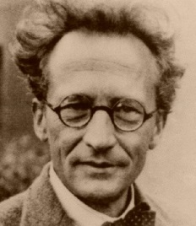
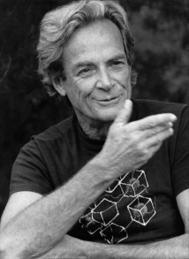
Time-Space Tradeoffs for Simulating Quantum Circuits
Given a general quantum circuit with n qubits and m>>n two-qubit gates, how should we simulate it classically?
“Schrödinger way”:
Store whole wavefunction
O(2^{n}) memory, O(m2^{n}) time
n=40, m=1000: Feasible but requires TB of RAM
“Feynman way”:
Sum over paths
O(m+n) memory, O(4^{m}) time
n=40, m=1000: Infeasible but requires little RAM
Best of both worlds?

Slide 13
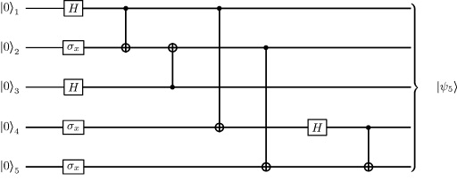
Theorem: Let C be a quantum circuit with n qubits and d layers of gates. Then we can compute each transition amplitude, ⟨x|C|y⟩, in d^{O(n)} time and poly(n,d) space.
C₂
C₁
Proof: Savitch’s Theorem! Recursively divide C into two chunks, C₁ and C₂, with d/2 layers each. Then
Evaluation time:

Slide 14
Comments
Time/Space Tradeoff: Starting with the “naïve, ~2^{n}-time and -memory Schrödinger simulation,” every time you halve the available memory, multiply the running time by the circuit depth d and you can still simulate
If the gates are nearest-neighbor on a √n×√n grid, can replace the d by d/√n, by switching to tensor networks when the depth is small enough
Is our d^{O(n)} algorithm optimal? Open problem! Related to L vs. NL
We don’t get a polytime algorithm to guess ⟨x|C|y⟩ with greater than 4^{-m} success probability (why not?)

Slide 15
Another Thing We Show: Non-Relativizing Techniques Will Be Needed for Strong Quantum Supremacy Theorems
Theorem (Fortnow-Rogers 1998): There’s an oracle relative to which P=BQP and yet PH is infinite.
Our Improvement: There’s an oracle relative to which ApproxSamp=ApproxQSamp and yet PH is infinite.
“The sort of thing we conjecture holds for BosonSampling—i.e., fast approximate classical sampling collapses PH—doesn’t hold in complete black-box generality”
Note: [ Samp=QSamp ⇒ PH collapses ] holds relative to all oracles!

Slide 16
Theorem: There’s an oracle relative to which ApproxSamp=ApproxQSamp and yet PH is infinite.
Proof Sketch: Have one part of the oracle encode a PSPACE-complete language (collapsing ApproxSamp with ApproxQSamp), while a second part encodes exponentially many random bits that each require an exponential search to find. This second part makes PH infinite by [Rossman-Servedio-Tan 2015], and doesn’t re-separate ApproxSamp and ApproxQSamp by the BBBV lower bound

Slide 17
Isn’t there something more informative than query complexity, but easier than computational complexity?
Our Proposal: Complexity relative to oracles that are P/poly computable (i.e., black boxes that we can actually instantiate using small circuits)
SCOTT & LIJIE A NEW KIND OF HARDNESS

Slide 18
Two More “Structural Supremacy Results”
Theorem: Suppose P=NP and ApproxSamp=ApproxQSamp. Then ApproxSamp^{A}=ApproxQSamp^{A} for all A∈P/poly.
(Even to prove a quantum supremacy theorem relative to an oracle, some computational assumption is needed—if we demand that the oracle be efficiently computable)
Theorem (builds on Zhandry): Suppose that, for all f∈P/poly, there’s a poly-time classical algorithm that accesses f only as a black box, and passes a standard statistical test for sampling from f’s Fourier distribution. Then all one-way functions can be inverted in time
(With a modest computational assumption, one can indeed get quantum supremacy relative to an efficiently computable oracle)

Slide 19
Conclusions
In the near future, we might be able to perform random quantum circuit sampling with ~40 qubits
Central question: how do we verify that something classically hard was done?
Quantum computing theorists would be urgently called upon to think about this, even if there were nothing theoretically interesting to say. But there is!

