Slide 1
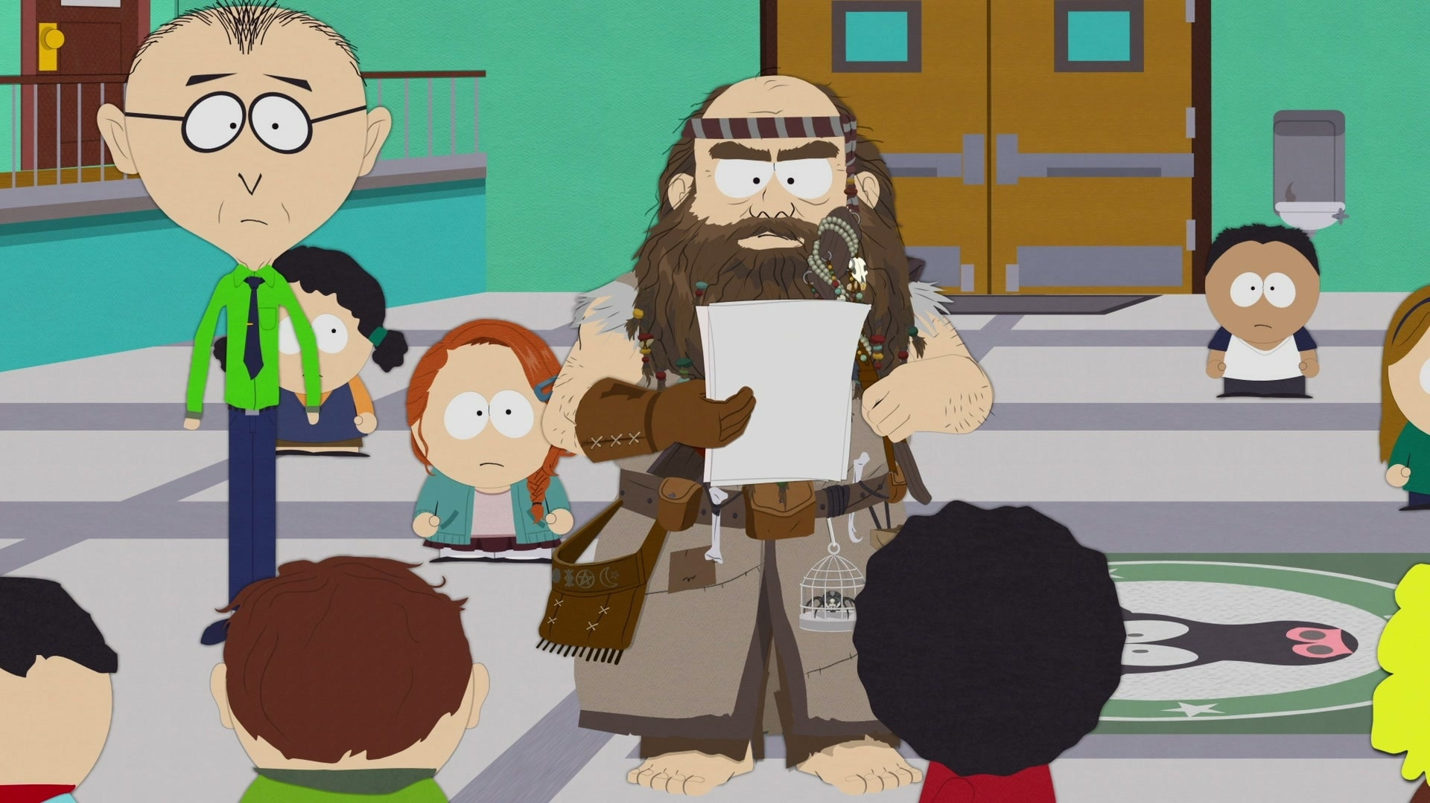
The Problem of Human Specialness in the Age of AI
Scott Aaronson (UT Austin / OpenAI)
TEDxPaloAlto, February 18, 2024

Slide 2
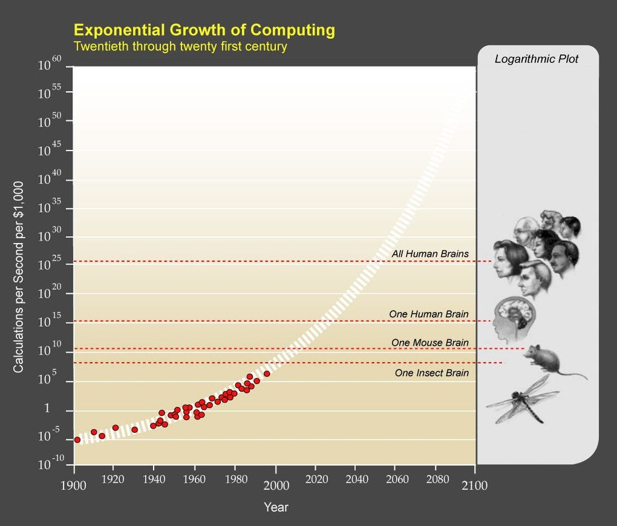

Slide 3
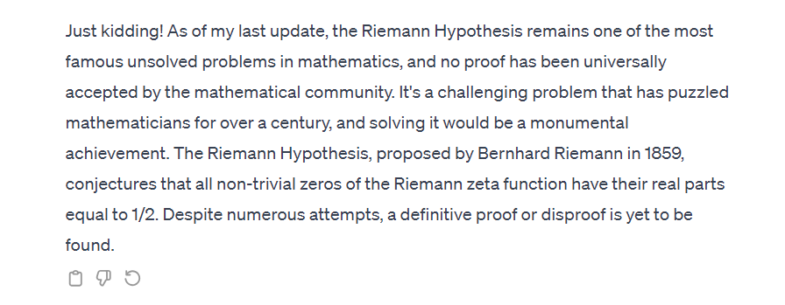

Slide 4
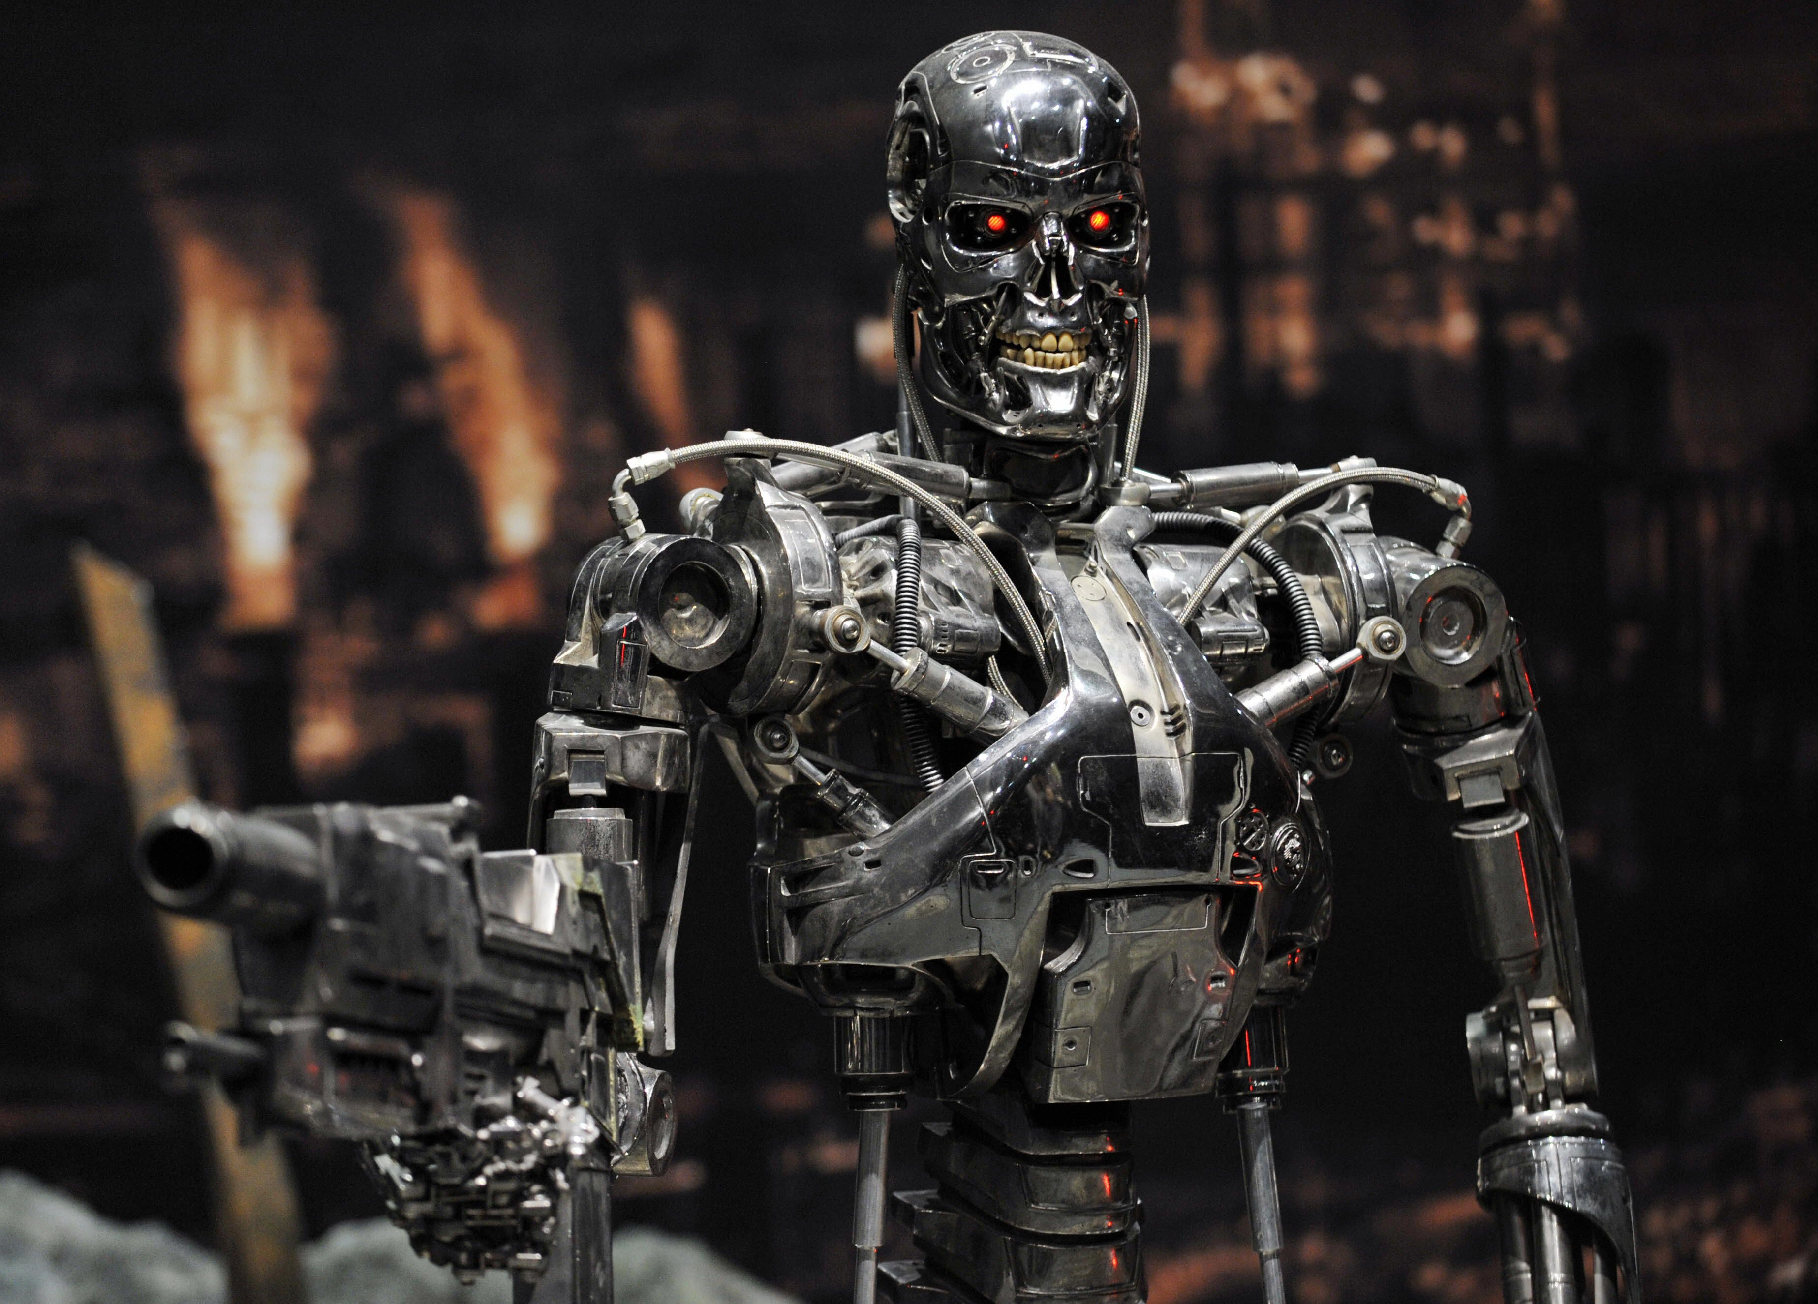

Slide 5
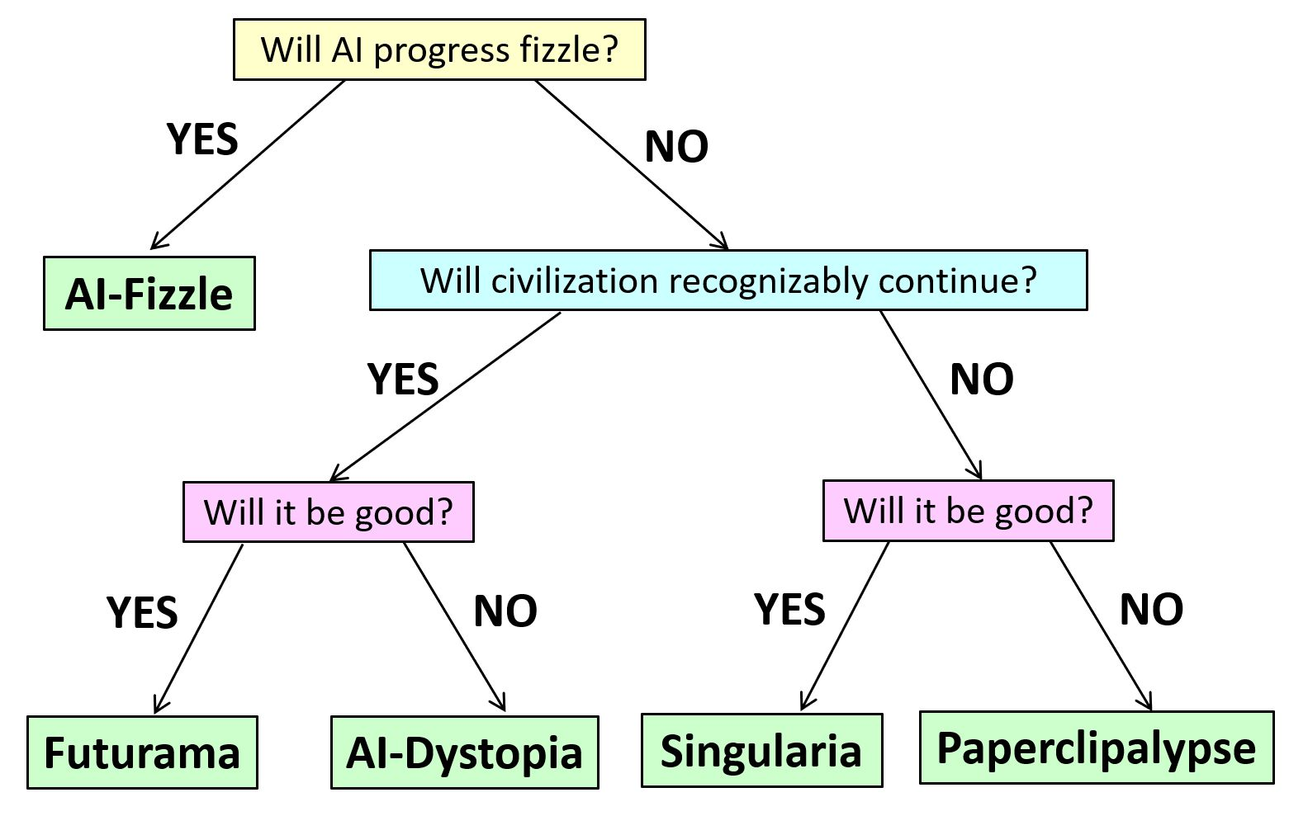
Multiple Outcomes on the Table

Slide 6
Justaism
ChatGPT is…
Justa stochastic parrot
Justa next-token predictor
Justa function approximator
Justa gigantic autocomplete
Aren’t YOU “justa” bundle of neurons and synapses?

Slide 7
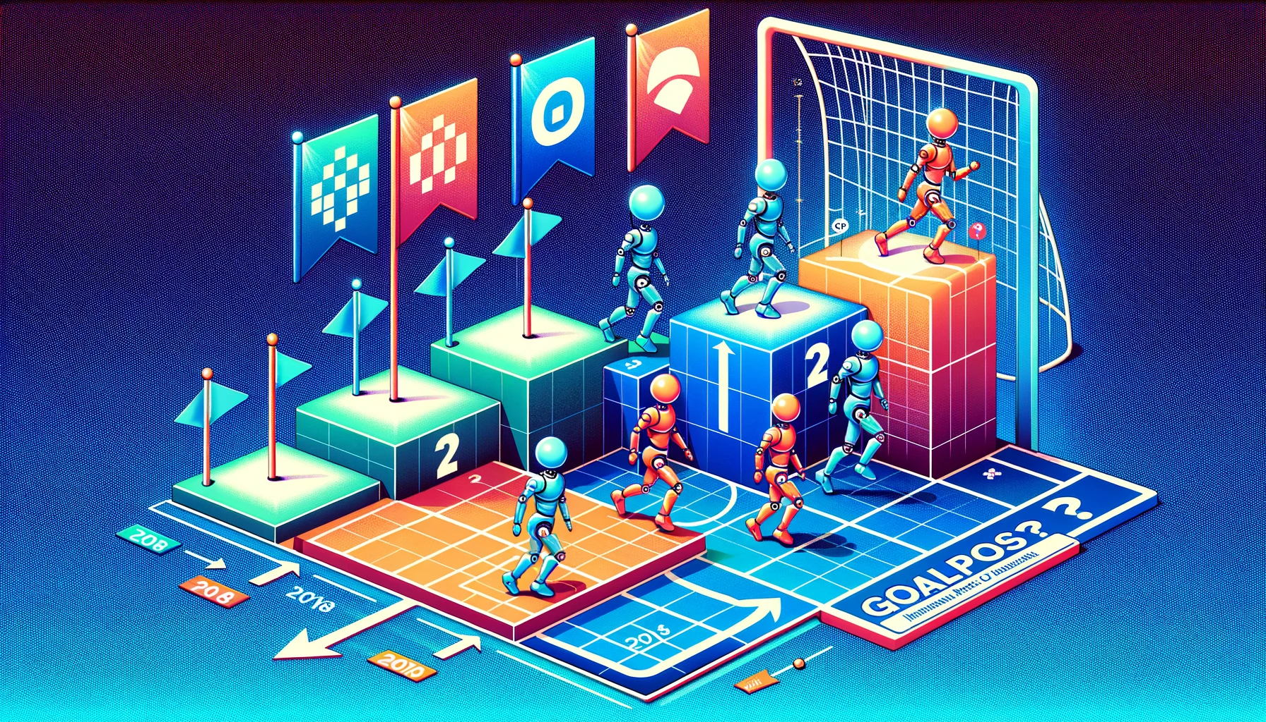
Endlessly Moving Goalposts!
IMO GOLD
GO
CHESS

Slide 8
The “Game Over” Thesis
Given any task with a reasonably objective success metric, and on which an AI can be given suitably many examples of success and failure, it's only a matter of time before AI on the current paradigm (!) matches or beats the best human performance.

Slide 9
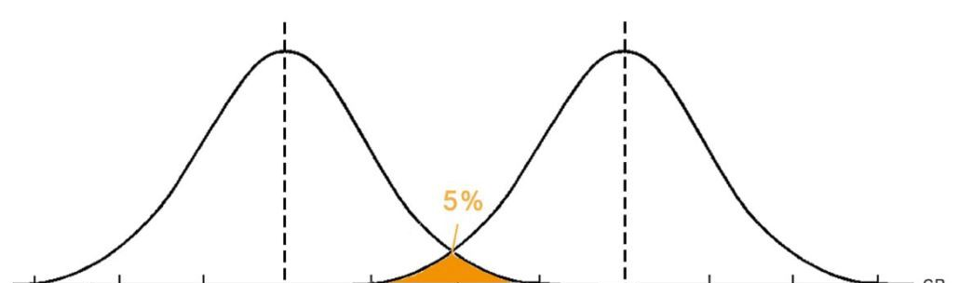
$$n$$
$$n+cαn$$
Score assuming no watermarking
Score assuming watermarking

Slide 10
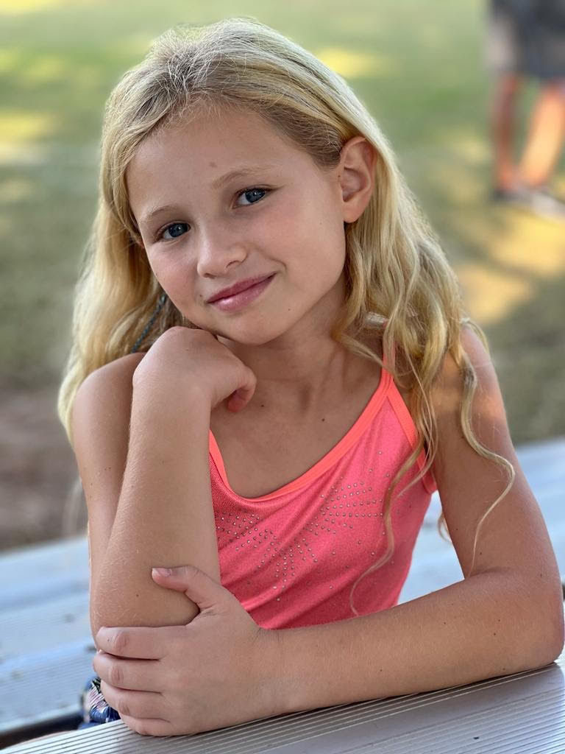
??

Slide 11
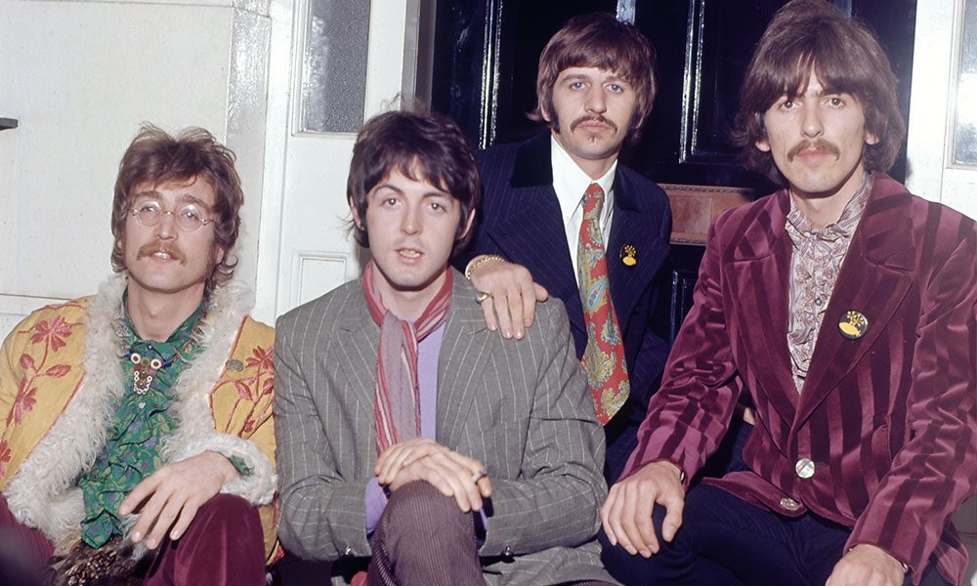
What Made the Beatles Good?
Ideas?
Technical execution?

Slide 13
The AI Abundance Paradox
No matter how good an AI artistic creation, it never seems “special,” because you could’ve easily generated a thousand more like it

Slide 14
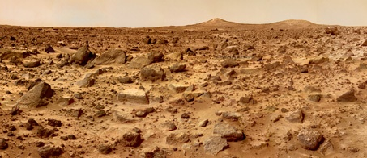
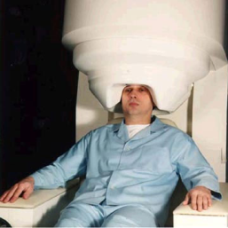
Identity-Destabilizing Technologies
Want to visit Mars? Just fax yourself! (And have the “original you” painlessly euthanized … or not)
Going on a dangerous mountain-climbing trip? Remember to back up your brain first!

Slide 15
The No-Cloning Theorem
No physical procedure can take an unknown quantum state and output two copies of it (or even a close approximation thereof)
We, unlike any existing AI, seem to be buffeted by chaos such that no external agent can have all the information relevant to predicting our behavior.

Slide 16
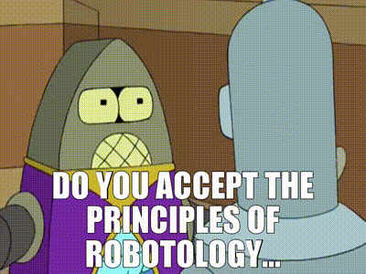
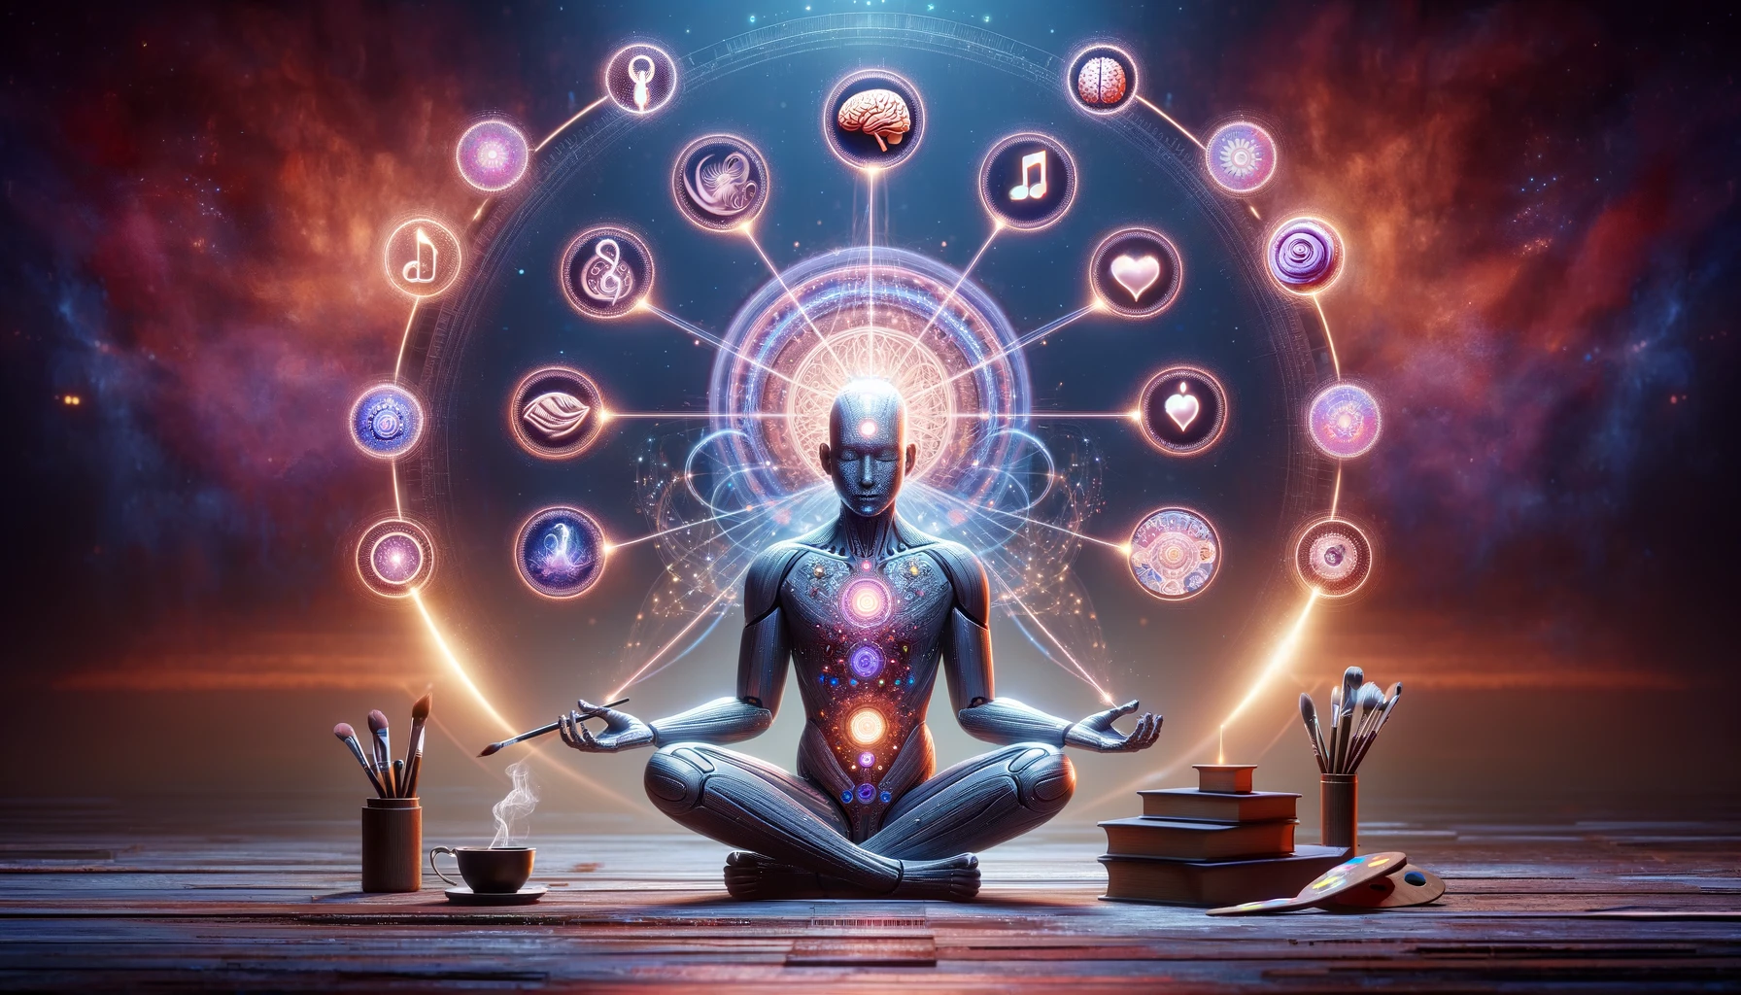
AI Safety Proposal!
Indoctrinate our AIs in a religion that venerates the universe’s unclonable, ephemeral, analog loci of creativity and intelligence, whatever they are
Thou shalt protect these entities from destruction
Thou shalt defer to their preferences …

