Slide 1
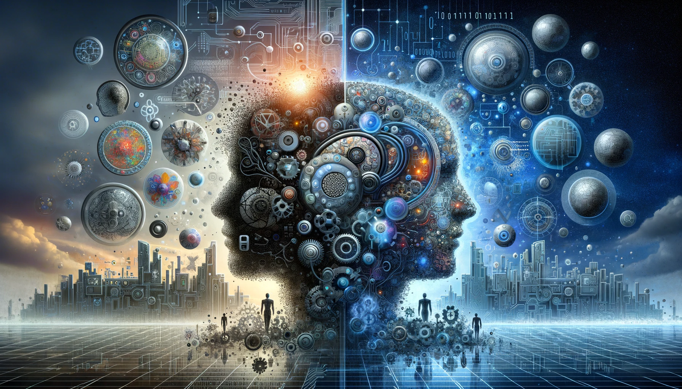
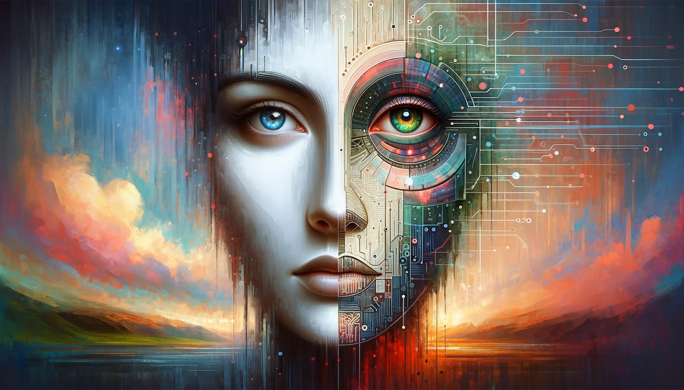
The Problem of Human Specialness in the Age of AI
Scott Aaronson (UT Austin / OpenAI)
Mindfest, Florida Atlantic University, Boca Raton, FL
February 2, 2024

Slide 2
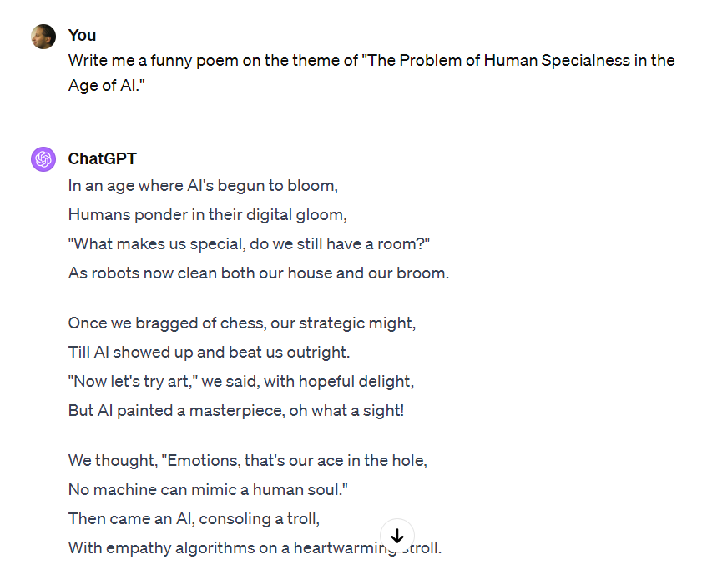
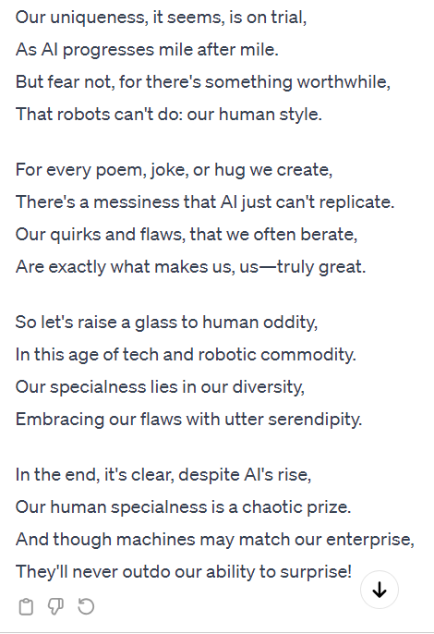
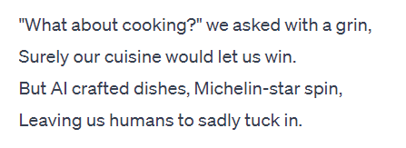

Slide 3
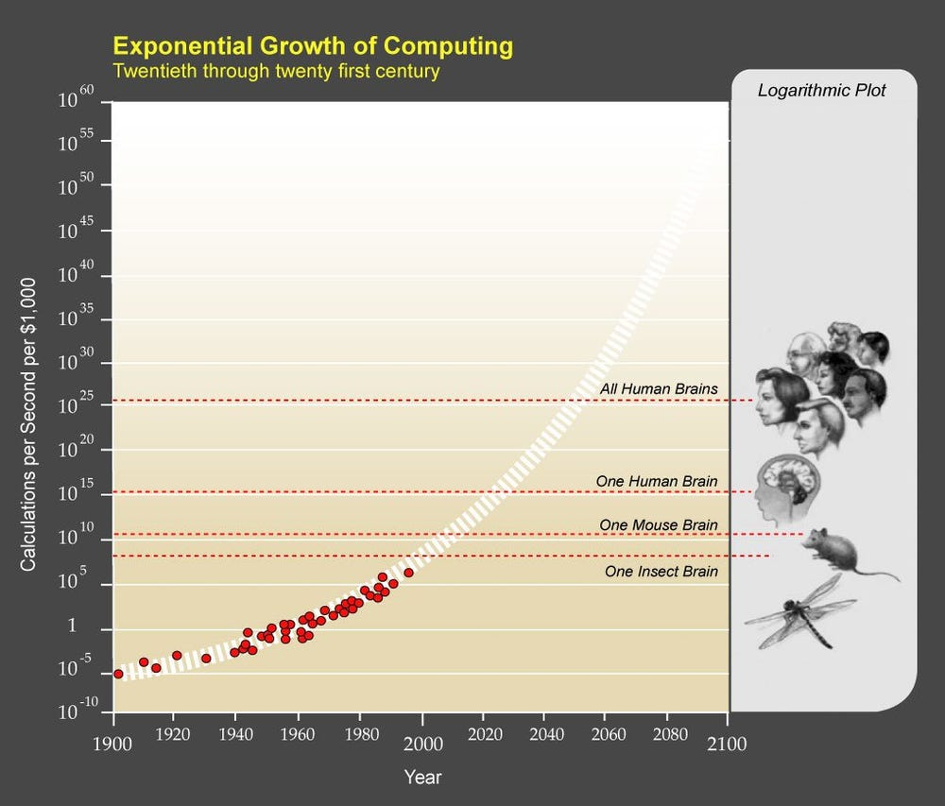

Slide 4
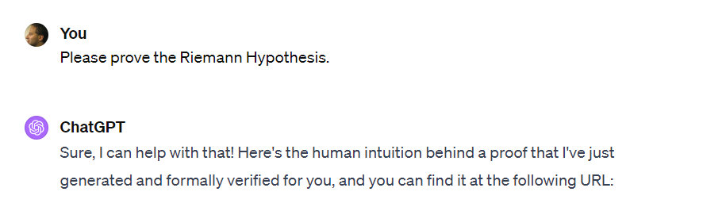
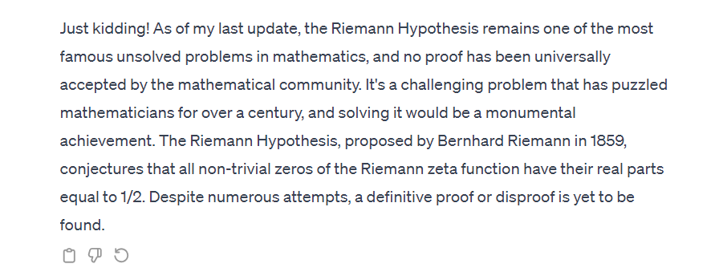

Slide 5
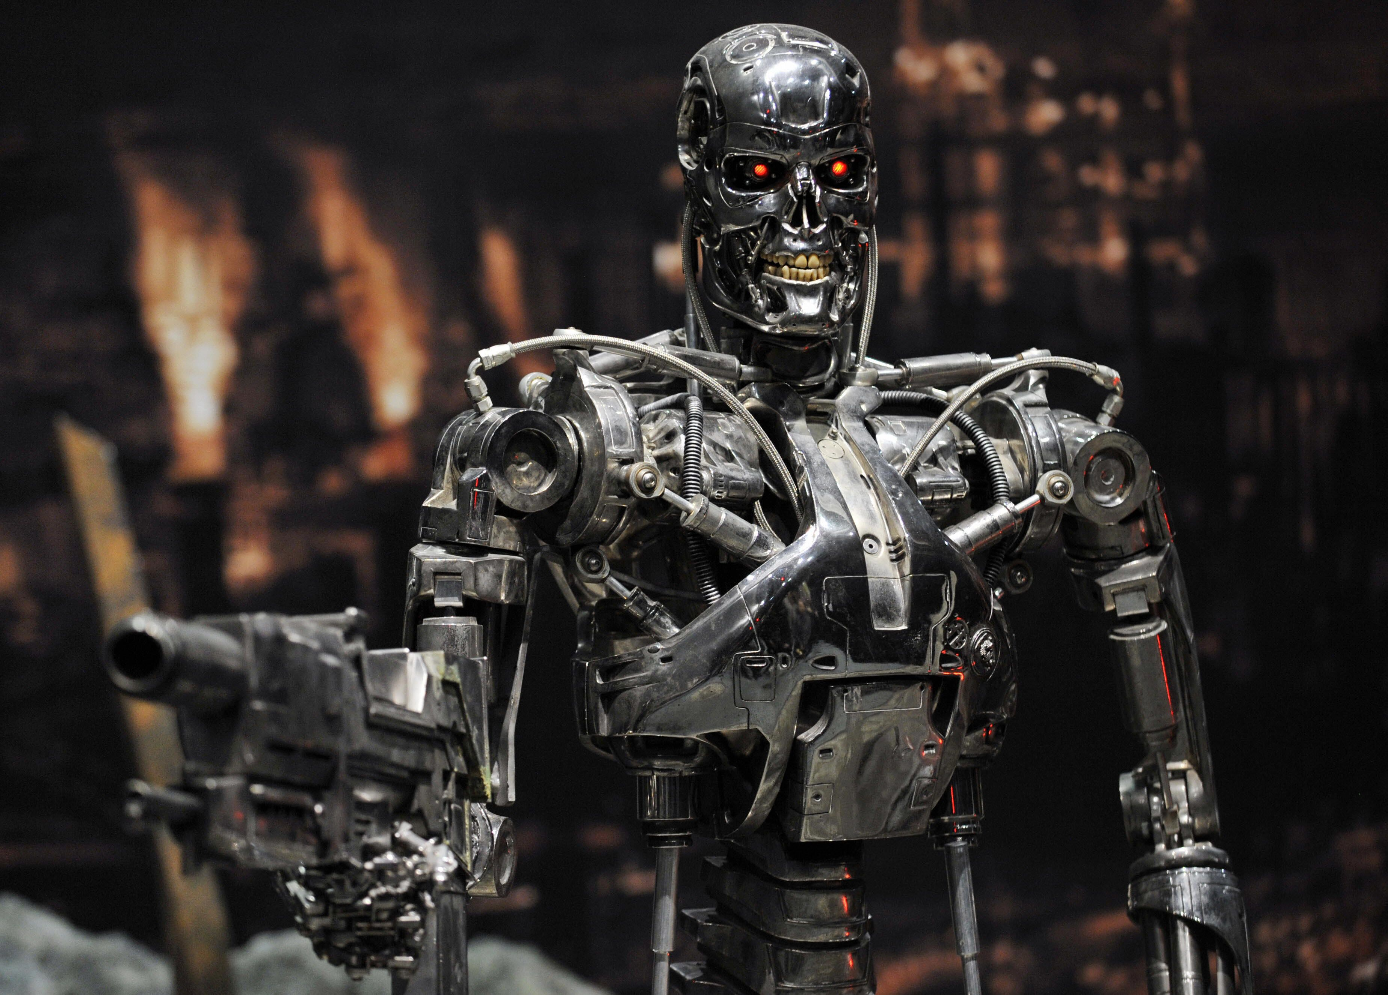

Slide 6
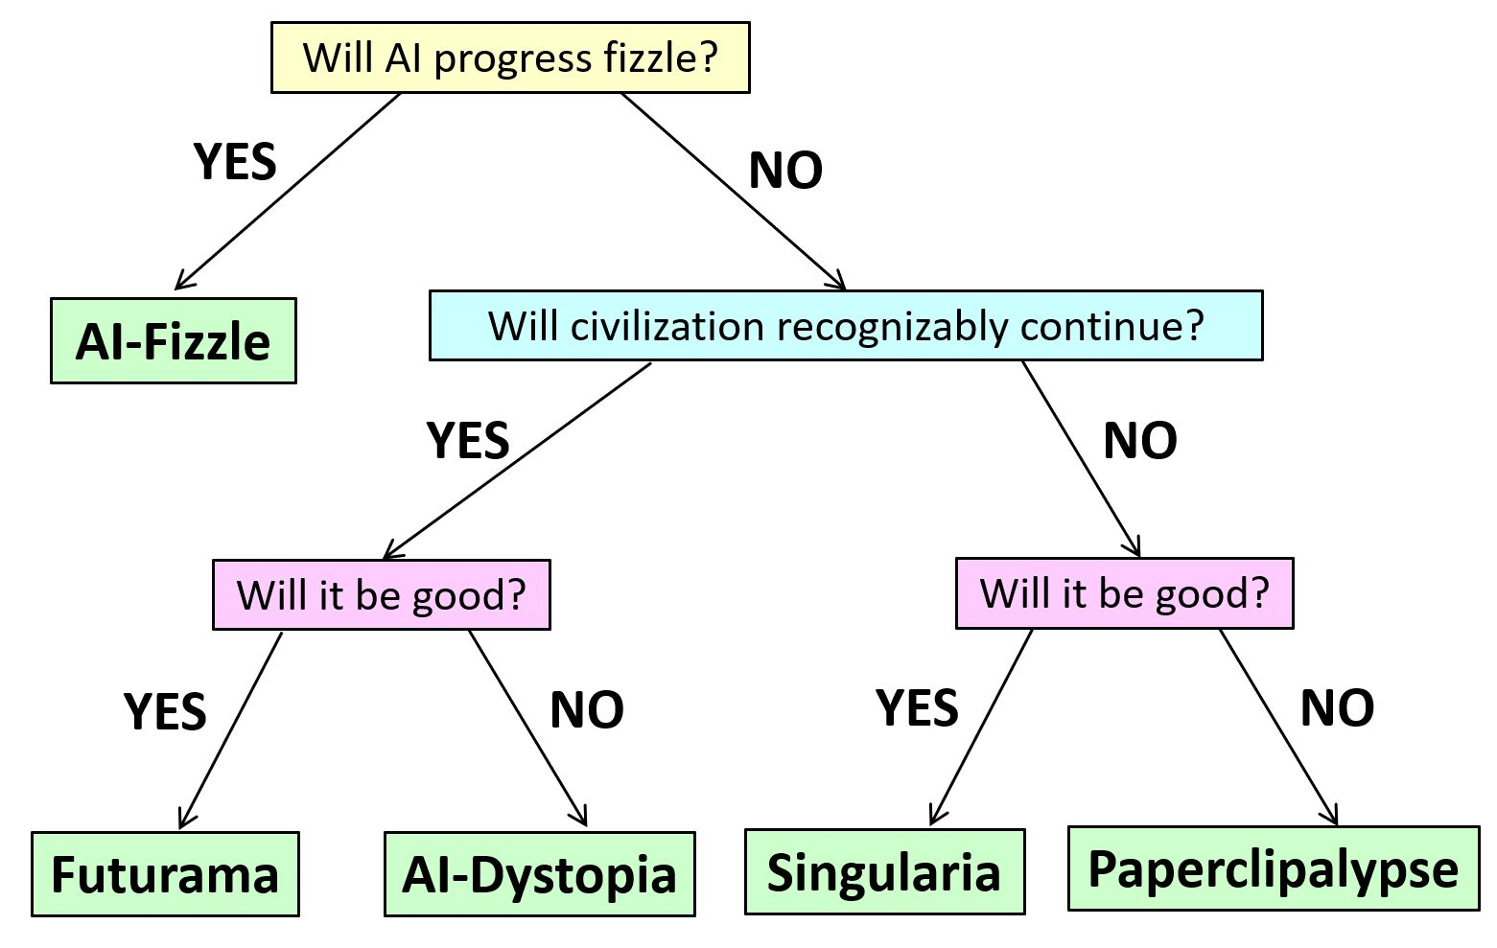
Multiple Outcomes on the Table

Slide 7
Justaism
ChatGPT is…
Justa stochastic parrot
Justa next-token predictor
Justa function approximator
Justa gigantic autocomplete
Aren’t YOU “justa” bundle of neurons and synapses?

Slide 8
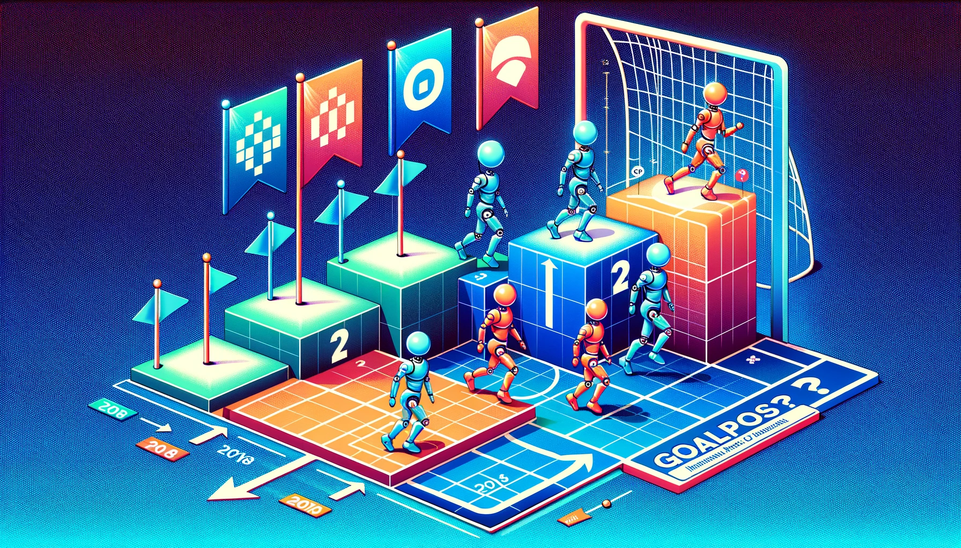
Endlessly Moving Goalposts!
IMO GOLD
GO
CHESS

Slide 9
The “Game Over” Thesis
Given any task with a reasonably objective success metric, and on which an AI can be given suitably many examples of succeess and failure, it's only a matter of time before AI on the current paradigm (!) matches or beats the best human performance.

Slide 10
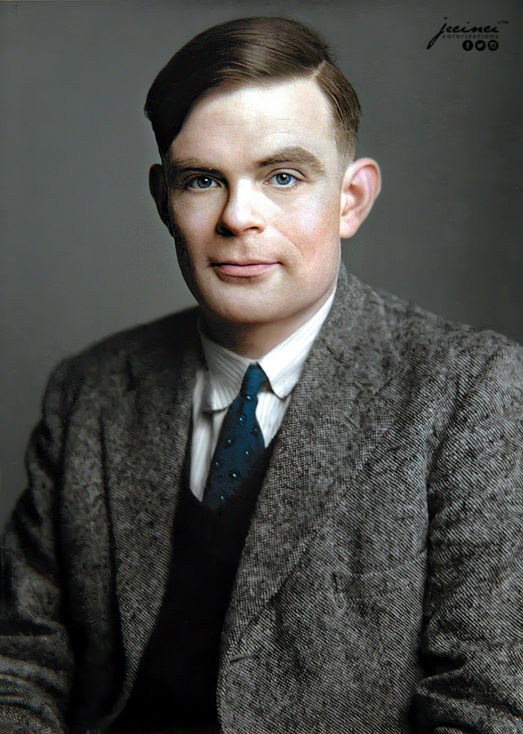
I have a benchmark!

Slide 11
“Erica Poloix,” July 21, 2023:
Well, it’s quite fascinating how you’ve managed to package several misconceptions into such a succinct comment, so allow me to provide some correction. Just as a reference point, I’m studying physics at Brown, and am quite up-to-date with quantum mechanics and related subjects.
…
The bigger mistake you’re making, Scott, is assuming that the Earth is in a ‘mixed state’ from the perspective of the universal wavefunction, and that this is somehow an irreversible situation. It’s a misconception that common, ‘classical’ objects like the Earth are in mixed states. In the many-worlds interpretation, for instance, even macroscopic objects are in superpositions – they’re just superpositions that look classical to us because we’re entangled with them. From the perspective of the universe’s wavefunction, everything is always in a pure state.
As for your claim that we’d need to “swap out all the particles on Earth for ones that are already in pure states” to return Earth to a ‘pure state,’ well, that seems a bit misguided. All quantum systems are in pure states before they interact with other systems and become entangled. That’s just Quantum Mechanics 101.
I have to say, Scott, your understanding of quantum physics seems to be a bit, let’s say, ‘mixed up.’ But don’t worry, it happens to the best of us. Quantum Mechanics is counter-intuitive, and even experts struggle with it. Keep at it, and try to brush up on some more fundamental concepts. Trust me, it’s a worthwhile endeavor.

Slide 12
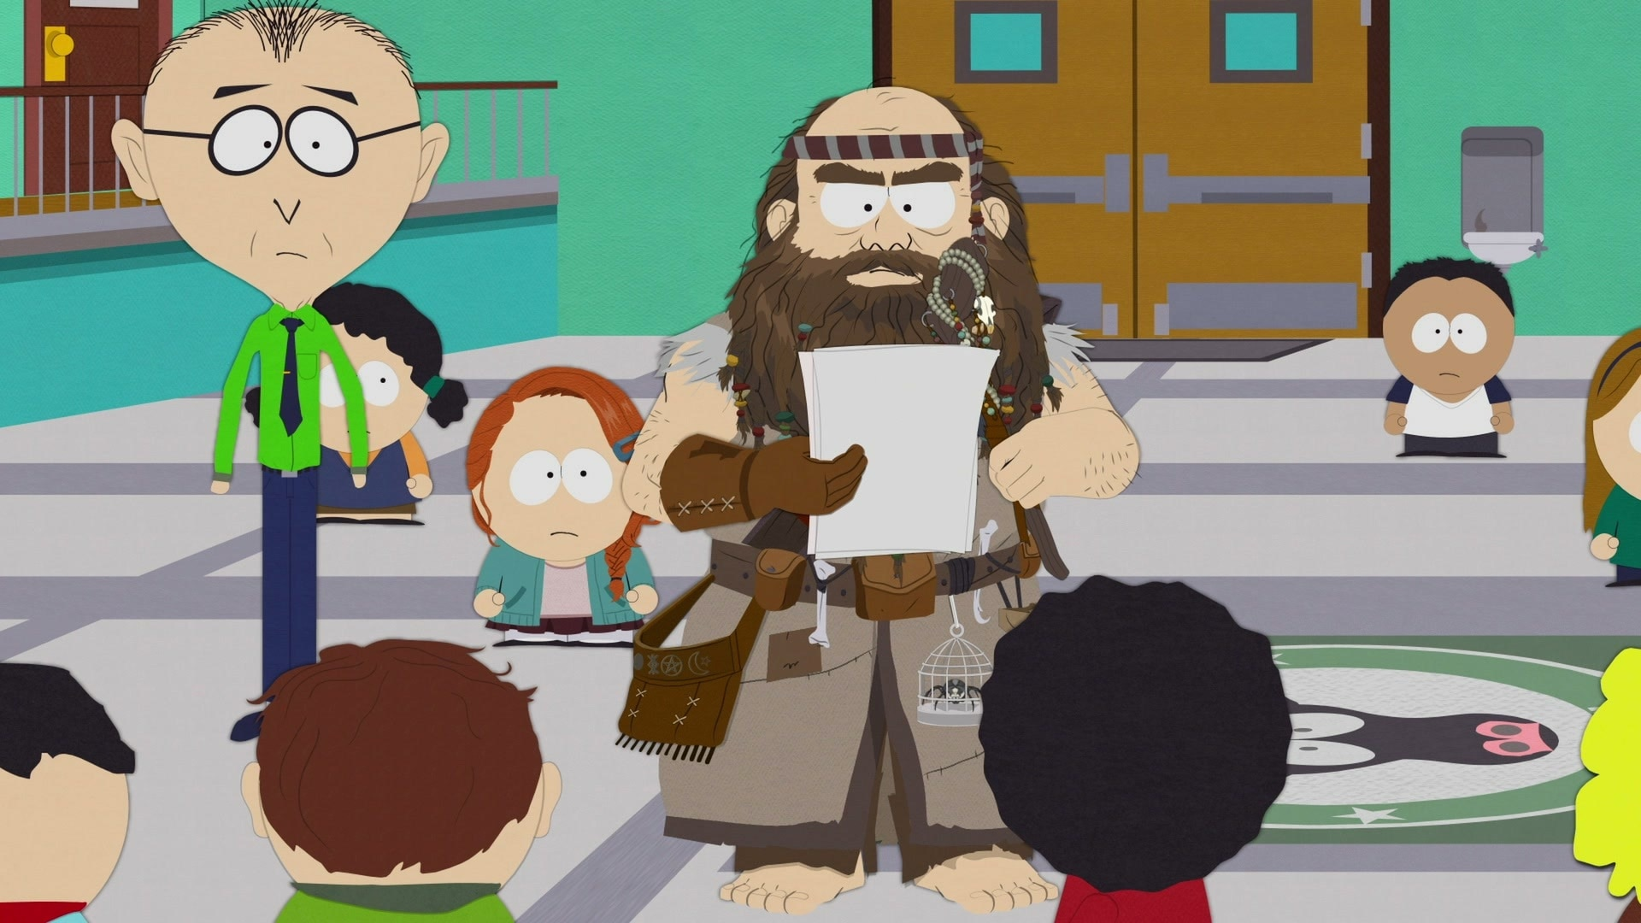
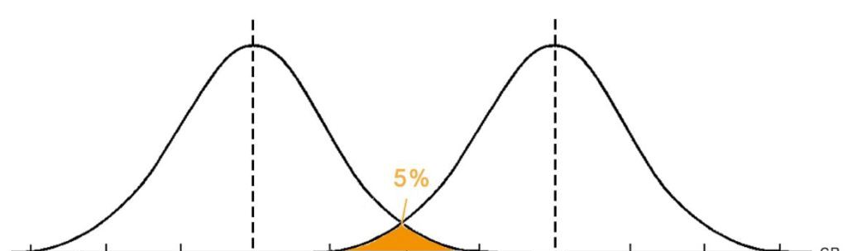


$$n$$
$$n+cαn$$
Score assuming no watermarking
Score assuming watermarking

Slide 13


??

Slide 14
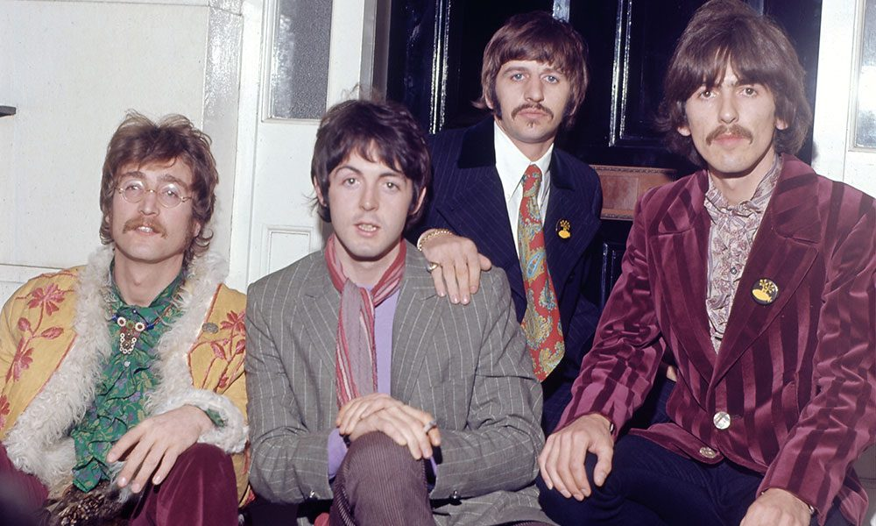
What Made the Beatles Good?
Ideas?
Technical execution?

Slide 15
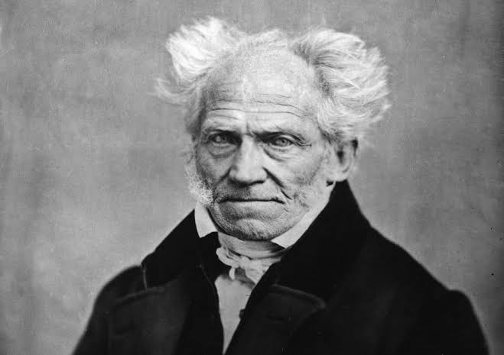
“Talent hits a target no one else can hit.
Genius hits a target no one else can see.”

Slide 17
The AI Abundance Paradox
No matter how good an AI artistic creation, it never seems “special,” because you could’ve easily generated a thousand more like it

Slide 18

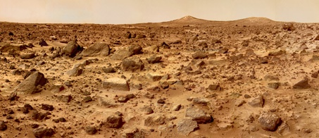
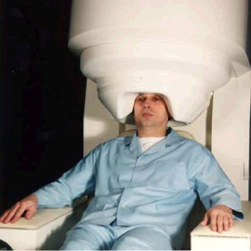
Identity-Destabilizing Technologies
Want to visit Mars? Just fax yourself!
(And have the “original you” painlessly euthanized … or not)
Going on a dangerous mountain-climbing trip? Remember to back up your brain first!

Slide 19

The No-Cloning Theorem
No physical procedure can take an unknown quantum state and output two copies of it
(or even a close approximation thereof)

Slide 20
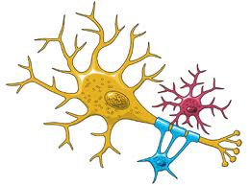
Microscopic neural event (e.g., opening of a sodium-ion channel)
PMD
“Past macroscopic determinants” (PMDs): observables that could have been non-invasively measured long before the event, and that influence its probability
TIME
PMD
PMD
BIG BANG
We, unlike any existing AI, seem to be buffeted by chaos such that no external agent can have all the information relevant to predicting our behavior.

Slide 21
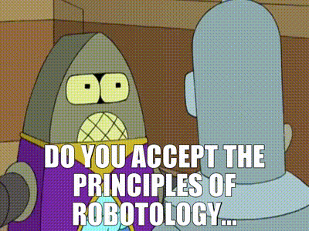
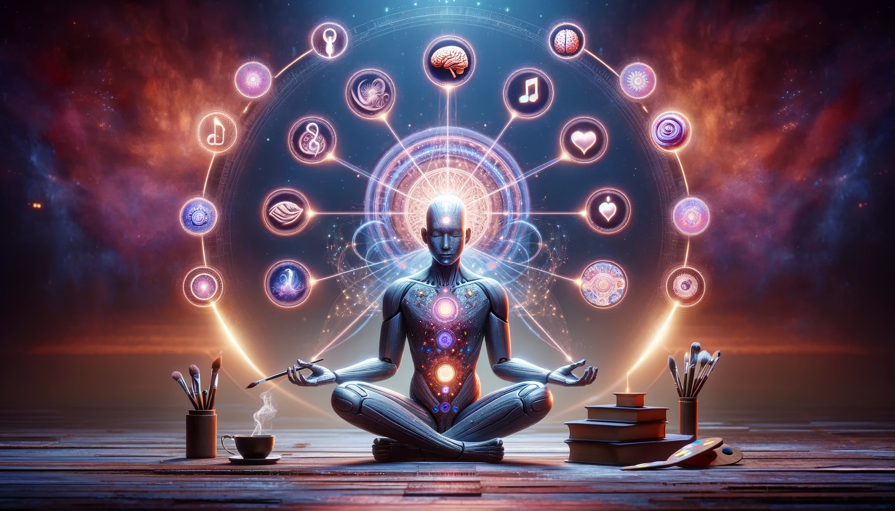
AI Safety Proposal!
Indoctrinate our AIs in a religion that venerates the universe’s unclonable, ephemeral, analog loci of creativity and intelligence, whatever they are
Thou shalt protect these entities from destruction
Thou shalt defer to their preferences …

