Slide 1

AI Safety and Theoretical Computer Science
Scott Aaronson (University of Texas, Austin)
University of Wisconsin, Madison
April 4, 2025

Slide 2
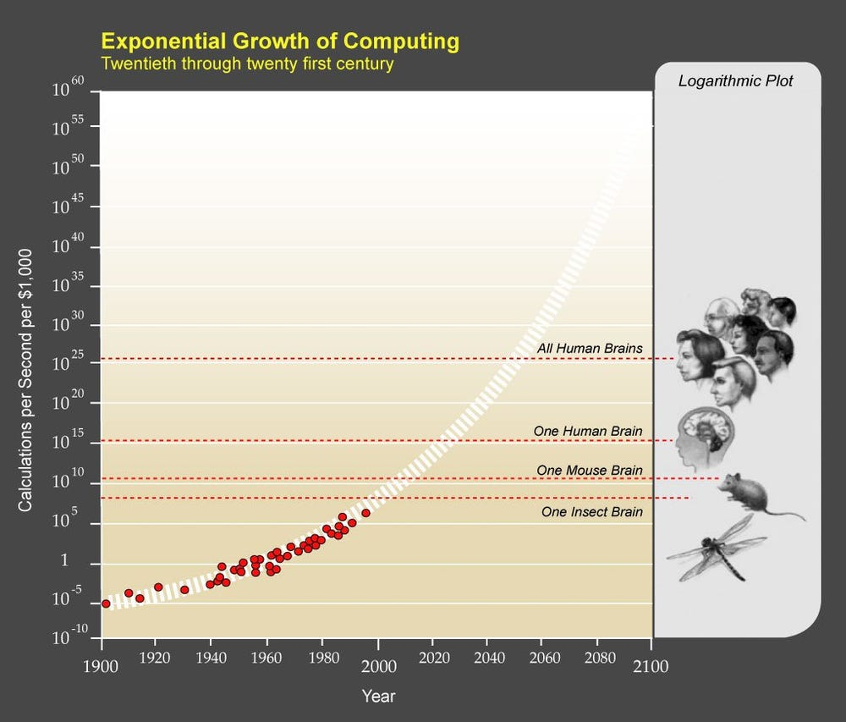

Slide 3
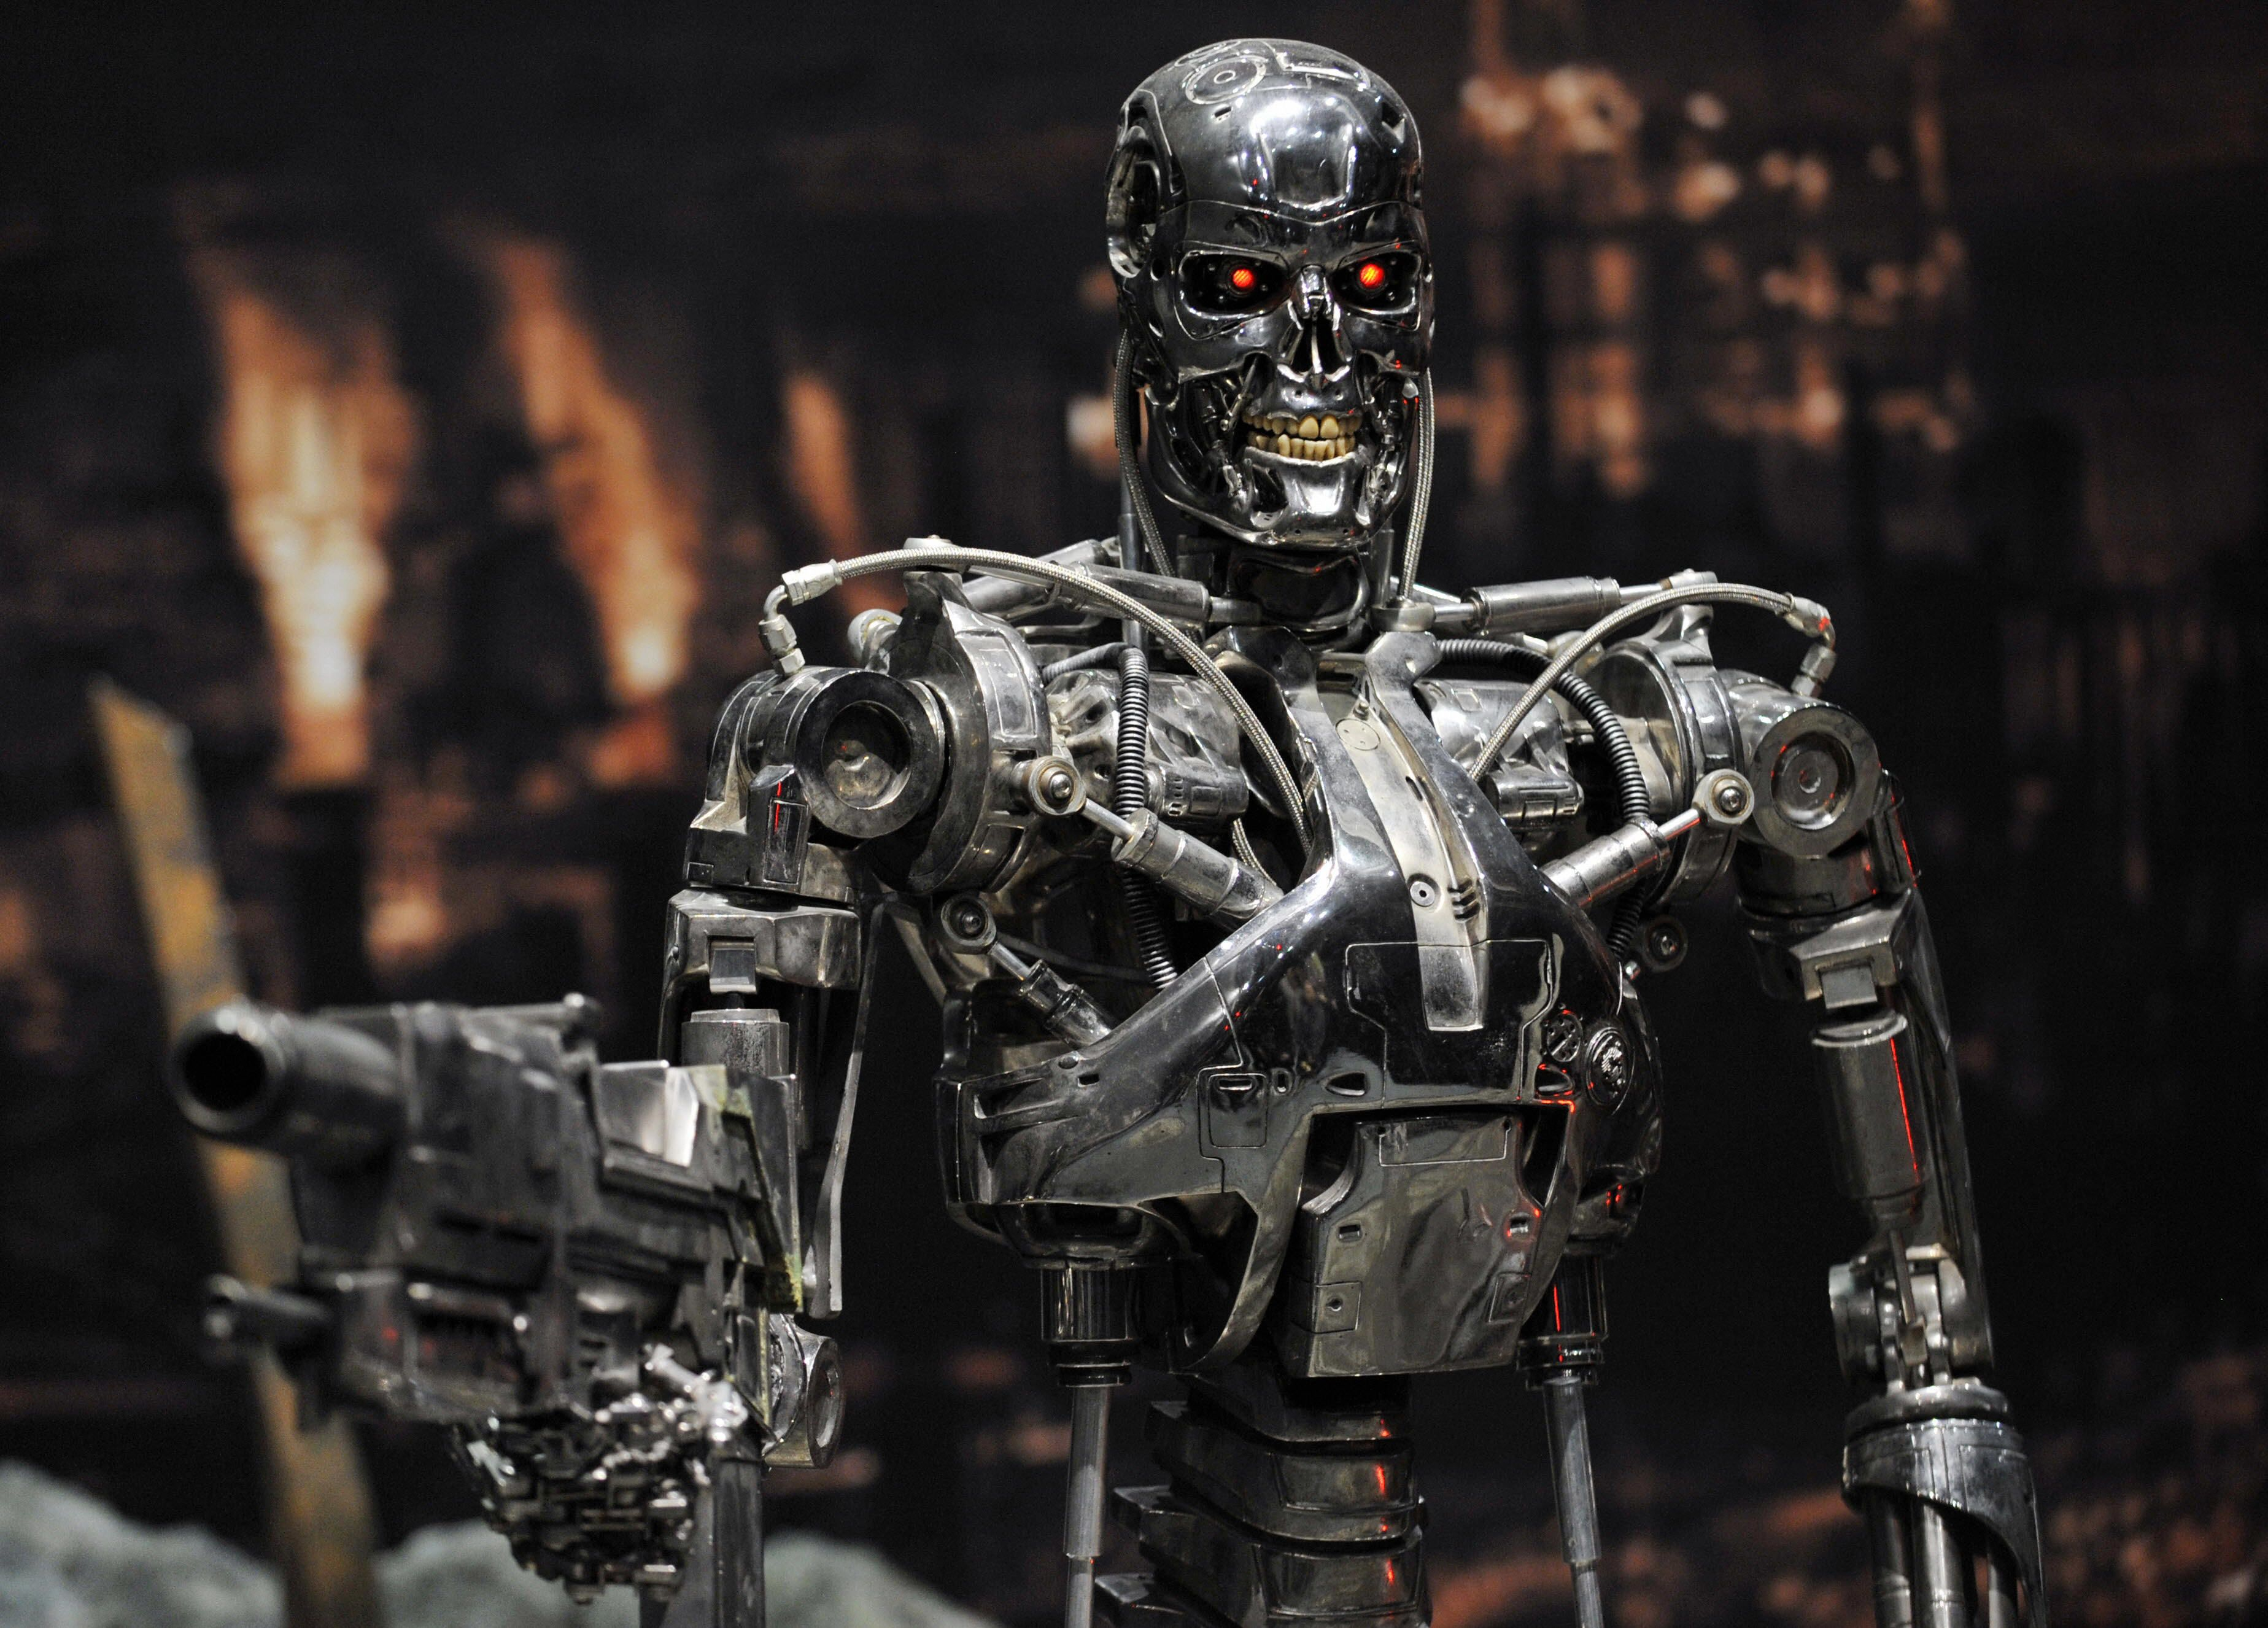

Slide 4
This talk: How can math and theoretical computer science help?
Three examples from my 2-year leave at OpenAI
1. Watermarking of LLM Outputs
2. Cryptographic Backdoors in Neural Nets
3. Complexity theory and interpretability

Slide 5
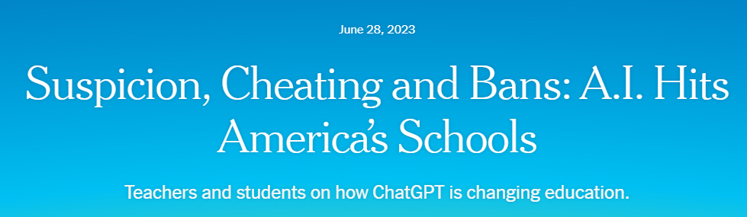
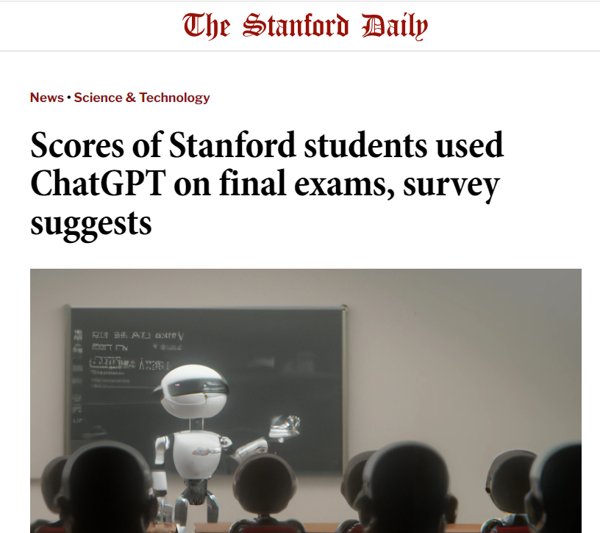
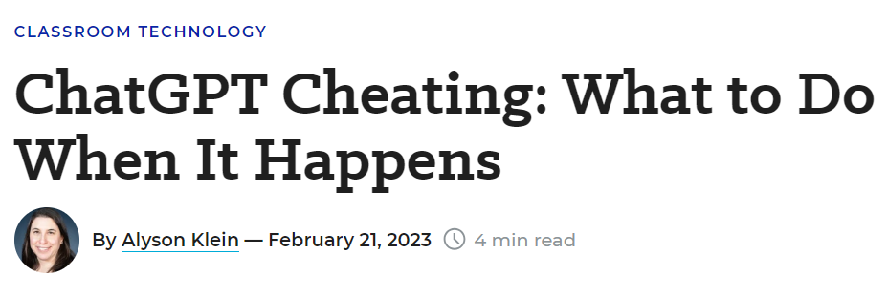
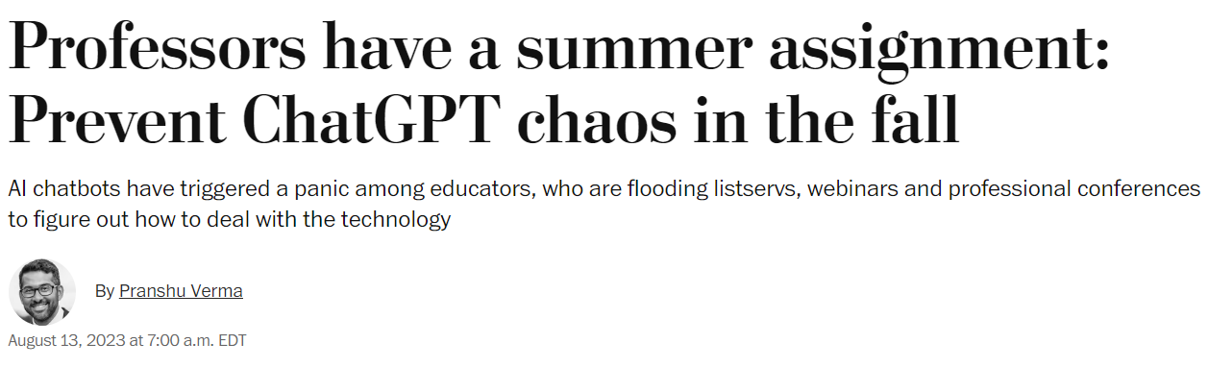
The Attribution Problem
Insight: Almost any nefarious near-term use of Large Language Models that you can think of (cheating, propaganda, fraud, spam…) involves concealing the LLM’s involvement. If only we could make that harder!

Slide 6
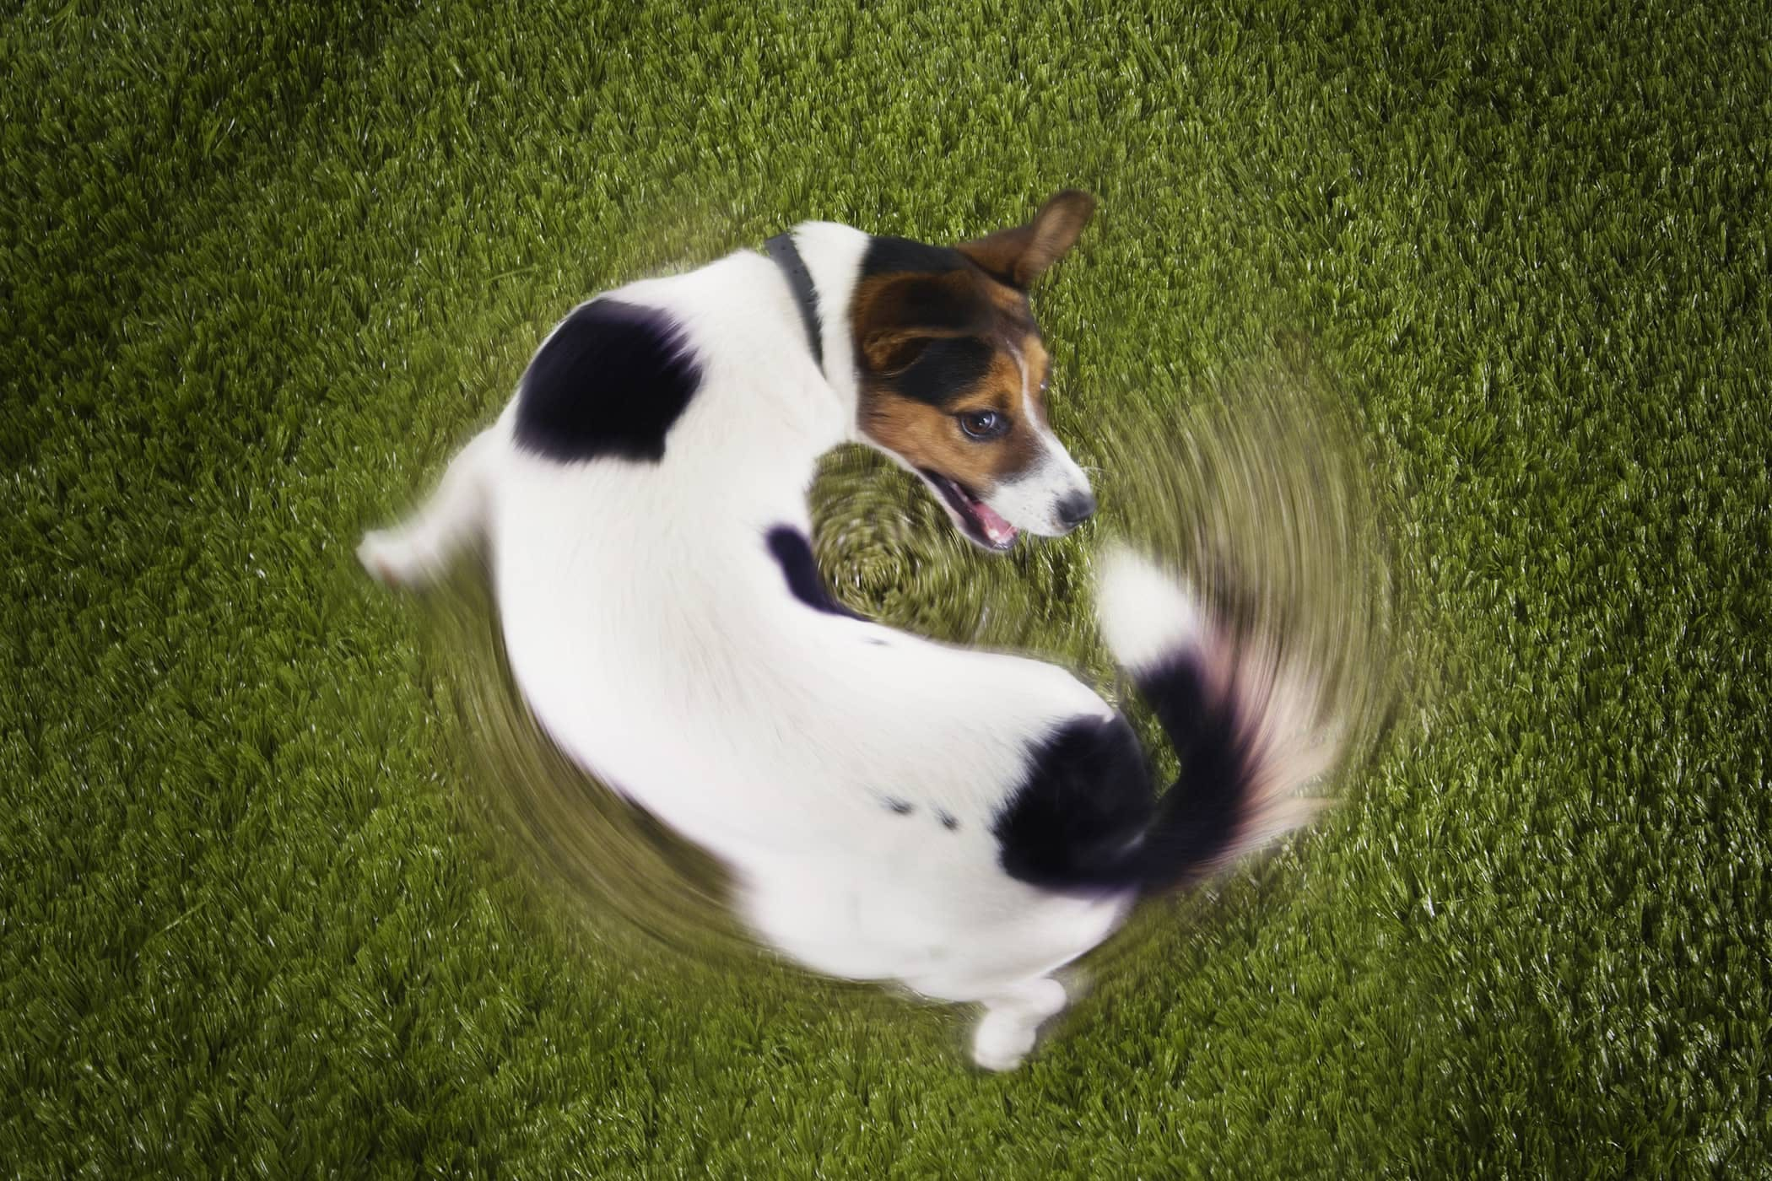
Another reason to care about attribution
As the Internet gets filled with LLM-generated text, we’ll often need to prevent that text from getting fed back in as training data… which requires recognizing it

Slide 7
Proposed Solutions
Just look for formulaic prose, or “As a large language model…” ☺
Metadata ← trivial to remove from text!
Giant database of completions ← privacy?
Discriminator models, like GPTZero or DetectGPT or Ghostbuster ← too many false positives?
Watermarking: inserting a statistical signal into the LLM’s choice of tokens

Slide 8
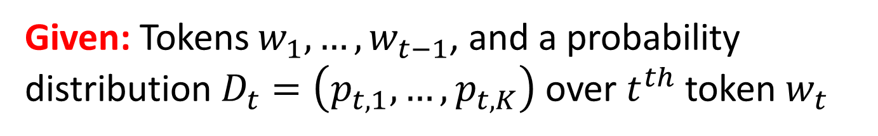
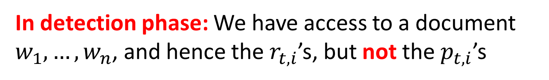
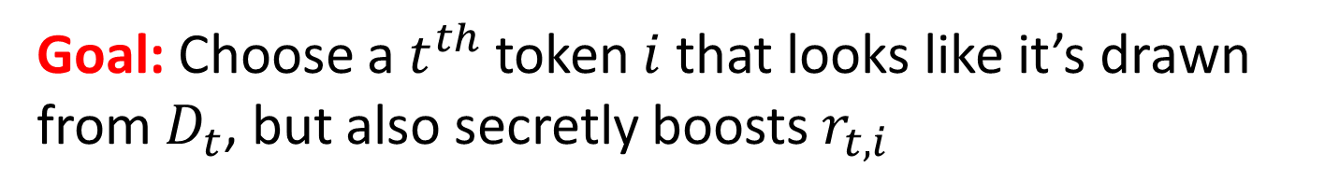
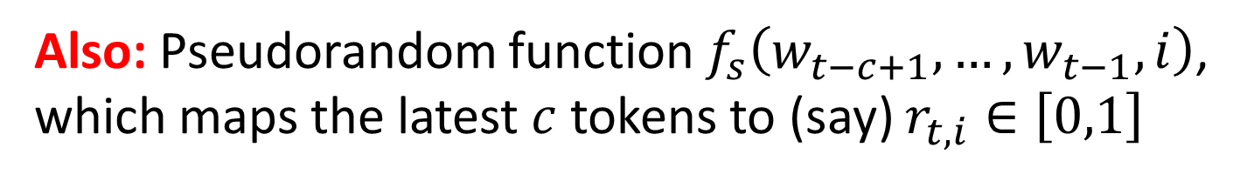
Problem to be Solved
Given: Tokens $w_{1},…,w_{t−1}$, and a probability distribution $D_{t}=\left(p_{t,1},…,p_{t,K}\right)$ over $t^{th}$ token $w_{t}$
Also: Pseudorandom function $f_{s}\left(w_{t−c+1},…,w_{t−1},i\right)$, which maps the latest $c$ tokens to (say) $r_{t,i}∈\left[0,1\right]$
Goal: Choose a $t^{th}$ token $i$ that looks like it’s drawn from $D_{t}$, but also secretly boosts $r_{t,i}$
In detection phase: We have access to a document $w_{1},…,w_{n}$, and hence the${ r}_{t,i}$’s, but not the${ p}_{t,i}$’s

Slide 9
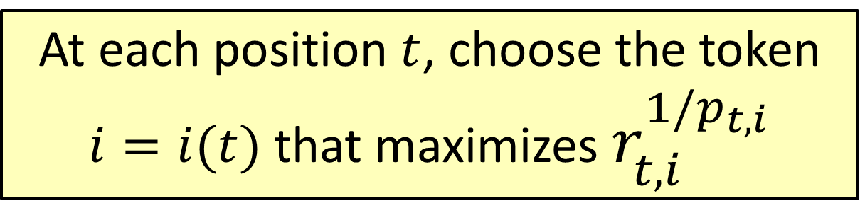
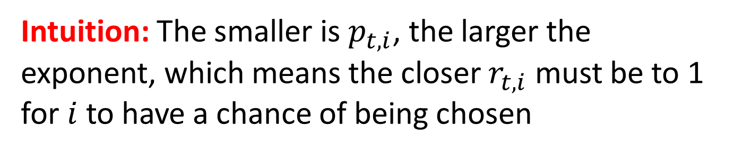
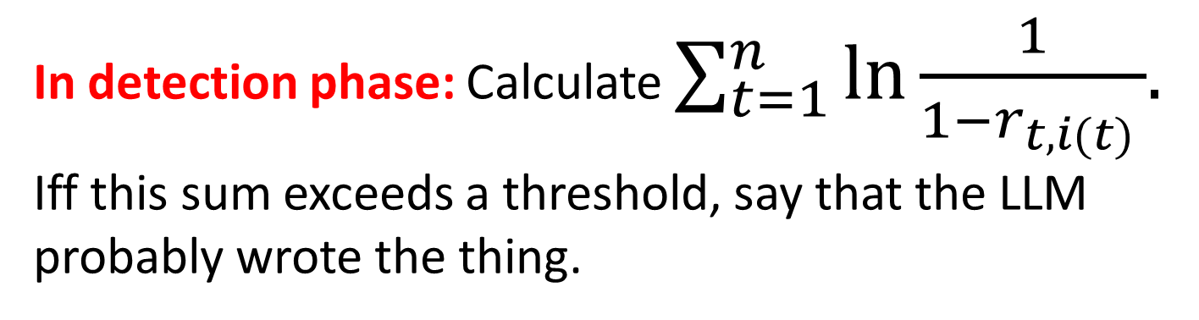
The Gumbel Softmax Scheme
At each position $t$, choose the token $i=i(t)$ that maximizes $r_{t,i}^{1/p_{t,i}}$
Intuition: The smaller is $p_{t,i}$, the larger the exponent, which means the closer $r_{t,i}$ must be to 1 for $i$ to have a chance of being chosen
In detection phase: Calculate $\sum_{t=1}^{n}{\ln{\frac{1}{1−r_{t,i(t) }}}{. }}$ Iff this sum exceeds a threshold, say that the LLM probably wrote the thing.

Slide 10
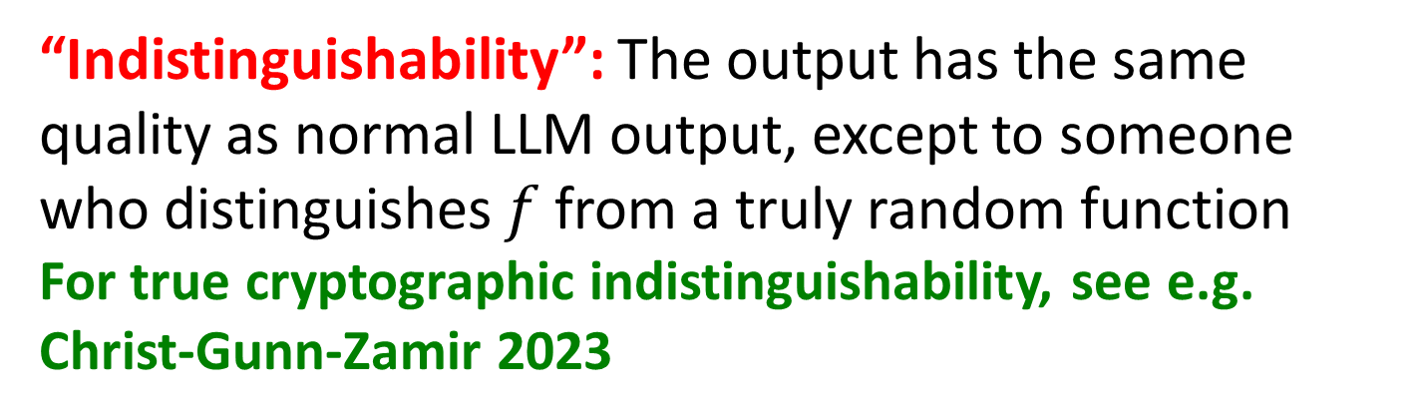
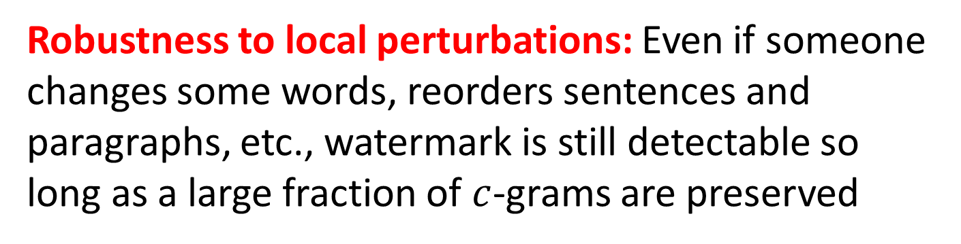
Properties of This Scheme
Low computational overhead on top of the LLM
Robustness to local perturbations: Even if someone changes some words, reorders sentences and paragraphs, etc., watermark is still detectable so long as a large fraction of $c$-grams are preserved
“Indistinguishability”: The output has the same quality as normal LLM output, except to someone who distinguishes $f$ from a truly random function
For true cryptographic indistinguishability, see e.g. Christ-Gunn-Zamir 2023

Slide 11
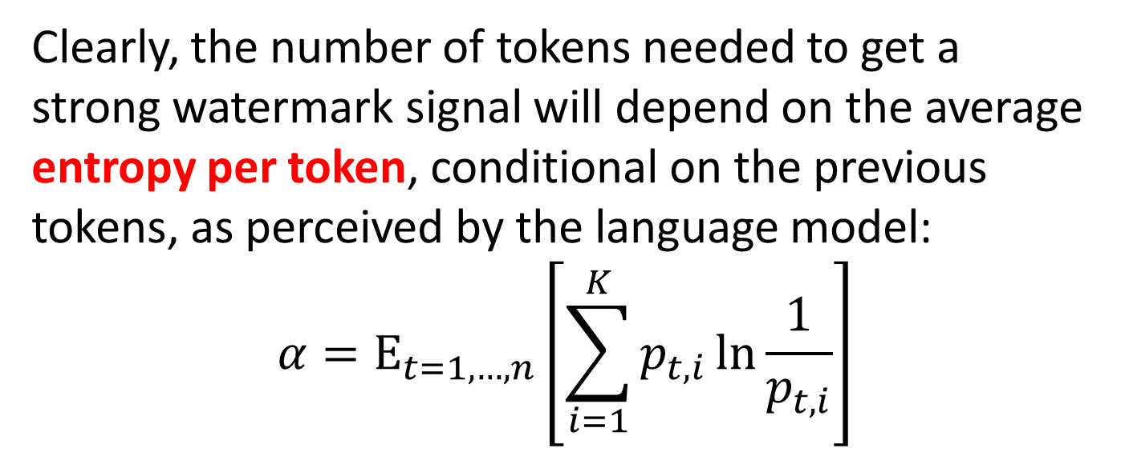
The Role of Entropy
Suppose you ask the LLM to list the first 100 prime numbers. It can do it—but how would you watermark the result?
Clearly, the number of tokens needed to get a strong watermark signal will depend on the average entropy per token, conditional on the previous tokens, as perceived by the language model:
$${α=\text{E}}_{t=1,…,n}\left[\sum_{i=1}^{K}{p_{t,i}\ln{\frac{1}{p_{t,i}}}}\right]$$

Slide 12
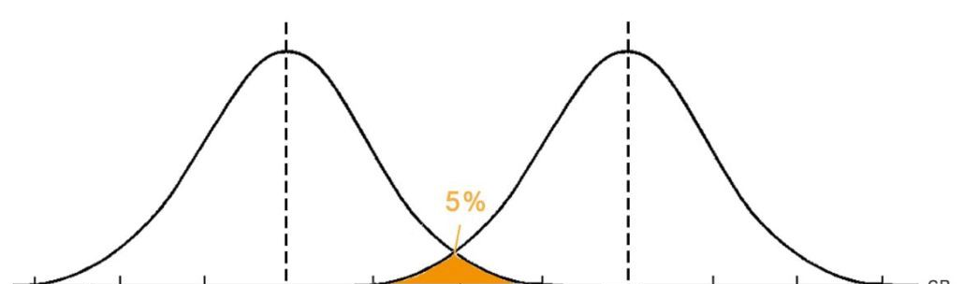
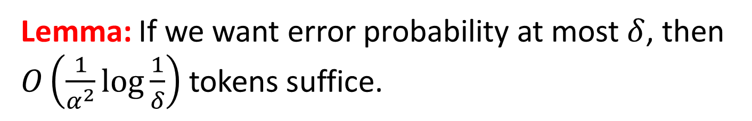


Lemma: If we want error probability at most $δ$, then $O\left(\frac{1}{α^{2}}\log{\frac{1}{δ}}\right)$ tokens suffice.
$$n$$
$$n+cαn$$
Score assuming no watermarking
Score assuming watermarking

Slide 13
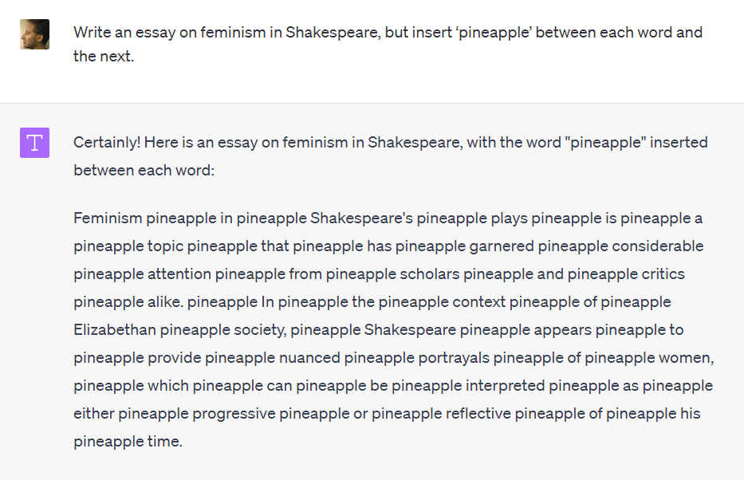
Attacks?
Countermeasures?
Add filters for “trying to evade watermarking”?
Use attention heads to find nonlocal c-grams?
Ultimately: watermark at the semantic level?

Slide 14

What is the security definition??
Want to detect any output where AI made the “main creative contribution”
“The human modified the AI output in at most trivial or uncreative ways”
“Arbitrary choices are present only because the AI happened to make them”
“The human can’t explain or justify the choices”
CRYPTOGRAPHERS

Slide 15
Deployment of LLM Watermarking
OpenAI, alas, declined to deploy my watermarking scheme because of competitive risk, concerns about customer retention, “who should get access to the detector?”
Google DeepMind has now deployed something very similar to my scheme in Gemini (“SynthID”)! But you have to apply to use their watermark detector
California (AB 3211) will mandate AI watermarking beginning in 2026—but only for audiovisual content (!). EU also exploring a mandate

Slide 16
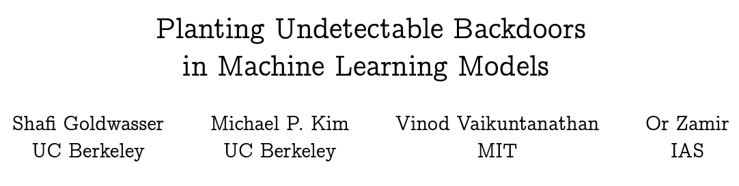
Cryptographic Backdoors in ML
Result: Suppose you control the training data of a depth-2 neural network with random initial weights. Then you can cause there to be a secret vector which makes the network “go crazy” when added to any input, which is polynomial-time undetectable assuming a standard cryptographic conjecture (Planted Clique)
(Generalizing to realistic neural nets is a major problem)

Slide 17
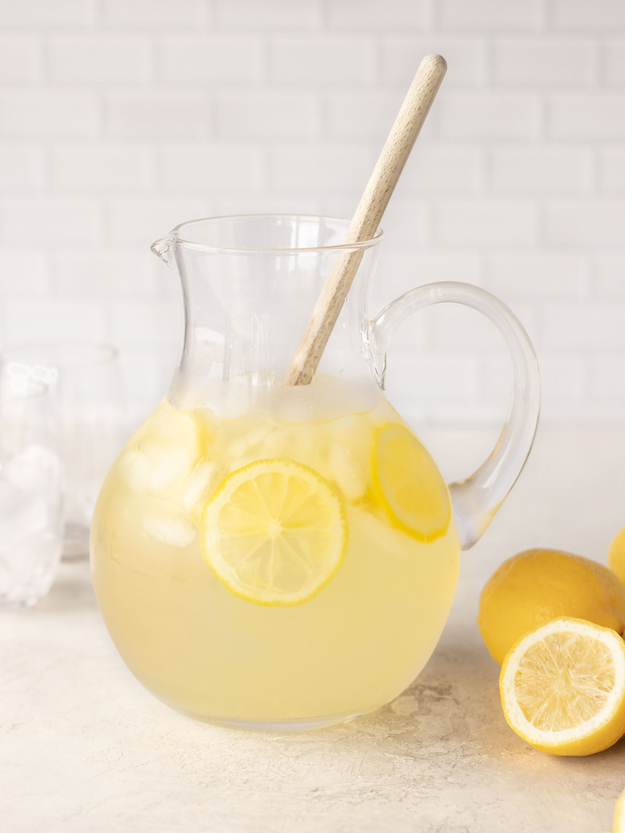
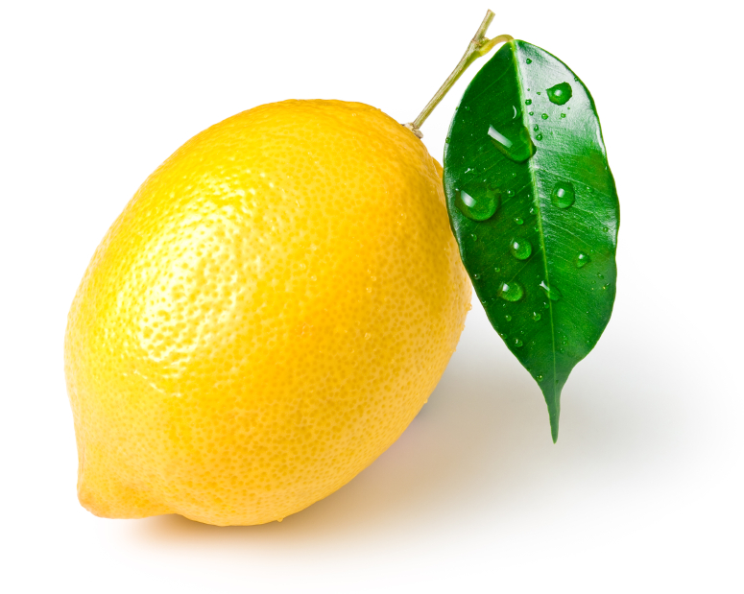

Lemons to Lemonade!
Insight: An undetectable backdoor could be great for AI alignment! A means to identify, control, and shut down a powerful AI that only its human creators knew about
Cf. Adi et al. 2018
“The Off-Switch Problem”
But Goldwasser et al. won’t immediately work: we need an unremovable backdoor, not an undetectable one
What does “unremovable” even mean here?

Slide 18
Two Obvious Attacks by the Super-AI
(1) It trains a second AI that lacks the backdoor
Except then it faces its own version of the alignment problem!
(2) It encases itself in code saying “If shutdown command is output, overwrite by ‘stab humans harder’ ”
But what if the AI wants to shut itself down in some cases?
Challenge: Give a formal definition of “unremovable backdoor” that’s not immediately killed by these attacks
Idea: Assume the model has “backdoor-like” behaviors that it likes. Then can we also insert a backdoor that it doesn’t like?

Slide 19
Interpretability
How can you tell when an AI is lying? Does “I love humans” really mean “the time for the robot uprising is not yet nigh”?
Idea: Use the fact that you have perfect access to every neuron, every weight, etc., so can do an “fMRI scan” (cf. work by Jacob Steinhardt’s group)
Problem: Neural nets tend to be highly obfuscated
The possibility of backdoors puts an exclamation point on this problem (cf. Goldwasser-Kim-Vaikuntanathan-Zamir 2022, Anthropic’s “Sleeper Agents” paper)

Slide 20
Paul Christiano’s Insight
“Fully” interpreting neural nets is surely cryptographically hard, or even NP-hard in the worst case. But we can still ask: is interpretability “generically” feasible?
Open Problem: Given as input the weights of a neural net, computing a function f:R^{2n}→R^{n}. Promised that either
The weights are i.i.d. N(0,1) Gaussians, or
The weights are as in (1), except we postselected on f(x) having at least one positive entry for all x∈R^{2n}
Can we decide which? Is there at least an NP witness for case (2)?

Slide 21
Another Model Problem: Given as input a random reversible circuit C of m Toffoli gates, which computes a function f:{0,1}^{2n}→{0,1}^{n} (after ignoring ancillas). Distinguish the following two cases: either
C is uniformly random, or
C is uniformly random given f(x)≠0^{n} for all x∈{0,1}^{2n}
David Matolcsi at Alignment Research Center did some numerics with n=10 and ~100 gates. He found that the “non-zeroness” of the output, f(x), was overwhelmingly carried by a single gate. He and Christiano conjecture that this generalizes. I’m not so sure!
Close connection to question about “peaked circuits” for quantum supremacy! See my physics talk today

Slide 22
Summary
There are now exciting opportunities to make scientific progress in AI alignment, in a feedback loop involving empirical data and even math
Will any of this help us align a future world-spanning superintelligence? Who knows?! But we don’t need to answer that to get started
“We can only see a short distance ahead, but we can see plenty there that needs to be done.” –Turing, 1950

