Slide 1
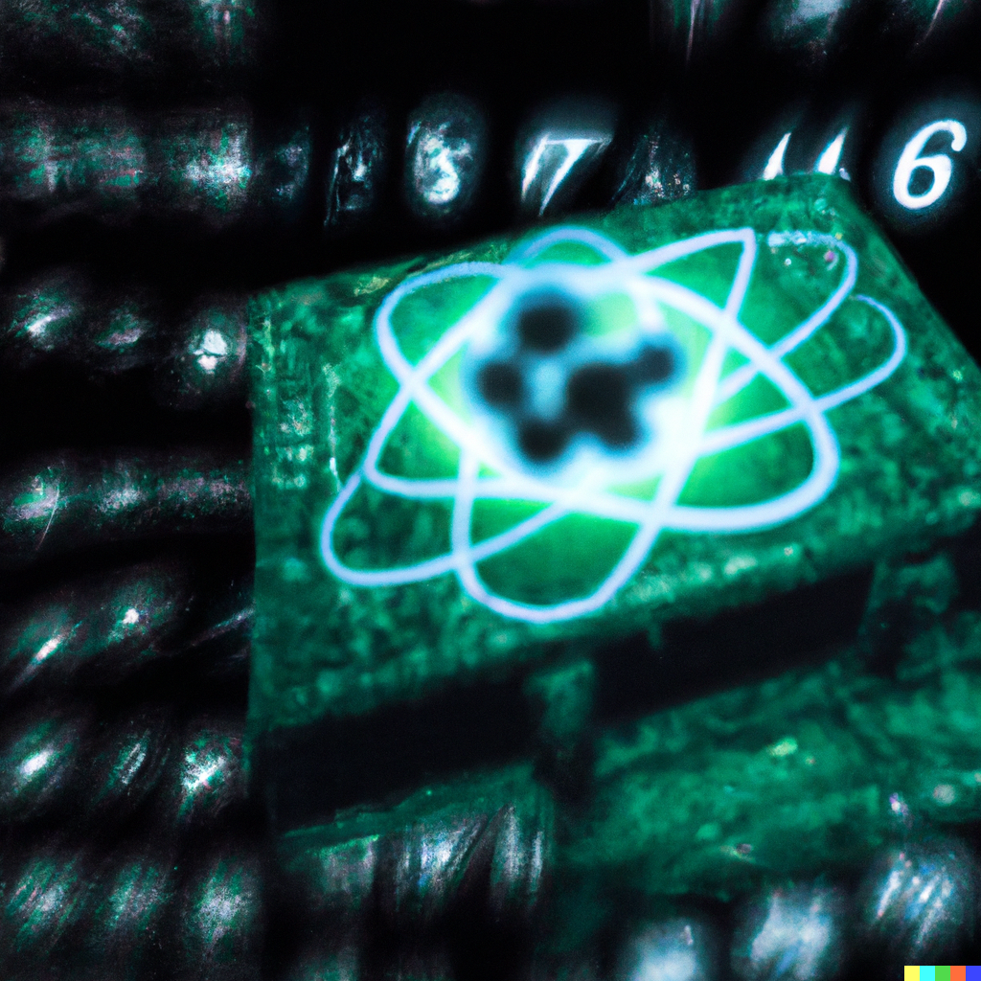
A Few Directions for Verifiable NISQ Experiments
Scott Aaronson (UT Austin / OpenAI)
NISQAH, Neve Ilan, Israel, June 7, 2023

Slide 2
Field Guide to Exponential Speedups
QAOA
NISQable
Efficiently
Verifiable
Quantum machine learning
?
Shor
Mahadev
BosonSampling
Yamakawa-Zhandry
Random Circuit Sampling
Physics simulations
In-Principle Quantum Advantage

Slide 3
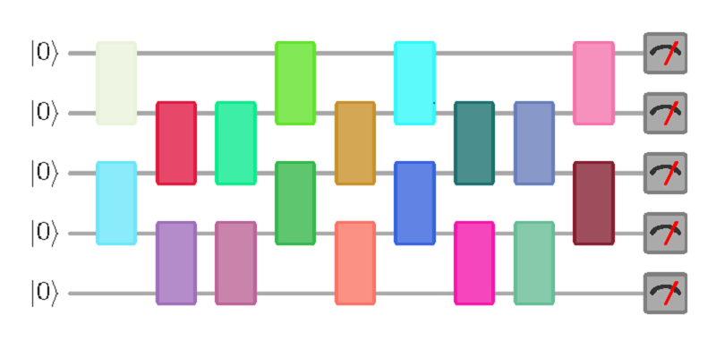
New Open Question
Call a quantum circuit C “peaked” if |⟨0^{n}|C|x⟩|²≥0.1 for some basis state |x⟩.
(More generally: if C|0^{n}⟩ has any nonrandom features easy to notice on measurement)
What does a uniformly random peaked circuit with (say) n qubits and m=n² gates look like? Just a bunch of gates and then their inverses? Pseudorandom?
|0⟩
|0⟩
vs.
U
U⁻¹
|0⟩
(obfuscated)

Slide 4
More Questions
Given an n-qubit, m-gate random quantum circuit, how many more gates must we add to get a peaked circuit?
At most m by inverting. At least m^{Ω(1)} by theorems on random quantum circuits being t-designs.
Even an upper bound of e.g., m/2 would be exceedingly interesting for quantum advantage experiments!
What fraction of quantum circuits are peaked?
How hard is it to sample a random peaked circuit? What about a peaked circuit that’s hard to distinguish from random?

Slide 5
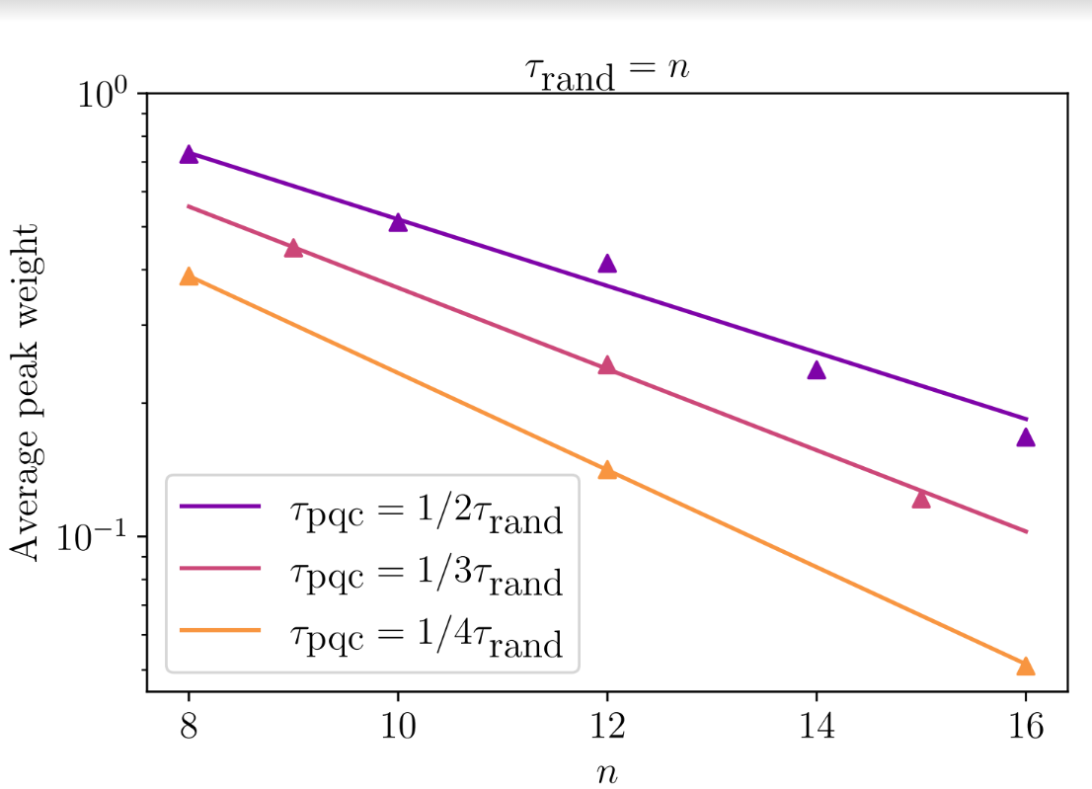
Preliminary Data on Peakedness (SA and Yuxuan Zhang)

Slide 6
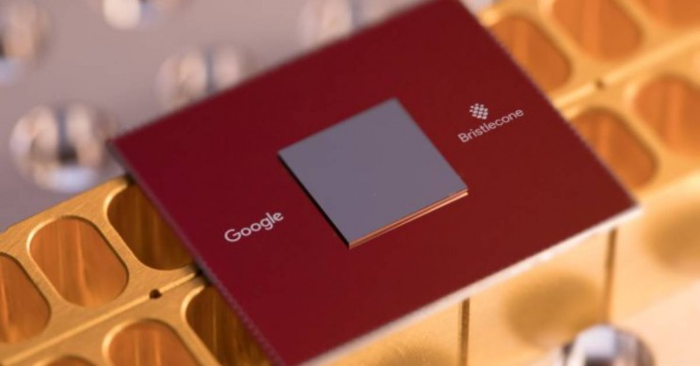
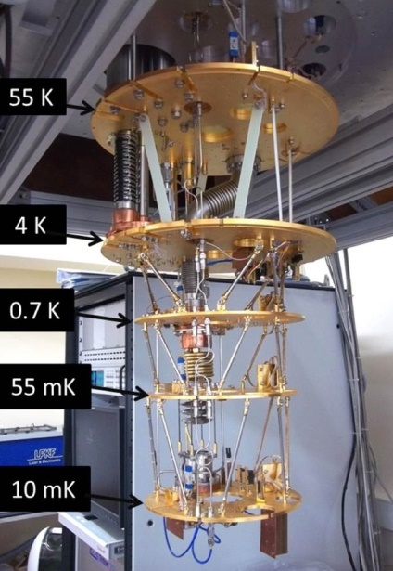
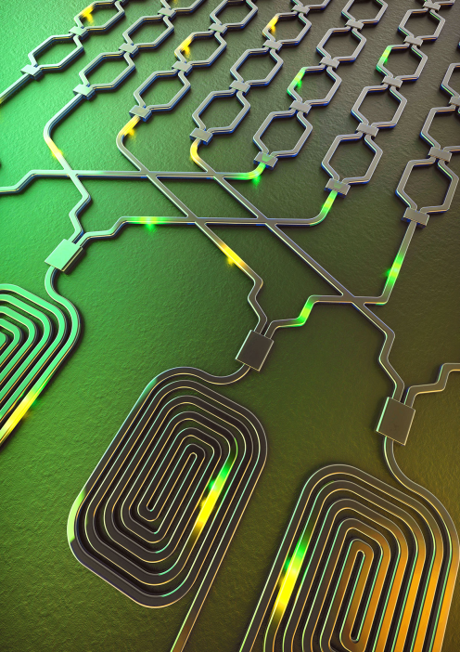
“Quantum Information Supremacy”
Over the past 4 years, Google, USTC, and Xanadu have famously claimed “quantum computational supremacy” on contrived sampling tasks (e.g. BosonSampling and Random Circuit Sampling), using small noisy QCs
But such “supremacy” depends on unproved assumptions about the tasks being hard for classical computers—and some of those assumptions have turned out to be false!
Here’s a proposal depending on no unproved assumptions…

Slide 7
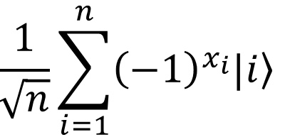
The Hidden Matching Problem Bar-Yossef-Jayram-Kerenidis 2004
Alice holds an n-bit string x (say, male/female for each of n people)
Bob holds a matching E on {1,…,n} (say, who’s dating whom)
Goal: Alice should send Bob a short message that lets him tell whether any one couple of his choice is same- or opposite-sex
Classically, a ~√n-bit message is necessary and sufficient (why?)
Quantumly, O(log n) qubits suffice!
Measurement basis:
$${\left\{\frac{|\left.i\right\rangle ±|\left.j\right\rangle }{\sqrt{2}}\right\}}_{\left(i,j\right)∈E}$$

Slide 8
New Implication A.-Buhrman-Kretschmer 2023, arXiv:2302.10332
FBQP/qpoly ≠ FBQP/rpoly
FBQP = Many-output problems in quantum polynomial time
For these problems, quantum advice is unconditionally stronger than classical! Striking contrast with decision problems, where BQP/qpoly ⊆ PostBQP/poly
Key Idea: Use the Bar-Yossef-Jayram-Kerenidis problem, but where Alice now has a string of 2^{n} bits, and Bob has one of 2^{n} efficiently describable matchings (it still works there)
Theorem: Classical advice (even randomized) needs at least ~2^{n/2} bits, whereas n qubits suffice for quantum advice

Slide 9
Potential Application: “Quantum Information Supremacy”
A new type of quantum supremacy experiment, which wouldn’t depend on any unproved complexity assumptions
Goal: Experimentally check that, if Nature is “secretly maintaining a classical description” for an n-qubit entangled state |ψ⟩, even a probabilistic one, that description must contain >>n classical bits to account for the outcomes of all possible measurements on |ψ⟩
E.g., if n=20, check that >100 classical bits are needed
How? By using the FBQP/qpoly Hidden Matching algorithm from the last slide!

Slide 10
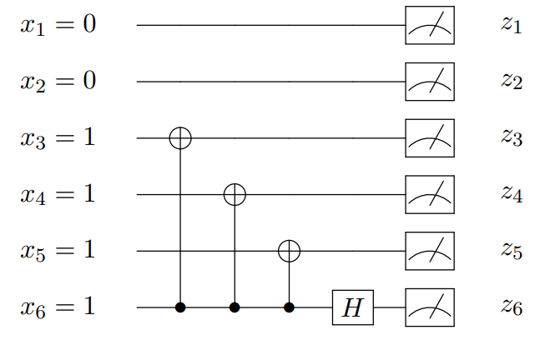
Experimental Considerations
Would first need to apply a random circuit C to |0^{n}⟩, to prepare a “quasi” Haar-random state C|0^{n}⟩
Would then need to measure C|0^{n}⟩ in a basis chosen “on the fly.” If we used the Hidden Matching separation, measurement circuit could look like this:
Want: ~20 qubits, all-to-all connectivity, universal control, extremely high fidelity. Good match for trapped ions?
To Do: Make measurement circuit even simpler! Find a problem where the classical lower bound is ~2^{n} rather than ~2^{n/2} ! Do an analysis that accounts for noise in the circuit!

Slide 11
Idea from the coffee break!
Do Random Circuit Sampling on n qubits, running with the same circuit C over and over ~2^{n/2} times, until collisions are found with high probability by the Birthday Paradox. Then you can calculate the Linear Cross-Entropy Benchmark!
Back-of-the-envelope: 50 qubits, 0.002 circuit fidelity, as fast as Google Sycamore ⇒ would need to collect samples for about a decade(?) to get decent statistics with a single QC
Would be a pain to keep the circuit calibrated, but possibly worth it!

