Slide 1
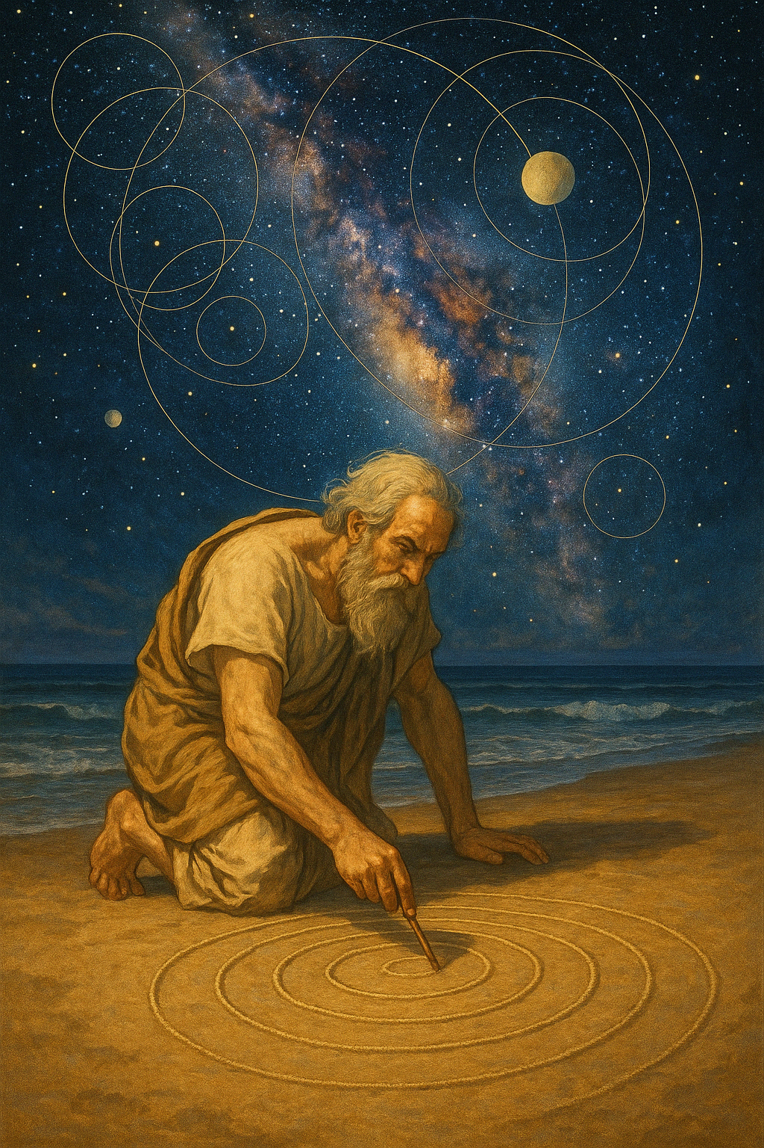
Computational Complexity and Explanations in Physics
Scott Aaronson
University of Texas, Austin
CS Department
University of Washington
January 8, 2026

Slide 2
Computational Complexity
Study of the inherent resources (time, memory, etc.) needed to solve computational problems, and how those resources scale with problem size
Computational intractability importantly differs from other reasons why someone might be unable to answer a question:
Limited information
Chaos (sensitive dependence on initial conditions)
Irrationality / biases

Slide 3
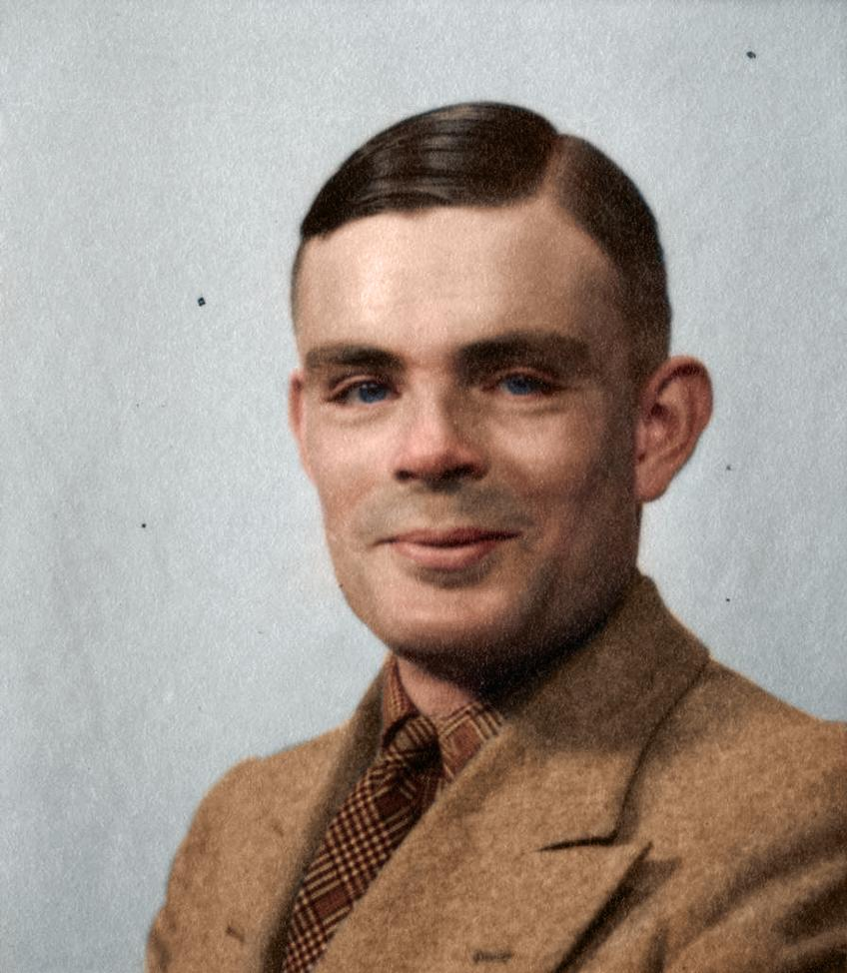
Alan Turing (who died before computational complexity theory started, but cofounded the closely-related computability theory), in 1950:
“The view that machines cannot give rise to surprises is due, I believe, to a fallacy to which philosophers and mathematicians are particularly subject. This is the assumption that as soon as a fact is presented to a mind all consequences of that fact spring into the mind simultaneously with it. It is a very useful assumption under many circumstances, but one too easily forgets that it is false.”

Slide 4

This Talk
Clearly computational complexity can be relevant to our knowledge of physics
But can computational complexity play a direct role in our explanations of the laws of physics, or is it too “anthropocentric” for that?
We’ll explore this question through three case studies:
Quantum Computing and Many Worlds
Complexity-Theoretic Occam’s Razor
Complexity as Armor for Effective Theories

Slide 5
I. Quantum Computing and the Many-Worlds Interpretation
To explain how quantum computers get such huge speedups, are we forced to posit the reality of parallel universes?

Slide 6
Quantum Mechanics
“Probability theory with minus signs”
p₁
p = p₁+p₂
p₂

Slide 7
Quantum Mechanics
“Probability theory with minus signs”
α₁
= ½
α = α₁+α₂
= 0
p = |α|²
= 0
α₂
= -½

Slide 8
Quantum Computing!
n entangled qubits (e.g. electron spins) take 2^{n} complex amplitudes to specify
Seems exponentially hard to simulate classically!
But not just magic exponential parallelism, because we only see a single sample on measurement!
Need to exploit interference. What’s that good for?

Slide 9
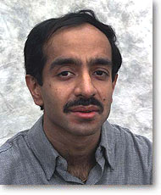
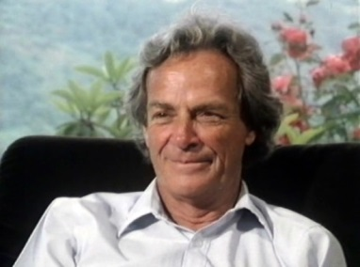


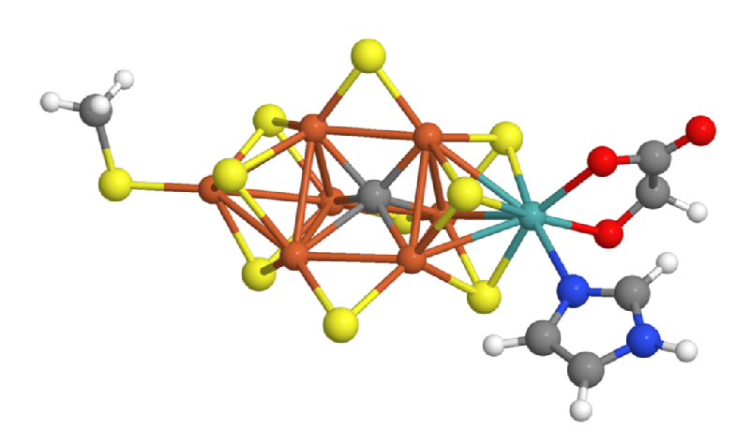
Main Known Applications of QCs
1. Breaking Current Public-Key Cryptography
2. Simulating Quantum Physics and Chemistry
3. Everything Else…
Grover’s algorithm
And the 0th application, the one I care about most:
Disproving all the people who said QC was impossible!
For AI and optimization, speedups currently look modest
Shor’s algorithm will force an upgrade to post-quantum crypto. Good?
Still the “best” practical application we know, in my view!

Slide 10
NP-complete
3SAT, packing…
Bounded-Error Quantum Polynomial
Time
Post-quantum crypto?
Graph isomorphism
NP
Factoring
Discrete Log
P
BQP
Linear equations, matching, …

Slide 11
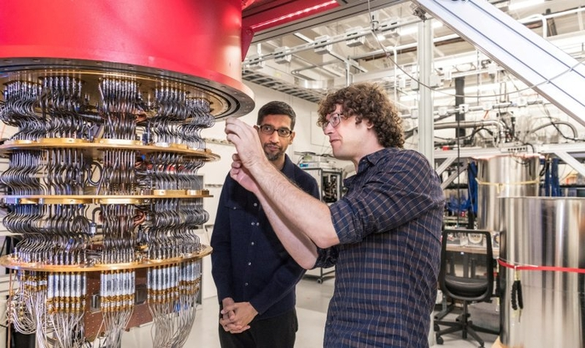
“Quantum Supremacy” Experiments
(Maybe my biggest contribution to QC was theory that led to these)
Google (Dec. 2024): Built a chip called Willow with 103 superconducting qubits, which gave us mathematical information that we don’t know how to get classically from the largest existing supercomputers in < 10²⁵ years
In the past year, Quantinuum and Google demonstrated quantum simulations of, e.g., the Fermi-Hubbard model and “OTOC” (out of time order correlator) circuits, which beat all known classical algorithms and can be verified against experiment or a second quantum computer
What is that information? “These 103-bit strings are statistically likely outputs of such-and-such quantum circuit”
(Hey, I didn’t say the information was useful! Or even checkable in less than 10²⁵ years…)

Slide 12
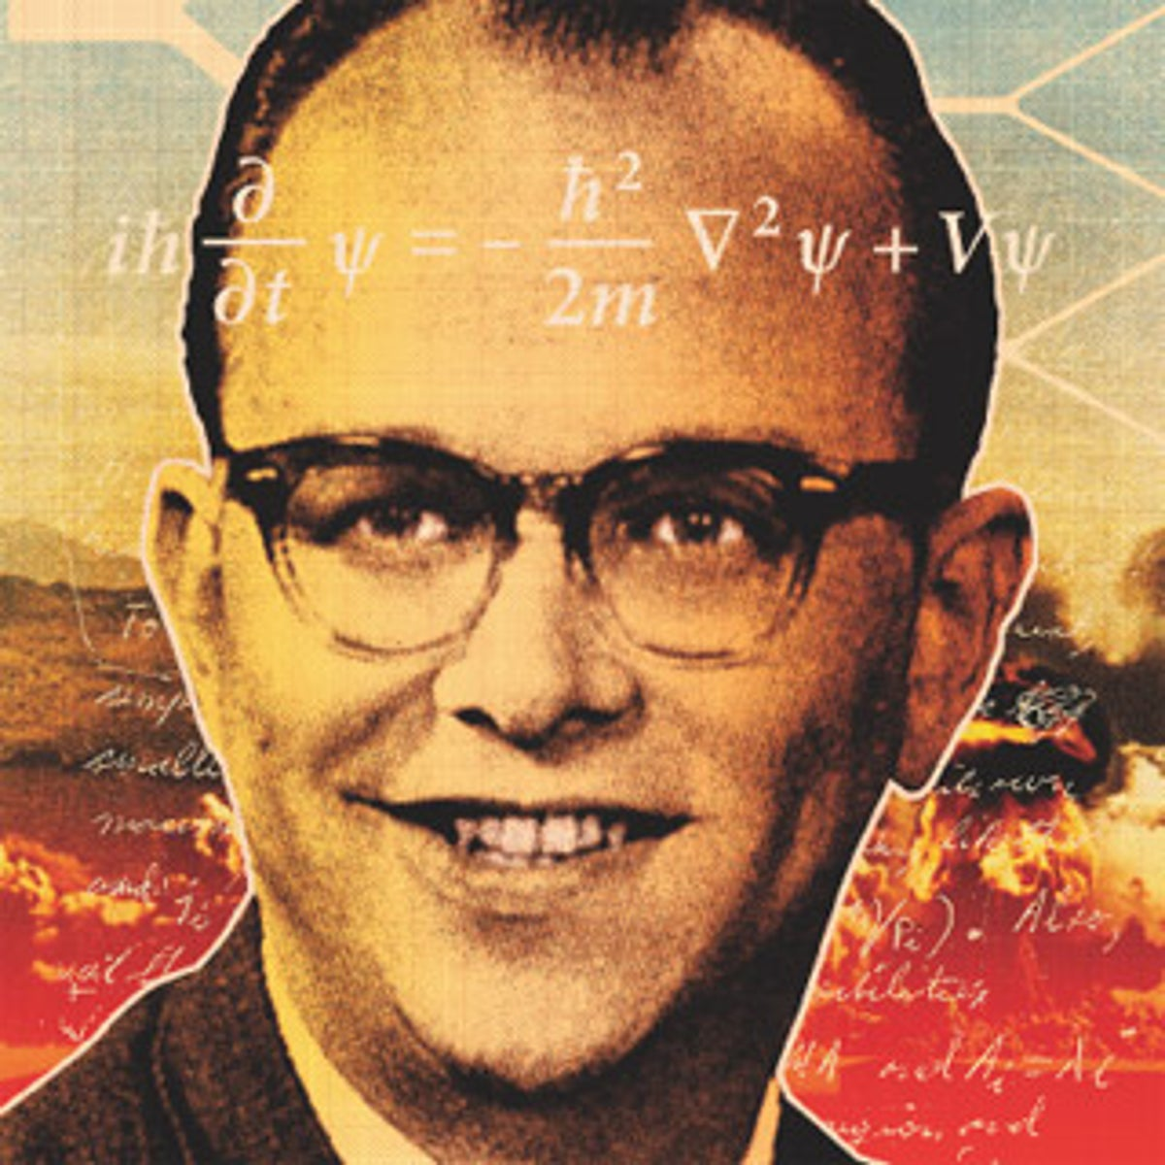
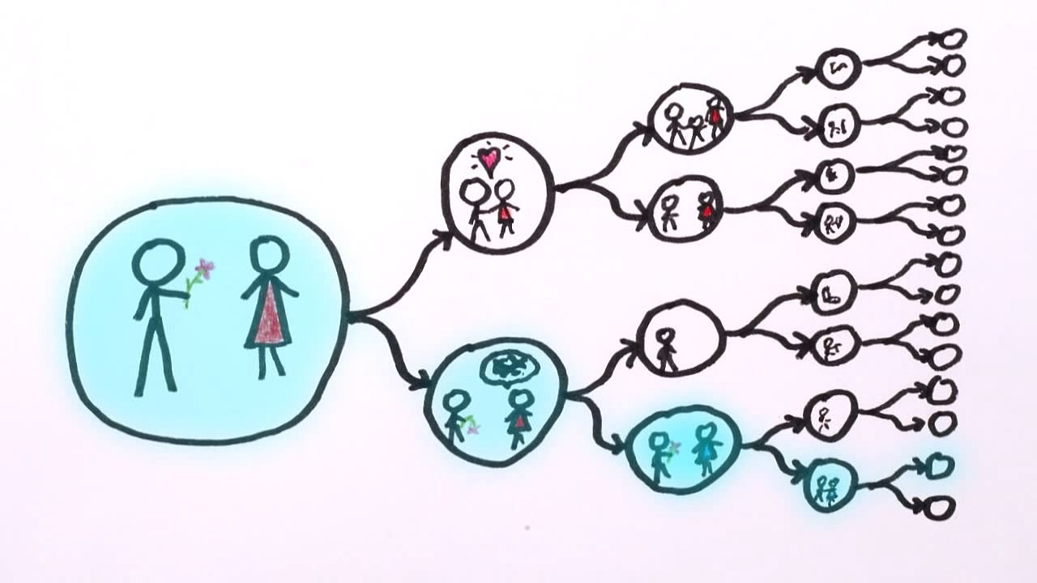
Many-Worlds Interpretation
(Everett 1957)
Key claim: The giant list of amplitudes is reality
What we call “measurement” of a state |ψ⟩ is just us and our environment getting entangled with |ψ⟩, as the world splits into equally-real branches
Main Alternatives:
Bohm-deBroglie (giant amplitude list + “real” branch)
New physics (e.g. dynamical collapse mechanism)
Copenhagen (“learn to stop asking the question!”)
(α|0⟩+β|1⟩)|You⟩
→ α|0⟩|You₀⟩ + β|1⟩|You₁⟩

Slide 13

Notorious 1997 challenge by David Deutsch (cofounder of QC):
“To those who still cling to a single-universe world-view, I issue this challenge: explain how Shor's algorithm works. I do not merely mean predict that it will work, which is merely a matter of solving a few uncontroversial equations. I mean provide an explanation. When Shor's algorithm has factorized a number, using 10⁵⁰⁰ or so times the computational resources that can be seen to be present, where was the number factorized? There are only about 10⁸⁰ atoms in the entire visible universe, an utterly minuscule number compared with 10⁵⁰⁰. So if the visible universe were the extent of physical reality, physical reality would not even remotely contain the resources required to factorize such a large number. Who did factorize it, then? How, and where, was the computation performed?”

Slide 14
To clarify…
Nearly every expert, regardless of whether they’re for or against Many-Worlds (or indifferent), does agree that Shor’s algorithm will work
Deutsch himself thinks the two-slit experiment already proves Many-Worlds: quantum computing is overkill! (Though useful for the psychologically weak ☺)
Philosophical problem: Is there any sense in which scalable QC—either the idea today, or (hopefully) the demonstrated reality tomorrow—adds to the case for Many-Worlds?

Slide 15
My View
At the core of Everett’s picture is the exponentiality of the amplitude vector—and yes, QC is unique in how it makes that aspect of QM impossible to wave away
But on the metaphysical question—“is anybody home in the other branches?”—quantum computing is silent
Ironically, to whatever extent branches interfere usefully in a quantum computation—to that extent, they never “sprouted off” into separate Everettian universes at all! They all stayed part of one giant interfering quantum-mechanical blob

Slide 16
II. Complexity-Theoretic Occam’s Razor
Should there be an inductive bias against physical theories that predict “computational superpowers”?

Slide 17
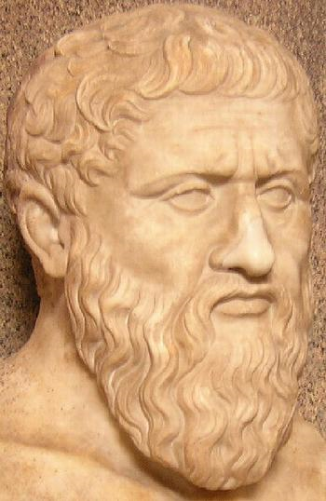
How Could Changes to Physical Law Yield Computational Superpowers?
I present: Zeno’s Finite-Time Goldbach DeciderTM!
4 = 2 + 2
Time (seconds)
6 = 3 + 3
8 = 5 + 3
10 = 5 + 5 = 7 + 3
12 = 7 + 5

Slide 18

“Relativity Computing”
DONE

Slide 19
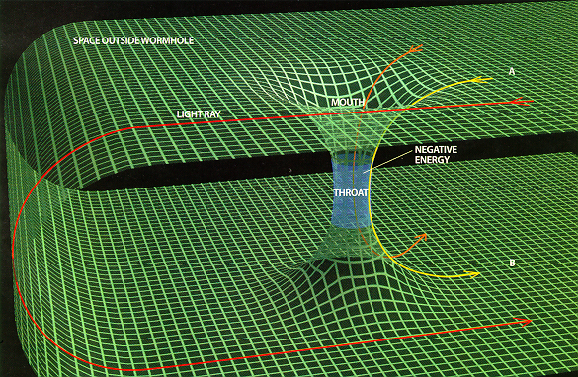
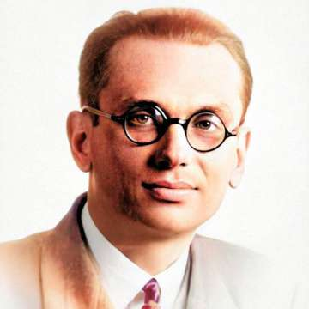
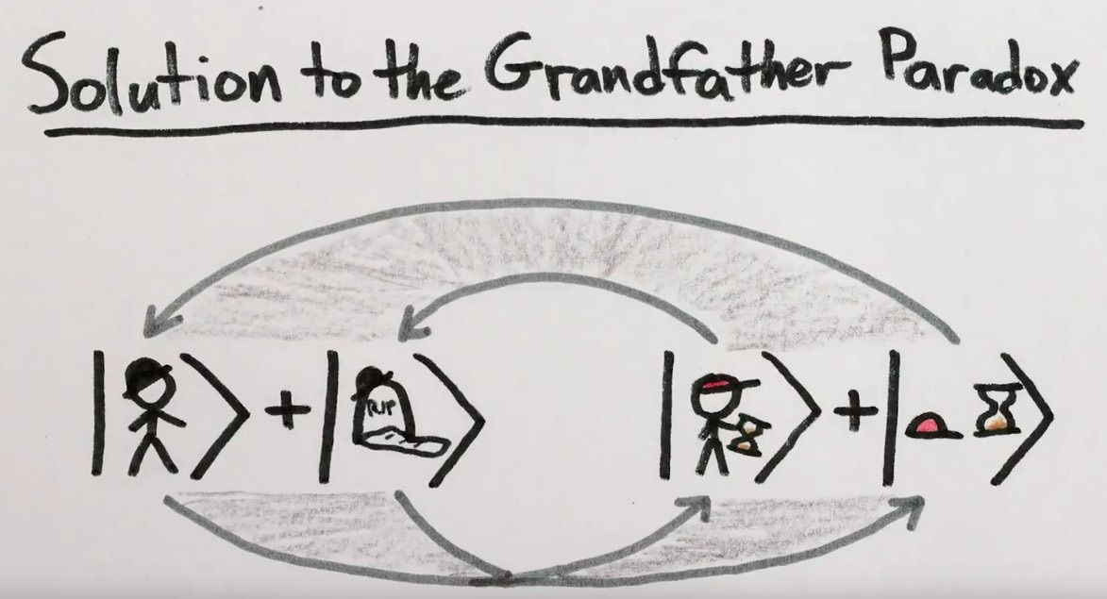
Time Travel / Closed Timelike Curves!
If this existed, wouldn’t it let us “reuse the same time over and over,” giving us computational superpowers?
Not quite, because we’ve ignored the Grandfather Paradox!
Deutsch 1991: Quantum-mechanical resolution (fixed points)
But in finding a fixed point, Nature can again be forced to solve a hard computational problem!
A.-Watrous 2009, A. et al. 2024 characterized exactly which problems (PSPACE-complete or the halting problem)

Slide 20
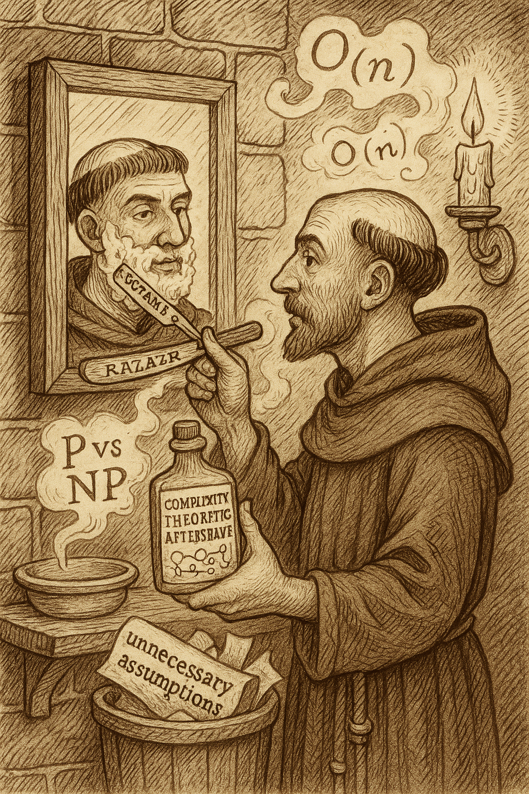
Occam’s Razor with Computational Complexity Aftershave?
Should we penalize physics hypotheses not only for high descriptive complexity, but computational complexity?
My view: Can’t be too dogmatic about this, or we’d rule out quantum computing, and arguably QM itself!
(As indeed many quantum computing skeptics do)
On the other hand, “no fast solution to NP-complete problems” feels not that dissimilar to “no superluminal signaling” or “no perpetual motion”
(Tellingly, the same physical hypotheses, like CTCs and modifications of QM, tend to violate all three principles)

Slide 21
II. Complexity As Armor
Can we delimit the range of validity of effective theories in physics, by saying that it would take astronomical computation time to engineer their breakdown?

Slide 22
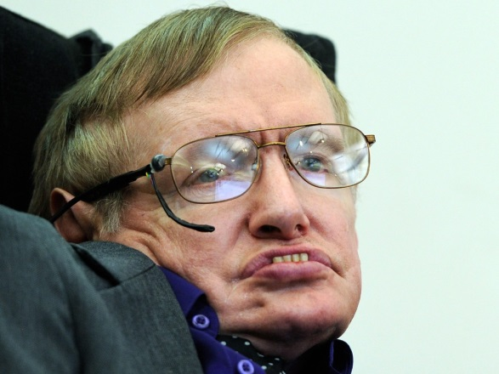
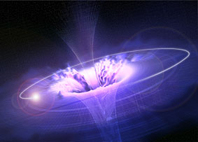
Hawking 1976: What happens to information dropped into a black hole?
|ψ⟩
Disappears into singularity ⇒ Violates the reversibility of physical law
But very hard to understand how it could get out, and into the Hawking radiation that the black hole slowly evaporates into!
Complementarity (Susskind, ‘t Hooft 1990s): From an infalling observer’s perspective, the information falls into the singularity. From an external observer’s perspective, it gets pancaked on the event horizon and then fizzles off as radiation. Both perspectives are valid!

Slide 23
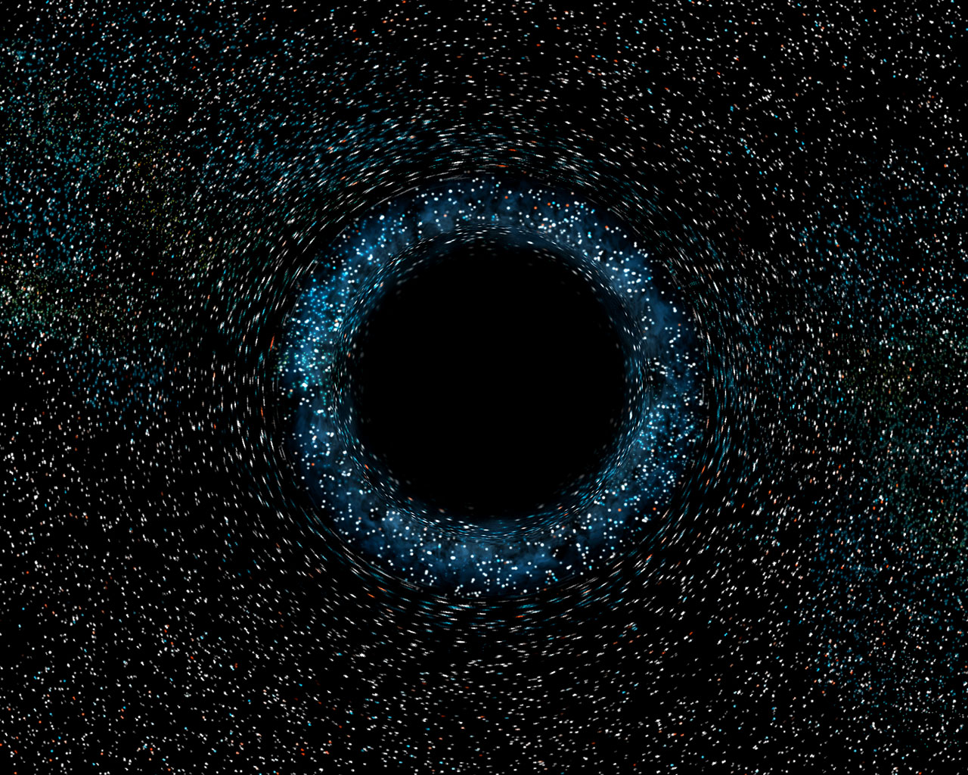


The Firewall Paradox
Almheiri, Marolf, Polchinski, Sully 2012
Alice collects all the Hawking radiation from a black hole until it’s mostly but not completely evaporated (typically taking ~10⁶⁷ years), processes the radiation in a quantum computer to detect the nonrandom patterns, and then jumps into the black hole.
Clear prediction from complementarity is that she’ll have destroyed the black hole interior, so will burn up at the event horizon.
This violates general relativity and quantum field theory, even in a low-energy regime where they were supposed to be valid!

Slide 24
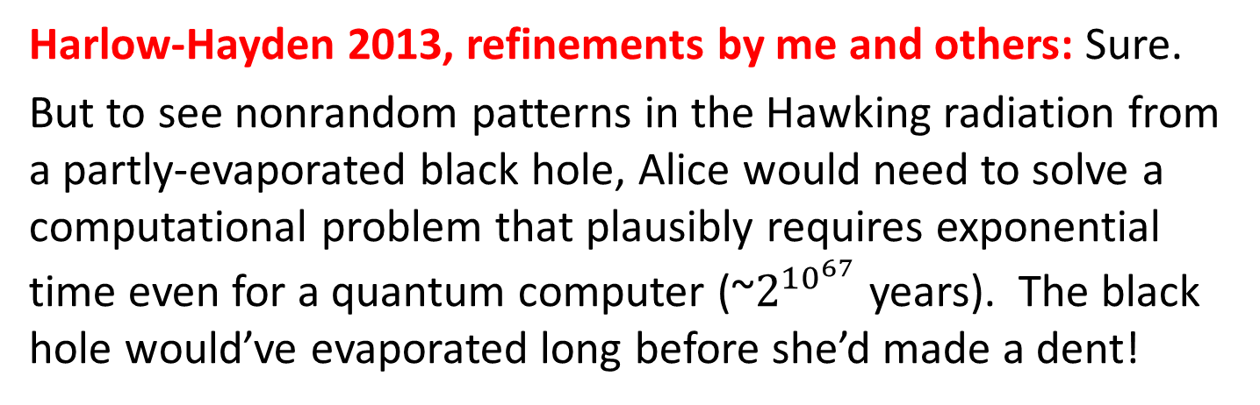
Complexity Theory to the Rescue?
Harlow-Hayden 2013, refinements by me and others: Sure.
But to see nonrandom patterns in the Hawking radiation from a partly-evaporated black hole, Alice would need to solve a computational problem that plausibly requires exponential time even for a quantum computer (~$2^{{10}^{67}}$ years). The black hole would’ve evaporated long before she’d made a dent!
Philosophical Problem: Would a contradiction in physics be OK if it took exponential time to uncover it?
Note: This is not what Harlow and Hayden are saying! The “contradiction” is in our effective field theories, GR and QFT, whose regime of validity is now protected by a computational barrier alongside the usual energy barrier. The true theory of QG would presumably remain free from contradiction!

Slide 25
Complexity and Thermodynamics
Ongoing joint work with Gülce Kardes and Harrison Hartle
We’ve constructed a toy situation where, if P=NP, then one could appear to reverse the Second Law of Thermodynamics, by building a Maxwell’s Demon that collects all the gas in a box onto one side
Normally, the entropy just gets transferred into the Demon’s own memory (Szilard/Landauer/Bennett). But in our model scenario, we can use the P=NP assumption to “uncompute” the Demon’s memory.
Note: In practice, quantum mechanics and/or classical chaos will normally make our strategy fail. Even so, we’ve shown that the appearance of the Second Law can be protected only by computational complexity, just like GR/QFT in the Harlow-Hayden scenario!

Slide 26
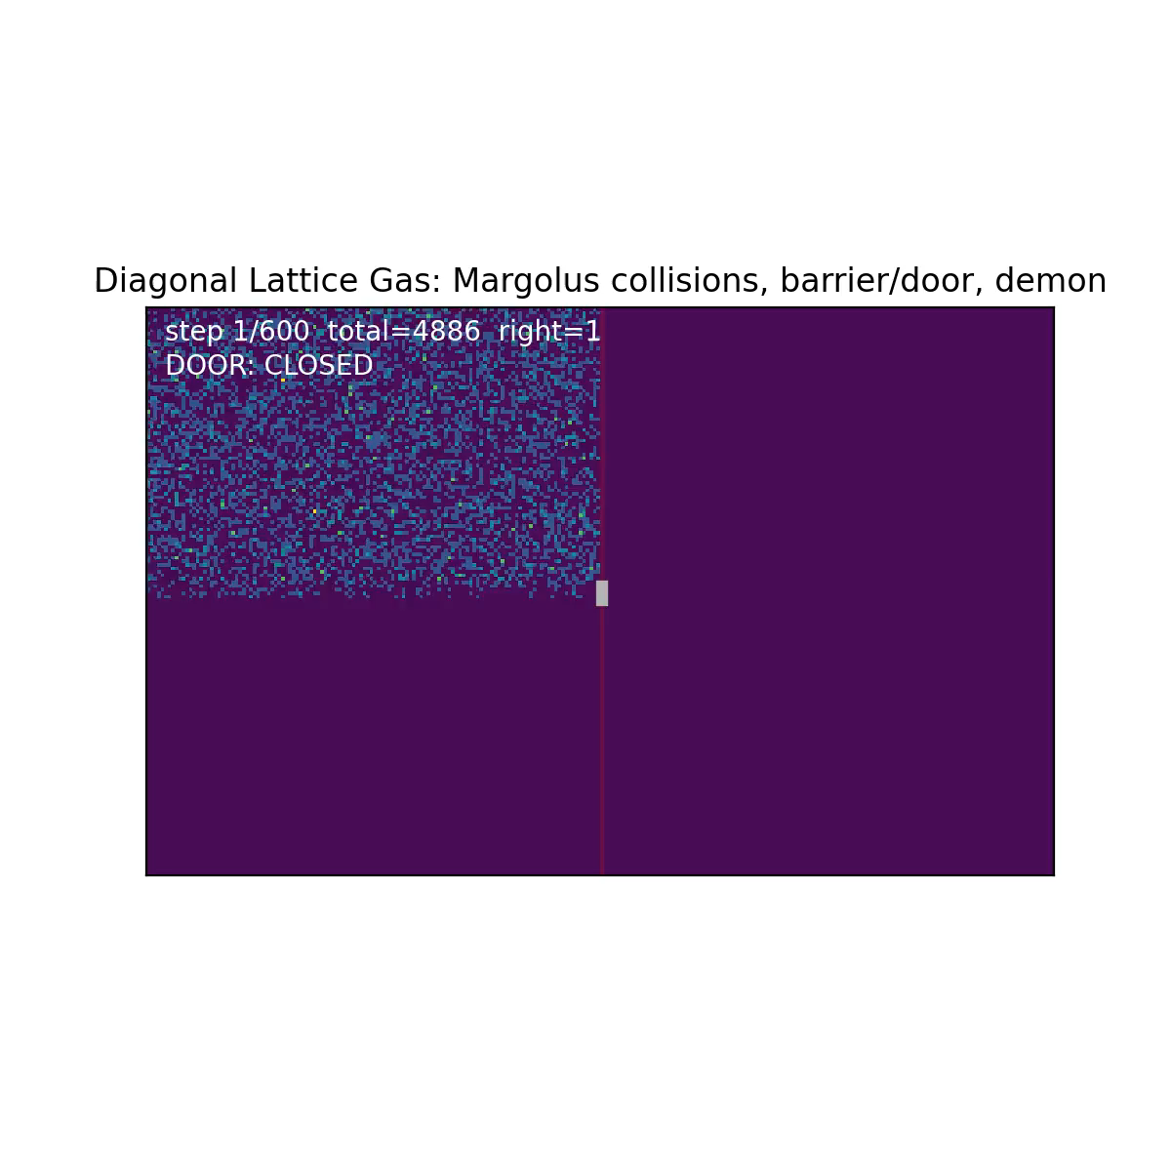

Slide 27
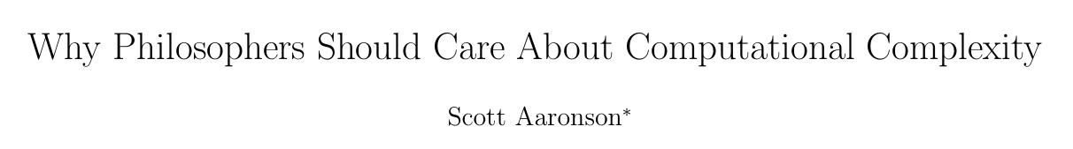
Concluding Thoughts
More than a century ago, knowledge and information, despite their apparent anthropocentrism, snuck into our best explanations in physics—e.g., via statistical thermodynamics and no-signaling in relativity
Should we be so surprised if computational limits likewise sneak into physics explanations in our own time?
One difference: progress in pure math, e.g. a solution to P vs. NP, would help clarify which of the computational limits are real
https://www.scottaaronson.com/papers/philos.pdf

