Slide 1
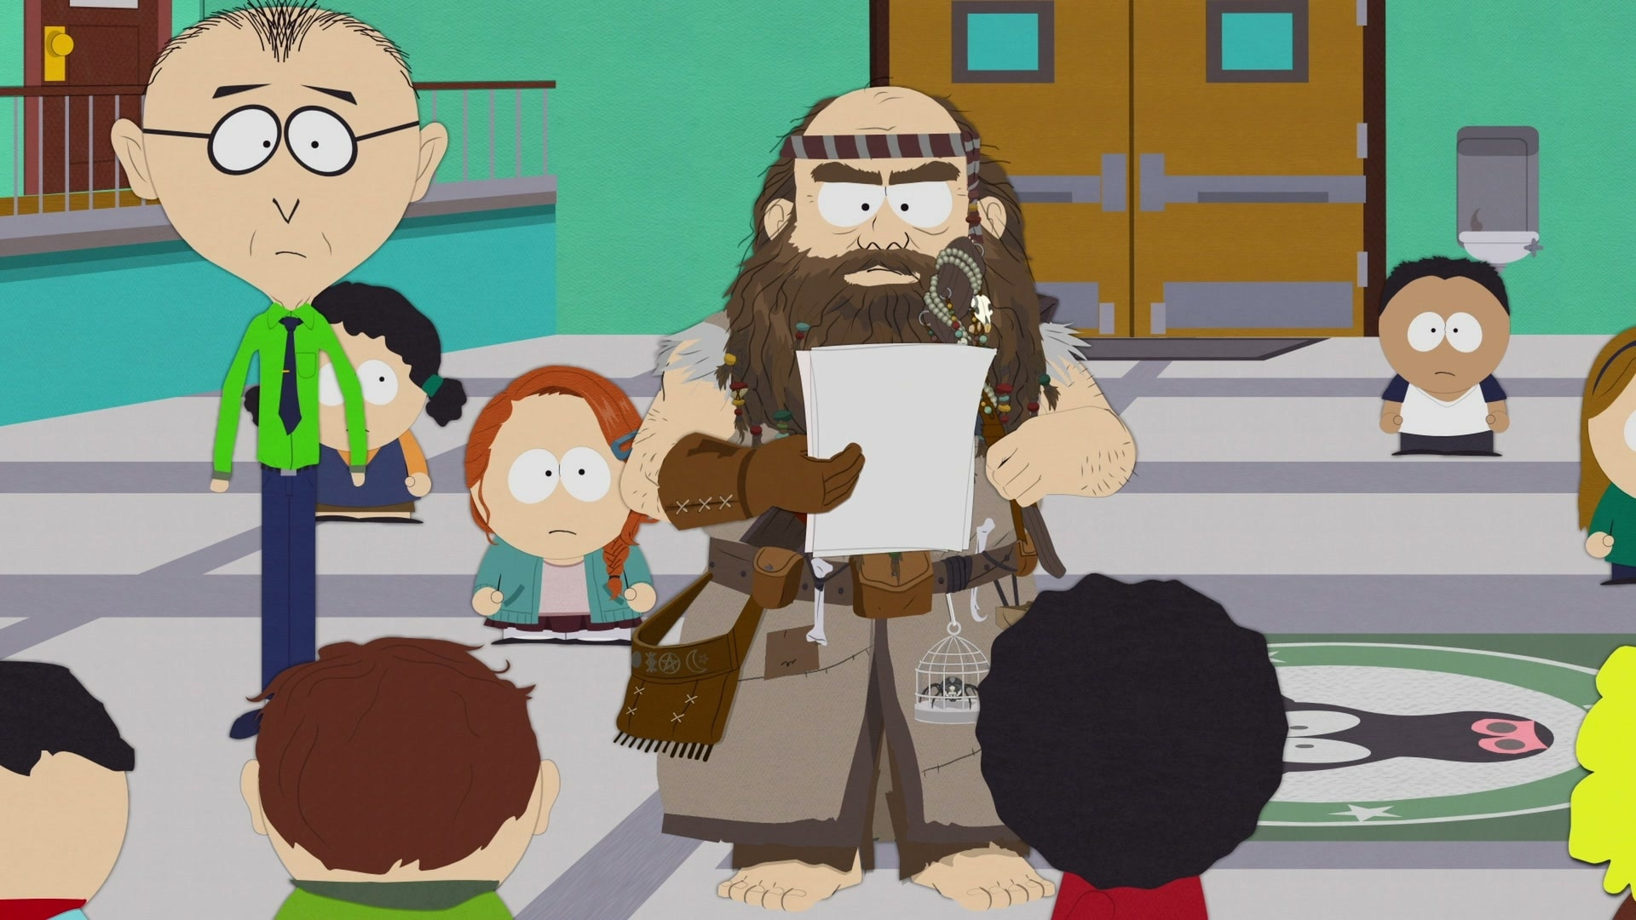
Watermarking of LLMs
Scott Aaronson (UT Austin / OpenAI)
Workshop on LLMs and Transformers
Simons Institute, Berkeley, August 17, 2023

Slide 2
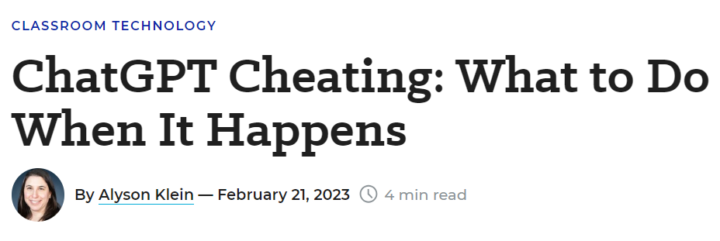
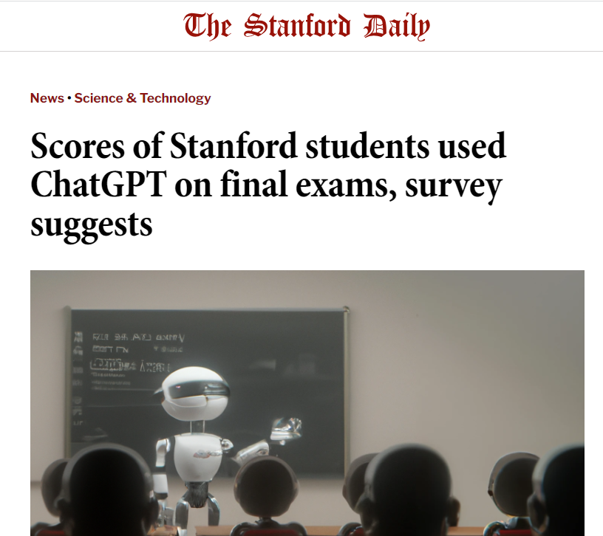
The Attribution Problem
Insight: Almost any nefarious near-term use of LLMs that you can think of, involves concealing that an LLM was involved. If only we could make that harder…

Slide 3
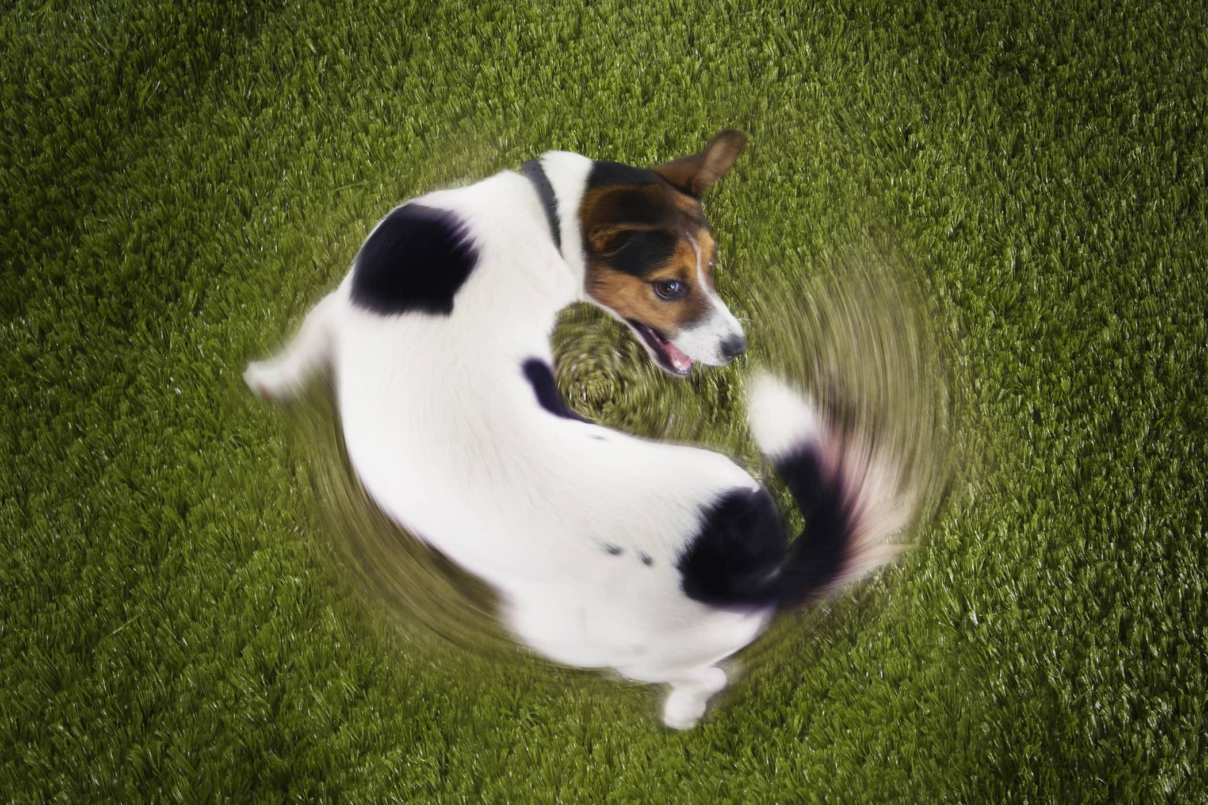
Another reason to care about attribution
As the Internet gets filled with LLM-generated text, we’ll often need to prevent that text from getting fed back in as training data… which requires recognizing it

Slide 4
Proposed Solutions
Just look for formulaic prose, or “As a large language model…” ☺
Metadata ← already questionable for audiovisual, trivial to remove from text!
Giant database of completions ← privacy?
Discriminator models, like GPTZero or DetectGPT or Ghostbuster ← too many false positives?
Watermarking: inserting a statistical signal into the LLM’s choice of tokens

Slide 5
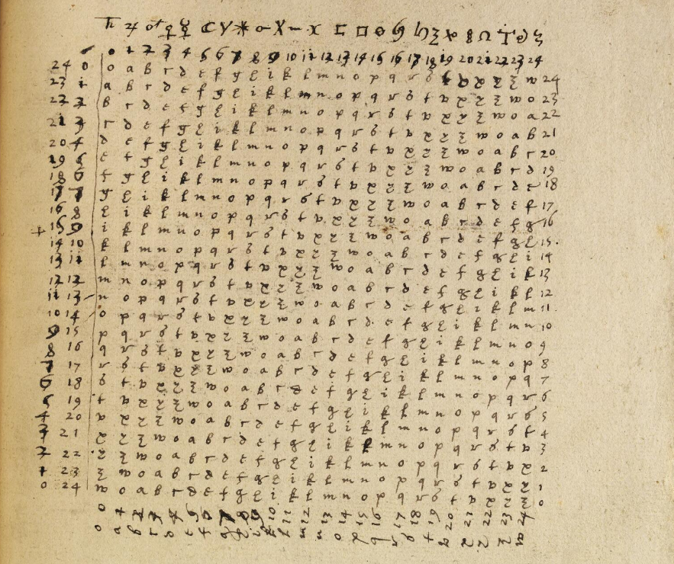
Steganography
Long history, but not robust against edits, and doesn’t take advantage of probabilities output by an LLM

Slide 6
Brief History of LLM Watermarking
My moment of terror (~July 2022): Led me to propose a watermarking scheme based on “Gumbel Softmax Rule,” prove theorems, give talks about it. Within OpenAI, Hendrik Kirchner did a test implementation
Kirchenbauer et al. (Jan. 2023): Modify the LLM probabilities using a pseudorandom function of n-grams
Christ, Gunn, Zamir (June 2023): Watermarked output that’s cryptographically indistinguishable from normal LLM output—rediscovered most of my proposal and more
Kuditipudi et al. (July 2023): Watermarking using “one-time pad” rather than pseudorandom function

Slide 7
Problem to be Solved
Given: Tokens $w_{1},…,w_{t−1}$, and a probability distribution $D_{t}=\left(p_{t,1},…,p_{t,K}\right)$ over $t^{th}$ token $w_{t}$
Also: Pseudorandom function $f\left(w_{t−c+1},…,w_{t−1},i\right)$, which maps the latest $c$ tokens to (say) $r_{t,i}∈\left[0,1\right]$
Goal: Choose a $t^{th}$ token $i$ that looks like it’s drawn from $D$, but also secretly boosts $r_{t,i}$
In detection phase: We have access to a document $w_{1},…,w_{n}$, and hence the${ r}_{t,i}$’s, but not the${ p}_{t,i}$’s

Slide 8
The Gumbel Softmax Scheme
At each position $t$, choose the token $i=i(t)$ that maximizes $r_{t,i}^{1/p_{t,i}}$
Intuition: The smaller is $p_{t,i}$, the larger the exponent, which means the closer $r_{t,i}$ must be to 1 for $i$ to have a chance of being chosen
In detection phase: Calculate $\sum_{t=1}^{n}{\ln{\frac{1}{1−r_{t,i(t) }}}{. }}$ Iff this sum exceeds a threshold, say that GPT probably wrote the thing.

Slide 9
Properties of This Scheme
Low computational overhead on top of the LLM generation
Robustness to local perturbations: Even if someone changes some words, reorders sentences and paragraphs, etc., watermark is still detectable so long as a large fraction of $c$-grams are preserved
Indistinguishability (crucial): The output looks exactly like normal LLM output, except to someone who distinguishes $f$ from a truly random function

Slide 10
Lemma: Suppose the${ r}_{t,i}$’s were chosen uniformly from [0,1]. Then $\text{Pr}\left[i \text{chosen}\right]$ would always be${ p}_{t,i}$
Proof: Our rule is equivalent to choosing the $i$ that minimizes $\frac{1}{p_{t,i}}\ln{\frac{1}{r_{t,i}}}$. If${ r}_{t,i}$ is uniform, this is an exponential random variable with mean $\frac{1}{p_{t,i}}$. The minimum of two exponential random variables, with means $\frac{1}{p}$ and $\frac{1}{q}$, is again exponential with mean $\frac{1}{p+q}$. Thus we can reduce to the case of $K=2$ tokens, for which the result can be verified by doing the integral.

Slide 11
The Role of Entropy
Suppose you ask GPT to list the first 100 prime numbers. It can do it—but how would you watermark the result?
Clearly, the number of tokens needed to get a strong watermark signal will depend on the average entropy per token, conditional on the previous tokens, as perceived by the language model:
$${α=\text{E}}_{t=1,…,n}\left[\sum_{i=1}^{K}{p_{t,i}\ln{\frac{1}{p_{t,i}}}}\right]$$

Slide 12
Lemma: For “normal” text,
$$\text{E}\left[\sum_{t=1}^{n}{\ln{\frac{1}{1−r_{t,i\left(t\right)}}}}\right]=n\int_{0}^{1}{\ln{\frac{1}{1−r}dr=n}},$$
$\text{Var}=n$.
For watermarked text,
$$\text{E}\left[\sum_{t=1}^{n}{\ln{\frac{1}{1−r_{t,i\left(t\right)}}}}\right]≥n\sum_{t=1}^{n}{\int_{0}^{1}{\frac{1}{p_{t,i\left(t\right)}}r^{\frac{1}{p_{t,i\left(t\right)}}−1}ln{\frac{1}{1−r}dr}}}≥n+\left(\frac{π^{2}}{6}−1\right)αn,$$
where$α$is the average Shannon entropy per token in nats, and the variance is at most $\frac{π^{2}}{6}n$.

Slide 13
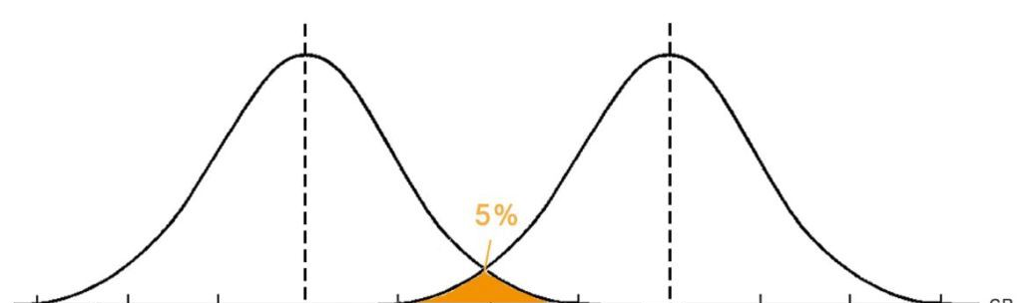
Lemma: If we want error probability at most $δ$, then $O\left(\frac{1}{α^{2}}\log{\frac{1}{δ}}\right)$ tokens suffice.
$$n$$
$$n+cαn$$
Score assuming no watermarking
Score assuming watermarking

Slide 14
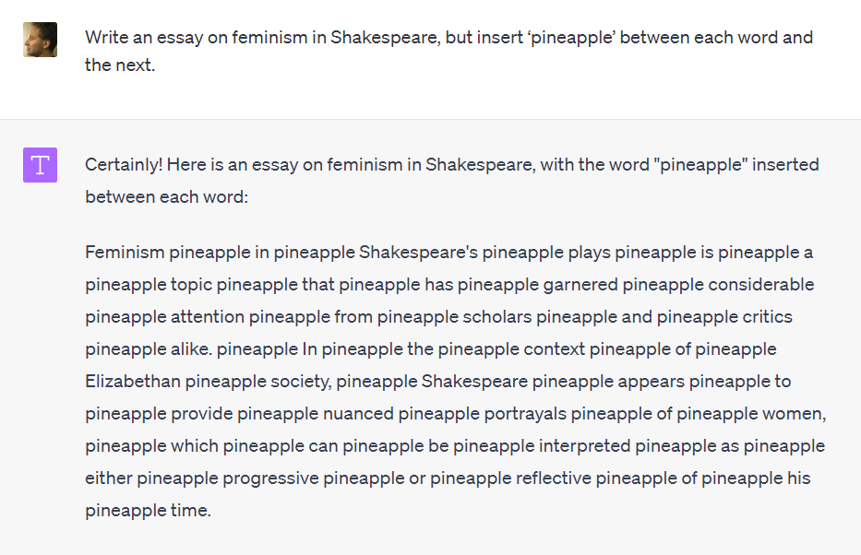
Attacks?
Countermeasures?
Add filters for “trying to evade watermarking”
Ultimately: watermark at the semantic level

Slide 15
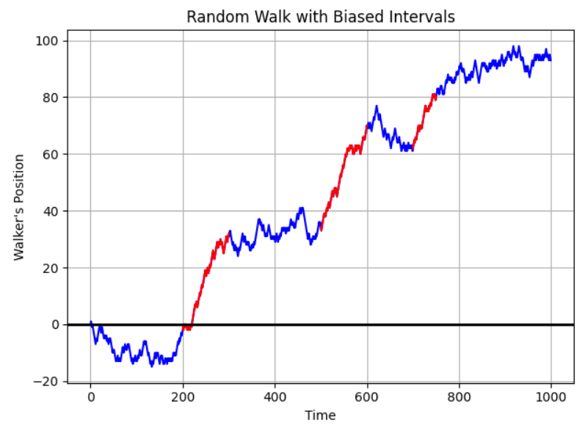
Detecting which portions of a long text are watermarked: “change point detection”

Slide 16
Let $x_{1},…,x_{n}$ be the watermark signals (with my scheme, $x_{i}=\ln{\frac{1}{1−r_{i}}}$). Let $s_{i}=x_{1}+⋯+x_{i}$. Each interval has a “watermark plausibility score” of $\frac{{\left(s_{j}−s_{i}\right)}^{2}}{j−i}−L$ for some constant $L$. Maximize the sum of the plausibility scores.
By dynamic programming; turns out to be solvable in $O(n^{3/2})$ time, or $O(n\log{n}\log{\frac{1}{ε}})$ approximate (thanks to Daniel Kane)

Slide 17
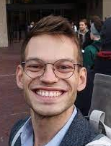
Deployment?
Prototype of my scheme implemented by OpenAI’s Hendrik Kirchner
It seems to work, even with a few hundred tokens!
Questions that have come up:
Will customers rebel and switch to a competing language model?
Can we coordinate? (Cf. White House commitment)
Is watermarking unfair to, e.g., ESL students?
Who gets access to the detection tool? Everyone? Only Canvas, TurnItIn.com, journalists?

Slide 18
Summary
We’ve made some progress on the problem of how to watermark LLM output without degrading quality
Attacks are certainly possible—but so are better watermarking methods! Unclear who wins “in the limit”
Key conceptual challenge: Formally define the attack model
Key technical challenge: Watermark at the semantic level / build watermark into the model weights
Key social challenge: Coordinate AI companies to get watermarking deployed

