Slide 1
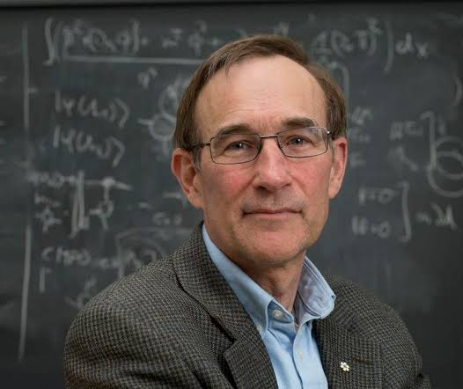
Raymond Laflamme, Complexity Theorist (?!)
P^{#P}
PH
AM
PP
NP
BQP
BPP
P
Scott Aaronson (UT Austin / OpenAI)
IQC, Waterloo, Canada, July 19, 2023

Slide 2
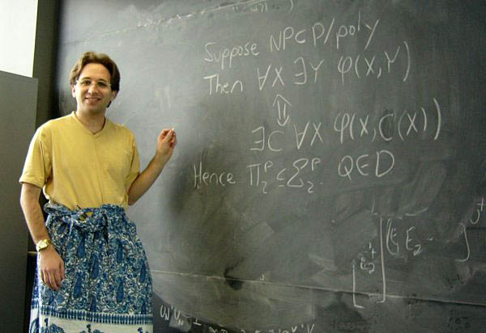
My Postdoc in Waterloo (2005-2007)
Me proving the Karp-Lipton Theorem in Daniel Gottesman’s office at Perimeter while wearing a sarong
In Waterloo, I:
✓ Started my blog
✓ Had my first relationship
✓ Taught the course that became Quantum Computing Since Democritus
✓ Invented quantum copy-protection, quantum oracle separations, PAC-learning of quantum states

Slide 3
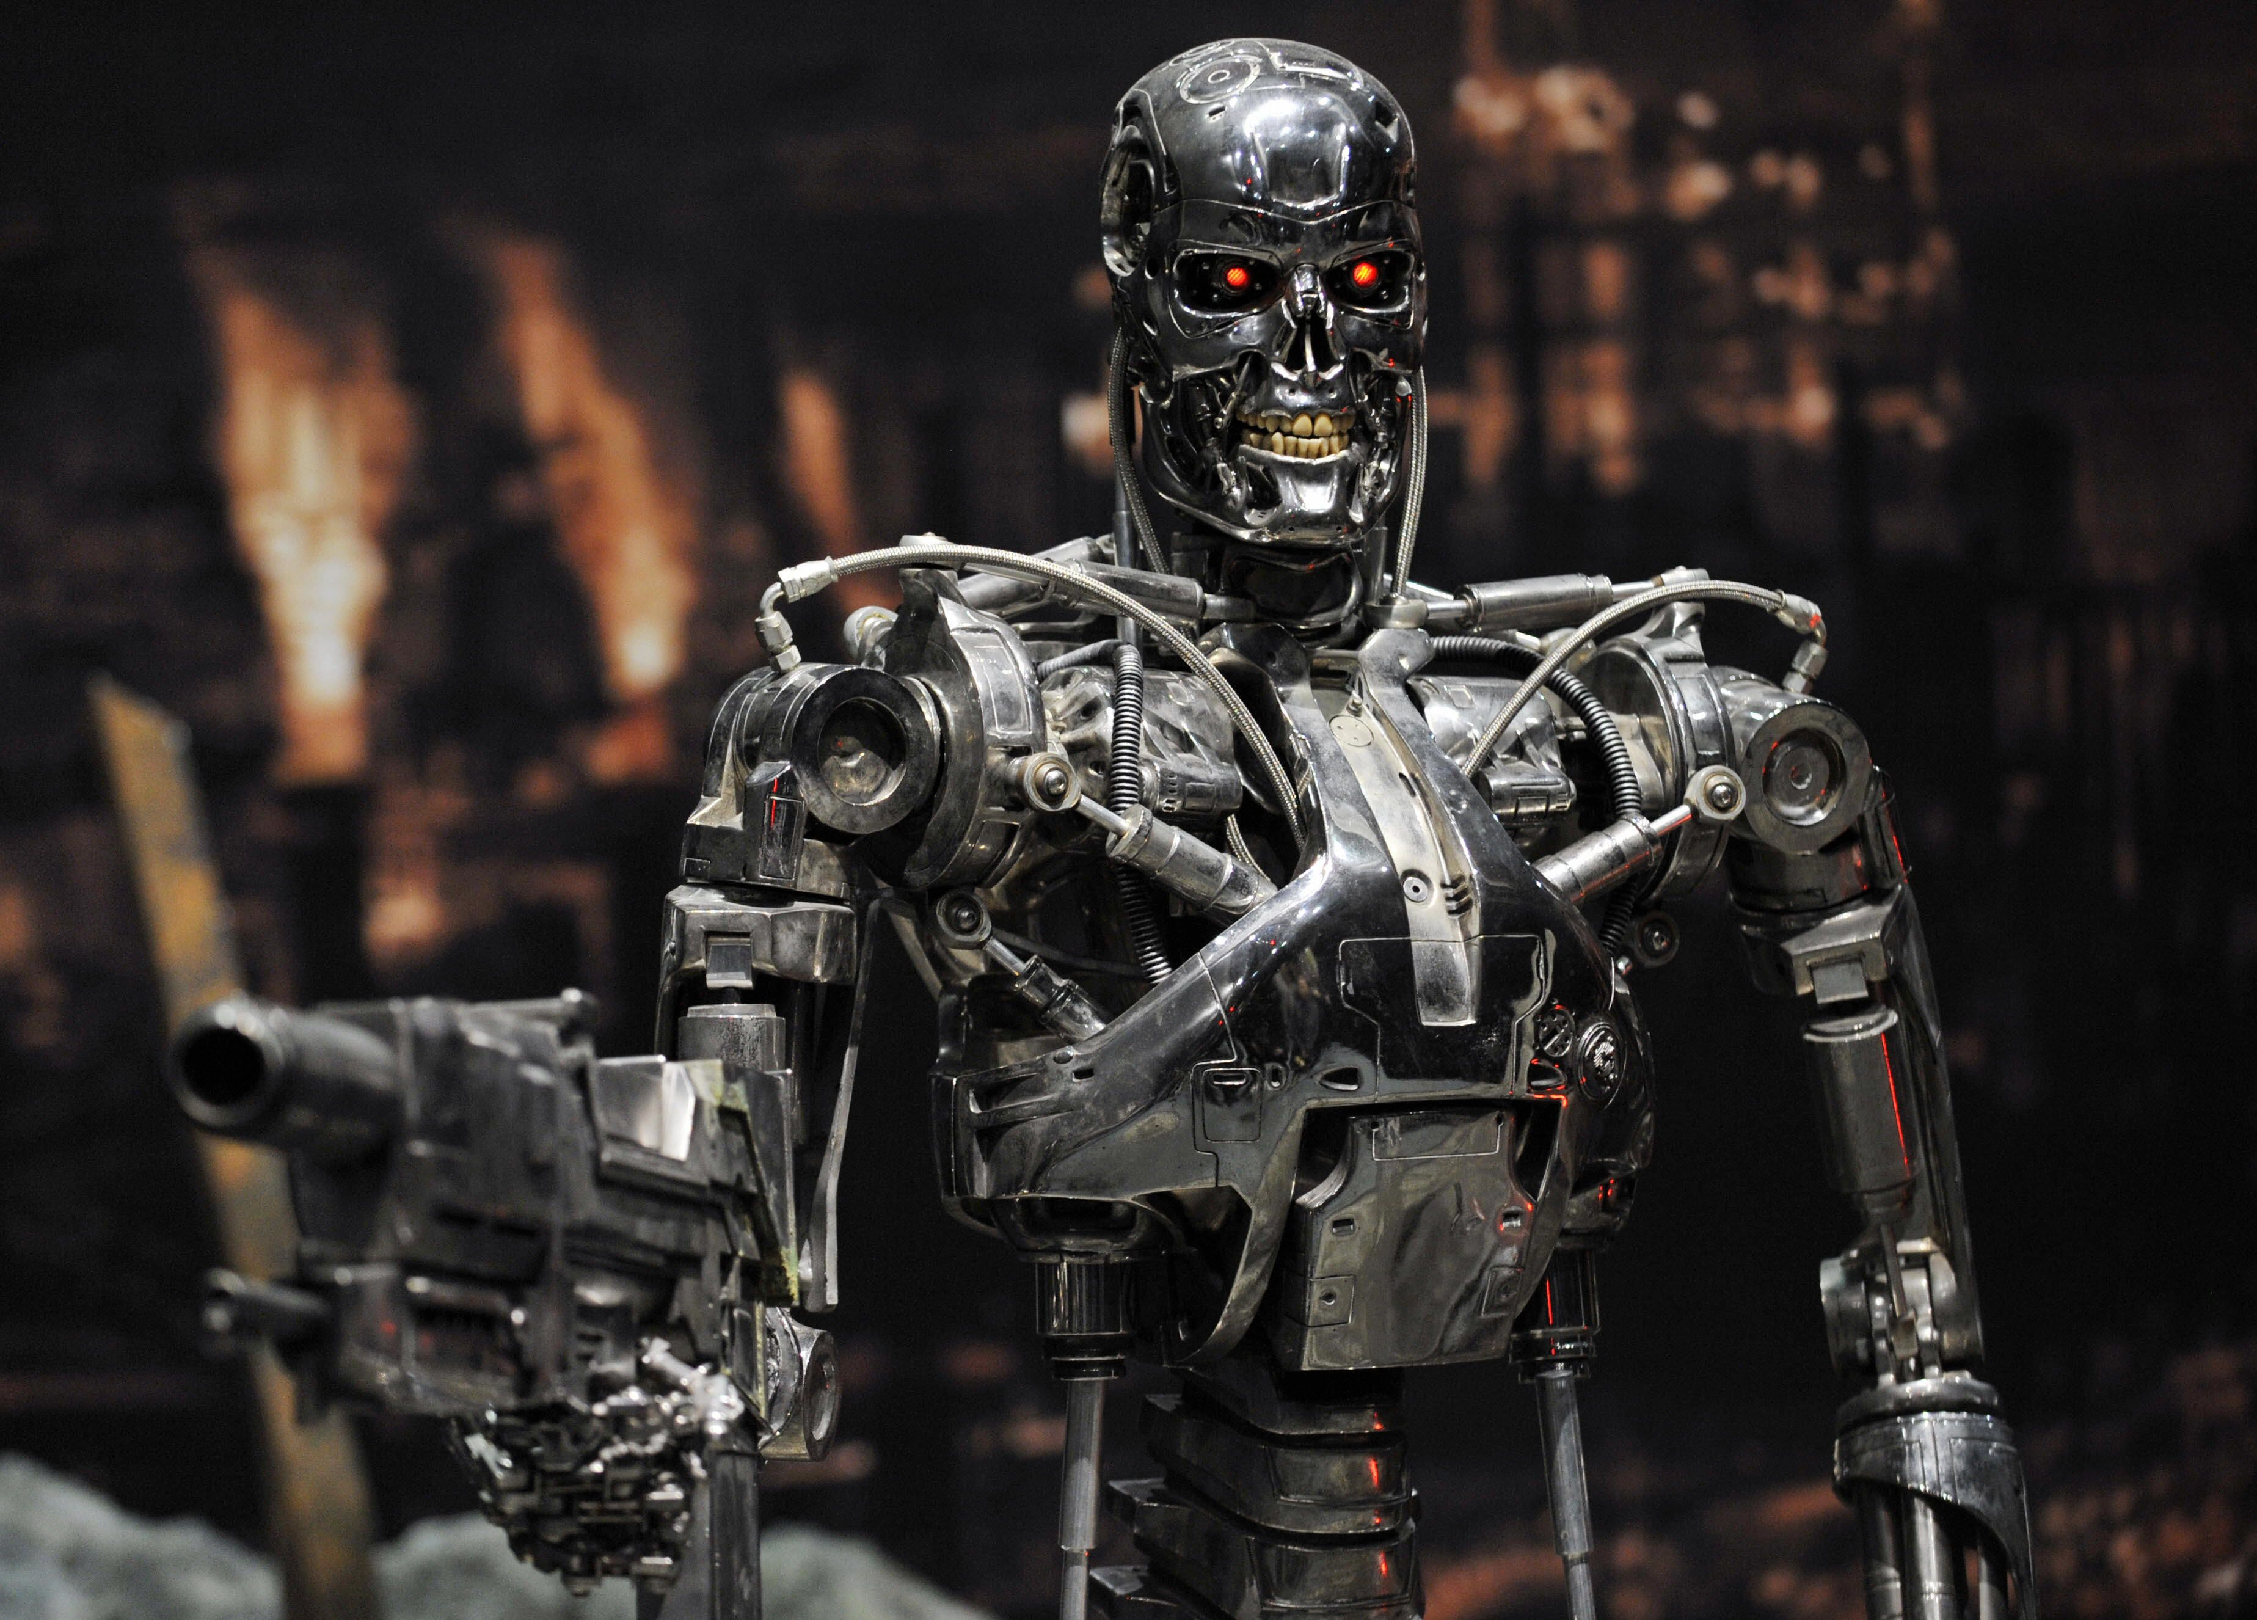
My Research Today
1. Trying to stop the robot apocalypse
2. Also still quantum complexity theory, because I don’t know how to stop the robot apocalypse

Slide 4
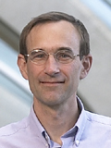
My Boss in Waterloo
Directed the IQC
Created an environment where I and others thrived
Participated in my Democritus lectures
Gave me a raise

Slide 5
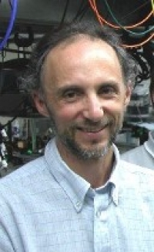
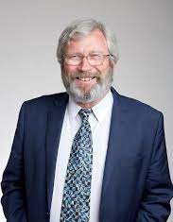
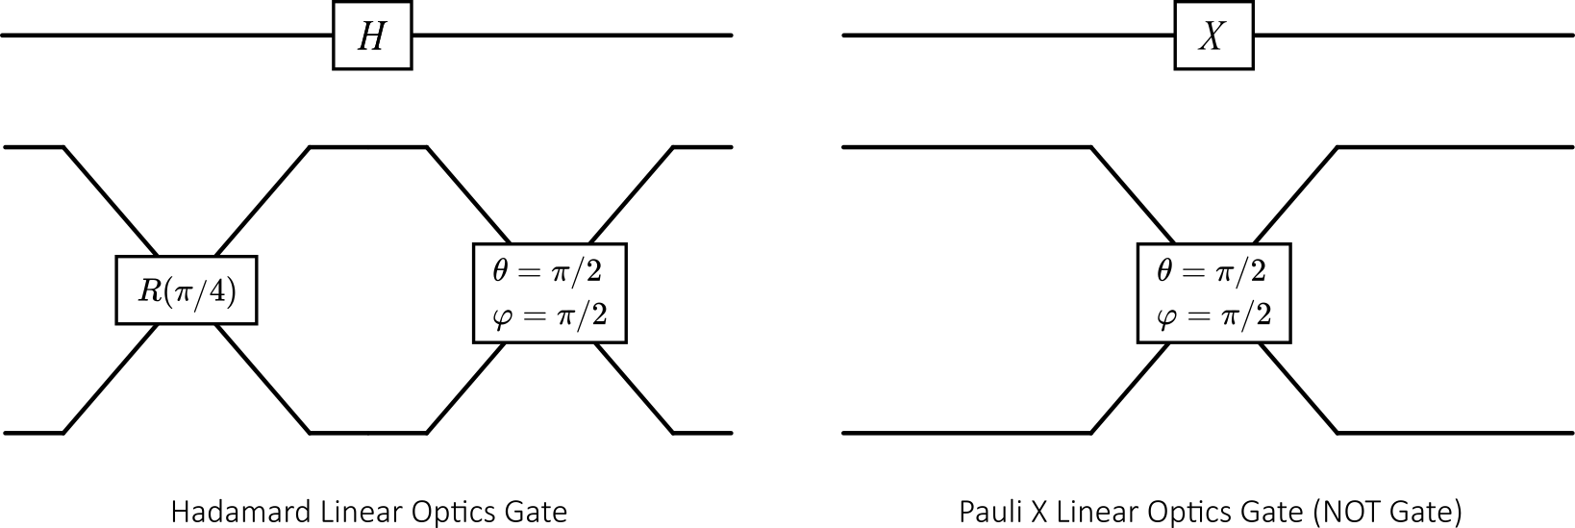
The KLM Theorem (2001)
A landmark in quantum computing theory
Linear optics + adaptive measurements is universal for BQP!
The trouble with photons is that they fly past each other … but we can use adaptive measurements to simulate 2-photon interactions

Slide 6
Lemma: Postselected linear optics is universal for postselected QC
Each qubit is encoded by a pair of optical modes (“dual-rail representation”). 1-qubit gates are easy
Using postselection, we can simulate a 2-qubit CSIGN gate with 1/16 success probability
$$α_{0}\left.|0\right\rangle +α_{1}\left.|1\right\rangle +α_{2}\left.|2\right\rangle →α_{0}\left.|0\right\rangle +α_{1}\left.|1\right\rangle −α_{2}\left.|2\right\rangle$$

Slide 7
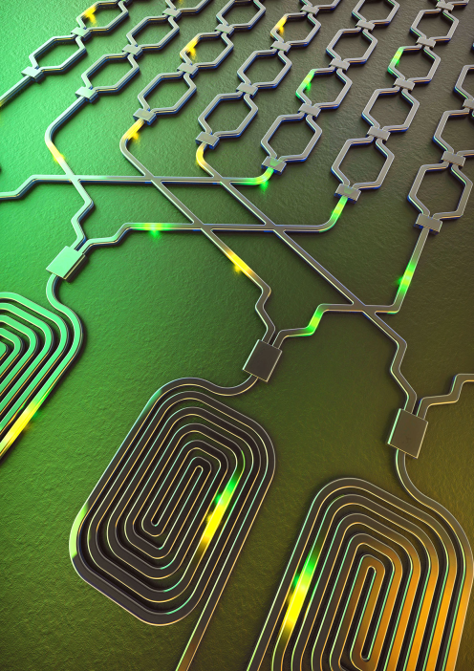
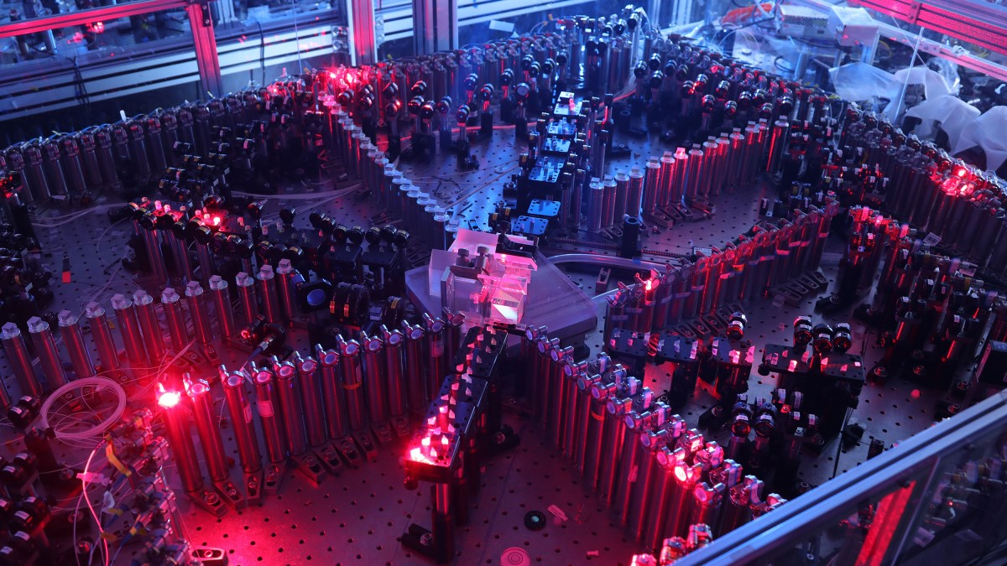
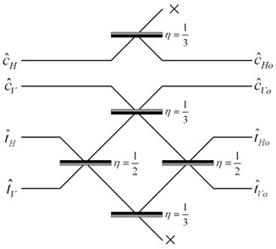
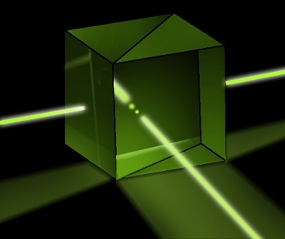
BosonSampling (A.-Arkhipov 2011)
Linear optics without the adaptive measurements
Probably not universal for quantum or even classical computing, but a way to demonstrate near-term quantum supremacy for a sampling task
Actually demonstrated by USTC group in 2020, with ~100 average photons—though evading clever classical simulations remains a challenge

Slide 8
Key to BosonSampling’s Hardness
A transition amplitude for n photons is given by the permanent of an n×n complex matrix:
$$\text{Per}\left(\begin{matrix}a & b & c \\ d & e & f \\ g & h & i\end{matrix}\right)=aei+afh+bdi+bfg+cdh+ceg$$
Valiant 1979: Calculating the permanent is #P-complete— as hard as any combinatorial counting problem
Using that fact, we showed that a fast, exact classical simulation of BosonSampling would collapse the polynomial hierarchy

Slide 9
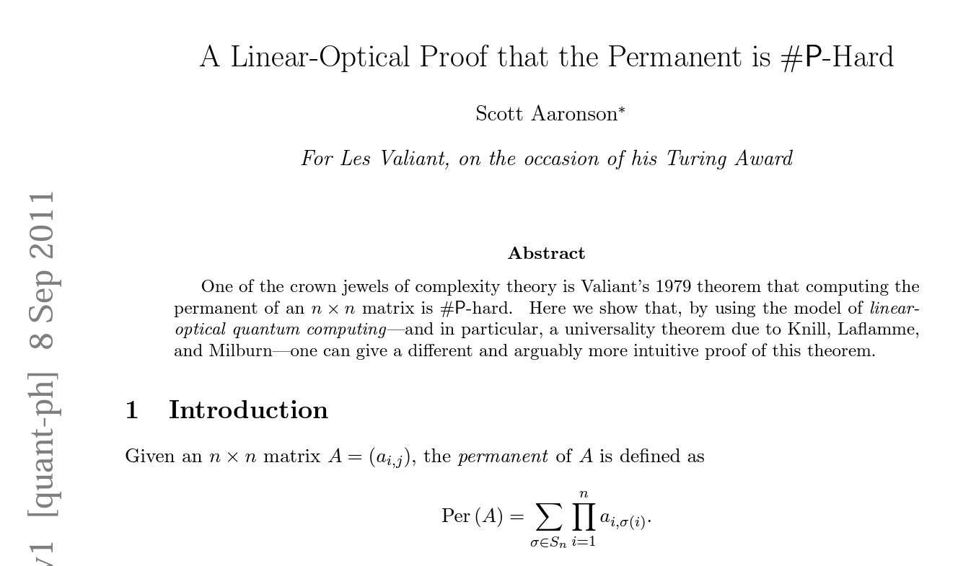
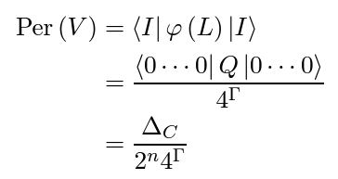
Reversing the Logic!
A 2011: Postselected linear optics can express postselected universal QC + postselected universal QC can express #P-complete problems ⇒ a brand new proof that the permanent is #P-complete!

Slide 10
New Results
Daniel Grier, Luke Schaeffer 2016: Calculating the permanent of a unitary matrix is #P-complete
The only known proof of this classical complexity result works by modifying my KLM-based construction
But wait, there’s more! Their construction implied that, for all k∉{2,3}, calculating the permanent of an orthogonal matrix, over some finite fields of order k, is complete for the class Mod_{k}P
What about when k = 2 or 3?? AHA!

Slide 11
More Laflamme Complexity Theory!
Laflamme-Milburn 1998: Defined DQC1—the class of problems solvable in polynomial time by a quantum computer with initial state $|\left.0\right\rangle \left\langle 0|⊗I_{n−1}\right.$
DQC1 has since shown up in far more contexts than it’s had any right to!

Slide 12
Concluding Thought
There are interdisciplinary fields … and then there’s quantum information, where you can’t avoid CS if you’re trying to do only physics and vice versa.
Happy 60th Quannaninniing Ray!!!

