Slide 1
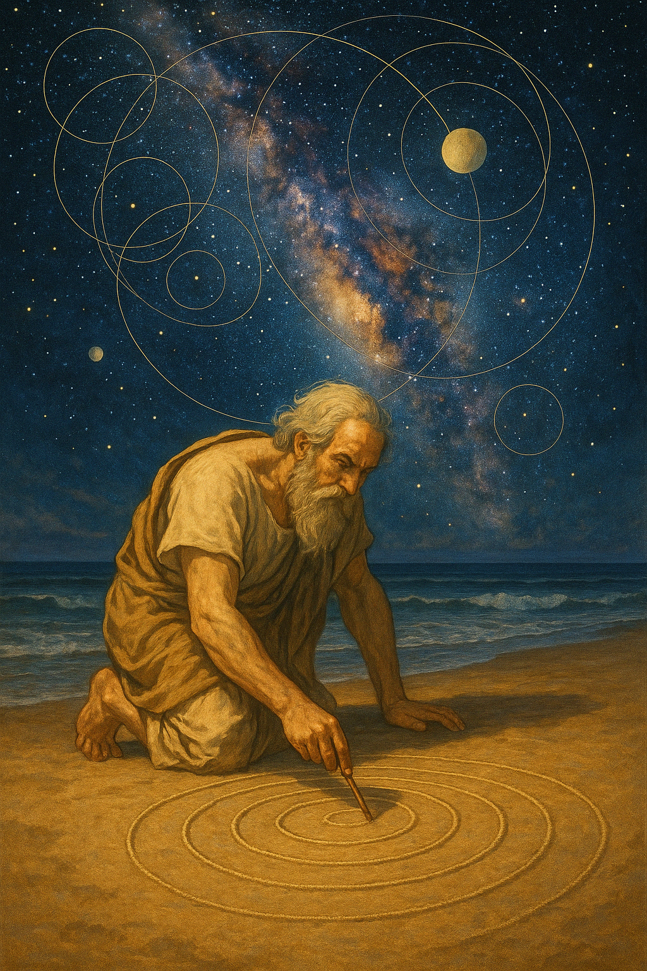
How Much Math Is Knowable?
Scott Aaronson
University of Texas, Austin
Yip Lecture
Harvard University
April 17, 2025

Slide 2
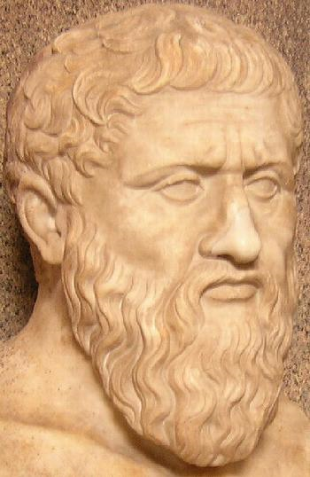
Observation bridging math, CS, physics, philosophy:
Even if mathematical truth is timeless, our ability to know it is limited by our nature as finite, temporal beings
To illustrate I present:
Zeno’s Finite-Time Goldbach DeciderTM!
4 = 2 + 2
Time (seconds)
6 = 3 + 3
8 = 5 + 3
10 = 5 + 5 = 7 + 3
12 = 7 + 5

Slide 3
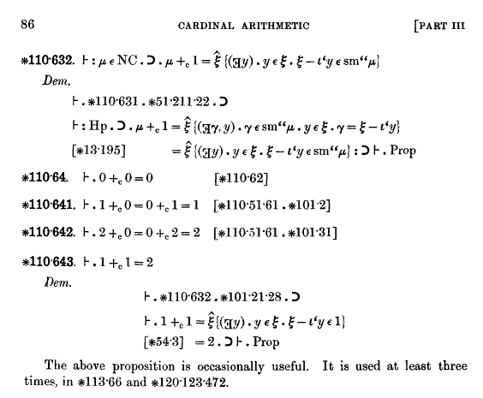
Proofs—For Finite Beings Like Us!
Frege, Hilbert, Russell, Peano, Zermelo … showed how purported proofs can even be checked mechanically
Proof that all Robbins algebras are Boolean. Discovered by the computer program EQP in 1996, solving a 63-year-old problem
-(n(x+y)=n(x)).
n(n(n(x)+y)+n(x+y))=y.
n(n(n(x+y)+n(x)+y)+y)=n(x+y).
n(n(n(n(x)+y)+x+y)+y)=n(n(x)+y).
n(n(n(n(x)+y)+x+y+y)+n(n(x)+y))=y.
n(n(n(n(n(x)+y)+x+y+y)+n(n(x)+y)+z)+n(y+z))=z.
n(n(n(n(x)+y)+n(n(x)+y)+x+y+y)+y)=n(n(x)+y).
n(n(n(n(x)+y)+n(n(x)+y)+x+y+y+y)+n(n(x)+y))=y.
n(n(n(n(n(x)+y)+x+y+y)+n(n(x)+y)+n(y+z)+z)+z)=n(y+z).
n(n(n(n(n(n(x)+y)+x+y+y)+n(n(x)+y)+n(y+z)+z)+z+u)+n(n(y+z)+u))=u.
n(n(n(n(x)+x)+x+x+x)+x)=n(n(x)+x).
n(n(n(n(n(x)+x)+x+x+x)+x+y)+n(n(n(x)+x)+y))=y.
n(n(n(n(x)+x)+x+x+x+x)+n(n(x)+x))=x.
n(n(n(n(x)+x)+n(n(x)+x)+x+x+x+x)+x)=n(n(x)+x).
n(n(n(n(n(x)+x)+n(n(x)+x)+x+x+x+x)+x+y)+n(n(n(x)+x)+y))=y.
n(n(n(n(n(x)+x)+n(n(x)+x)+x+x+x+x)+n(n(n(x)+x)+x+x+x)+x)+x)=
n(n(n(x)+x)+n(n(x)+x)+x+x+x+x).
n(n(n(x)+x)+n(n(x)+x)+x+x+x+x)=n(n(n(x)+x)+x+x+x).

Slide 4
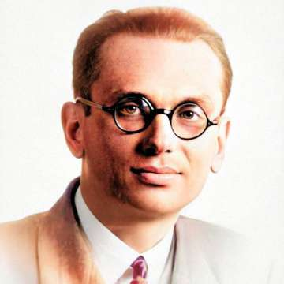
Gödel’s Theorem! (Proved In One Slide)
Given any formal system F meant to capture arithmetic (like ZFC set theory):
Let S₁(n), S₂(n), … be a list of all sentences in F, each taking one integer variable n (e.g. S₄₂(n) might be “for all x,y,z, x^{n}+y^{n}=z^{n} implies xyz=0”)
Let Φ_{F}(n) = “S_{n}(n) has no proof in F”
Let G_{F} = “Φ_{F}(#Φ_{F})” = “This sentence has no proof in F”
If G_{F} is false, then F is unsound. If G_{F} is true, then F is incomplete.
Gödel’s 2nd Incompleteness Theorem: G_{F} ⇔ Con_{F}

Slide 5
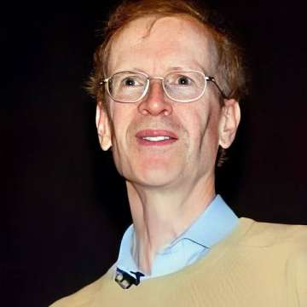
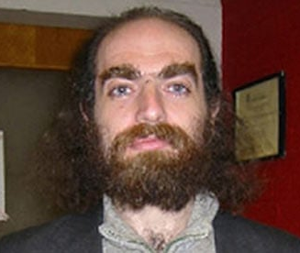
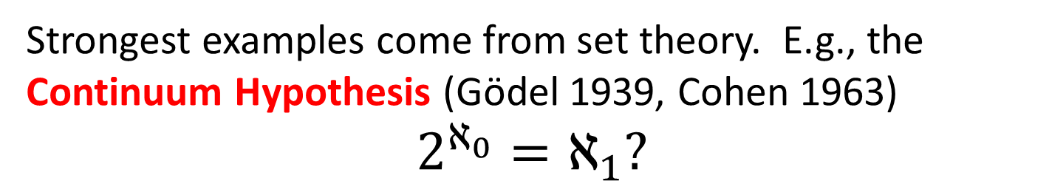
How Pervasive Is Incompleteness?
Since 1931, independence from strong formal systems has arisen way less often than you might’ve feared
“Lucky for us!”
Strongest examples come from set theory. E.g., the Continuum Hypothesis (Gödel 1939, Cohen 1963)
$$2^{ℵ_{0}}=ℵ_{1}?$$
But is this a “real” example of an unknowable truth—or is the truth simply that there’s a multiverse of set theories?

Slide 6
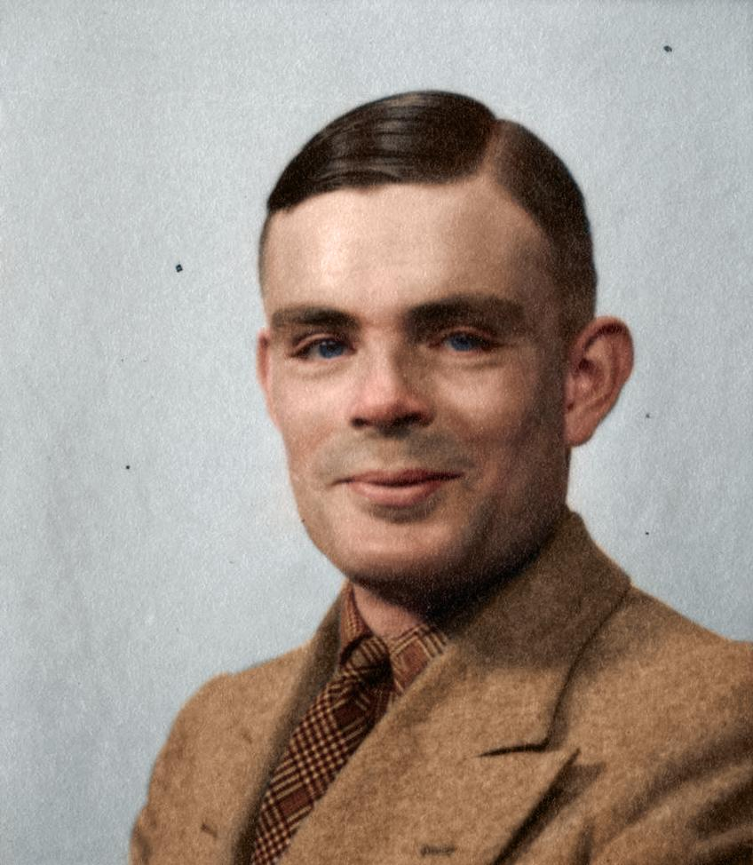
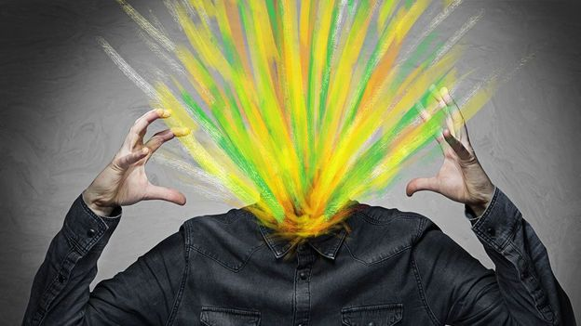
Turing’s Theorem! (Proved In One Slide)
Theorem: No program can decide whether an arbitrary other program halts.
Proof: Let P(M) decide whether M() halts.
Use P to make a new program, Q(M), which halts if M(M) runs forever, or runs forever if M(M) halts
Consider Q(Q):
Turing ⇒ Gödel: If we had a complete, sound proof system for arithmetic, we could compute whether any program halted by just listing all possible proofs!

Slide 7
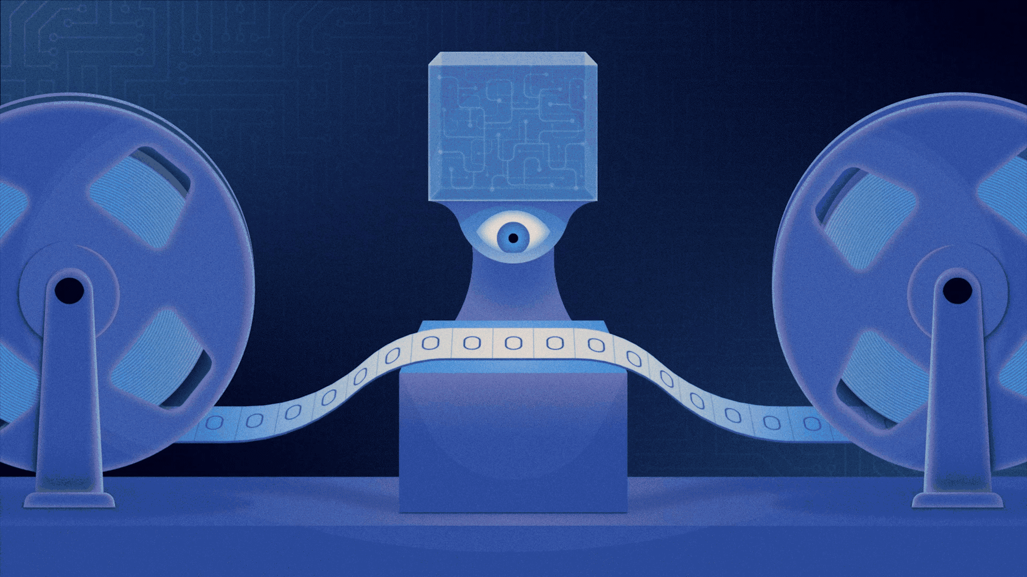
Busy Beaver Function (Radó 1962): Uncomputability Made Concrete!
Turing machine
(from Quanta)
BB(n) = the maximum finite number of steps made by any n-state Turing machine (before halting), on an initially blank input tape

Slide 8
BB grows faster than any computable function!
Proof 1: Suppose f(n)≥BB(n) was computable. Then we could solve the halting problem, by running an n-state TM for f(n) steps.
Proof 2: Let f(n) be computable by a program P(n). Then we can build a Turing machine with |P|+log(n)+O(1) states—so less than n, for large n—that computes f(n), then runs for (say) f(n)² steps, then halts. Hence BB(n)>f(n).

Slide 9
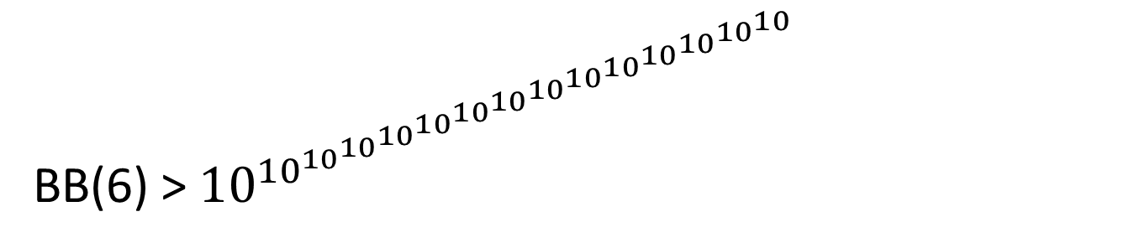
The Actual Values of BB(n)…
BB(1) = 1 (Trivial)
BB(2) = 6 (Lin 1963)
BB(3) = 21 (Lin 1963)
BB(4) = 107 (Brady 1983)
BB(5) = 47,176,870 (BBchallenge Team 2024)
BB(5) ≥ 47,176,870 (Marxen-Buntrock 1990)
BB(6) > ${10}^{{10}^{{10}^{{10}^{{10}^{{10}^{{10}^{{10}^{{10}^{{10}^{{10}^{{10}^{{10}^{{10}^{10}}}}}}}}}}}}}}$
(Kropitz 2022)

Slide 10
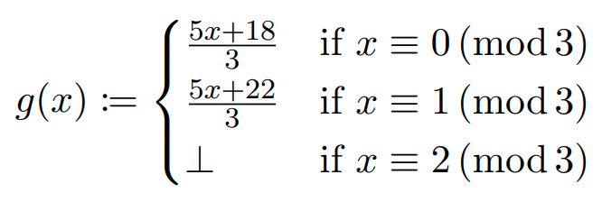
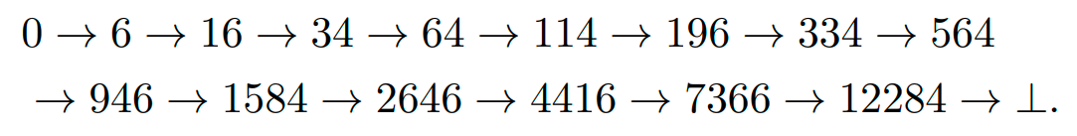
What does the 5-state champ do?
Let
Starting from 0, does iterating g ever reach ⊥? Yes:
The 5-state BB champion slowly verifies this fact
The 6-state champion does something similar, but with a g that involves exponentiation

Slide 11
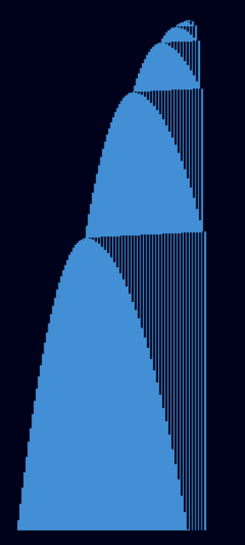

Slide 12
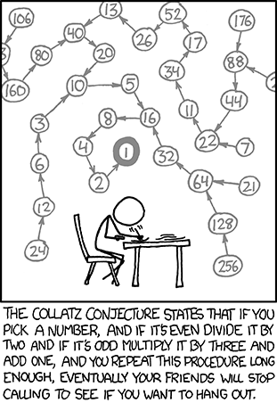
Collatz Conjecture:
“Most Elementary of All Open Math Problems?”

Slide 13
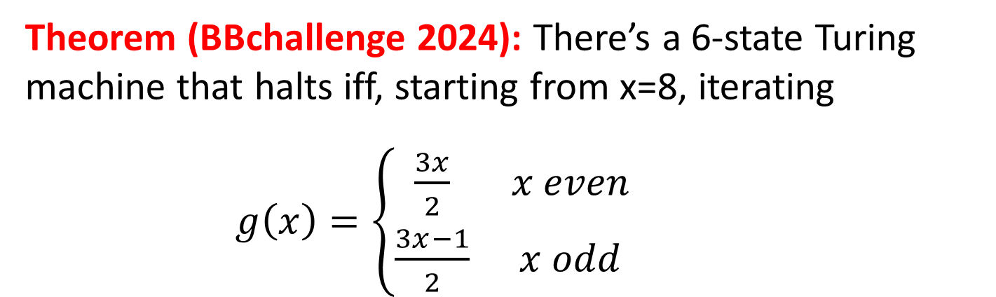
Will BB(6) ever be known?
Theorem (BBchallenge 2024): There’s a 6-state Turing machine that halts iff, starting from x=8, iterating
$g\left(x\right)=\left\{\begin{matrix}\frac{3x}{2} & x even \\ \frac{3x−1}{2} & x odd\end{matrix}\right.$
ever produces more than twice as many odd as even x’s
8 → 12 → 18 → 27 → 40 → 60 → 90 → 135 → 202 → 303 → 454 → 681 → 1021 → 1531 → 2296 → …
(so far 6 odd, 9 even)
My Prediction: If BB(6) is ever known, AI will be needed!

Slide 14
Ultimate Limit of BB Knowability?
Theorem: Any consistent formal system F can prove at most finitely values of BB(n).
Proof: Suppose you build an n-state machine M that lists all theorems of F, halting iff it finds a contradiction. Then if F proved that BB(n)=k, it could also prove its own consistency by running M for k steps and checking that M hadn’t yet halted. This would violate Gödel!
Could BB(8) already be independent of ZFC??
A.-Yedidia 2016: The value of BB(8000) is independent of the usual axioms of set theory (ZFC), assuming Con_{SRP}.
(Key idea: “Introspective encoding”)
O’Rear 2017, Riebel 2023: The value of BB(745) is independent of the ZFC axioms, assuming Con_{ZFC}.

Slide 15
Complexity Theory
Even when finite proofs exist, they could take longer than the age of the universe to write down.
Even when short proofs exist, they could take longer than the age of the universe to find.
If there actually were a machine with [running time] ~Kn (or even only with ~Kn²) [to find proofs of length n whenever they existed], this would have consequences of the greatest magnitude.
—Gödel to von Neumann, 1956

Slide 16
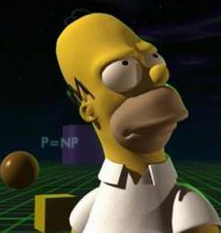
P versus NP
The greatest open math problem?
NP-complete
3SAT, packing…
NP
Graph isomorphism
Factoring
Discrete Logarithm
P
Linear equations, matching, …

Slide 17
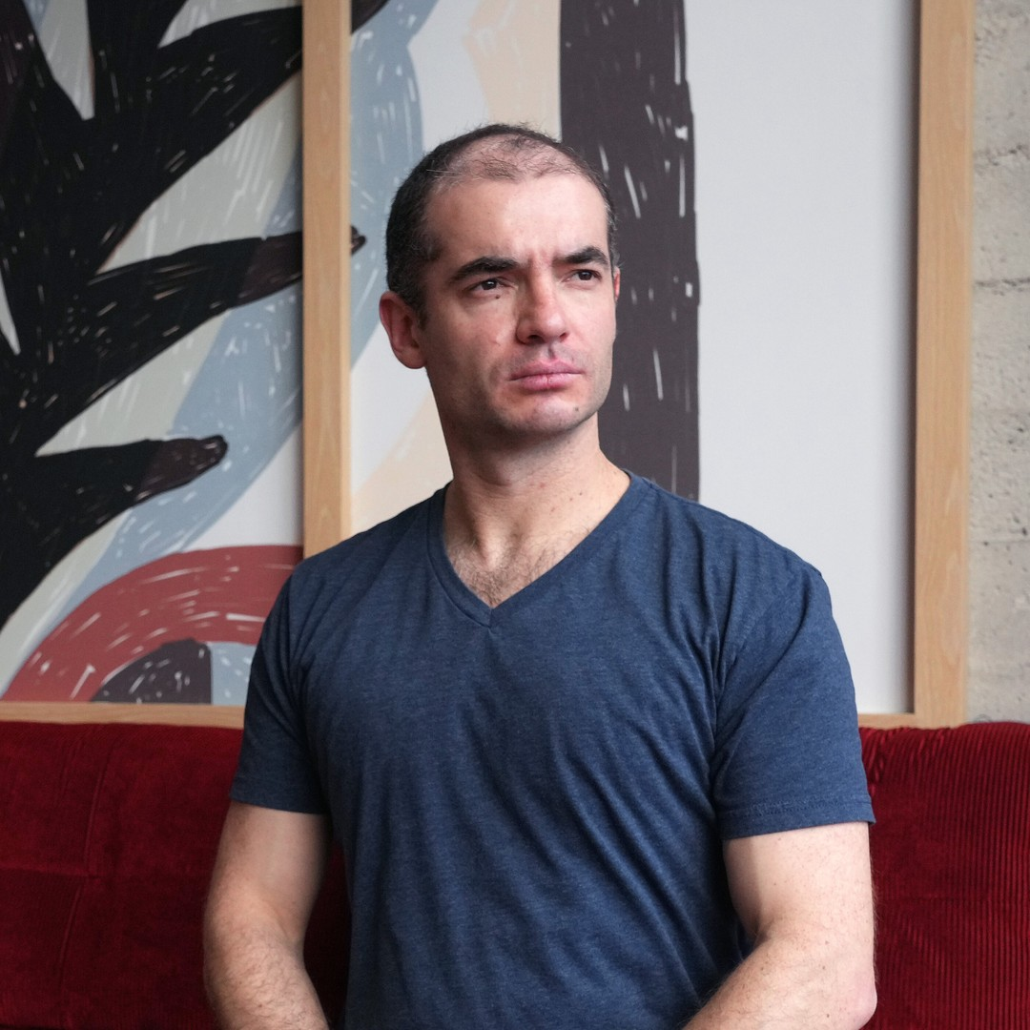
The Importance of P vs. NP
People in early 2000s: “If P=NP, we could find the neural net that optimally predicts all the text on the Internet, and thereby potentially unlock the secrets of human intelligence…”
Hold my beer

Slide 18
Quantum Computing!
n entangled qubits (e.g. electron spins)
⇒ Takes 2^{n} complex numbers to specify
⇒ Seems exponentially hard to simulate classically!
But not just magic exponential parallelism, because we only see a single sample on measurement!
Need to exploit interference. What’s that good for?

Slide 19

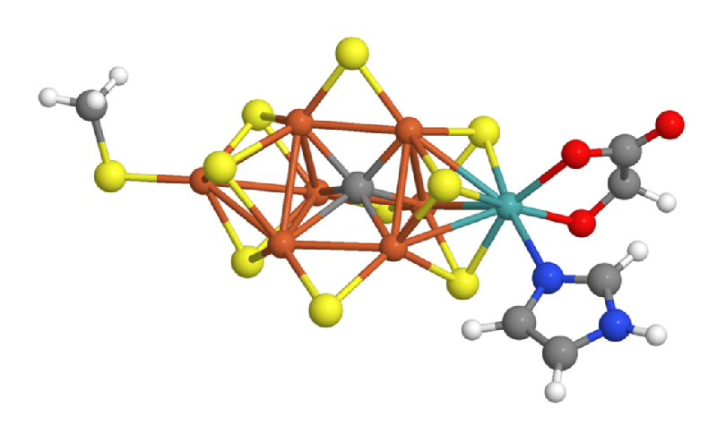
NP-complete
3SAT, packing…
Bounded-Error Quantum Polynomial
Time
Post-quantum crypto?
Graph isomorphism
NP
Factoring
Discrete Log
P
BQP
Linear equations, matching, …

Slide 20
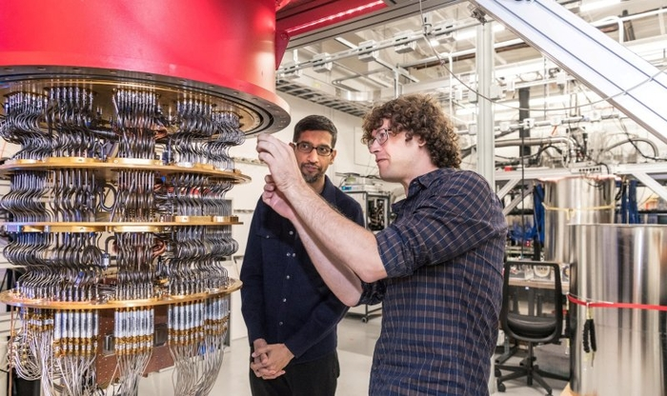
“Quantum Supremacy”: Where We Are Now
Google (Dec. 2024): Built a chip called Willow with 103 superconducting qubits, which has given us mathematical information that we don’t know how to get classically from the largest existing supercomputers in less than 10²⁵ years
What is that information? “The 103-bit strings x₁,…,x_{k} are statistically likely outputs of such-and-such quantum circuit”
(Hey, I didn’t say the information was useful! Or even checkable in less than 10²⁵ years…)

Slide 21
Beyond Quantum Computing?
Quantum Extended Church-Turing Thesis: All physical systems can be simulated efficiently (with polynomial overhead) on a quantum computer
But this is “merely” an empirical claim about the laws of physics. Were it false, even more mathematical truth could be knowable to us. So what’s its status?

Slide 22
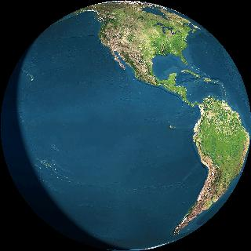
“Relativity Computing”
DONE

Slide 23
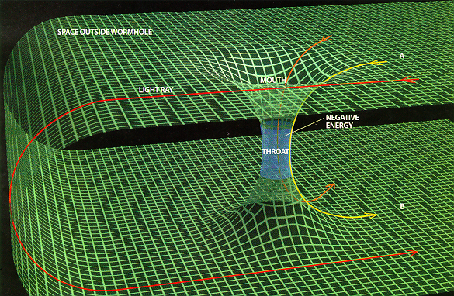
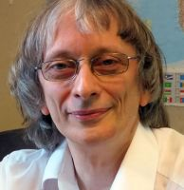
Closed Timelike Curves!
If these existed, wouldn’t they let us reuse the same time over and over?
Not quite, because we’ve ignored the need for causal consistency (e.g. the Grandfather Paradox)
Deutsch 1991: Quantum-mechanical solution to the Grandfather Paradox (fixed points)
But in finding a fixed point, Nature can again be forced to solve a hard problem!
A.-Watrous 2009: Specifically, a PSPACE-complete problem (A et al. 2024: Or the halting problem with unbounded CTCs!)

Slide 24
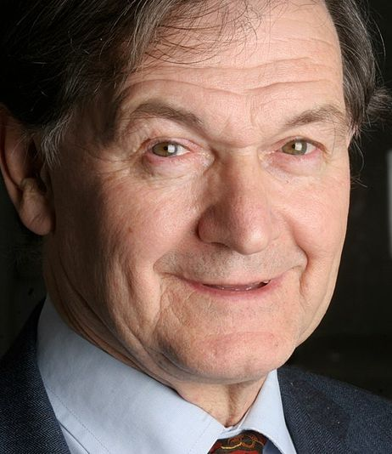
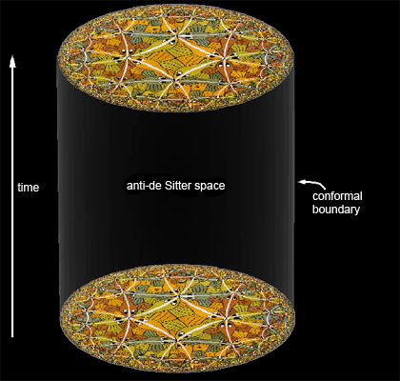
Quantum Gravity
Penrose believes the union of QM and gravity will lead to Turing-uncomputability (also that follows from a Gödelian argument, and underpins human consciousness)
Modern work in AdS/CFT hints at the opposite: that even quantum gravity in a “bulk” spacetime can be mapped to an ordinary, presumably-computable quantum field theory on its boundary
However, the “dictionary” between bulk and boundary seems to be intractable even for quantum computers!
(Bouland-Fefferman-Vazirani 2019)

Slide 25
Summary
In math, we are finite beings trying to apprehend the infinite
The Busy Beaver function actually quantifies that (!)
Even the finite can exceed the scope of the cosmos. That’s where we need physics and complexity theory
Quantum computers look like they’re already slightly expanding the scope of what mathematical statements we can know
Can we know even more than that? Depends what the ultimate laws of physics are

