Slide 1
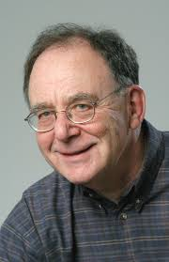
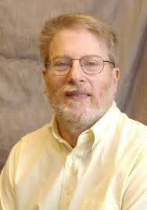
Quantum Versions of the Karp-Lipton Theorem
| ⟩ + | ⟩
Will I shatter my own record for most quantum complexity classes in one talk??
Scott Aaronson (University of Texas at Austin)
Simons Quantum Reunion Workshop
UC Berkeley
May 29, 2025

Slide 2
The Setting…
PSPACE/poly=BQPSPACE/qpoly
PSPACE
PP/poly
QMA/qpoly
PP=PostBQP
QMA/poly
QCMA/qpoly
QMA
QCMA/poly
BQP/qpoly
QCMA
BQP/poly
BQP
P/poly
BPP
P

Slide 3
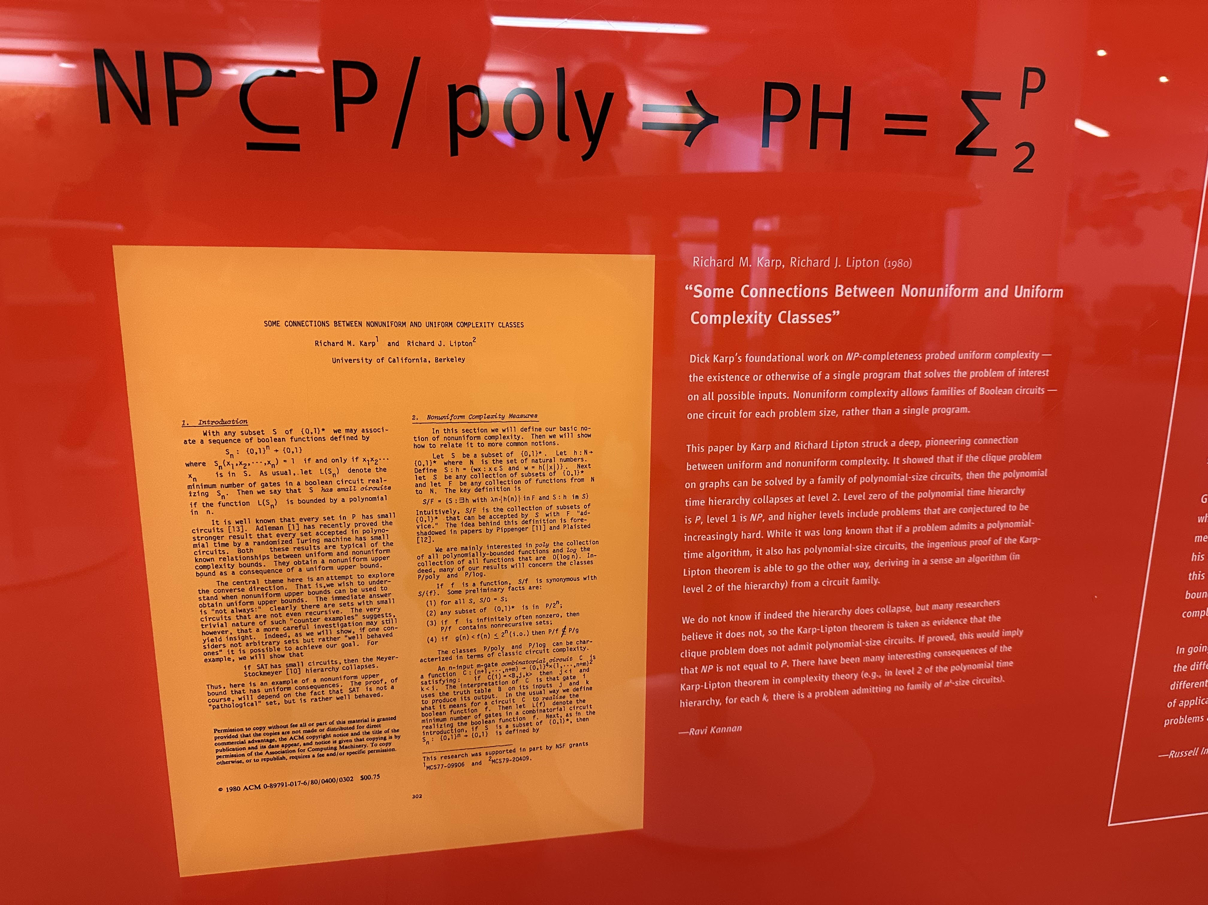
The Karp-Lipton Theorem (1982)

Slide 4
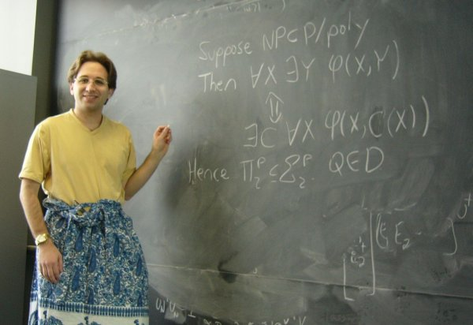
Proof of the Karp-Lipton Theorem!

Slide 5
KL’s Importance for Complexity Theory
Evidence that P/poly isn’t “ridiculously” strong
Connects the uniform and nonuniform worlds
Early example of PH as “yardstick of implausibility” “If pigs could fly then donkeys could whistle”
An ingredient in circuit lower bounds!
Example: The third level of PH is known not to have circuits of size n^{k} for any fixed k. But that means that the second level can’t either! For if it did, it would equal the third level, by Karp-Lipton

Slide 6
Quantum Version: What Goes Wrong?
Suppose NP ⊂ BQP/qpoly
Then in QMA, we can guess a quantum advice state |ψ_{n}⟩
The QMA machine can then pass |ψ_{n}⟩ to an oracle that … hey wait, you can’t pass a state to the oracle!

Slide 7
A. 2006: “Oracles Are Subtle But Not Malicious”
Best-known result (solving an old problem of Fortnow): There exists an oracle A relative to which PP has linear-sized circuits.
Vinodchandran (2005) had shown that PP has no circuits of size n^{k}, for any fixed k
My result implied that Vinodchandran’s evaded both the relativization and natural proofs barriers.
This set the stage for the algebrization barrier (A.-Wigderson 2008)

Slide 8
Another Theorem in A. 2006: EXP^{#P} ⊄ BQP/qpoly.
Proof: Guess the maximally mixed state I for the (amplified) advice to a BQP/qpoly machine M.
Then form the truth table of a Boolean function f:{0,1}^{n}→{0,1} by repeatedly choosing the output (0 or 1) that cuts M’s success probability by at least half, conditioned on success on all previous inputs.
The requisite computations can all be done in EXP^{#P}.
f can no longer be in BQP/qpoly, once the success probability drops below 2^{-poly(n)}
Similarly, P^{#P} has no quantum circuits of size n^{k} (even with n^{k}-sized quantum advice) for any fixed k

Slide 9
Even Better Quantum Circuit Lower Bound!
Theorem (A. 2006): QMA_{EXP} ⊄ BQP/qpoly.
Proof: Suppose QMA_{EXP} ⊂ BQP/qpoly. Then certainly P^{#P} ⊂ BQP/qpoly as well.
The #P-complete Permanent is self-checkable (LFKN).
So in QMA, we can guess quantum advice for P^{#P} and check it ourselves, giving QMA = P^{#P}.
So QMA_{EXP} = EXP^{#P} by padding.
But EXP^{#P} ⊄ BQP/qpoly by the last slide.
So QMA_{EXP} ⊄ BQP/qpoly as well.
Likewise: QCMA_{EXP} ⊄ BQP/poly.

Slide 10
My Idea To “Scale Down” That Quantum Circuit Lower Bound!
Quantum Karp-Lipton Theorem (A. 2006):
Suppose PP ⊂ BQP/poly. Then CH = QCMA.
(CH = Counting Hierarchy = PP ∪ PP^{PP} ∪ …)
Result We’ll Need (Fortnow-Rogers 1998): PP^{BQP} = PP
Proof: In QCMA, guess a small quantum circuit C for PP.
Turn C into a small circuit C’ for the #P-complete Permanent. Using self-correction, check that C’ works.
Then use C’ to simulate PP^{PP} in PP^{BQP} = PP, which C’ can again simulate in BQP, and so on for higher levels of CH.

Slide 11
Corollary (Quantum Vinodchandran’s Theorem): PP ⊄ BQSIZE(n^{k}) for every fixed k.
Proof: Suppose PP ⊂ BQSIZE(n^{k}) ⊆ BQP/poly. Then by the last slide, CH = QCMA.
So P^{#P} = PP as well.
But we showed before that P^{#P} ⊄ BQSIZE(n^{k}).
So PP ⊄ BQSIZE(n^{k}) as well.

Slide 12
Better Yet: PP ⊄ BQSIZE(n^{k})/qn^{k} for every fixed k.
Proof: Suppose PP ⊆ BQSIZE(n^{k})/qn^{k} ⊆ BQP/qpoly. Then by self-checking of the Permanent, P^{#P} = QMA.
But we showed before that P^{#P} ⊄ BQSIZE(n^{k})/qn^{k}.
So QMA and hence PP are not in BQSIZE(n^{k})/qn^{k} either.
“Look Ma, no Quantum Karp-Lipton!”

Slide 13
Even Better (Proved While Preparing This Talk Yesterday): PromiseQMA ⊄ BQSIZE(n^{k})/qn^{k} for every fixed k.
Proof: Similar to PromiseMA ⊄ SIZE(n^{k}) (Santhanam 2007).
If PP ⊂ BQP/qpoly, then P^{#P} = QMA. But we already showed P^{#P} is not in BQSIZE(n^{k})/qn^{k}, so neither is QMA.
If PP ⊄ BQP/qpoly, then there’s some superpolynomial function s (not necessarily time-constructible) such that
MAJSAT ∈ BQSIZE(s(n))/qs(n) \ BQSIZE(s(n)-1)/q(s(n)-1).
Define a promise problem Π=(Π_{Y},Π_{N}) by
Π_{Y} = { x1^{s(n)^1/(2k)} : x∈MAJSAT },
Π_{N} = { x1^{s(n)^1/(2k)} : x∉MAJSAT }.
Then Π ∉ BQSIZE(n^{k})/qn^{k}, by construction.
But Π ∈ PromiseQMA since we can guess the size-s(n) circuit for Π and then verify it in s(n)poly(n) time using the self-checkability of the Permanent.

Slide 14
Rumpelstiltskin Time!
“Theorem” (A. 2006): Suppose PP ⊂ BQP/qpoly. Then CH = QMA.
Proof: In QMA, guess small quantum advice |ψ⟩ for PP. Turn |ψ⟩ into small advice |ψ’⟩ for the #P-complete Permanent. Using self-correction (LFKN), check that |ψ’⟩ works. Then use |ψ’⟩ to simulate PP^{PP} in PP^{BQP} = PP, which using |ψ’⟩ we can again simulate in BQP, and so on for all higher levels of CH.
Corollary: PP ⊄ BQSIZE(n^{k})/qn^{k} for every fixed k.

Slide 15
Key Result Needed To Fix This
A.-Drucker 2010: BQP/qpoly ⊆ QMA/poly.
Improved BQP/qpoly ⊆ PostBQP/poly = PP/poly (A. 2004)
Indeed, BQP/qpoly = YQP*/poly.
Here, YP* is the class of languages decided by a polytime algorithm A with the help of a poly-size advice string w_{n}, which depends only on the input length n and can be verified by another polytime algorithm B.
“Trusted quantum advice is equivalent to trusted classical advice plus untrusted quantum advice”
YQP* is the same except w_{n} → |ψ_{n}⟩ and both algorithms are quantum
YP, YQP: Same except that algorithm to verify w_{n} or |ψ_{n}⟩ can also depend on x

Slide 16
BQP/qpoly = YQP*/poly Proof Sketch
“Majority-Certificates Lemma”: Let S be a set of Boolean functions f:{0,1}^{n}→{0,1}. Then any f*∈S can be represented as MAJ(f₁,…,f_{m}) for m=O(n), where f₁,…,f_{m}∈S, and each f_{i} can be uniquely specified within S by listing its values f_{i}(x₁),…,f_{i}(x_{k}) on k=O(log|S|) points.
We proved a version of this where S={f_{|ψ⟩}:|ψ⟩} is a set of Boolean functions computable with quantum advice.
Then the /poly can uniquely specify functions f₁,…,f_{m} such that MAJ(f₁,…,f_{m}) is the BQP/qpoly function that we want, while YQP* can supply verifiable quantum advice states |ψ₁⟩,…,|ψ_{m}⟩ with which f₁,…,f_{m} can be computed.

Slide 17
Our 2010 Application!
A.-Drucker 2010 (Quantum Karp-Lipton v2): Suppose NP ⊂ BQP/qpoly. Then coNP^{NP} ⊆ QMA^{PromiseQMA}.
Proof Sketch: By hypothesis + BQP/qpoly = YQP*/poly,
NP ⊂ YQP*/poly.
We need to decide a coNP^{NP} predicate, of the form
∀x ∃y ϕ(x,y).
In QMA^{PromiseQMA}, we guess a /poly advice string w, along with quantum advice |ψ⟩ that passes the YQP* check given w, such that for all x and all |ψ’⟩ that (again) passes the YQP* check given w,
ϕ(x,C(x,a,|ψ’⟩)) holds (where C finds NP witnesses)
Key Point: We never needed to pass |ψ⟩ to the PromiseQMA oracle—we just re-guessed it given w!

Slide 18
Justin Yirka’s Use of BQP/qpoly = YQP*/poly to Fix My 2006 Quantum Karp-Lipton Proof
Yirka 2024: Suppose PP ⊆ BQP/qpoly. Then CH = PP = YQP*.
Proof Sketch: By the hypothesis, PP ⊂ YQP*/poly.
So, having guessed the /poly advice w—which we can do in the lowest level of CH—we can then pass w up the counting hierarchy to replace each PP by YQP*.
But we need one more fact to collapse the hierarchy: that PP^{YQP*} = PP.
To prove this, Justin shows that YQP* ⊆ APP, where APP is a subclass of PP for which PP^{APP} = PP is known (Li 1993).

Slide 19
Another New Result from Yesterday!
Theorem: If PromiseQCMA ⊂ BQP/poly, then QCMA^{QCMA…} ⊆ ZPP^{PromiseQCMA}.
Proof Sketch: Follows the argument by Bshouty et al. that NP ⊂ P/poly implies PH = ZPP^{NP}.
In the first stage, our ZPP^{PromiseQCMA} machine learns a small quantum circuit C for PromiseQCMA, using boosting, plus random hash functions to sample inputs, plus the equivalence between search and decision for QCMA (to verify whether a circuit’s output is valid).
In the second stage, we use C to recursively unravel QCMA^{QCMA…}. By passing C upward in oracle calls, we can replace each QCMA by BQP, then QCMA^{BQP} = QCMA, etc.

Slide 20
Summary
Most of the story of the Karp-Lipton Theorem, and the associated circuit lower bounds, can be ported to Quantumland successfully
One repeated difficulty is that quantum states can’t be passed to classical oracles. But the BQP/qpoly = YQP*/poly theorem helps with this
A separate difficulty is in using a uniform quantum containment to unravel a hierarchy (P=NP implies that PH collapses, but NP⊆BQP might not). But it helps that PP^{BQP} = PP^{YQP*} = PP and that QCMA^{BQP} = QCMA

Slide 21
Open Problems
Connections to the Quantum Polynomial Hierarchy (Gharibian et al. 2018)?
They showed: PSPACE ⊂ BQP/qpoly ⇒ QCΠ₂ = QCΣ₂
Also known: QCMA ⊂ BQP/poly collapses QCPH
NP ⊂ BQP/qpoly ⇒ any hierarchies collapse?
PromiseQMA ⊂ BQP/qpoly ⇒ QMA^{QMA…} collapses? Difficulty: Lack of search/decision equivalence for QMA
What if BQP/qpoly can prepare QMA witness states?
YP* = YP? YQP* = YQP?
MA_{EXP} ⊄ BQP/qpoly? PromiseMA ⊄ BQSIZE(n^{k})/qn^{k}?

Slide 22
General Open Problems About Quantum Advice
Classical oracle A such that BQP^{A}/poly ≠ BQP^{A}/qpoly?
Closely related to QMA vs. QCMA. A.-Kuperberg 2006 gave quantum oracle separations, but the classical oracle case has resisted recent attacks
Candidate problem in BQP/qpoly \ BQP/poly?
Group Membership Problem: Still a candidate, even after the recent breakthrough by Le Gall, Nishimura, and Thakkar, putting Group Order in QCMA (!)
QMA(2)/qpoly, QSZK/qpoly = ALL?

