Slide 1


How Much Information Is In A Quantum State?
|ψ⟩
Scott Aaronson (UT Austin / OpenAI)
Harvard CS Colloquium, March 9, 2023

Slide 2
In quantum mechanics, a state of n entangled particles requires at least 2^{n} complex numbers to specify
To a computer scientist, this is probably the central fact about quantum mechanics
Where does the fact rear its head?

Slide 3
Interlude: Mixed States
2^{n}×2^{n} Hermitian positive semidefinite matrix with Tr(ρ)=1
The most general kind of state in QM: encodes (everything measurable about) a probability distribution over n-qubit states |ψ₁⟩, |ψ₂⟩, …, where |ψ_{i}⟩ occurs with probability p_{i}
Maximally mixed state: I/2^{n}. A.k.a. uniform distribution over {0,1}^{n}. Unique state of maximal ignorance.
In this talk, I’ll use pure states whenever possible, but everything generalizes to mixed states!

Slide 4
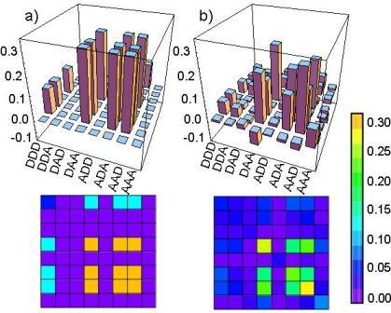
Quantum State Tomography
Task: Given lots of copies of an unknown quantum state, produce an approximate classical description of it
Central problem: To do tomography on an entangled state of n particles, you need ~c^{n} measurements
8 particles → ~656,000 experiments!

Slide 5
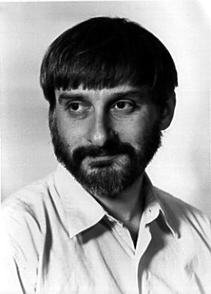

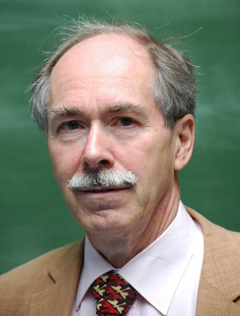
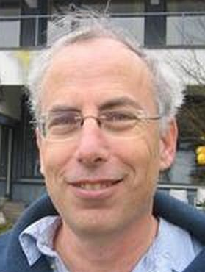
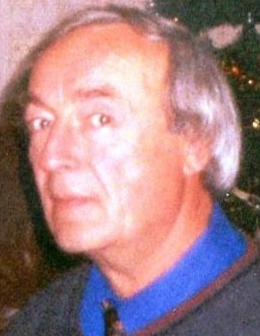
Quantum Computing Skepticism
Levin
Goldreich
‘t Hooft
Kalai
Dyakonov
Some physicists and computer scientists still believe scalable quantum computers are fundamentally impossible
For many of them, the problem is that a quantum computer “manipulates an exponential amount of information using only polynomial resources”
Is it really an exponential amount?

Slide 6
In asking “how many qubits,” we have to be ridiculously careful in how we phrase the question operationally
Analogy: A probability distribution over n-bit strings also takes ~2^{n} bits to specify. But that fact seems “just in our heads”!
Holevo’s Theorem (1973): By sending an n-qubit quantum state, Alice can transmit no more than n classical bits to Bob (or 2n with preshared entanglement)
Much of my work over the past 20 years has further shown how, for many purposes, there’s “less information in n qubits than meets the eye” [A. 2004], [A. 2006], [A.-Drucker 2010], [A. 2018], [A.-Chen-Hazan-Kale-Nayak 2018], [A.-Rothblum 2019]. Deep reason: the linearity of QM

Slide 7


The Absent-Minded Advisor Problem
|ψ⟩
Can you hand all your grad students the same n-qubit (or n²-qubit, etc.) quantum state |ψ⟩, so that by measuring their copy of |ψ⟩ in a suitable basis, each student can learn the yes-or-no answer to their n-bit question with high probability?
NO [Ambainis, Nayak, Ta-Shma, Vazirani 1999]
Indeed, quantum communication is no better than classical for this task as n→∞

Slide 8
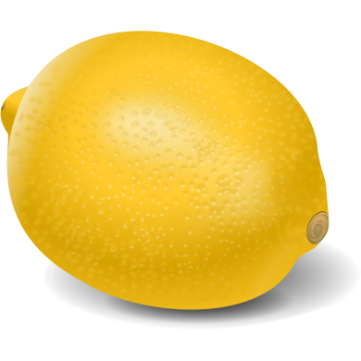

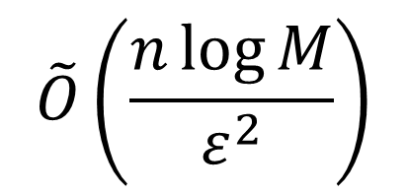
Turning the lemon into lemonade…
Suppose Alice wants to describe an n-qubit state |ψ⟩ to Bob, well enough for Bob to estimate Pr[C_{i} accepts |ψ⟩] to within ±ε, for any of M circuits C₁,…,C_{M} known to both players
Postselected Learning Theorem (A. 2004): In that case, it suffices for Alice to send Bob only
classical bits (trivial bounds: ~2^{n}, ~M)

Slide 9
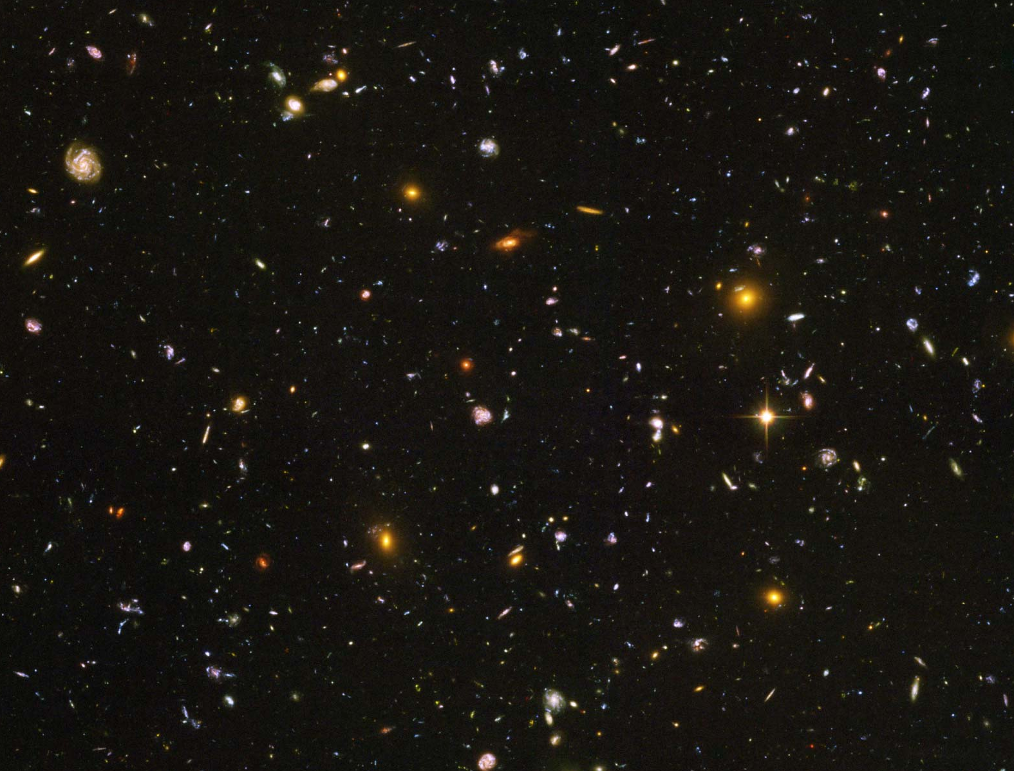
|ψ⟩
ALL BINARYMEASUREMENTS PERFORMABLE USING ≤n² QUANTUM GATES
ALL BINARY MEASUREMENTS

Slide 10


How does the theorem work?
ρ₁
ρ₂
ρ₃
I
Alice is trying to describe the n-qubit state |ψ⟩ to Bob
In the beginning, Bob knows nothing about |ψ⟩, so he guesses it’s the maximally mixed state ρ₀=I
Then Alice helps Bob improve, by repeatedly telling him a circuit C_{t}∈S on which his current guess ρ_{t-1} badly fails
Bob lets ρ_{t} be the state obtained by starting from ρ_{t-1}, then applying C_{t} and postselecting on getting the right outcome

Slide 11
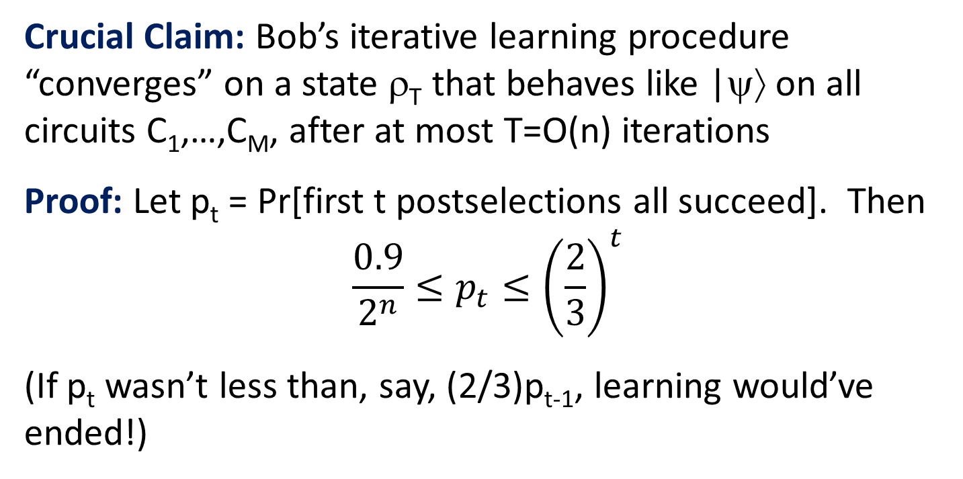
Solving, we find that t = O(n)—or O(n log n) accounting for amplification to push down error probability
So it’s enough for Alice to tell Bob about T=O(n log n) circuits C_{i(1)},…,C_{i(T)}, using log(M) bits per circuit

Slide 12
In terms of complexity classes…
BQP/qpoly ⊆ PostBQP/poly
BQP = Bounded-Error Quantum Polynomial-Time
/qpoly = with polynomial-sized “quantum advice” |ψ_{n}⟩
PostBQP = BQP where we allow postselected measurements
/poly = with polynomial-sized classical advice
[A.-Drucker 2010] strengthened this to
BQP/qpoly ⊆ QMA/poly
QMA = Quantum Merlin Arthur (quantum version of NP)
“Trusted quantum advice can always be replaced by trusted classical advice combined with untrusted quantum advice”

Slide 13
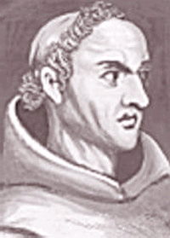

Quantum Occam’s Razor Theorem (A. 2006)
Let |ψ⟩ be an unknown entangled state of n particles
Suppose you just want to be able to estimate the acceptance probabilities of most measurements E drawn from some probability distribution μ
Then it suffices to do the following, for some m=O(n):
Choose m measurements independently from μ
Go into your lab and estimate acceptance probabilities of all of them on |ψ⟩
Find any “hypothesis state” approximately consistent with all measurement outcomes
“Quantum states are PAC-learnable”
Experimentally demonstrated in optics (Rocchetto et al. 2019)

Slide 14
Online Learning of Quantum States
A.-Chen-Hazan-Kale-Nayak 2018
Let |ψ⟩ be an unknown n-qubit mixed state
Repeatedly, someone hands you a circuit C and challenges you to estimate Pr[C accepts |ψ⟩] to within ±ε
If you fail, they give you an estimate themselves.
Theorem: There’s a strategy where you can fail at most ~n/ε² times. Yes, even if the measurements are adaptively chosen to trip you up!

Slide 15
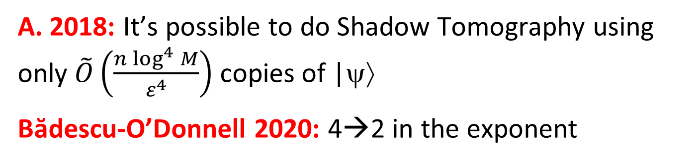
Shadow Tomography (A. 2018)
Suppose you’re given an n-qubit state |ψ⟩, along with a list of circuits C₁,…,C_{M}. You want to estimate
Pr[C_{i} accepts |ψ⟩] to within ±ε for every i∈[M], with high success probability
How many physical copies of |ψ⟩ do you need for this?
Clearly Õ(2^{n}) copies suffice, and also Õ(M) copies. But what if 2^{n} and M are both exponentially large?
A. 2018: It’s possible to do Shadow Tomography using only $\tilde{O}\left(\frac{n\log^{4}{M}}{ε^{4}}\right)$ copies of |ψ⟩
Bădescu-O’Donnell 2020: 4→2 in the exponent

Slide 16
Key Idea: “Gentle Measurement”
Winter 1999, A. 2004
Suppose you measure a quantum state |ψ⟩ in such a way that, given knowledge of |ψ⟩, the measurement outcome could be predicted with near-certainty
Then the measurement needs to damage |ψ⟩ only by a little!
A.-Rothblum 2019 closely related gentle measurement to differential privacy, a subfield of classical CS
We then used that connection to give an improved Shadow Tomography protocol!

Slide 17
Classical Shadows
Huang-Kueng-Preskill 2020
An influential variant of Shadow Tomography that’s more specialized (good for estimating fidelities, entanglement entropies, two-point correlation functions, expectation values of local observables…), but also much more amenable to experimental implementation, because it doesn’t rely on gentle measurements

Slide 18
Having spent the whole talk telling you why there’s “less information in an n-qubit quantum state than meets the eye,” let me now turn around and tell you why there’s exp(n) classical information there after all!

Slide 19
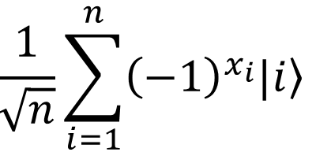
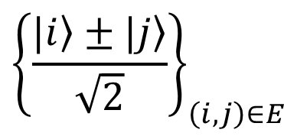
The Hidden Matching Problem
Bar-Yossef-Jayram-Kerenidis 2004
Alice holds an n-bit string x
(say, male/female for each of n people)
Bob holds a matching E on {1,…,n}
(say, who’s dating whom)
Goal: Alice should send Bob a short message that lets him tell whether any one couple of his choice is same- or opposite-sex
Classically, a ~√n-bit message is necessary and sufficient (why?)
Quantumly, O(log n) qubits suffice!
Measurement basis:
$${\left\{\frac{|\left.i\right\rangle ±|\left.j\right\rangle }{\sqrt{2}}\right\}}_{\left(i,j\right)∈E}$$

Slide 20
New Implication
A.-Buhrman-Kretschmer 2023, arXiv:2302.10332 last month!
FBQP/qpoly ≠ FBQP/rpoly
FBQP = Many-output problems in quantum polynomial time
For these problems, quantum advice is unconditionally stronger than classical! Striking contrast with decision problems, where BQP/qpoly ⊆ PostBQP/poly
Key Idea: Use the Bar-Yossef-Jayram-Kerenidis problem, but where Alice now has a string of 2^{n} bits, and Bob has one of 2^{n} efficiently describable matchings (it still works there)
Theorem: Classical advice (even randomized) needs at least ~2^{n/2} bits, whereas n qubits suffice for quantum advice

Slide 21
Potential Application: “Quantum Information Supremacy”
A new type of quantum supremacy experiment, which wouldn’t depend on any unproved complexity assumptions
Goal: Experimentally check that, if Nature is “secretly maintaining a classical description” for an n-qubit entangled state |ψ⟩, even a probabilistic one, that description must contain >>n classical bits to account for the outcomes of all possible measurements on |ψ⟩
E.g., if n=20, check that >100 classical bits are needed
How? By using the FBQP/qpoly Hidden Matching algorithm from the last slide!

Slide 22
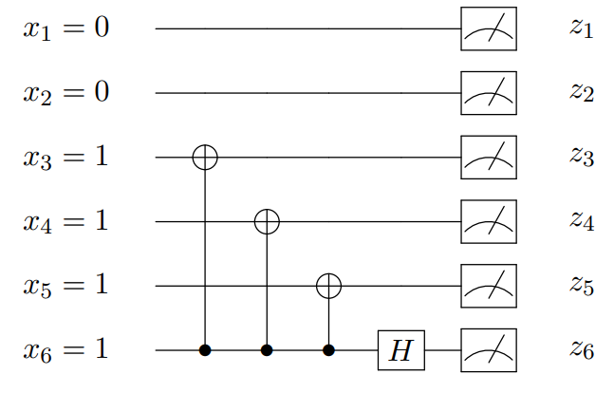
Experimental Considerations
Would first need to apply a random circuit C to |0^{n}⟩, to prepare a “quasi” Haar-random state C|0^{n}⟩
Would then need to measure C|0^{n}⟩ in a basis chosen “on the fly.” If we used the Hidden Matching separation, measurement circuit could look like this:
Want: ~20 qubits, all-to-all connectivity, universal control, extremely high fidelity. Good match for trapped ions?
To Do: Make measurement circuit even simpler! Find a problem where the classical lower bound is ~2^{n} rather than ~2^{n/2} ! Do an analysis that accounts for noise in the circuit!

Slide 23
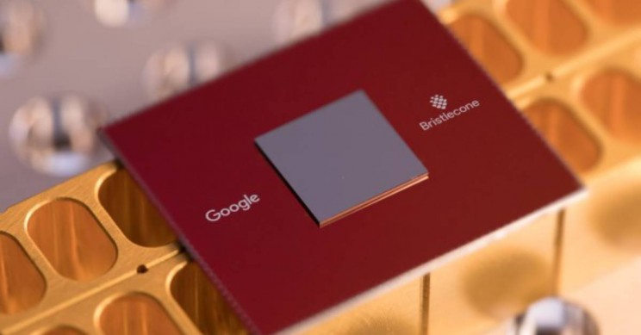
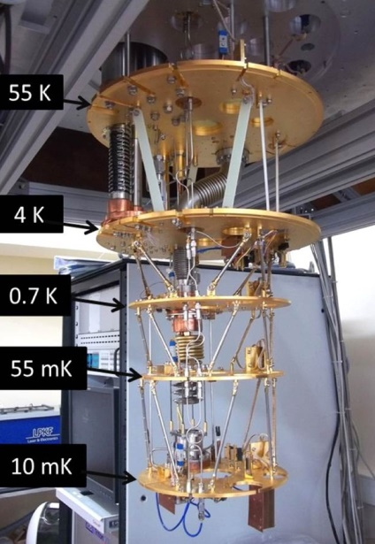

What’s the Point?
Over the past 4 years, Google, USTC, and Xanadu have famously claimed “quantum computational supremacy” on contrived sampling tasks (e.g. BosonSampling and Random Circuit Sampling), using small noisy QCs
But such “supremacy” depends on unproved assumptions about the tasks being hard for classical computers—and some of those assumptions have turned out to be false!
The new proposal depends on no unproved assumptions

Slide 24
So then, how many classical bits are in an n-qubit quantum state?
n because of Holevo’s Theorem?
2n because of superdense coding and teleportation?
~2^{n/2} because of one-way communication complexity?
~2^{n} because that’s how many parameters there are?
∞ because amplitudes form a continuum?
I’m now optimistic that, in the near future, we could get direct experimental evidence for these two answers

