Slide 1

The Future of Quantum Supremacy Experiments
Scott Aaronson (UT Austin / OpenAI)
Arizona State University, Tempe, AZ, February 8, 2024

Slide 2
Quantum Computing
n entangled particles
⇒ 2^{n} complex numbers to specify
Not just magic exponential parallelism—we only see a single sample on measurement!

Slide 3
What Will QCs Be Good For?
→ Simulating quantum physics and chemistry
→ Breaking current public-key encryption
→ We’ll have to get lucky for other applications
You’ve been systemically lied to about this
→ But no matter! The #1 application: disproving all the people who say it can never work!

Slide 4
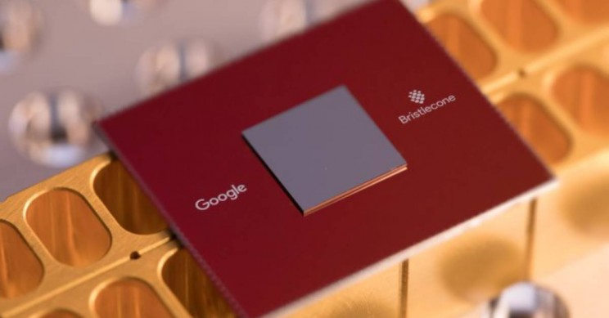

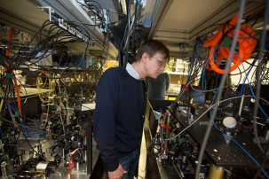
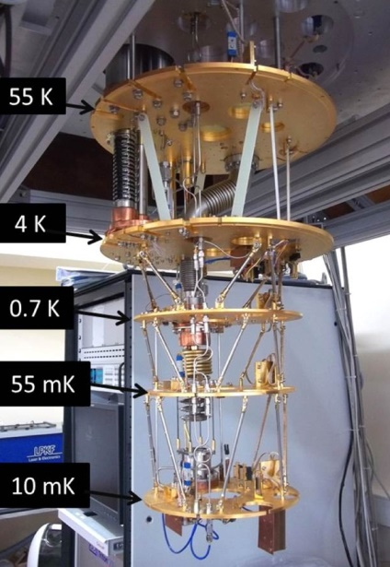
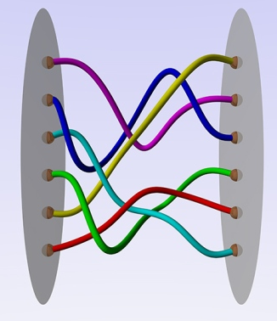

How to Build a QC…
Trapped Ions
(IonQ, Honeywell…)
Cold Atoms
(Harvard/
QuEra…)
Superconducting Qubits
(Google, IBM, Yale…)
Photonics
(PsiQuantum…)
Nonabelian Anyons (Microsoft…)

Slide 5
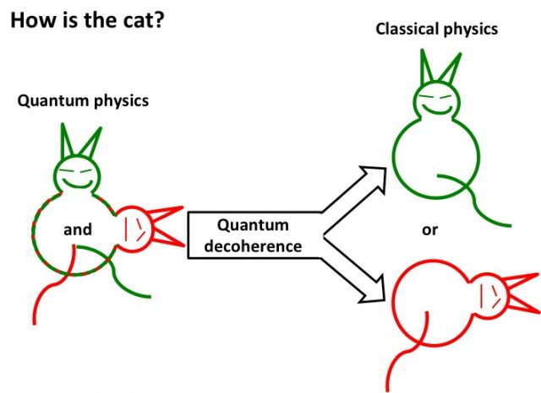
Why Is Building a QC So Damn Hard?
Decoherence: Unwanted interaction between the QC and its environment, prematurely “measuring” the QC
The more operations and qubits, the worse things get
In most QC researchers’ view, quantum fault-tolerance (discovered in the mid-1990s) provides the ultimate theoretical solution to decoherence
But fault-tolerance itself will require very precise physical control over the qubits—of a sort experimentalists seem unlikely to achieve for years (though they’ve made great strides)

Slide 6

What Is Quantum Computational Supremacy?
Preskill 2012
The use of a quantum computer to solve some well-defined problem much faster than any available classical computer running any known algorithm
Problem doesn’t need to be useful, but does need a hardware-independent definition (no “simulate yourself”)
Need: an actual observed speedup, and a theoretical asymptotic speedup, and a causal connection between the two

Slide 7
The Random Circuit Proposal
Challenge the QC by sending it a randomly generated quantum circuit C on n qubits
Ask the QC to send back (quickly!) samples s₁,…,s_{k} from D_{C}, the distribution over n-bit strings obtained by applying C to 0…0
Then, using classical brute force, check if
Google’s “Linear Cross-Entropy Benchmark”
for some constant b∈(1,2)

Slide 8
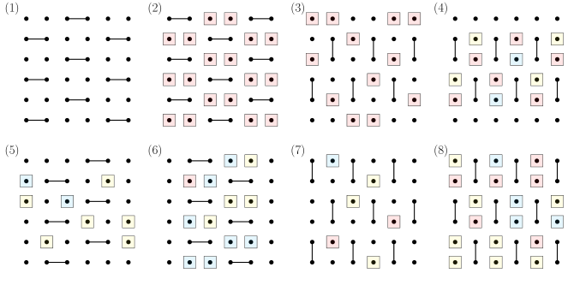
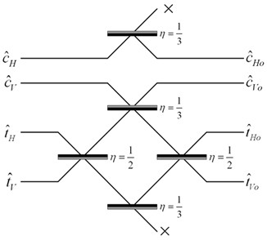
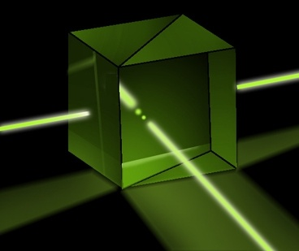
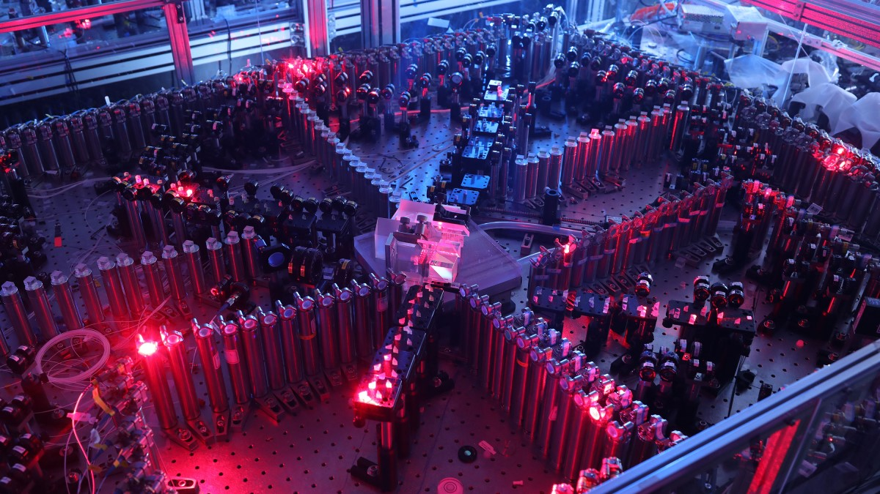
Quantum Supremacy Experiments Now
Random Circuit Sampling
(53-qubit experiment by Google team 2019; another by USTC team 2020)
BosonSampling
(A.-Arkhipov 2011, ~100-photon experiments by USTC team 2020, Xanadu 2022)

Slide 9
What’s Wrong With the Current Supremacy Experiments?
Lack of error-correction prevents scaling: Obvious.
Spoofing attacks:
Pan-Chen-Zhang 2021: Tensor network contraction
Gao-Kalinowski-Chou-Lukin-Barak-Choi 2021: Gets 1/exp(depth) advantage on Linear Cross Entropy Benchmark (XEB)
Most fundamental (in my view): Exponential time needed for classical verification!! (E.g. via Linear XEB)

Slide 10
Field Guide to Big Quantum Speedups
QAOA
NISQy
Efficiently
Verifiable
Quantum machine learning
?
Shor
Mahadev
BosonSampling
Yamakawa-Zhandry
Random Circuit Sampling
Physics simulations
In-Principle Quantum Advantage

Slide 11
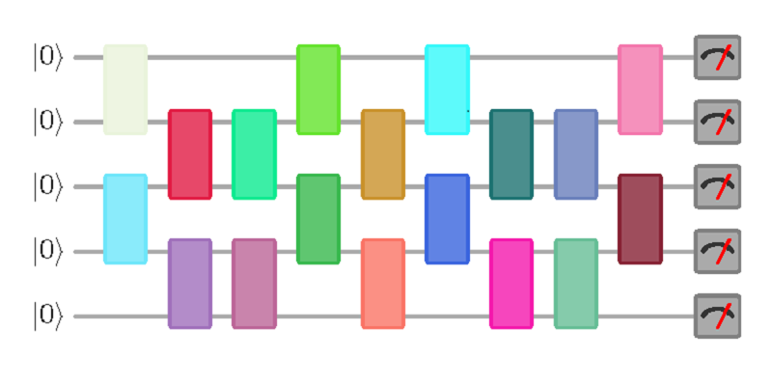
New Open Question
Call a quantum circuit C “peaked” if |⟨x|C|0^{n}⟩|²≥0.1 for some basis state |x⟩.
(More generally: if C|0^{n}⟩ has any nonrandom features easy to notice on measurement)
What does a uniformly random peaked circuit with (say) n qubits and m=n² gates look like? Just a bunch of gates and then their inverses? Pseudorandom?
|0⟩
|0⟩
vs.
U
U⁻¹
|0⟩
(obfuscated)

Slide 12
More Questions
Given an n-qubit, m-gate random quantum circuit, how many more gates must we add to get a peaked circuit?
Even an upper bound of e.g., m/2 would be exceedingly interesting for quantum advantage experiments!
What fraction of quantum circuits are peaked?
How hard is it to sample a random peaked circuit? What about a peaked circuit that’s hard to distinguish from random?

Slide 13
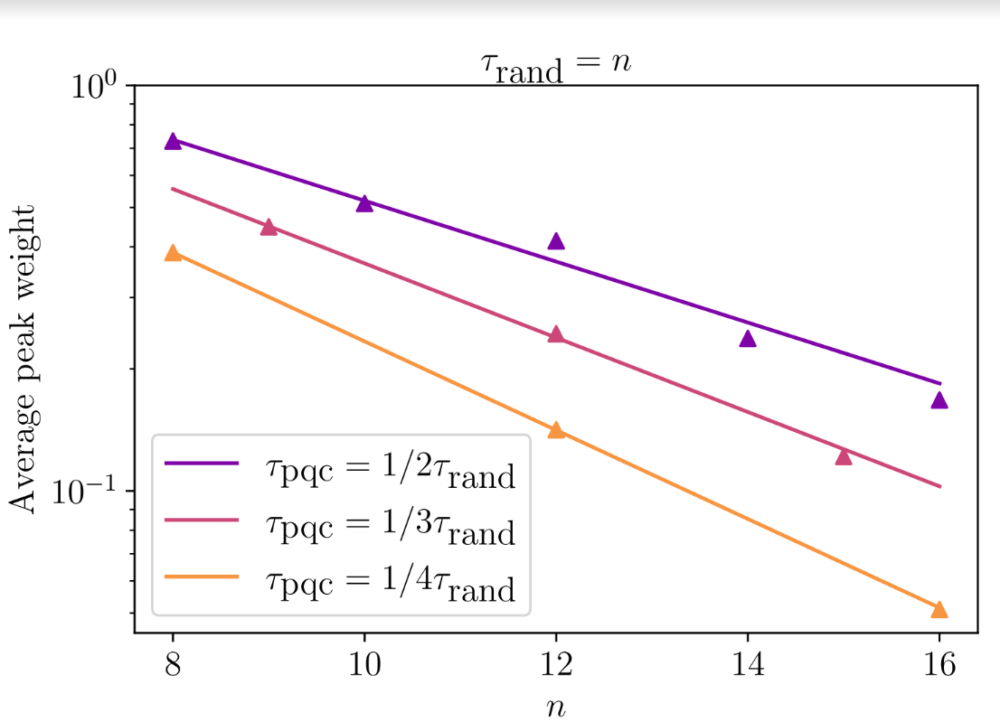
Preliminary Data on Peakedness
(SA and Yuxuan Zhang)

Slide 14

Hardness of Simplification
Clément, Heurtel, Mansfield, Perdrix, Valiron, June 2022: Complete equational theory for quantum circuits
Solved a longstanding problem! (Previously: ZX-calculus)
Another question relevant to quantum advantage:
Are there polynomial-size quantum circuits that implement the identity (i.e. do nothing), but that take exponentially many “rewrite moves” to simplify to the identity?

Slide 15
“Quantum Information Supremacy”
A new type of quantum supremacy experiment I’ve been working on (with Quantinuum in Colorado), which wouldn’t depend on any unproved complexity assumptions
Goal: Experimentally check that, if Nature is “secretly maintaining a classical description” for an n-qubit entangled state |ψ⟩, even a probabilistic one, that description must contain >>n classical bits to account for the outcomes of all possible measurements on |ψ⟩
E.g., if n=20, check that >100 classical bits are needed
How? By using separations between quantum and classical one-way communication complexity

Slide 16


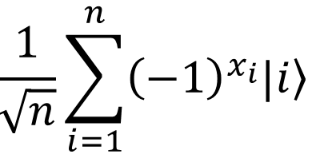
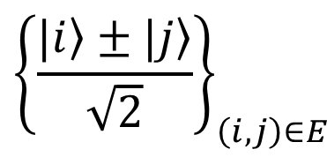
The Hidden Matching Problem
Bar-Yossef-Jayram-Kerenidis 2004
Alice holds an n-bit string x
(say, male/female for each of n people)
Bob holds a matching E on {1,…,n}
(say, who’s dating whom)
Goal: Alice should send Bob a short message that lets him tell whether any one couple of his choice is same- or opposite-sex
Classically, a ~√n-bit message is necessary and sufficient (why?)
Quantumly, O(log n) qubits suffice!
Measurement basis:
$${\left\{\frac{|\left.i\right\rangle ±|\left.j\right\rangle }{\sqrt{2}}\right\}}_{\left(i,j\right)∈E}$$

Slide 17
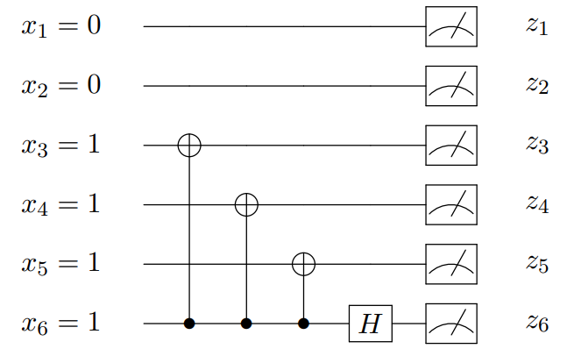
Experimental Considerations
Will first need to apply a random circuit C to |0^{n}⟩, to prepare a “quasi” random quantum state C|0^{n}⟩
Will then need to measure C|0^{n}⟩ in a basis chosen “on the fly.” If we used the Hidden Matching separation, measurement circuit could look like this:
Want: ~20 qubits, all-to-all connectivity, universal control, extremely high fidelity. Good match for trapped ions?
To Do: Make measurement circuit even simpler! Find a problem where the classical lower bound is ~2^{n} rather than ~2^{n/2} ! Do an analysis that accounts for noise in the circuit!

Slide 18
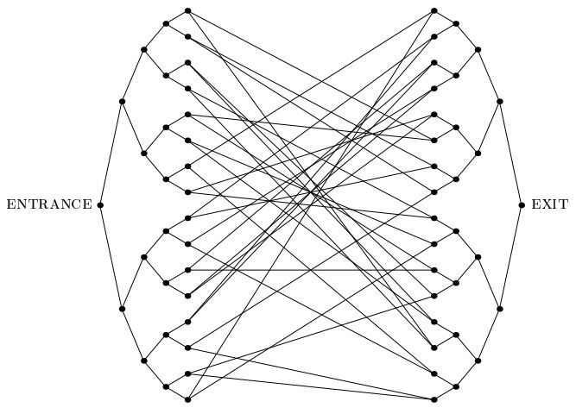
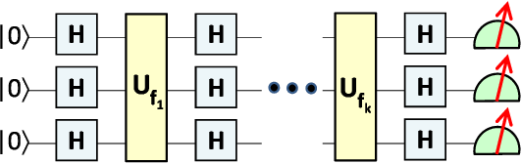
Summary
Exponential quantum speedups that are easily verifiable classically tend to be “weird” and “finely tuned”
If we want to demonstrate a totally unambiguous speedup, on a near-term device without error-correction, we’ll need to make it as “generic” as possible
There’s always quantum simulation…!

