Slide 2
QUANTUM COMPUTING
AND THE LIMITS OF THE EFFICIENTLY COMPUTABLE
SCOTT AARONSON
Massachusetts Institute of Technology

Slide 3
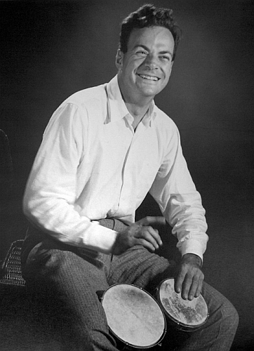
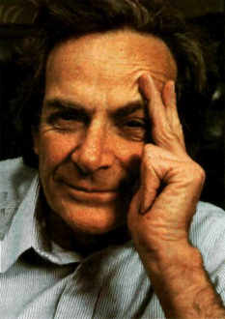
PHYSICS IN THE 21ST CENTURY:
TOILING IN FEYNMAN’S SHADOW
Will any of us ever discover anything that wouldn’t have been dopily obvious to this man?
Maybe we all should just give up and play bongo drums instead.
Oh, wait…

Slide 4
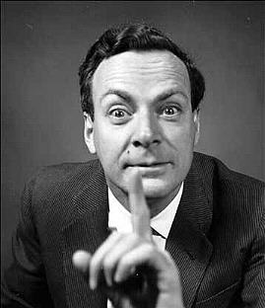
ONE RAY OF HOPE:
FEYNMAN NEVER REALLY APPRECIATED PURE MATH
“Mathematics is to physics as masturbation is to sex.”
At Princeton, Feynman challenged the math grad students to give him any math problem, and he
would instantly answer it… without proof
Obvious: ~n³ Best Known: ~n^{2.376} Lower Bound: ~n²
–Richard Feynman [allegedly]
Open Problem: Where does that leave theoretical computer science?
What I Would’ve Asked Him:
What’s the fastest algorithm to multiply two nxn matrices?

Slide 5
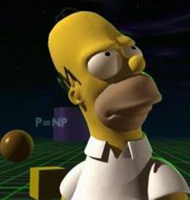



COMPUTER SCIENCE’S $1,000,000 QUESTION: DOES P=NP?
“If there’s a fast computer program to RECOGNIZE
a solution to a problem, then is there also a fast computer program to FIND a solution?”
–One of seven Clay Millennium Problems
Note that if P=NP, you could solve not only this question, but also the other six!

Slide 6
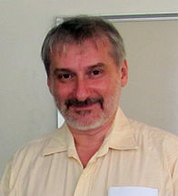
ACCORDING TO LEONID LEVIN:
Feynman had trouble accepting that
P vs. NP was an open problem at all!
I often point out that, if theoretical computer scientists had been physicists, we would’ve long ago declared P≠NP a “law of nature” and been done with it.
There have been countless mistaken claims over the years to
have proved P≠NP. (The most recent, by Vinay Deolalikar, led to
my controversially taking a $200,000 bet against it at infinite odds.)
Even though it would “merely” confirm what we already believe,
I think a correct proof of P≠NP would be one of the biggest advances
in human understanding that hasn’t happened yet.

Slide 7
WHY DO WE NEED TO PROVE EVEN “OBVIOUS” LIMITATIONS OF COMPUTERS?
Nothing illustrates the need better than…
QUANTUM COMPUTING
Example: It’s “obvious” that factoring
integers is much harder than multiplying
them… except that Peter Shor discovered that for a quantum computer, it isn’t!
The Power of 2^{n} Complex Numbers Working for YOU
Feynman didn’t live to see such discoveries, but he famously anticipated them
He also understood much more clearly than his contemporaries that
QM = probability + minus signs

Slide 8
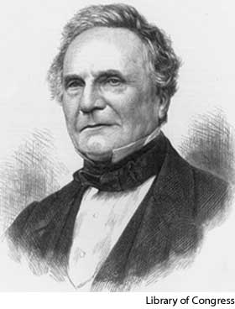
If QCs are so great, how come they haven’t been built yet?
  They have—and they’ve proved that 15=3x5 (with high probability!)
If QCs are so great, how come they haven’t been built yet?
  They have—and they’ve proved that 15=3x5 (with high probability!)
Scaling quantum computers to useful size is
incredibly hard, because of decoherence
Scaling quantum computers to useful size is
incredibly hard, because of decoherence
We’re in roughly the situation of Babbage in the 1830s
We’re in roughly the situation of Babbage in the 1830s
So far, the known obstacles are technological
  If QC is impossible for a fundamental reason, that’s
  much more interesting than if it’s possible!
So far, the known obstacles are technological
  If QC is impossible for a fundamental reason, that’s
  much more interesting than if it’s possible!
Challenge: Short of building a universal quantum computer, do some quantum experiment for which one can give evidence that it’s hard to simulate classically
Challenge: Short of building a universal quantum computer, do some quantum experiment for which one can give evidence that it’s hard to simulate classically
Motivated recent work by myself and Alex Arkhipov on the computational complexity of linear optics

Slide 9
WILD PREDICTION
The effort to build quantum computers, and to understand their capabilities and limitations, will lead to a major conceptual advance in our understanding of QM (one that hasn’t happened yet)
“I think I can safely say that nobody understands quantum mechanics.”
–Richard Feynman
You’ll recognize the advance because it will look like science, not philosophy

