Slide 1


Experimentally Demonstrating the Enormity of Hilbert Space
|ψ⟩
Scott Aaronson (UT Austin)
Harvard Physics Colloquium, November 3, 2025

Slide 2
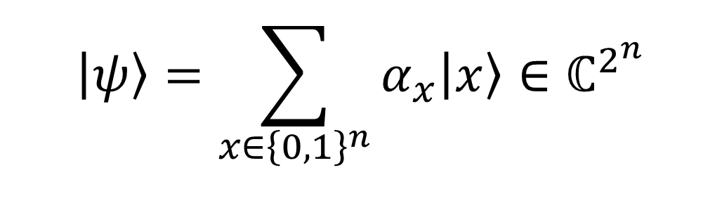
In quantum mechanics, a state of n qubits requires 2^{n} complex numbers to specify
$$\left|ψ\right\rangle =\sum_{x∈{\left\{0,1\right\}}^{n}}{α_{x}\left|x\right\rangle }∈ℂ^{2^{n}}$$
To a computer scientist, this is probably the central fact about quantum mechanics
But why do we care so much?

Slide 3
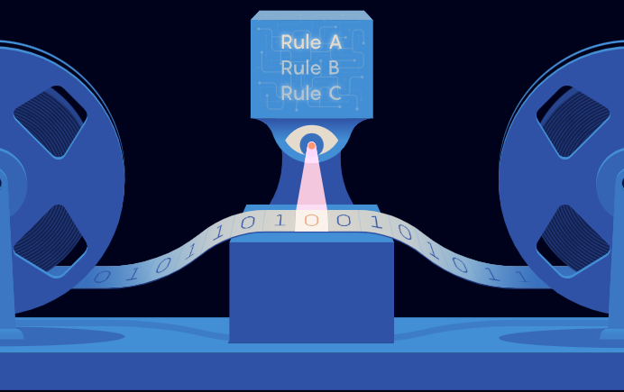
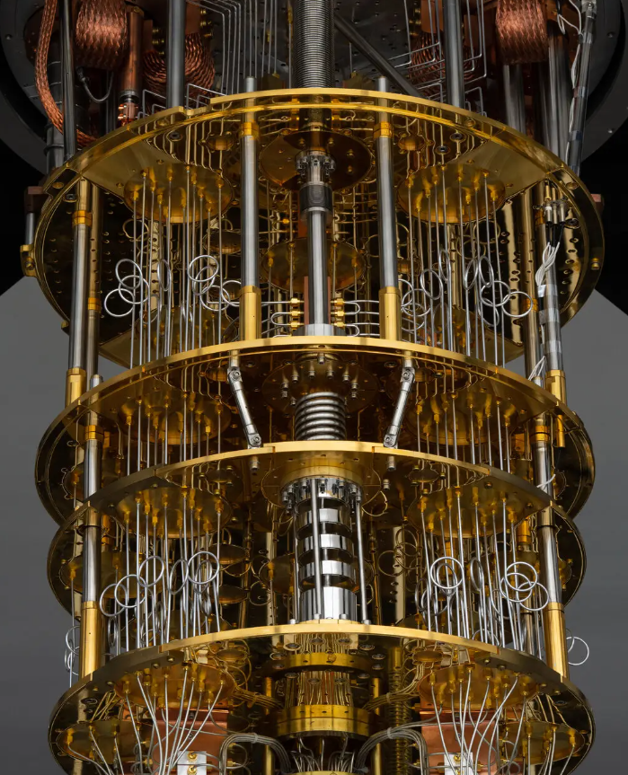

Extended Church-Turing Thesis: “Every reliable physical process can be simulated on a Turing machine, with polynomial time and space overhead”
Quantum computing poses a (the only?) severe challenge to this thesis
Peter Shor (1994): Fast quantum algorithm for factoring (hence breaking RSA). So, either (1) QC is impossible, (2) the ECT is false, or (3) factoring is easy classically

Slide 4

Notorious 1997 challenge by David Deutsch (cofounder of QC):
“To those who still cling to a single-universe world-view, I issue this challenge: explain how Shor's algorithm works. I do not merely mean predict that it will work, which is merely a matter of solving a few uncontroversial equations. I mean provide an explanation. When Shor's algorithm has factorized a number, using 10⁵⁰⁰ or so times the computational resources that can be seen to be present, where was the number factorized? There are only about 10⁸⁰ atoms in the entire visible universe, an utterly minuscule number compared with 10⁵⁰⁰. So if the visible universe were the extent of physical reality, physical reality would not even remotely contain the resources required to factorize such a large number. Who did factorize it, then? How, and where, was the computation performed?”

Slide 5


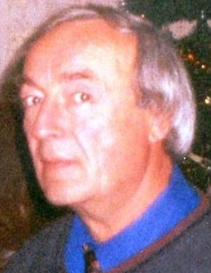
Skepticism of Quantum Computing
‘t Hooft
Kalai
Dyakonov
Despite the progress of the past decade, some physicists and computer scientists still say that scalable quantum computers are fundamentally impossible
For many, the problem is that a quantum computer “manipulates an exponential amount of information using only polynomial resources”

Slide 6
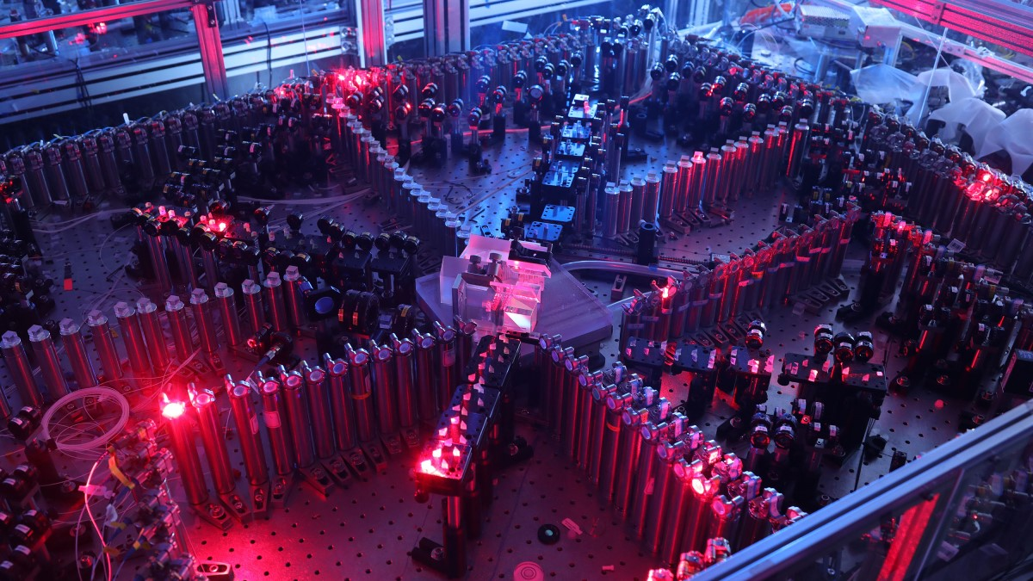
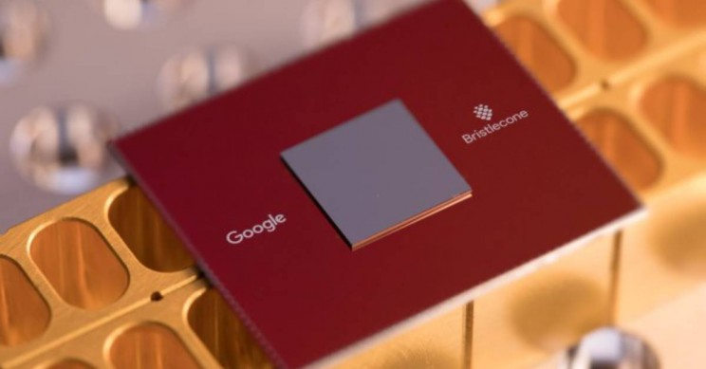
arXiv:2506.10191
Can’t we just refute the QC skeptics empirically?
Eventually, by building a scalable QCs capable of running Shor’s algorithm?
Today, using “quantum computational supremacy experiments”?
BosonSampling (A.-Arkhipov 2011 → demonstrations by USTC, Xanadu)
Random Circuit Sampling (A.-Chen 2017 → demonstrations by Google, Quantinuum, others)
This past month: verifiable quantum supremacy (Google OTOC arXiv:2506.10191, peaked circuits arXiv:2510.25838, …)

Slide 7
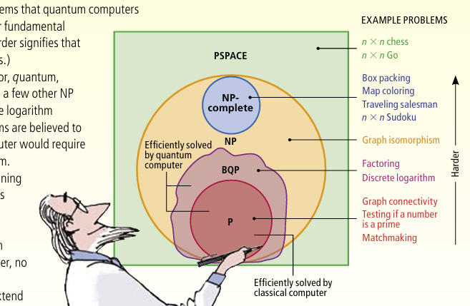
Issue: All such supremacy demonstrations depend on the unproven conjecture that the problems in question are hard for classical computers!
Barring a breakthrough in theoretical computer science (similar to P≠NP), there’s no hope to prove these conjectures unconditionally

Slide 8
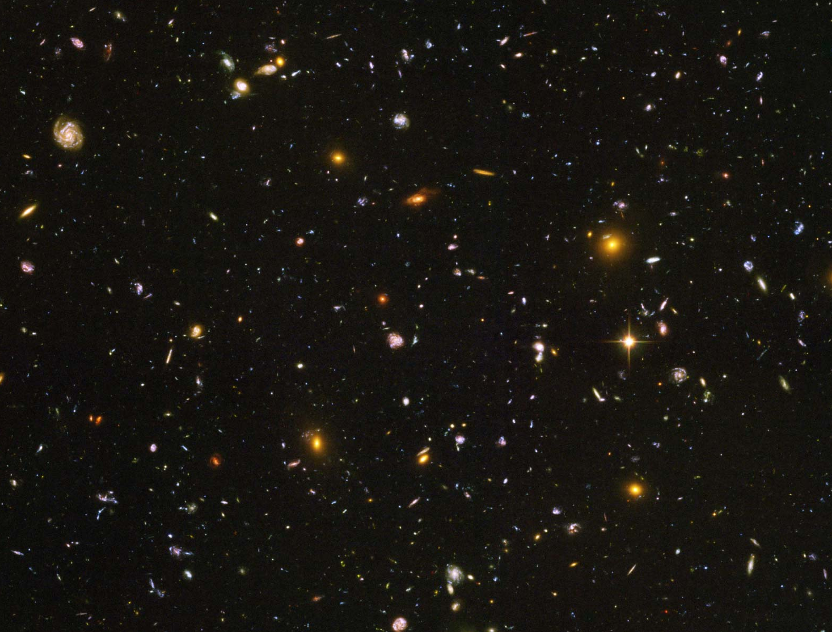
|ψ⟩
“Look, we just want to experimentally demonstrate that Hilbert space is BIG. Can’t we do that with no unproved hardness assumptions?”

Slide 9
The whole difficulty: 2^{n} amplitudes … but when you measure, you see only n bits!
Analogy: A probability distribution over n-bit strings also takes ~2^{n} bits to specify. But that fact seems “just in our heads”!
Holevo’s Theorem (1973): By sending an n-qubit quantum state, Alice can communicate no more than n classical bits to Bob (or 2n with preshared entanglement)
Puzzle: How many classical bits are “in” n qubits?
n because of Holevo’s Theorem?
2n because of superdense coding and teleportation?
~2^{n} because that’s how many amplitudes there are?
∞ because amplitudes form a continuum?

Slide 10
My Quantum State Shrinkage Theorems!
A 2004 (Postselected Learning Theorem): Given an n-qubit state ρ and a list of 2-outcome measurements E₁,…,E_{M}, you can describe ρ well enough to estimate Tr(E_{i}ρ) for all i, using only Õ(n log M) classical bits. Relatedly, BQP/qpoly ⊆ PostBQP/poly
A 2006 (Quantum Occam’s Razor Theorem): Given an n-qubit state ρ and distribution D over 2-outcome measurements, if you find a hypothesis state σ such that Tr(E_{i}σ)≈Tr(E_{i}ρ) on each of m=O(n) sample measurements E₁,…,E_{m} drawn from D, that σ will probably approximately match ρ on most future measurements drawn from D as well
A 2018 (Shadow Tomography): Given an n-qubit state ρ and a list of 2-outcome measurements E₁,…,E_{M}, you can estimate Tr(E_{i}ρ) for all i by carefully measuring only Õ(n log⁴M) copies of ρ
Key ideas of proofs:
Linearity of QM!
Start with the 2^{n}-dimensional maximally mixed state I/2^{n}; then each conditioning on the outcome of a 2-outcome measurement slices the Hilbert space dimension roughly in half, halting once we reach a pure state |ψ⟩⟨ψ|

Slide 11
Despite these shrinkage theorems, in the field of quantum communication complexity, there have long been special tasks for which we can prove unconditional exponential separations between the number of bits and the number of qubits…

Slide 12


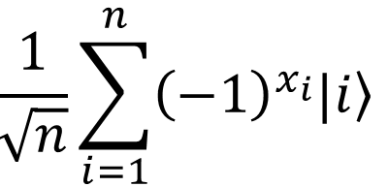
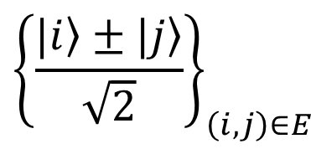
The Hidden Matching Problem
Bar-Yossef-Jayram-Kerenidis 2004
Alice holds an n-bit string x
(say, male/female for each of n people)
Bob holds a matching E on {1,…,n}
(say, who’s dating whom)
Goal: Alice should send Bob a short message that lets him tell whether any one couple of his choice is same- or opposite-sex
Classically, a ~√n-bit message is necessary and sufficient (why?)
Quantumly, O(log n) qubits suffice!
Measurement basis:
$${\left\{\frac{|\left.i\right\rangle ±|\left.j\right\rangle }{\sqrt{2}}\right\}}_{\left(i,j\right)∈E}$$

Slide 13

“Quantum Information Supremacy”
Idea (A. & William Kretschmer): Use a problem like Hidden Matching to perform a different kind of quantum supremacy experiment, which won’t depend on any unproved complexity assumptions
Goal: Experimentally check that, if Nature is “secretly maintaining a classical description” for an n-qubit entangled state |ψ⟩, even a probabilistic description, then it must contain ≥c^{n} classical bits to account for the observed statistics from measuring |ψ⟩
E.g., if n=20, check that >100 classical bits are needed?

Slide 14
Difficulty: The Hidden Matching separation is “only” n vs. 2^{n/2}, while the difficulty of state preparation limits us to n≈12 qubits. Once you include errors, not quite good enough to get a separation with current hardware!
Want: An optimal n vs. 2^{n} separation
We achieve this using a version of the Random Circuit Sampling problem, which was previously used for quantum computational supremacy experiments
“Bell inequality violation for exponential Hilbert space”
Key point: “Alice” and “Bob” will be separated in time rather than in space

Slide 15
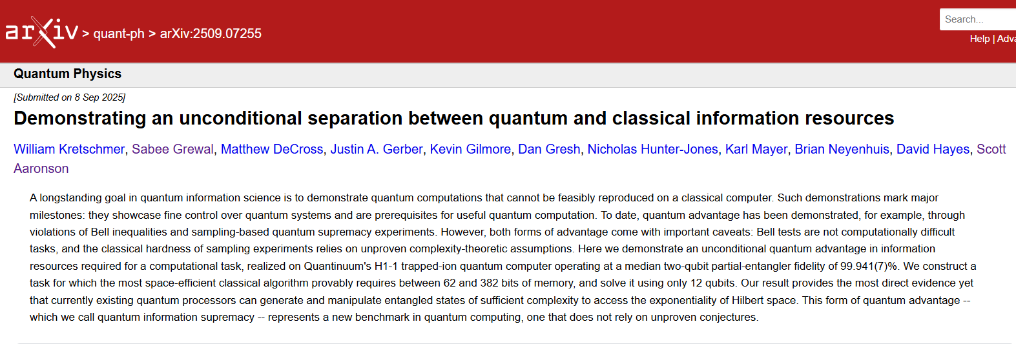
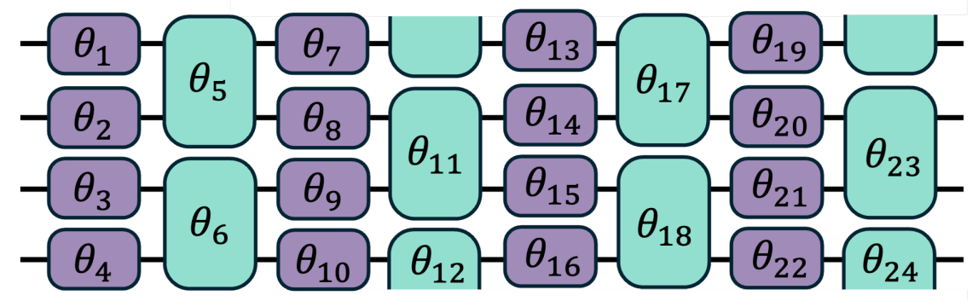

Slide 16
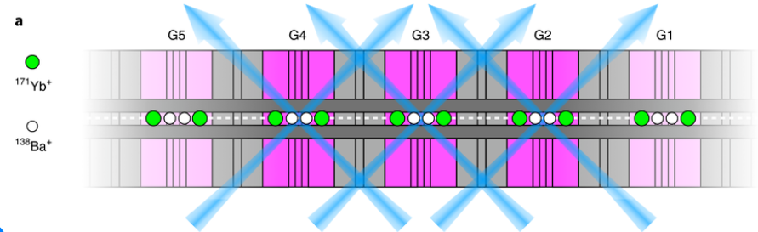
Quantinuum’s H1-1 trapped ion processor
Fully programmable, all-to-all connectivity
We use 12 qubits out of a possible 20
2-qubit gates with >99.9% fidelity → ~50% circuit fidelity even after hundreds of gates

Slide 17
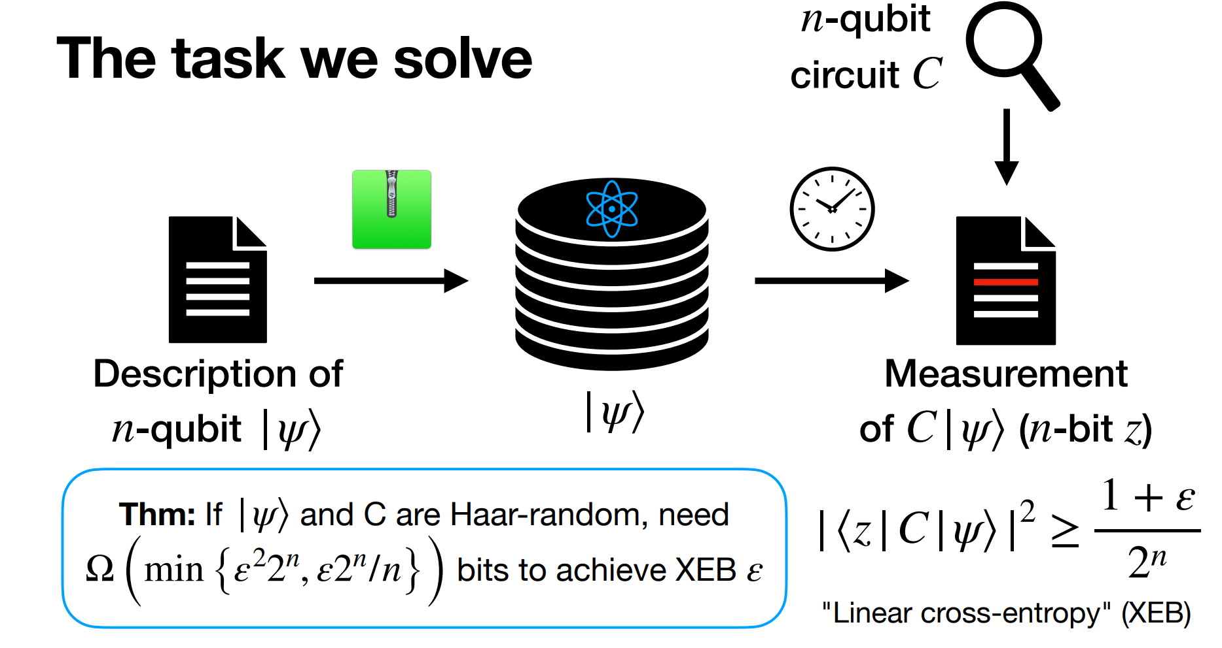
“Alice”
“Bob”
For greater efficiency, we have Bob apply a random “stabilizer” circuit C only. We show that a similar classical lower bound still holds.

Slide 18
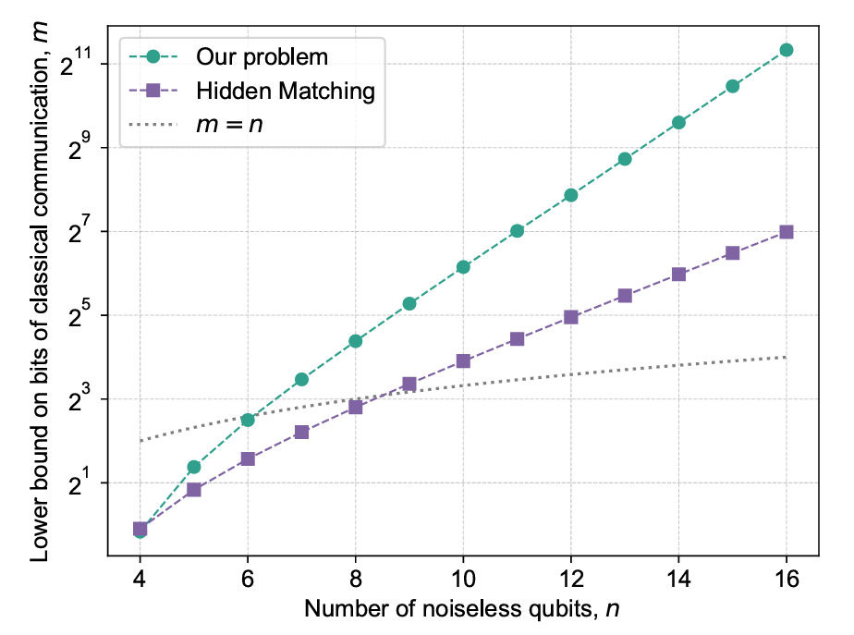

Slide 19
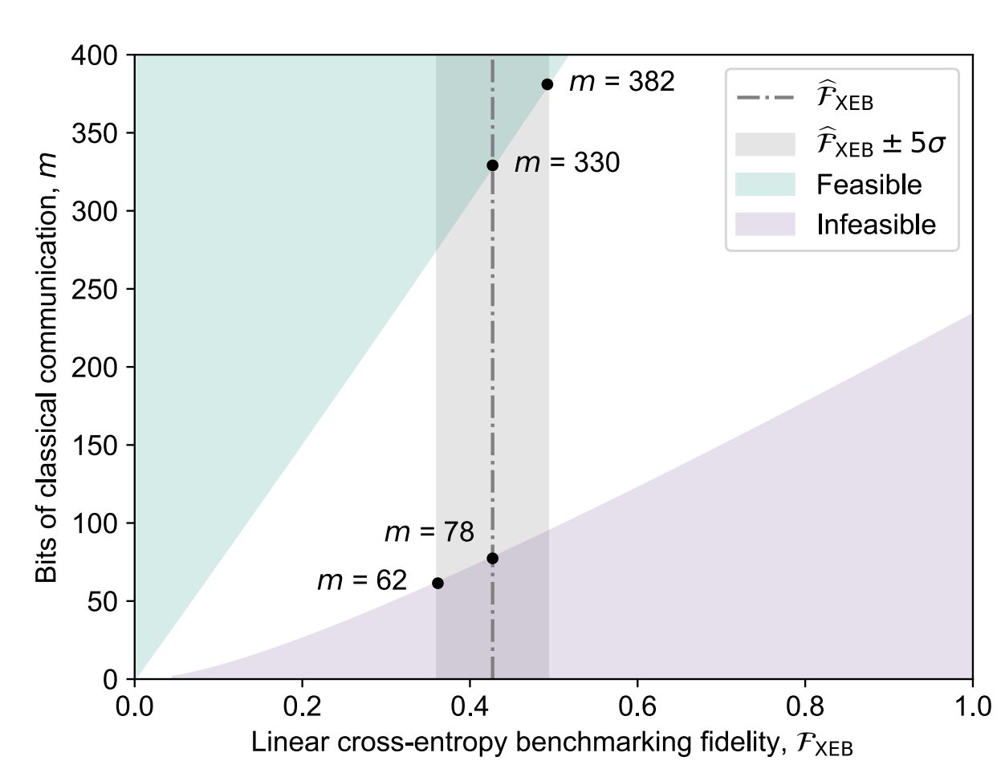

Slide 20
Summary
QM has always said Hilbert space is exponentially large, but it’s tricky to design an experiment to test this directly
Quantum computational supremacy demonstrations depend on unproved hardness assumptions
Short classical descriptions often suffice to simulate measurement outcomes
Our experiment with Quantinuum showed that one can prepare 12-qubit entangled states that need >60 classical bits to simulate
This was possible only because of hardware advances in the past few years (esp. 2-qubit gates with >99.9% fidelity)

Slide 21
Future Directions
Better experimental separation—e.g., 20 qubits vs. 100,000 bits?
Address the “environment loophole”?
Show quantum information supremacy for a task where the verification of outputs is yes/no rather than statistical?
Find something useful to do with quantum information supremacy?
The obvious one: build a scalable fault-tolerant QC, finally refuting those who said it was impossible!

