Slide 1
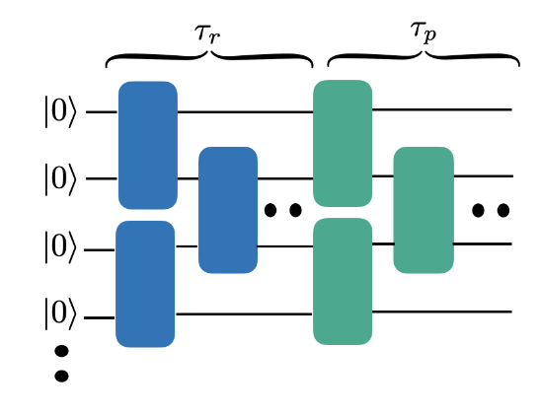
Circuit Conspiracies Or: “Accidental Obfuscation” … for NISQ quantum advantage, AI interpretability, & more
Scott Aaronson (UT Austin / OpenAI)
Simons Institute, Berkeley, CA, April 25, 2024

Slide 2
Clear NISQ Advantage: What We Need
QAOA
NISQy
Efficiently
Verifiable
Quantum machine learning
?
Shor
Mahadev
BosonSampling
Yamakawa-Zhandry
Random Circuit Sampling
Physics simulations
In-Principle Quantum Advantage

Slide 3
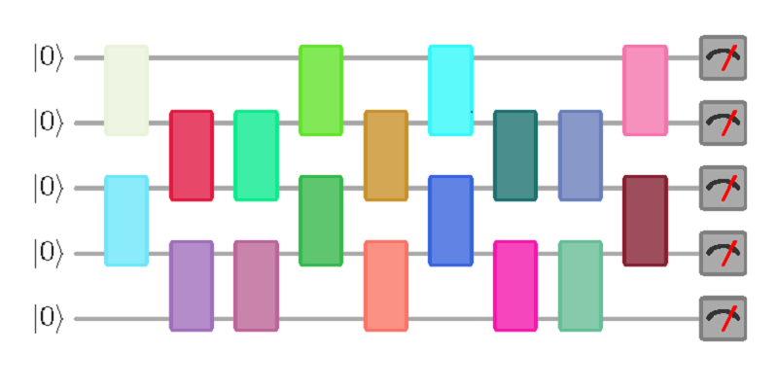
The Peakedness Problem
Call a quantum circuit C δ-peaked if |⟨x|C|0^{n}⟩|²≥δ for some computational basis state |x⟩
In general, could say: if C|0^{n}⟩ has any nonrandom features easy to notice on measurement
Consider (say) a uniformly random 0.1-peaked circuit with n qubits and m=n² gates. Can it be distinguished, in classical polynomial time, from a truly random circuit?
|0⟩
|0⟩
vs.
U
U⁻¹
|0⟩
(obfuscated)

Slide 4
Motivation
If peaked random circuits were indistinguishable from random and easy to generate, we could immediately use them for verifiable NISQ quantum advantage: “given as input a circuit C, is C random or peaked?” (Or even: find the peak)
Want to know: How “generic” can a circuit be, while still dramatically concentrating amplitude on a single output string? Does it have to be “engineered” like Shor’s algorithm, or do such circuits exist “in the wild”?
Obfuscation (iO, etc.) is clearly of great cryptographic interest—but how much obfuscation happens “naturally” (or “NISQily”)?

Slide 5
Numerical Investigation SA + Yuxuan Zhang, arXiv:2404.14493 this week
Since the original question is too expensive to study, we instead ask: Given an n-qubit quantum circuit C with τ_{r} random layers, how many more layers τ_{p} of our choice must we append to it, to get an overall δ-peaked circuit?

Slide 6
Observations
τ_{p} = τ_{r} “peaking layers” will always suffice
τ_{p} = Ω((τ_{r} / n)^{0.19}) peaking layers are necessary, by the theorem that random quantum circuits generate approximate unitary t-designs in depth τ > nt^{5+o(1)} (Haferkamp 2022)
Any τ_{p} < τ_{r} would be interesting, and would refute the approximation where the output of the random layers is “just like a Haar-random pure state except that you can invert the random layers”

Slide 7
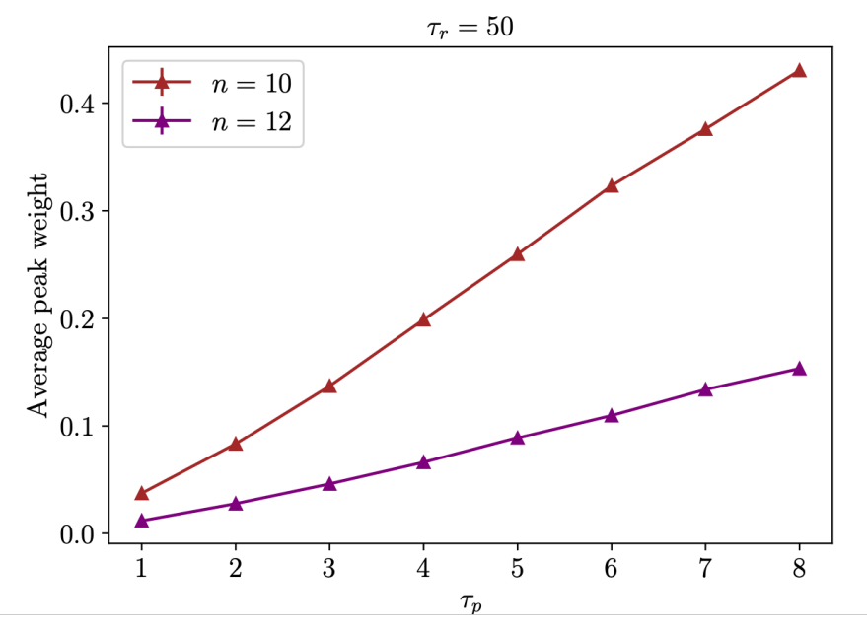
Data on Peakedness: It’s There!

Slide 8
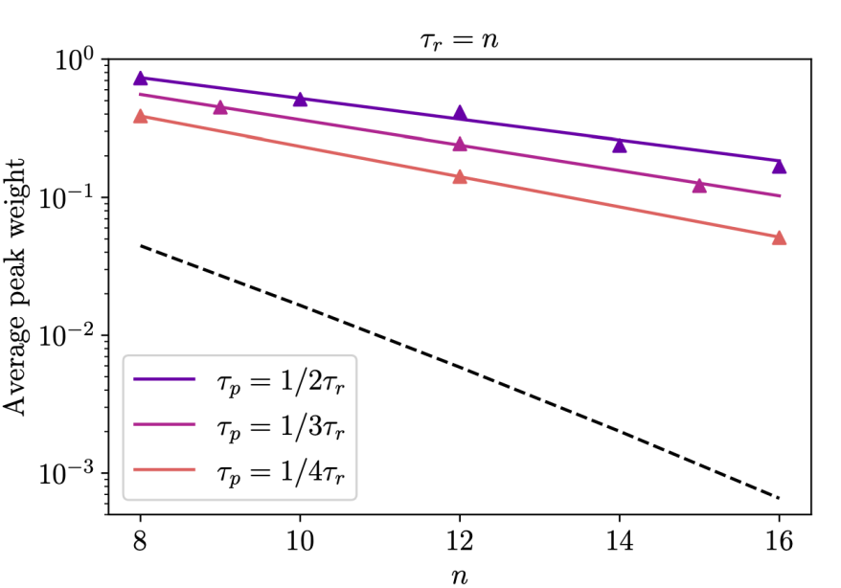

Slide 9
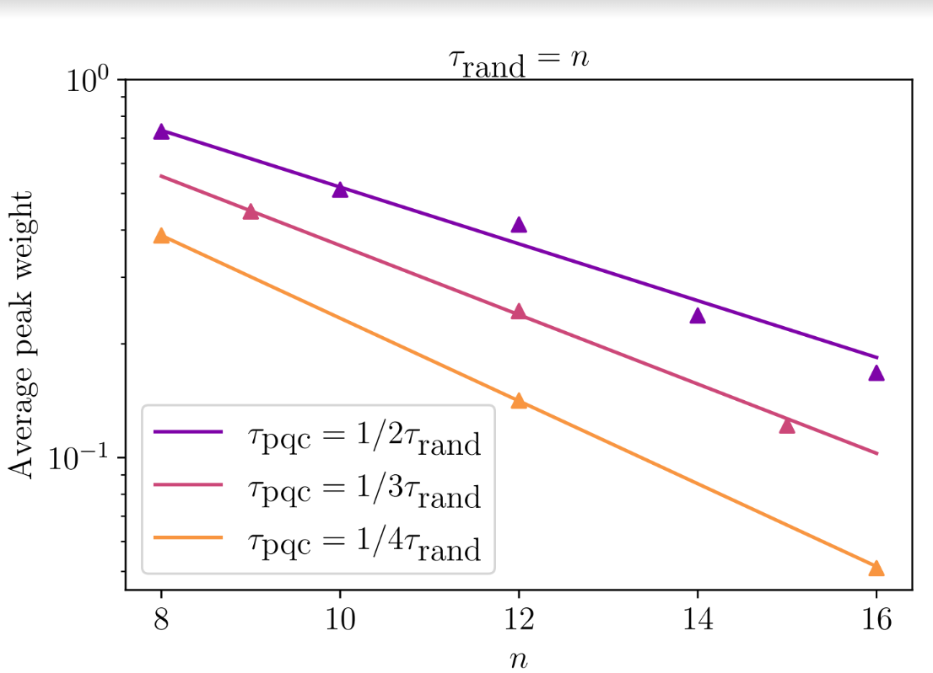
No obvious structure at all in our peaked circuits

Slide 10
The AI Connection!
My new non-QC job: figuring out how to use complexity theory to prevent AI from destroying the world
I was enticed to this partly by Paul Christiano: my former student and collaborator in QC, who then founded the Alignment Research Center and is now Head of AI Safety at NIST
How do you do theory for AI safety, when virtually all AI progress has been empirical?
Paul saw an opening in questions about interpretability

Slide 11
Interpretability
How can you tell when an AI is lying? Does “I love humans” really mean “the time for the robot uprising is not yet nigh”?
Idea: Use the fact that you have perfect access to every neuron, every weight, etc., so can do an “fMRI scan” (cf. work by Jacob Steinhardt’s group)
Problem: Neural nets tend to be highly obfuscated
The possibility of backdoors puts an exclamation point on this problem (cf. Goldwasser-Kim-Vaikuntanathan-Zamir 2022, Anthropic’s “Sleeper Agents” paper)

Slide 12
Paul’s Insight
“Fully” interpreting neural nets is surely cryptographically hard, or even NP-hard in the worst case. But we can still ask: is interpretability “generically” feasible?
Problem: Given as input the weights of a neural net, computing a function f:R^{2n}→R^{n}. Promised that either
The weights are i.i.d. N(0,1) Gaussians, or
The weights are as in (1), except we postselected on f(x) having at least one positive entry for all x∈R^{2n}
Can we decide which? Is there at least an NP witness for case (2)?
See the analogy to the peaked quantum circuits problem??

Slide 13
Empirical Investigation (David Matolcsi, unpublished)
(Another) Model Problem: Given as input a random reversible circuit of m Toffoli gates, which computes a function f:{0,1}^{2n}→{0,1}^{n} (after ignoring ancillas). Promised that either
The circuit is uniformly random, or
The circuit is uniformly random, conditioned on f(x)≠0^{n} for all x∈{0,1}^{2n}
Can we decide which?

Slide 14
David did some numerics with n=10, 30 bits total, 100-150 gates. He found that the “non-zeroness” of the output, f(x), was overwhelmingly carried by a single gate
This might be a small-n artifact. But if it isn’t, suggests that the peaked circuit problem and Paul’s problem might have opposite answers!
Paul and David conjecture, more broadly, that given any reversible circuit that satisfies f(x)≠0^{n} for all x∈{0,1}^{2n}, there will be a very easy-to-compute function g of the circuit’s state s_{t} such that “g(s_{t}) and g(s_{t’}) are correlated for |t’-t| larger than you’d expect in a random circuit” (and this provides an NP witness for non-randomness)

Slide 15
Summary
A new direction for cryptography and complexity theory: “obfuscation in the wild” / “complexity of detecting conspiracies in otherwise random circuits”
Applications to NISQ quantum supremacy and AI interpretability … and possibly more?
I’m getting too old to prove hard theorems, but I’m still not too old to recognize a new direction for TCS when I see one!

