Slide 1
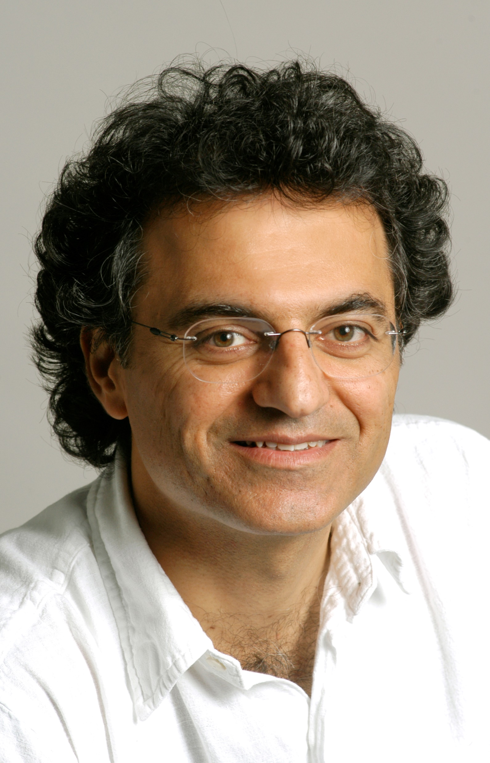
BQP
Scott Aaronson (UT Austin) UmeshFest, Berkeley, CA, April 27, 2024

Slide 2
Here’s a graphic that I made 20 years ago, while still Umesh’s PhD student, to illustrate my then-new theorem that BQP/qpoly ⊆ PP/poly:
Useful?
NARRATOR: “Umesh’s advice states |ψ⟩ were, as it turned out, among the most useful Scott would receive in his life.”

Slide 3
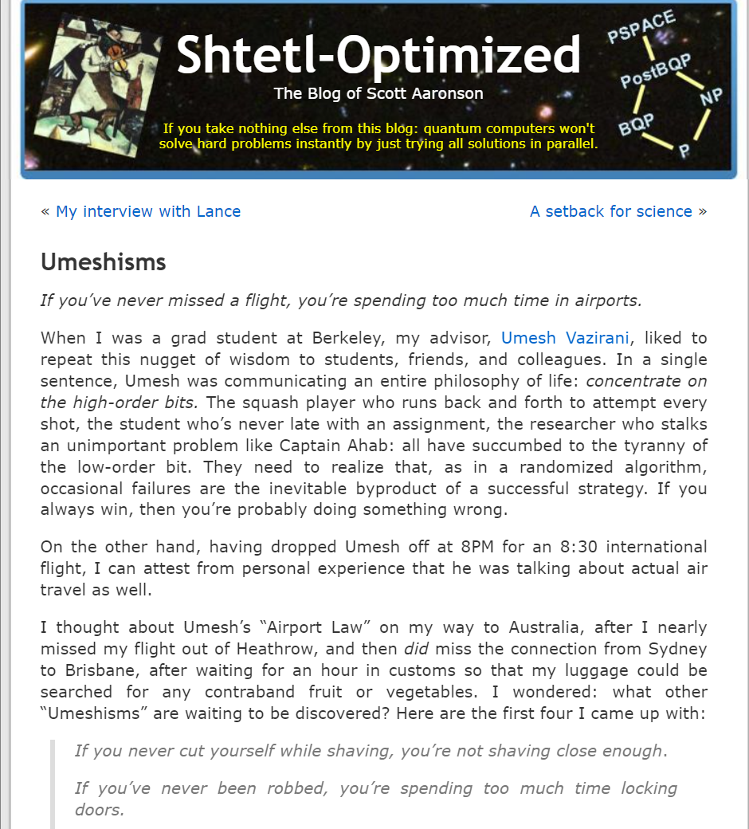

Slide 4
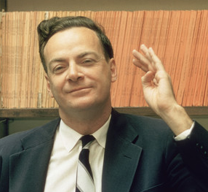
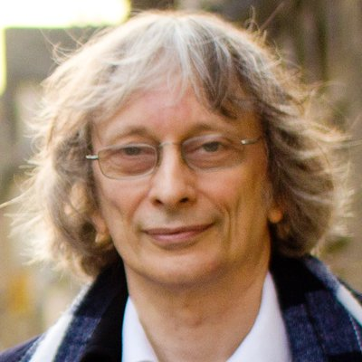
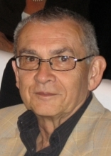
The Prehistory of BQP
Can QM be simulated efficiently on a classical computer?
Deutsch-Jozsa 1992: 2 vs. 1 query speedup for XOR
Berthiaume-Brassard 1992: There exists an oracle relative to which EQP ⊄ RP and even ⊄ NP (the Deutsch-Jozsa constant vs. balanced problem, easy for BPP)
“We have not yet investigated the relative powers of QBPP versus BPP which is likely to be a difficult problem”

Slide 5
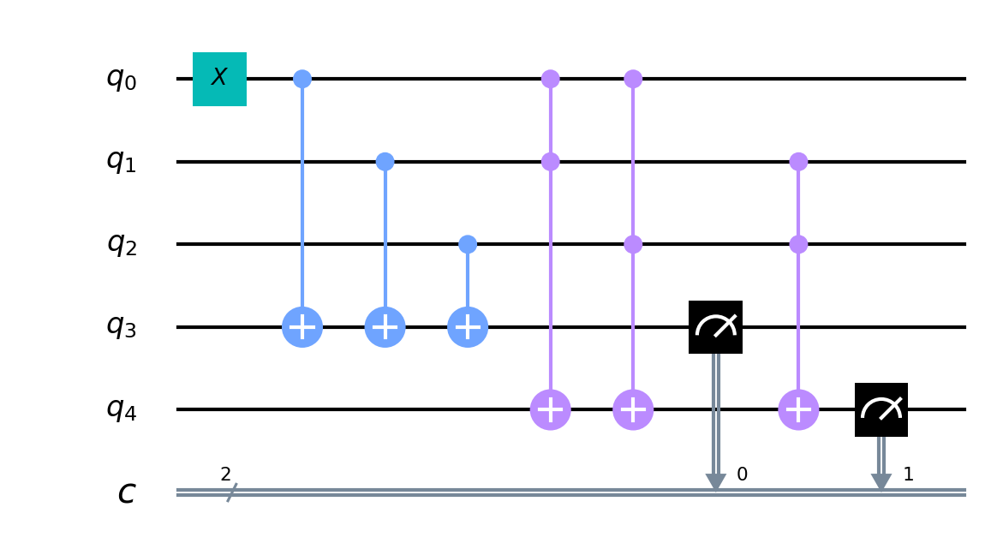
BQP’s Birth!
Bernstein-Vazirani 1993: BQP (Bounded-Error Quantum Polynomial-Time) is the class of languages L⊆{0,1}* decided by a polynomial-time quantum Turing machine with error probability at most 1/3
Alas, quantum Turing machines are monstrous to define and work with, because of the unitarity constraint!
Yao 1993: BQP is also the class of languages L⊆{0,1}* decided by a P-uniform family of quantum circuits, over some fixed universal set of 1- and 2-qubit gates, with error probability at most 1/3

Slide 6
The Results of [BV’93]
In a T-step quantum computation, operations only need to be accurate to ~1/T precision
The earliest seed of quantum fault-tolerance and a key well-definedness property for BQP
P ⊆ BPP ⊆ BQP ⊆ P^{#P} ⊆ PSPACE ⊆ EXP
“Feynman path integral”
Means “there’s no hope for now of proving BPP≠BQP, but it’s not the quantum people’s fault”

Slide 7
First Superpolynomial Speedup!
BV Problem: Given oracle access to f:{0,1}^{n}→{0,1}, and promised there’s an s such that f(x)=s⋅x(mod 2), find s
Classical query complexity = n Quantum query complexity = 1
They then made this recursive!
Classical query complexity = n^{d} Quantum query complexity = 2^{d}
Setting d = log n yields the first oracle relative to which BPP ≠ BQP
g(s)
g(s)

Slide 8
The Floodgates Were Open…
Simon 1994: Given oracle access to f:{0,1}^{n}→{0,1}^{n}, and promised that there’s an s≠0^{n} such that f(x)=f(y) ⇔ y=x⊕s, find s
Classical query complexity is ~2^{n/2} Quantum query complexity is O(n)
Shor 1994: O(1)-query quantum algorithm to find the period of a black-box periodic function f:N→N
Poly-size quantum circuits for Quantum Fourier Transform
(Decision versions of) Factoring, discrete log ∈ BQP

Slide 9
BBBV’94
BQP^{BQP} = BQP: quantum algorithms can call other quantum algorithms as subroutines
Amplification + uncomputing
There exists an oracle relative to which NP ⊄ BQP
Indeed, black-box search of N elements takes Ω(√N) steps, meaning that Grover’s algorithm is optimal (except Grover’s algorithm hadn’t been discovered yet!)
Proof (“hybrid argument”) crucially exploits the linearity of QM; indeed nonlinear QM can solve NP problems efficiently

Slide 10
P^{#P}
NP-complete
3SAT
Calculate a single amplitude
NP
Post-quantum crypto?
Factoring
BQP
P
2SAT
??

Slide 11
Quantum Complexity Research Agenda
What is contained in BQP?
What is BQP contained in?
Can everything in BQP be classically verified?
Is there anything “physical” beyond BQP?
BQP-complete problems and subclasses of BQP
…

Slide 12
What Is Contained In BQP?
More number-theoretic problems
More oracular problems (Glued Trees, Forrelation)
Graph Isomorphism? Approximate Shortest Vector?
More generally, Nonabelian Hidden Subgroup?
Other NP approximation problems (Unique Games)??
A. 2002: Lower bound for finding collisions in two-to-one functions. Means that there exists an oracle relative to which SZK ⊄ BQP

Slide 13
What Is BQP Contained In?
Adleman-DeMarrais-Huang 1997: BQP ⊆ PP
Fortnow-Rogers 1998: BQP ⊆ AWPP ⇒ PP^{BQP} = PP
Is BQP ⊆ AM? Is BQP ⊆ PH? Candidate oracle separation, besides BV’s Recursive Fourier Sampling?
A. 2009: Forrelation. Given f,g:{0,1}^{n}→{-1,1}, decide whether f and g are uniformly random or whether f≈ĝ, promised that one of those is true. Quantum query complexity is 1, classical is Ω(2^{n/4}) → Ω(2^{n/2}/n)
Raz-Tal 2018: Forrelation yields an oracle relative to which BQP ⊄ PH

Slide 14
Classical Verification of BQP Computations Via Interactive Protocols
Broadbent-Fitzsimons-Kashefi, Aharonov-BenOr-Eban 2008: Using single qubits sent to the prover
Reichardt-Unger-Vazirani 2012: Using two non-communicating provers
Mahadev 2018: Using cryptography (assuming LWE is quantumly hard)
OPEN: Using none of these things?

Slide 15
Beyond BQP?
PromiseBQP: Home of quantum simulation problems
SampBQP: Home of BosonSampling, Random Circuit Sampling, IQP Sampling, etc.
FBQP: Relative to a random oracle, contains NP search problems not in FBPP (Yamakawa-Zhandry 2022). Contrast with AA Conjecture, implying there’s no random oracle separation between BPP and BQP
Even if BPP=BQP, these classes are plausibly hard! Even if BQP⊆NP (or ⊆PH), these are plausibly not!
Quantum Field Theory Polynomial-Time? Quantum Gravity Polynomial-Time?

Slide 16
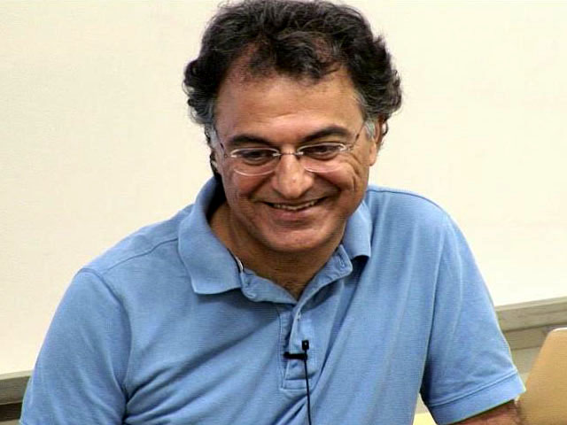
Summary
I covered only one thread of Umesh’s contribution to QC—didn’t mention Hamiltonian complexity, area laws, certified randomness, …
Yet BQP would’ve been enough to keep us busy!
Thank you, Umesh, for 25 years of friendship, advice, support, and inspiration to focus on the high-order bits Also (a low-order bit) for its not being called QBP or QBPP

