Slide 1
The Largest Possible Quantum Speedups
|0⟩
H
H
H
|0⟩
H
f
H
g
H
|0⟩
H
H
H
Scott Aaronson (MIT)
ThinkQ conference, IBM, Dec. 2, 2015

Slide 2
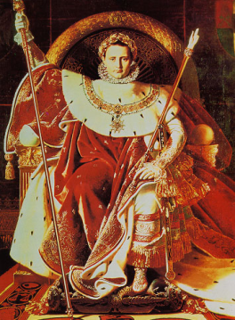
QUANTUM SUPREMACY
| ⟩
What can you do with a medium-sized quantum computer?
DISPROVE THE QC SKEPTICS!

Slide 3
Three General Principles
Can forget temporarily about practical applications of QC: the more immediate goal is just to show a clear quantum speedup for anything
Need not just a “hard-to-simulate physical system,” but a clearly-defined hard problem (with classical inputs and outputs) for the system to solve
“What’s the evidence that the problem is hard classically?” is not a side question, it’s the central question. Means we can’t avoid complexity theory!
These principles motivate a general question…

Slide 4
What’s the biggest advantage QC ever gives you for anything?
Factoring and Discrete Log:
quantum
classical
Of course, only conjectural.
But in the black-box model, we can actually prove stuff!
x
f
f(x)
“Quantum query to f”:
Often M=2

Slide 5
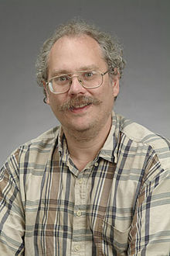
Let P be a promise problem about f—e.g., is f one-to-one or two-to-one? Is f periodic or far from periodic?
Q(P) = Bounded-error quantum query complexity of P
R(P) = Bounded-error randomized query complexity of P
“Shor’s real result”:
Buhrman et al.’s Speedup Question (2001):
Is this the best possible? Could there be a property of N-bit strings that took only O(1) queries to test quantumly, but Ω(N) classically?

Slide 6
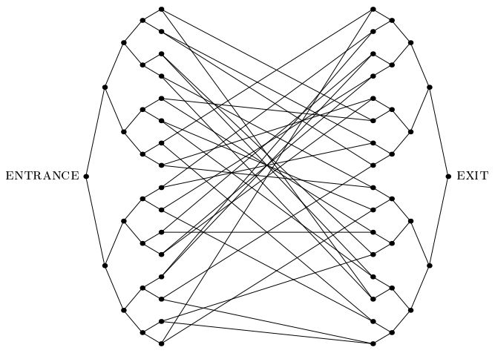
Known separations are “suboptimal”!
Simon’s Problem: Q=O(log N), R=Ω(√N)
Glued Trees (Childs et al. 2003): Q=O(polylog N), R=Ω(√N)
For total Boolean functions [BBCMW’98] and permutation-symmetric problems [A.-Ambainis 2013], only polynomial separations are possible

Slide 7
A.-Ambainis, STOC’2015
1. Largest Known Quantum Speedup. A problem (“Forrelation”) with
2. Optimality of Speedup. For every partial Boolean function P, if Q(P)≤T then
Answers Buhrman et al.’s Speedup Question in the negative

Slide 8
The Forrelation Problem
Given black-box access to two Boolean functions
Let
Decide whether Φ_{f,g}≥0.6 or |Φ_{f,g}|≤0.01, promised that one of these is the case
A. 2010: Introduced this problem, as a candidate for a black-box problem in BQP but not in PH
Showed that R(Forrelation)=Ω(N^{1/4}) and Q(Forrelation)=1

Slide 9
Example
f(0000)=-1 f(0001)=+1 f(0010)=+1 f(0011)=+1 f(0100)=-1 f(0101)=+1 f(0110)=+1 f(0111)=-1 f(1000)=+1 f(1001)=-1 f(1010)=+1 f(1011)=-1 f(1100)=+1 f(1101)=-1 f(1110)=-1 f(1111)=+1
g(0000)=+1 g(0001)=+1 g(0010)=-1 g(0011)=-1 g(0100)=+1 g(0101)=+1 g(0110)=-1 g(0111)=-1 g(1000)=+1 g(1001)=-1 g(1010)=-1 g(1011)=-1 g(1100)=+1 g(1101)=-1 g(1110)=-1 g(1111)=+1

Slide 10
Trivial Quantum Algorithm!
|0⟩
H
H
H
|0⟩
H
f
H
g
H
|0⟩
H
H
H
Probability of observing |0⟩^{⊗n}:
Can even reduce from 2 queries to 1

Slide 11
How Do We Prove that Forrelation Requires Ω(√N / log N) Queries Classically?
Eh, I had some slides about this, but I took them out

Slide 12
Classical Simulation of k-Query Quantum Algorithms
Beals et al. 1998: Let A be a quantum algorithm that makes T queries to X=(x₁,…,x_{N}). Then p(X)=Pr[A accepts X] is a real polynomial in the x_{i}’s, of degree at most 2T
Our Result: Let p(x₁,…,x_{N}) be any degree-k real polynomial that’s bounded in [0,1] for all Boolean x₁,…,x_{N}. Then there’s a randomized algorithm that approximates p to within ±ε, with high probability, by querying only
variables

Slide 13
Proof Idea: Repeatedly identify influential variables and “split” them. Produces exp(k)⋅O(N) new variables, which is linear for constant k
Then just pick a set S of variables at random, query them, and estimate q by summing only monomials over S
Note: The original algorithm of A.-Ambainis only worked for multilinear forms, a special class of polynomials. This was enough to imply the conclusion about quantum algorithms
But very recently, A.-Ambainis-Iraids-Kokainis-Smotrovs showed that any algorithm that works for degree-k multilinear forms, works for all degree-k real polynomials

Slide 14
k-Fold Forrelation
Given k Boolean functions f₁,…,f_{k}:{0,1}^{n}→{1,-1}, estimate
Once again, there’s a trivial k-query quantum algorithm! (Can be improved to k/2 queries)
|0⟩
H
H
H
Bonus Theorem: k-fold Forrelation is BQP-complete for k=poly(n), if f₁,…,f_{k} are described by circuits—giving a second sense in which it “captures the full power of QC”
|0⟩
H
f₁
H
f_{k}
H
|0⟩
H
H
H
Our Conjecture: k-fold Forrelation requires Ω(N^{1-1/k}) randomized queries—achieving the optimal gap for all k

Slide 15
What About Total Functions?
Beals et al. 1998 showed that, for all total Boolean functions F:{0,1}^{N}→{0,1},
(D(F) = Classical deterministic query complexity)
Longstanding Conjecture: The biggest such separation is actually quadratic, as achieved by Grover’s algorithm for the N-bit OR function
Ambainis et al. 2015: Totally wrong! There’s a total F with D(F)~Q(F)⁴. But their example still satisfies R(F)=O(Q(F)²), so maybe the latter always holds?

Slide 16
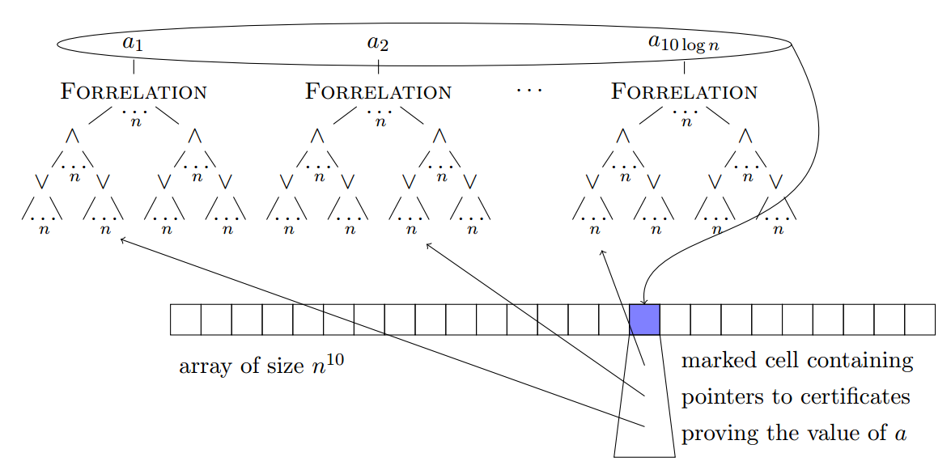
Ben-David 2015: Nope! There’s a total F with R(F)~Q(F)^{2.5}.
“Cheat Sheet”

Slide 17
Connecting Two Open Problems
Suppose Ambainis and I are right that k-fold Forrelation has randomized query complexity Ω(N^{1-1/k}). Then, plugging k-fold Forrelation into Shalev’s construction, his separation automatically improves to R(F)~Q(F)³
A.-BenDavid-Kothari 2015: Used the “cheat sheet” construction to achieve lots of other separations in query complexity, including a total Boolean function F with a 4th-power gap between approximate degree and quantum query complexity (previous best: 1.3rd power)

Slide 18
The Fourier Sampling Problem
Given a Boolean function
sample a random z∈{0,1}^{n} with probability close to
Also a search version: “Find z’s that mostly have large values of
A. 2009: If f is a random black-box function, then the search problem isn’t even in FBPP !
Trivial Quantum Algorithm:
|0⟩
H
H
|0⟩
H
f
H
|0⟩
H
H
PH^{f}

Slide 19
A.-Ambainis 2015: Fourier Sampling has quantum query complexity 1 but randomized query complexity
(by our previous results, bigger than the biggest possible separation obtainable for promise problems)
Moral: Enlarging what we mean by a “computational problem” can make it easier to demonstrate quantum supremacy!
This was the inspiration for BosonSampling…

Slide 20
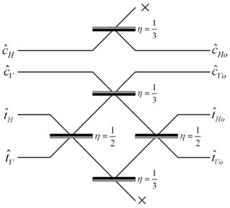
BosonSampling A.-Arkhipov 2011
The Task: Sample a complex matrix, A∈C^{n×n}, with probability proportional to μ(A)|Per(A)|² (μ being the Gaussian measure)
(#P-complete)
Note: Realistically, the best you can hope for is to sample from approximately the right distribution. We think fast classical approximate sampling would already collapse PH, but that depends on an unproved classical conjecture.
Easy to solve if you can build a network of beamsplitters and phaseshifters, input n identical photons, then measure the number of photons in each output mode
Our Result: If a classical computer can do the same thing in polynomial time, then PH collapses

Slide 21
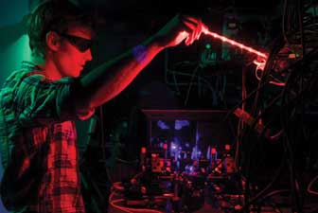
Experimental Realizations
2012: Several 3- and 4-photon BosonSampling realizations
2015: 6-photon realization (by O’Brien group in Bristol)! But for matrices with repeated rows
Lots of hard questions at the experiment / complexity theory interface (!!)
SPDC sources rather than single photons. Can address using Scattershot BosonSampling
Photon Losses. A-Brod 2015 can handle a constant number of them. We don’t know how to handle more

Slide 22
Other Sampling Tasks
Bremner et al. (2011, 2015) have developed the commuting Hamiltonians model—extremely closely related to what I called Fourier Sampling. They proved analogous results to A.-Arkhipov’s for BosonSampling
It’s plausible that, with ~40 qubits with short coherence times (but arbitrary long-range couplings), you could already do Fourier Sampling faster than classically
Difficulty with all these sampling tasks: How do you verify that your device is actually solving it?
Will usually be asymptotically hard! But still feasible for n≈40, which should suffice to show quantum supremacy

Slide 23
Conclusions
There’s a tremendous opportunity to demonstrate quantum supremacy with the medium-sized devices of the near future—devices that fall short of universal QC
But if we want to avoid “D-Wave Redux,” then the hardness of classical simulation must always be front and center—suggesting a need (and opportunity!) for direct collaboration between CS theory and experiment
Maybe we should stop obsessing so much about “the need for more quantum algorithms,” and worry instead about a paucity of classical hardness results

