Slide 1
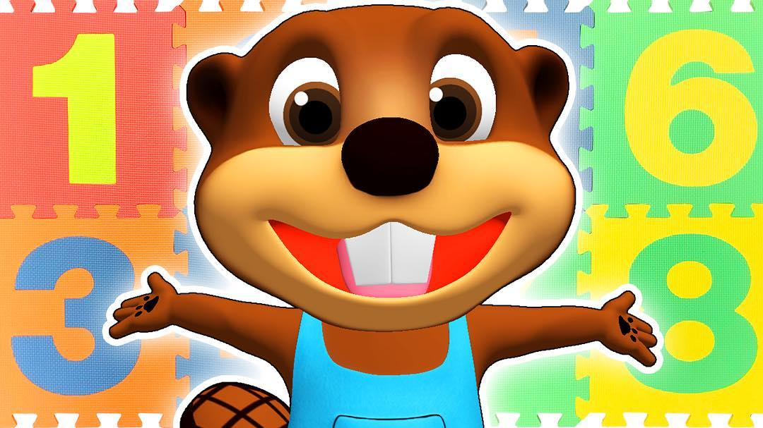
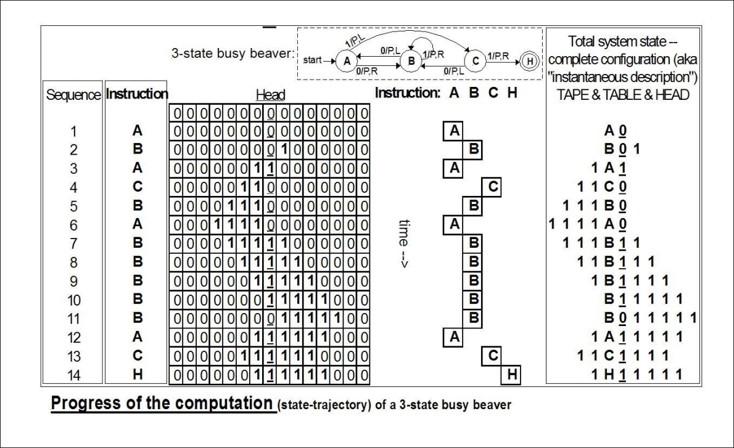
BIG NUMBERS
Scott Aaronson (University of Texas at Austin)
Sigma Camp, Connecticut, August 7, 2025

Slide 2
Calibration
Number of sand grains to fill the solar system?
~10⁵⁶
We will quickly leave all these numbers in the dust and never look back…
Number of atoms in the observable universe?
~10⁸²
Maximum number of bits of information that the observable universe could store?
~10¹²²

Slide 3
CONTEST: 15 seconds to write down the largest positive integer you can
Ground Rules:
Positive integers only, no infinities!
No referring to other people’s numbers (“the largest number anyone else named, plus one”)
A mathematician, looking only at your paper, must understand exactly what number you named

Slide 4
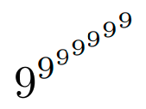
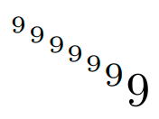
What do people try?
99999999999999999999
11111111111111111111
:= ⁷9
^{b}a = a “tetrated” to the b

Slide 5
The Power of Iteration!
Addition (a+b) Repeated incrementing
Multiplication (ab) Repeated adding
Exponentiation (a^{b}) Repeated multiplying
Tetration (^{b}a) Repeated exponentiating
Pentation Repeated tetrating
Hextation Repeated pentating
…
(After exponentiation, we lose almost all nice arithmetical properties!)

Slide 6
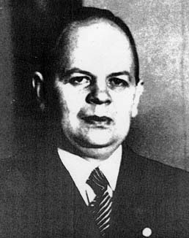
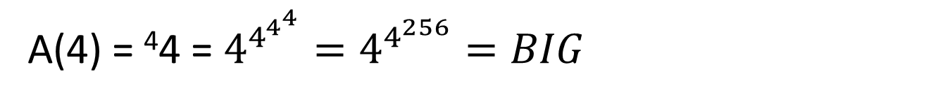
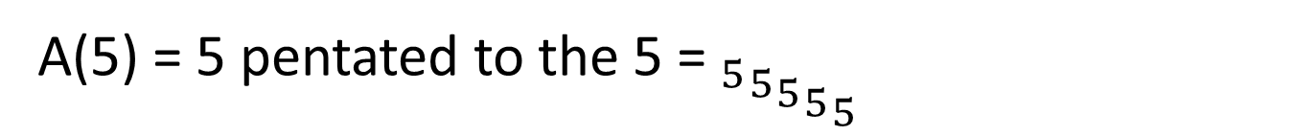
Ackermann Function (1928)
A(1) = 1 + 1
A(2) = 2 × 2
A(3) = 3³
A(4) = ⁴4 = $4^{4^{4^{4}}}=4^{4^{256}}=BIG$
A(5) = 5 pentated to the 5 =${{{{ _{5}}_{5}}_{5}}_{5}}_{5}$
A(100)
In biggest number contest:

Slide 7
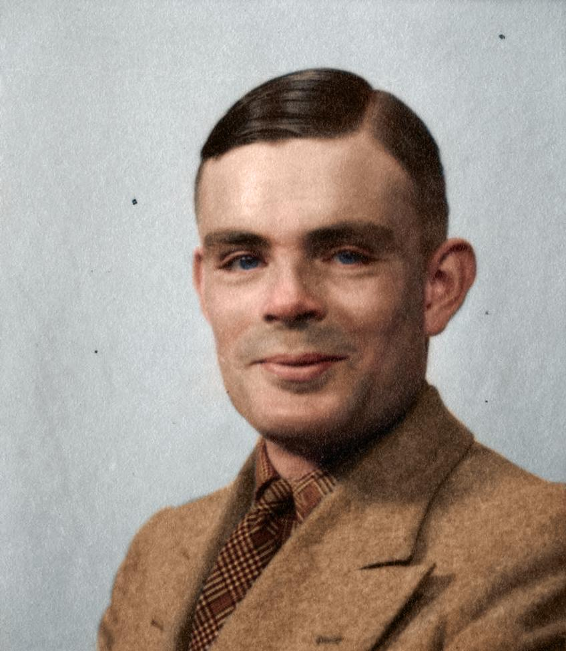
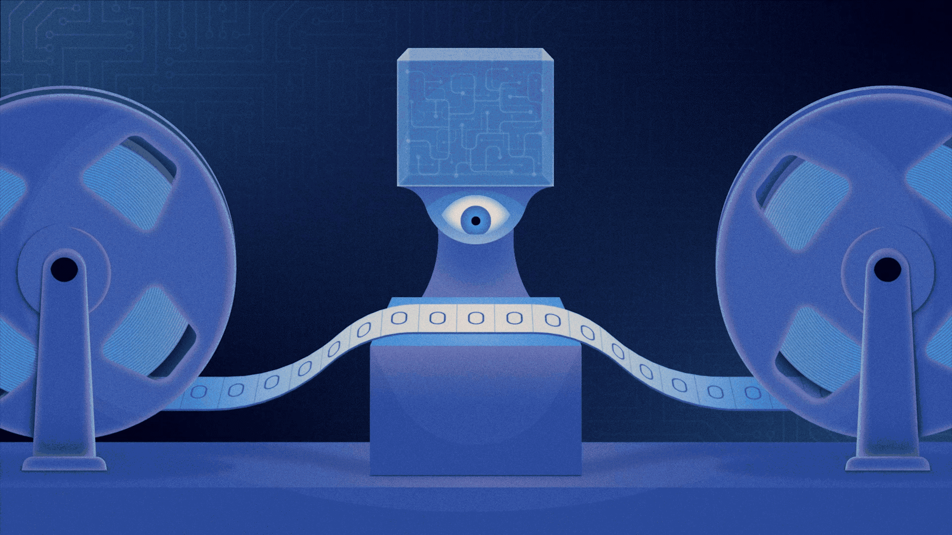
But Ackermann is still computable! (Given unlimited time and memory)
We’d like a function that exceeds any computable function.
What does “computable” mean, anyway?
Turing machine
(from Quanta)

Slide 8
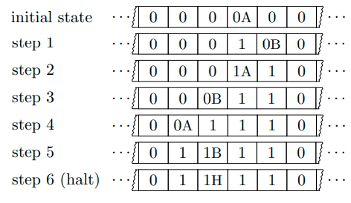
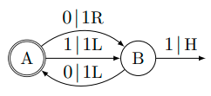
Example Turing Machine
One infinite tape, initially all 0’s
2-symbol alphabet consisting of 0 and 1
Allowed operations: read the current symbol, overwrite the current symbol, move one square left or right, transition to a new internal state, halt

Slide 9
Turing machines—our standard mathematical model of “computer” to this day—can do many things!
Adding, multiplying, running Minecraft, simulating other Turing machines described on their tape…
But crucially, not everything!

Slide 10
The Halting Problem (HALT)
Given as input a description ⟨M⟩ of a Turing machine M (i.e. a program), decide if M() halts
Example program:
n = 2; do { n = n + 2;
b = 0; for i=2 to n-1 { if isPrime(i) and isPrime(n-i) then b = 1; } if b==0 then HALT;
}

Slide 11
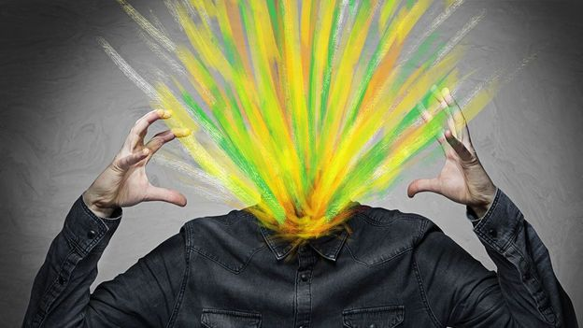
Turing’s Theorem! (Proved In One Slide)
Theorem: No program exists to solve HALT
Proof: Let P(⟨M⟩) decide whether M() halts. Use P to make a new program, call it Q(⟨M⟩), which halts if M(⟨M⟩) runs forever, or runs forever if M(⟨M⟩) halts
Now consider Q(⟨Q⟩):
Turing ⇒ Gödel’s Incompleteness Theorem: If we had a complete, sound proof system for arithmetic, we could compute whether any program halted, by listing all possible proofs and disproofs until we found one that worked!

Slide 12
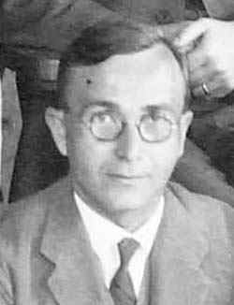
Busy Beaver Function (Radó 1962)
BB(n) = the maximum finite number of steps made by any n-state Turing machine (before halting), on an initially blank input tape

Slide 13
BB grows uncomputably quickly!
Theorem: There’s no computable function f such that f(n)≥BB(n) for all n.
Proof: Suppose there was. Then given an n-state Turing machine M, we could decide whether M halts by computing f(n) and then running M for ≤f(n) steps. If M hasn’t halted by then, then it never can!
Homework: For any computable function f, we have BB(n)>f(n) for all sufficiently large n.

Slide 14
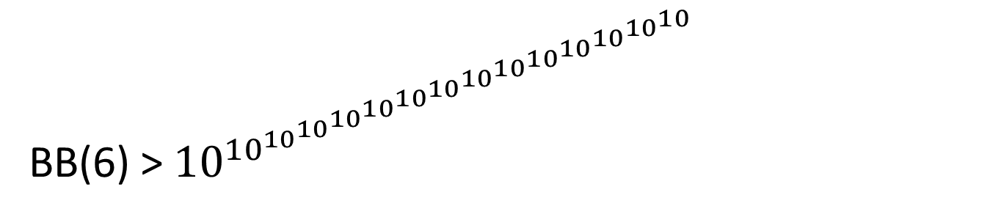
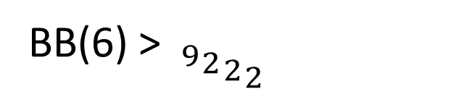
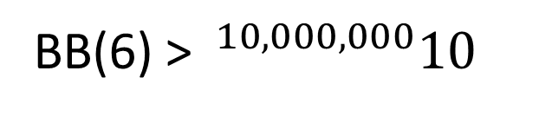
The Actual Values of BB(n)…
BB(1) = 1 (Trivial)
BB(2) = 6 (Lin 1963)
BB(3) = 21 (Lin 1963)
BB(4) = 107 (Brady 1983)
BB(5) = 47,176,870 (BBchallenge Team 2024)
BB(5) ≥ 47,176,870 (Marxen-Buntrock 1990)
BB(6) > $^{10,000,000}10$
BB(6) > ${{{ _{9}}_{2}}_{2}}_{2}$
(mxdys 2025)
BB(6) > ${10}^{{10}^{{10}^{{10}^{{10}^{{10}^{{10}^{{10}^{{10}^{{10}^{{10}^{{10}^{{10}^{{10}^{10}}}}}}}}}}}}}}$
BB(7) > Ackermann(11)
(Kropitz 2022)

Slide 15
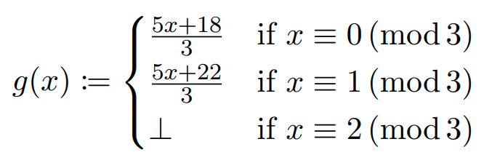
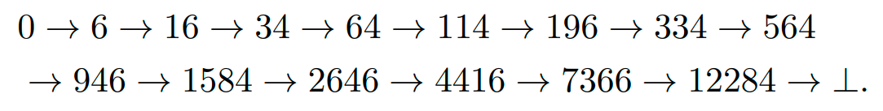
What does the 5-state champ do?
Let
Starting from 0, does iterating g ever reach ⊥? Yes:
The 5-state BB champion slowly verifies this fact

Slide 16
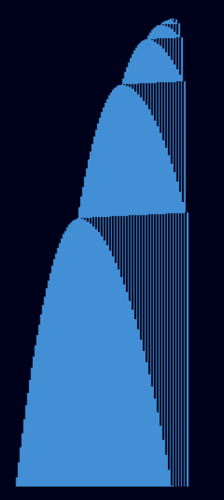

Slide 17
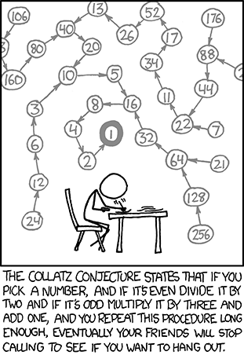
Collatz Conjecture: “Most Elementary of All Open Math Problems?”

Slide 18
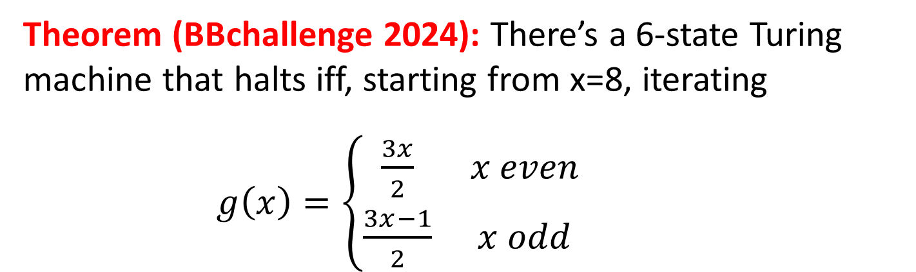
Will BB(6) ever be known?
Theorem (BBchallenge 2024): There’s a 6-state Turing machine that halts iff, starting from x=8, iterating
$g\left(x\right)=\left\{\begin{matrix}\frac{3x}{2} & x even \\ \frac{3x−1}{2} & x odd\end{matrix}\right.$
ever produces more than twice as many odd as even x’s
8 → 12 → 18 → 27 → 40 → 60 → 90 → 135 → 202 → 303 → 454 → 681 → 1021 → 1531 → 2296 → … (so far 6 odd, 9 even)
My Prediction: If BB(6) is ever known, AI will be needed!

Slide 19
How many BB values are knowable?
Theorem (Aaronson-Yedidia 2016): There’s an 8,000-state Turing machine that halts if and only if the ZFC axioms of set theory are inconsistent.
(So if set theory is consistent, then it can never prove the value of BB(8,000)…!)
To get from a million states down to 8,000 took a lot of optimizations! Subsequent improvements have gotten it down to 549
Could the values of BB(20) or BB(6) already be independent of ZFC?

Slide 20
Does Anything Grow Faster than Busy Beaver?
(And no, I don’t mean BB(n)², BB(BB(n)), or anything boring like that)
In computer science, an oracle is a hypothetical magic box that solves a certain problem for free
Is any problem even harder than HALT—meaning, uncomputable even given a HALT oracle?
Sure, the Halting Problem for Turing machines with HALT oracles!
Why? Because Turing’s proof “relativizes”
Just like there no largest infinity, there’s no hardest problem

Slide 21
Beyond Busy Beaver!
Theorem: Let SuperBB(n) be the Busy Beaver function for “Super Turing machines”—i.e., Turing machines with HALT oracles. Then SuperBB grows faster even than any function f computable given a HALT oracle (such as BB(n) itself)!
Can keep going: Super Duper BB, Super Duper Pooper BB, etc. Even for infinite ordinal numbers of steps!
A biggest number contest between two experts would quickly degenerate into an argument about which ordinals are well-defined. Which in turn depends on the axioms of set theory.

Slide 22
The Ultimate Approach?
The largest positive integer that can be named in a hundred English words or fewer
Hey wait…
One plus the largest positive integer that can be named in a hundred English words or fewer
“Berry Paradox” (which the BB function escaped)

Slide 23
Curious Unsolved Problems
For which n’s is BB(n) odd? Prime? A perfect square? Are there infinitely many such n’s? Are there algorithms that, given n, decide whether BB(n) has these properties?
Does every Busy Beaver halt on all finite inputs?
Can we prove that (say) BB(n+1)>2^{BB(n)} for all n≥5?
Does the first n for which the value of BB(n) is independent of set theory, match the first n for which it encodes the consistency of set theory?

