Slide 1

ARE WE COOKED?
It looks like you’re proving a theorem. Would you like help?
Scott Aaronson (University of Texas at Austin)
Math Dept, Columbia University, NY, Oct. 23, 2026
Notes:
ZOOM THRU ZOOM THRU Thanks so much for inviting me! When I typed “quantum computer” into Google Image Search, that’s the first picture that came up. That’s apparently what they look like. (I should warn you that I’m a theorist rather than an engineer.)

Slide 2
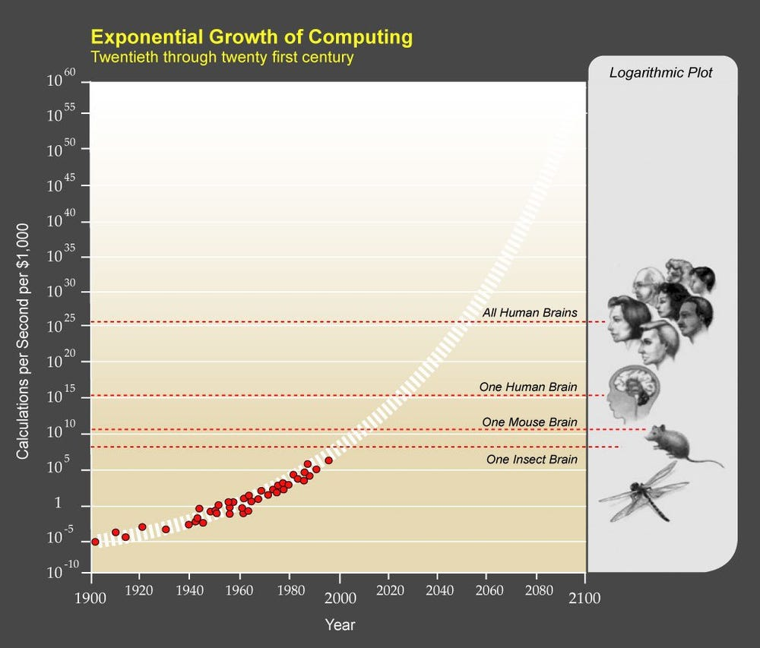
Superintelligence: From “nutty science fiction” to “plausibly achieved this summer, at least in the areas I know best”

Slide 3
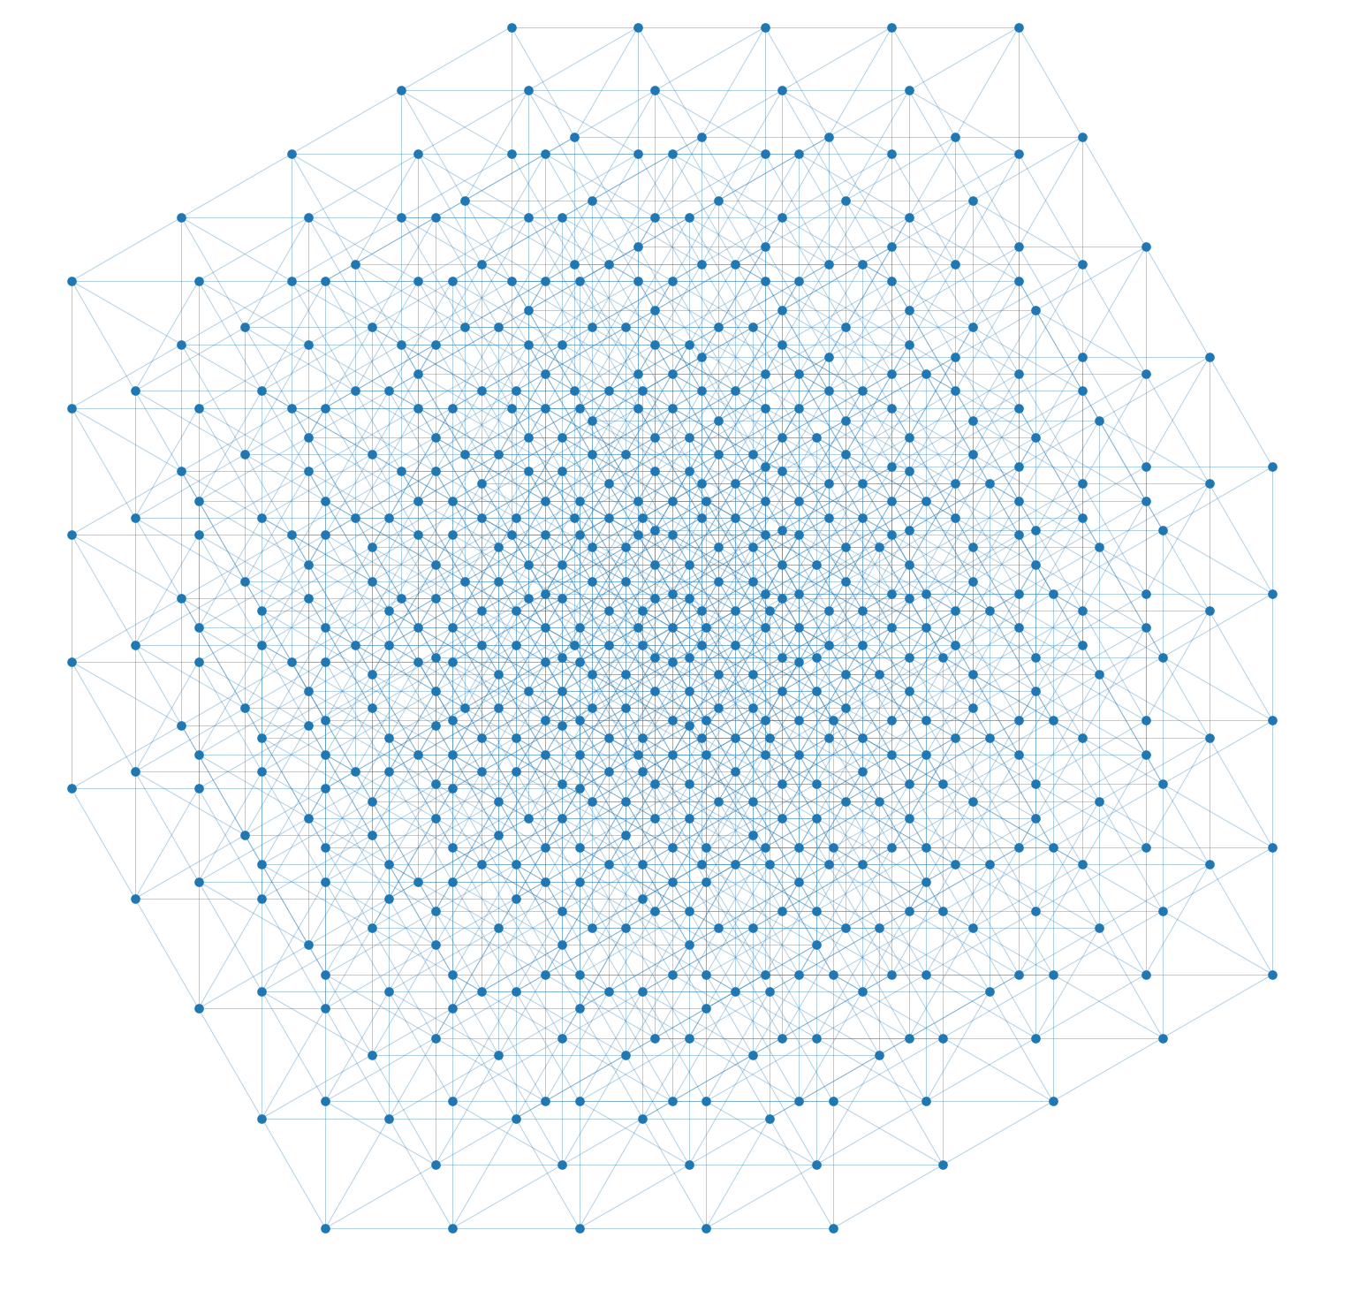
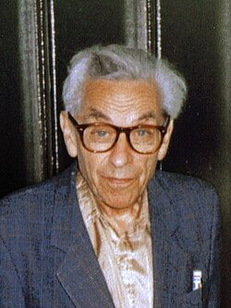
Erdős Unit Distance Conjecture (1946)
“Given n points in the plane, at most n^{1+o(1)} pairs can be distance 1 apart”
Refuted in May by an internal OpenAI model
n^{1+δ}, δ = 10⁻³⁸ → 0.035 (humans)

Slide 4
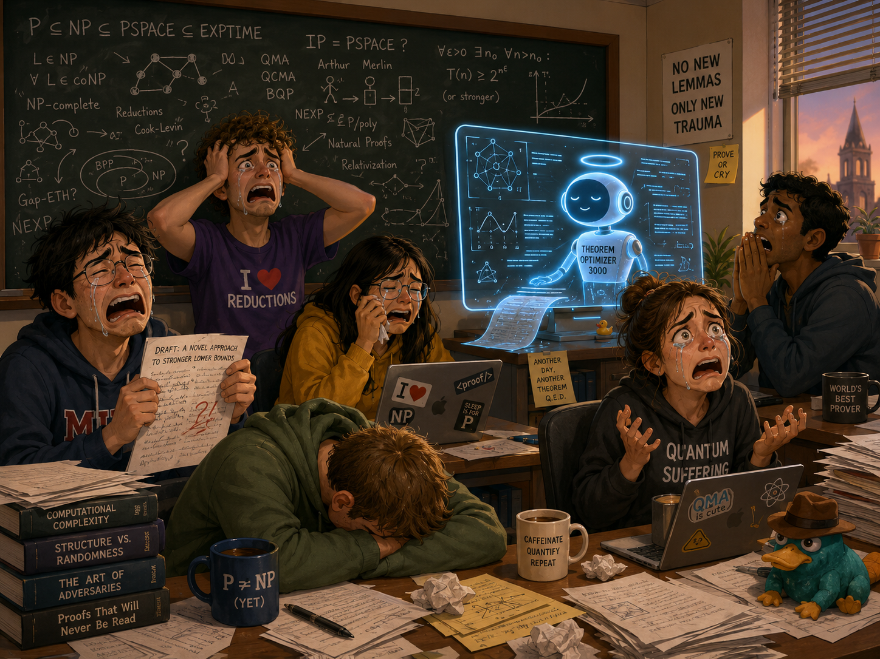
UTCS grad students when they told me the news

Slide 5
Meanwhile, commenters on my blog:
“This is just yet more AI marketing hype”
“The AI didn’t prove anything, it just generated lots of slop from which humans extracted a proof”
“The unit distance problem isn’t real math anyway, it’s just Hungarian combinatorics. Wake me up when it does algebraic geometry like Grothendieck”
“Timothy Gowers, and other experts who praised OpenAI’s result, aren’t real mathematicians”
“Erdős himself wasn’t a real mathematician either”

Slide 6
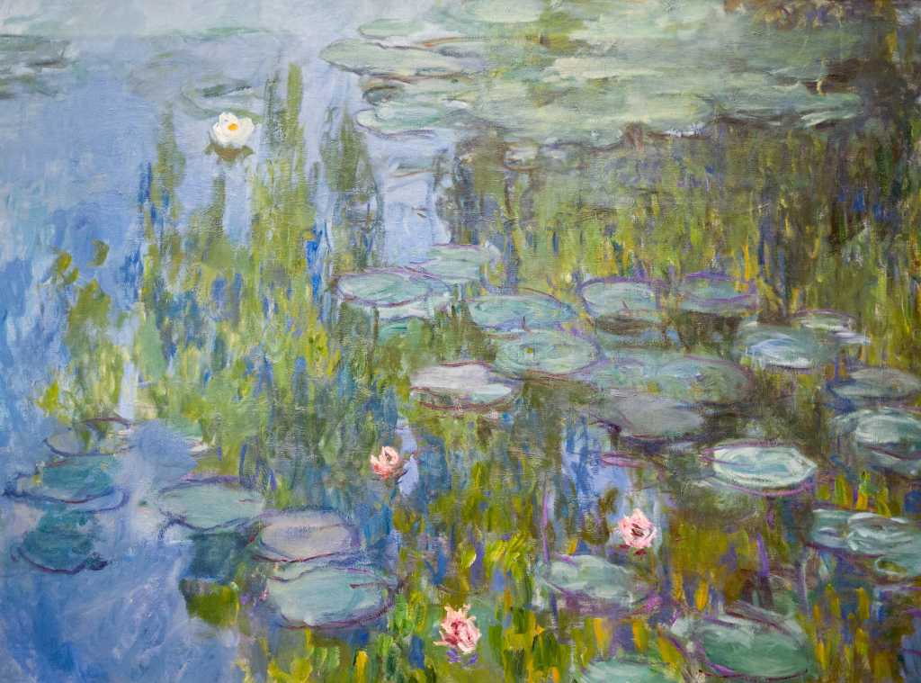
“Please describe, in as much detail as possible, what makes this inferior to a real Monet painting”
PEOPLE ON TWITTER/X:
Would not hold up next to the real thing seen F2F in a museum
There’s a certain harshness, no soft blending of colors, no depth, no symbiosis of the elements
No frame, no sense of the threshold between subject and object
Looks like high school level art 101 work, but not even, no cohesion of elements
It’s garbage
The delta exists in a space we don’t have the words to describe yet
It is (to me) emotionless. There is some spark missing. It is not Monet, it feels like an undergrad art student’s study from a museum visit.
There’s no tranquility, the water seems like it is on fire with greenish flames. It’s busy, artificial, nature in turmoil, polluted.
One can get lost in the atmosphere of a Monet, OTOH one wants to jump from the water and get far away from the place the AI crafted.
The purple on the lilypads is inconsistent with the rest of the painting. Some of the brushwork too, along with the colors of the water + reflected tree. It all adds up to make it feel like a trained but untalented student’s attempt at recreating Monet’s style.

Slide 7
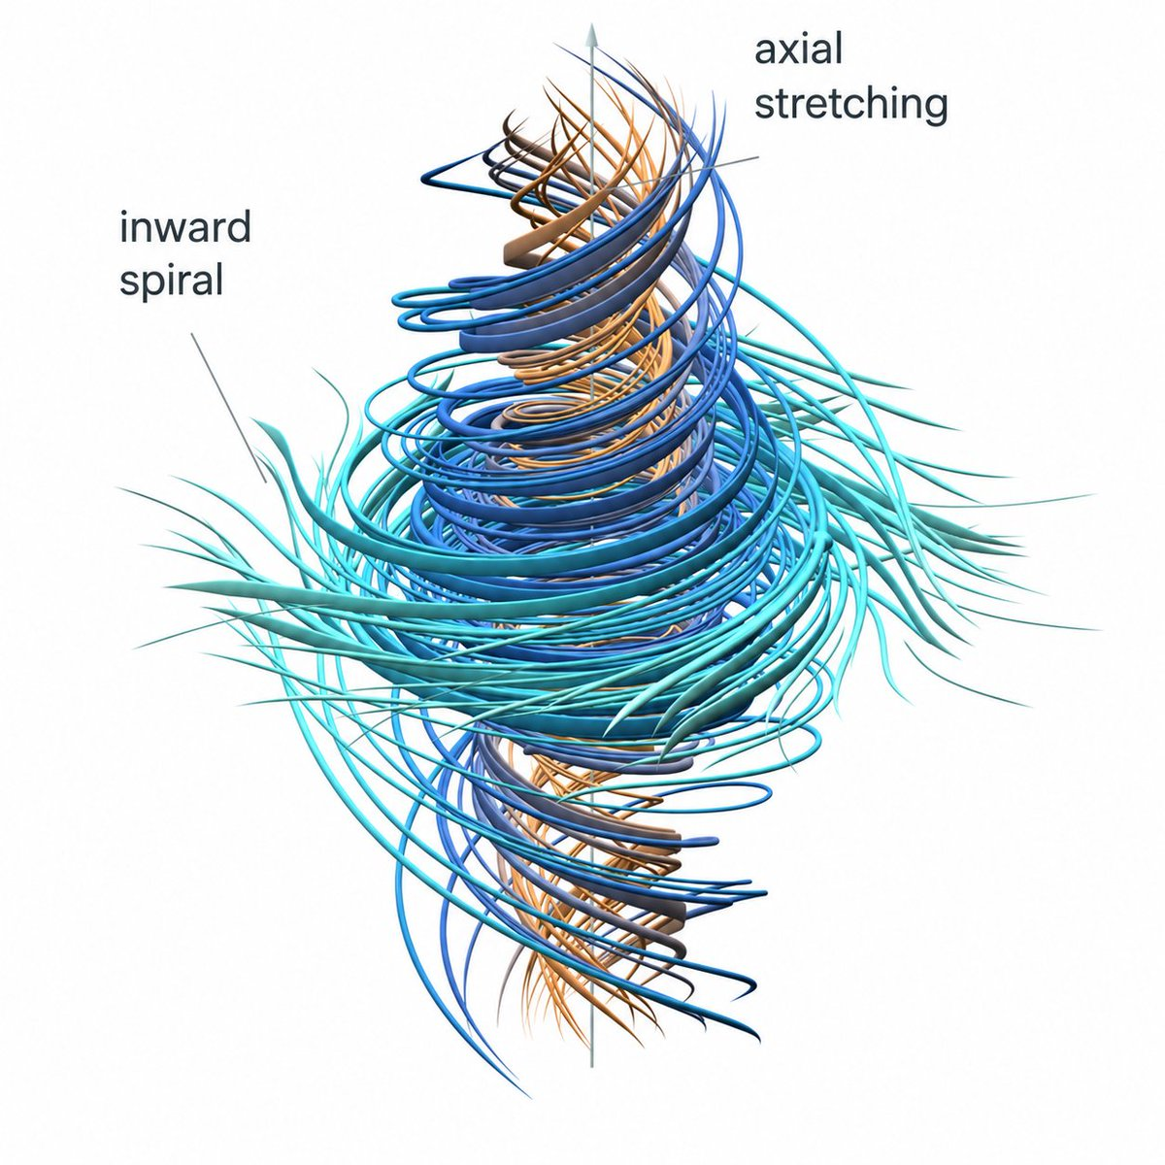
Finite-Time Blowup for Navier-Stokes Equations (with external force)

Slide 8
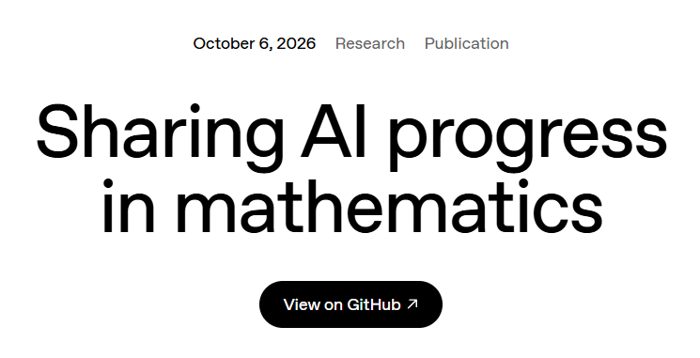
371 more across all fields (“mathocalypse”)
L = BPL
The Unique Games Conjecture
All zeta zeroes are within 3/8 of the critical line
Unitary Synthesis (A.-Kuperberg): For every n-qubit unitary U, there’s a classical oracle A such that U can be implemented in polytime given A access
Parity is not in QAC⁰
Fourier Transform and Integer Multiplication in O(n log^{0.9999999999999} n) time

Slide 9
Recent Examples of AI Use Close to Home for Me! Dramatis Personae…
PP = PreciseBQP = PostBQP
QMA
QCMA
MA
BQP
NP
BPP
P

Slide 10
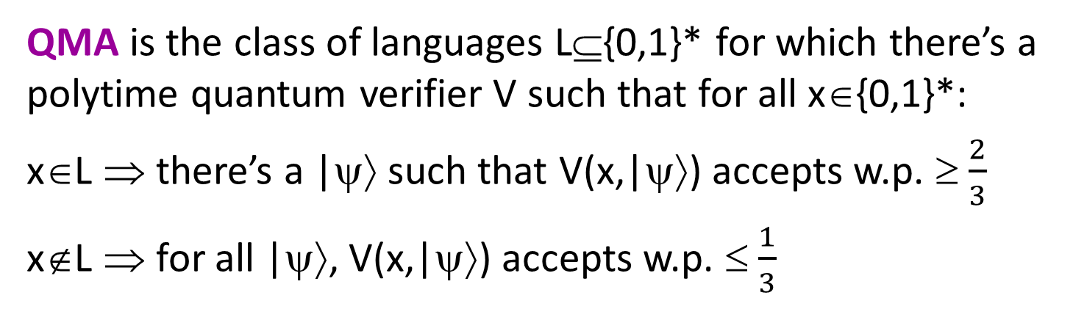
QMA Perfect Completeness Problem
QMA is the class of languages L⊆{0,1}* for which there’s a polytime quantum verifier V such that for all x∈{0,1}*:
x∈L ⇒ there’s a |ψ⟩ such that V(x,|ψ⟩) accepts w.p. ≥ $\frac{2}{3}$
x∉L ⇒ for all |ψ⟩, V(x,|ψ⟩) accepts w.p. ≤ $\frac{1}{3}$
Known: MA₁ = MA
As usual, can amplify 2/3 and 1/3 to 1-2^{-poly(n)} and 2^{-poly(n)}
Also, QCMA₁ = QCMA
(Jordan et al. 2011)
QMA₁ is the same except that if x∈L, then V(x,|ψ⟩) must accept with probability 1
(Warning: Gate-set dependent)
Clearly QMA₁ ⊆ QMA.
Longstanding open problem: Is this containment strict?

Slide 11
Theorem (A. 2009): There exists a quantum oracle U, relative to which that QMA^{U} ≠ QMA₁^{U}.
Theorem (Jeffery-Witteveen, June 2025): The completeness error in any QMA protocol can be made doubly exponentially small (!)
Theorem (A.-Witteveen-Harris, Sep. 2025): The Jeffery-Witteveen protocol is optimal relative to a quantum oracle
Went viral when I blogged about it as an early example of a complexity theorem proved with AI help

Slide 12
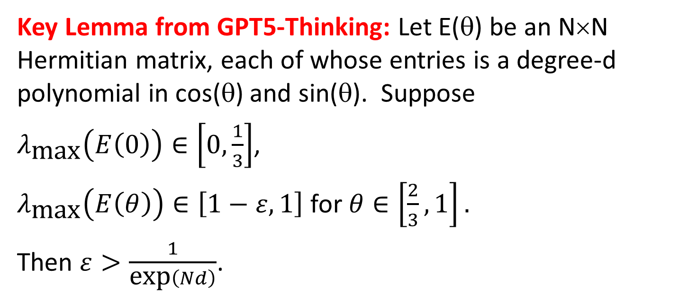

Key Lemma from GPT5-Thinking: Let E(θ) be an N×N Hermitian matrix, each of whose entries is a degree-d polynomial in cos(θ) and sin(θ). Suppose
$λ_{\text{max}}\left(E\left(0\right)\right)∈\left[0,\frac{1}{3}\right]$,
$λ_{\text{max}}\left(E\left(θ\right)\right)∈\left[1−ε,1\right]$ for $θ∈\left[\frac{2}{3},1\right].$
Then $ε>\frac{1}{\text{exp}\left(Nd\right)}$.
1
1-ε
1/3
GPT’s Proof Idea: Consider
0
$$f\left(θ\right)≔\text{Tr}\left[{\left(I−E\left(θ\right)\right)}^{−1}\right]=\sum_{k=1}^{N}{\frac{1}{1−λ_{k}\left(E\left(θ\right)\right)}}$$
Harris: Consider
f(θ) = Det(I-E(θ))

Slide 13
Whoa!
Theorem (Grewal-Rudolph and Liu-Vidick, Sep. 2026, with crucial AI contributions): QMA = QMA₁

Slide 14
Whoa! Part II
Theorem (A.-Bouland-Docter-Nehoran, Sep. 2026): There exists a quantum oracle U such that PreciseBQP^{U} ⊄ PostBQP^{U} (yet the inclusion holds for all U’s closed under inverses or complex conjugation—that part I proved with no AI help)

Slide 15
Whoa! Part III
Theorem (Bostanci et al., Sep. 2026, with help from AI): There exists a quantum oracle U such that QMA^{U} ≠ QMA(2)^{U}, where QMA(2) means QMA with two unentangled quantum witnesses
Grewal-Mutreja-Tomer, October 2026: A classical oracle separation

Slide 16
Patterns
Right now, AI seems to offer maximum alpha at
proving technical lemmas that would be “standard” for someone with different expertise than yours, and
trying many possible counterexamples or potential functions (or other tasks requiring “breadth-first search”)
It would have a huge impact on math and CS theory even if this were all it ever did! But it already isn’t

Slide 17
Apocaloptimistic Prognostications
The near future will be a golden age for solving math problems via human/AI collaboration—we won’t be cooked, we’ll be cooking!
Advice to young people: Get in on this while you can!
People with access to the latest internal models have an advantage, but it’s probably short-lived
Will even P vs. NP, Riemann, etc. fall? Dunno, but if they do, AI will almost surely play a central role

Slide 18
Apocaloptimistic Prognostications II
It’s possible that we won’t be able to do anything in math or CS theory that AI can’t do better
If that happens, I expect we’ll have bigger things to worry about than the academic job market. Everyone on earth will be affected.
If you’re worried about this, think about what math can do for AI alignment and safety! Possibly the most urgent problem in the world right now; desperate need for better mathematical foundations

