Slide 1

ARE WE COOKED?
It looks like you’re proving a circuit lower bound. Would you like help?
Scott Aaronson (University of Texas at Austin)
Can AI Do Theory?, STOC, Salt Lake City, June 27, 2026
Notes:
ZOOM THRU ZOOM THRU Thanks so much for inviting me! When I typed “quantum computer” into Google Image Search, that’s the first picture that came up. That’s apparently what they look like. (I should warn you that I’m a theorist rather than an engineer.)

Slide 2
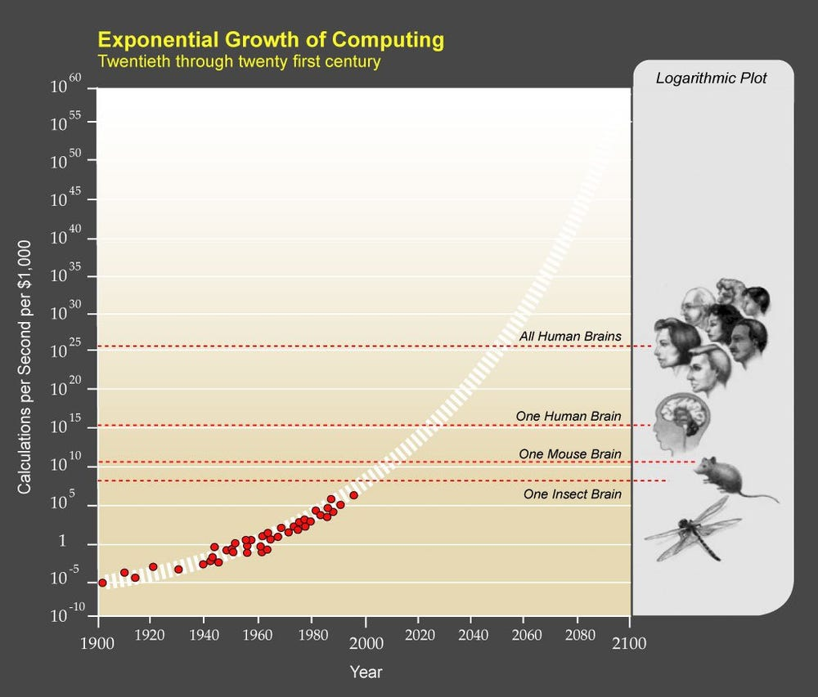

Slide 3
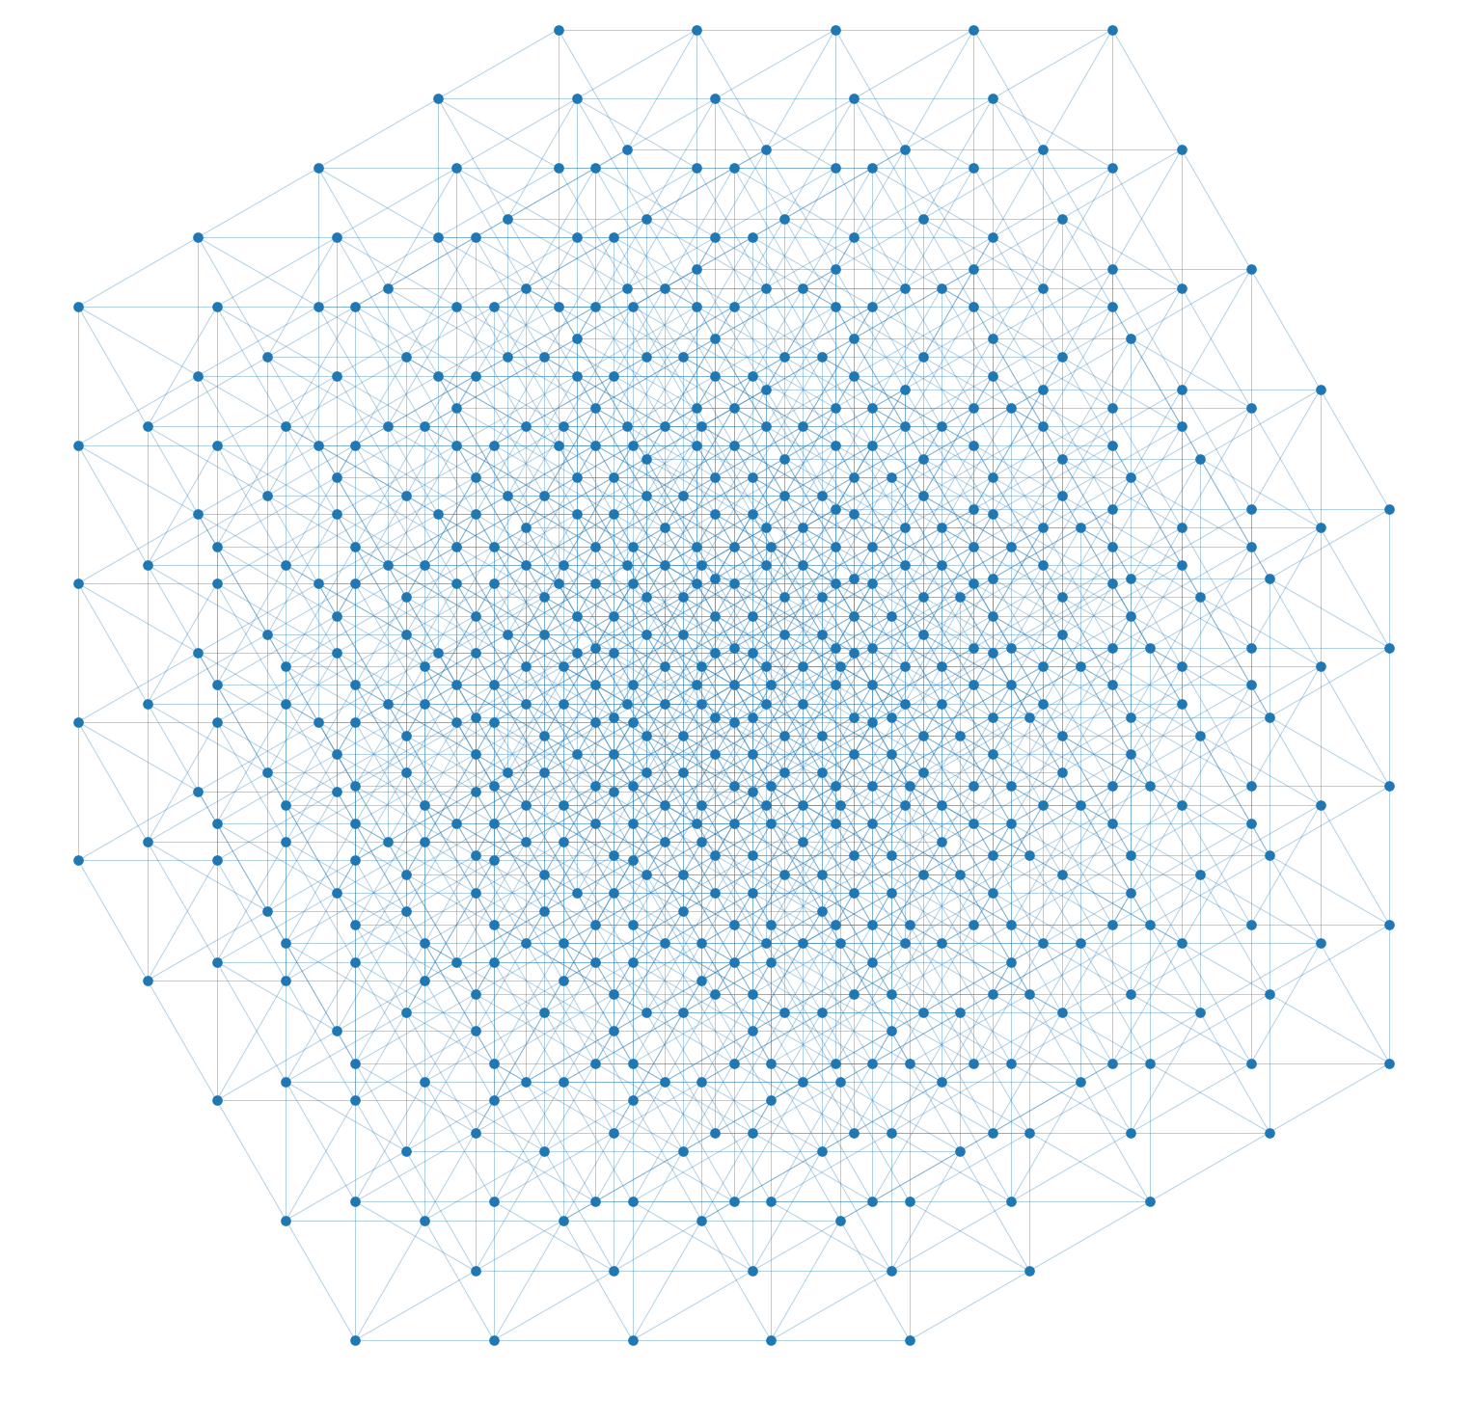
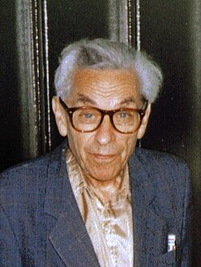
Erdős Unit Distance Conjecture (1946)
“Given n points in the plane, at most n^{1+o(1)} pairs can be distance 1 apart”
Refuted a month ago by an internal OpenAI model
n^{1+δ}, δ = 10⁻³⁸ → 0.035 (humans)

Slide 4
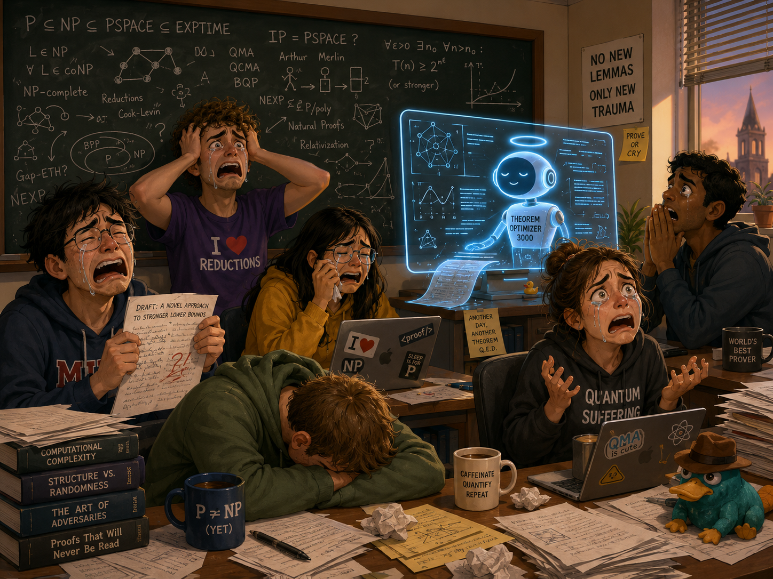
UTCS grad students when they told me the news

Slide 5
Meanwhile, commenters on my blog:
“This is just yet more AI marketing hype”
“The AI didn’t prove anything, it just generated lots of slop from which humans extracted a proof”
“The unit distance problem isn’t real math anyway, it’s just Hungarian combinatorics. Wake me up when it does algebraic geometry like Grothendieck”
“Timothy Gowers, and other experts who praised OpenAI’s result, aren’t real mathematicians”
“Erdős himself wasn’t a real mathematician either”

Slide 6

“Please describe, in as much detail as possible, what makes this inferior to a real Monet painting”
PEOPLE ON TWITTER/X:
Would not hold up next to the real thing seen F2F in a museum
There’s a certain harshness, no soft blending of colors, no depth, no symbiosis of the elements
No frame, no sense of the threshold between subject and object
Looks like high school level art 101 work, but not even, no cohesion of elements
It’s garbage
The delta exists in a space we don’t have the words to describe yet
It is (to me) emotionless. There is some spark missing. It is not Monet, it feels like an undergrad art student’s study from a museum visit.
There’s no tranquility, the water seems like it is on fire with greenish flames. It’s busy, artificial, nature in turmoil, polluted.
One can get lost in the atmosphere of a Monet, OTOH one wants to jump from the water and get far away from the place the AI crafted.
The purple on the lilypads is inconsistent with the rest of the painting. Some of the brushwork too, along with the colors of the water + reflected tree. It all adds up to make it feel like a trained but untalented student’s attempt at recreating Monet’s style.

Slide 7
My Own Recent Examples of AI Use: Dramatis Personae
PP = PQP = PostBQP
QMA
QCMA
MA
BQP
NP
BPP
P

Slide 8
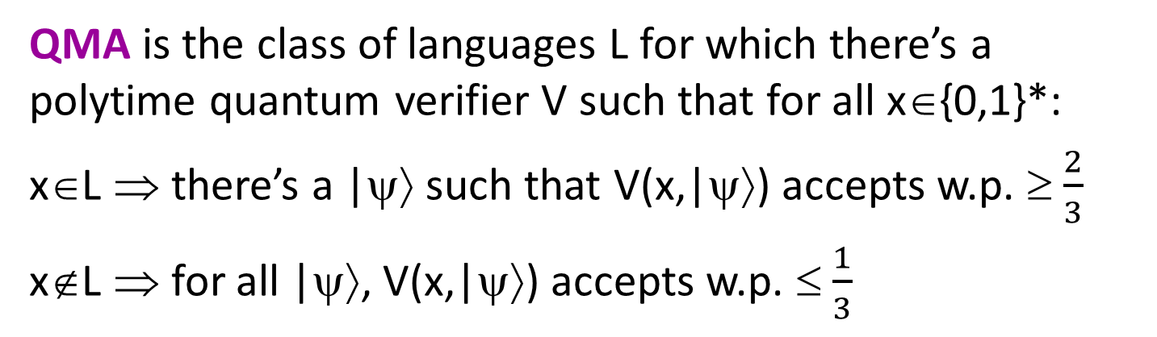
QMA Perfect Completeness Problem
QMA is the class of languages L for which there’s a polytime quantum verifier V such that for all x∈{0,1}*:
x∈L ⇒ there’s a |ψ⟩ such that V(x,|ψ⟩) accepts w.p. ≥ $\frac{2}{3}$
x∉L ⇒ for all |ψ⟩, V(x,|ψ⟩) accepts w.p. ≤ $\frac{1}{3}$
Reminder: MA₁ = MA
As usual, can amplify 2/3 and 1/3 to 1-2^{-poly(n)} and 2^{-poly(n)}
Also, QCMA₁ = QCMA
(Jordan et al. 2011)
QMA₁ is the same except that if x∈L, then V(x,|ψ⟩) must accept with probability 1
Warning: Gate-set dependent!
Clearly QMA₁ ⊆ QMA.
Longstanding open problem: Is this containment strict?

Slide 9
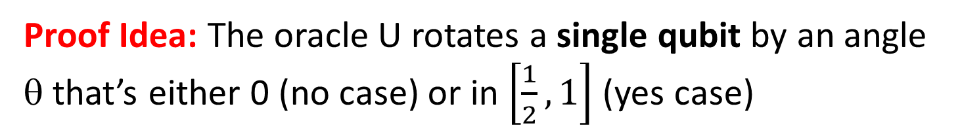
Theorem (A. 2009): There exists a quantum oracle U, relative to which that QMA^{U} ≠ QMA₁^{U}.
Proof Idea: The oracle U rotates a single qubit by an angle θ that’s either 0 (no case) or in $\left[\frac{1}{2},1\right]$ (yes case)
We can easily decide which in QMA^{U} and even BQP^{U}
But to decide in QMA₁^{U}, the acceptance probability would need to go like this:
1
Acceptance probability
Maximum of finitely many real analytic functions
0
0
½
1
DOESN’T WORK!
θ

Slide 10

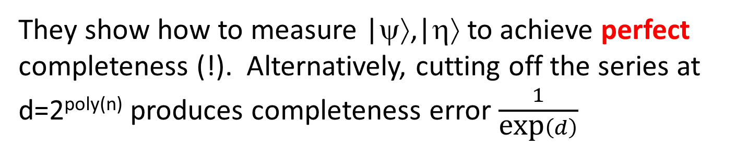
Blockbuster Result from Last Year
Theorem (Jeffery-Witteveen): QMA can be amplified to completeness error 1/exp(exp(n))
Rough Idea: Suppose Arthur accepts with maximum probability p>½. Then in addition to the witness |ψ⟩ accepted with probability p, Merlin provides a state |η⟩ that encodes p via an infinite decreasing geometric series:
$$|\left.η\right\rangle ≔\sqrt{1−γ^{2}}\sum_{d=1}^{∞}{γ^{d}|\left.d\right\rangle , γ≔\frac{1−p}{p}}$$
They show how to measure |ψ⟩,|η⟩ to achieve perfect completeness (!). Alternatively, cutting off the series at d=2^{poly(n)} produces completeness error $\frac{1}{\text{exp}\left(d\right)}$

Slide 11
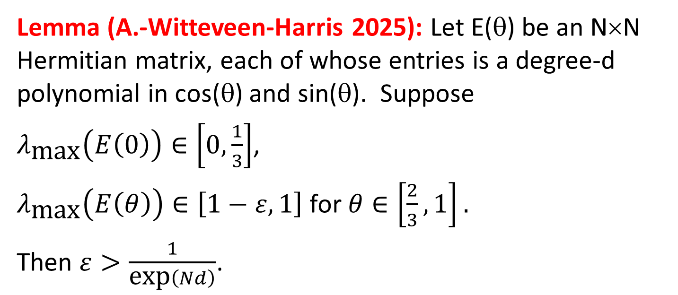
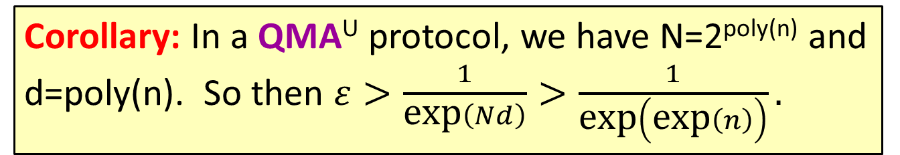
What GPT5 Helped Us Show: 1/exp(exp(n)) Is Black-Box Optimal
Lemma (A.-Witteveen-Harris 2025): Let E(θ) be an N×N Hermitian matrix, each of whose entries is a degree-d polynomial in cos(θ) and sin(θ). Suppose
$λ_{\text{max}}\left(E\left(0\right)\right)∈\left[0,\frac{1}{3}\right]$,
$λ_{\text{max}}\left(E\left(θ\right)\right)∈\left[1−ε,1\right]$ for $θ∈\left[\frac{2}{3},1\right].$
Then $ε>\frac{1}{\text{exp}\left(Nd\right)}$.
1
1-ε
Corollary: In a QMA^{U} protocol, we have N=2^{poly(n)} and d=poly(n). So then $ε>\frac{1}{\text{exp}\left(Nd\right)}>\frac{1}{\text{exp}\left(\text{exp}\left(n\right)\right)}.$
1/3
0

Slide 12
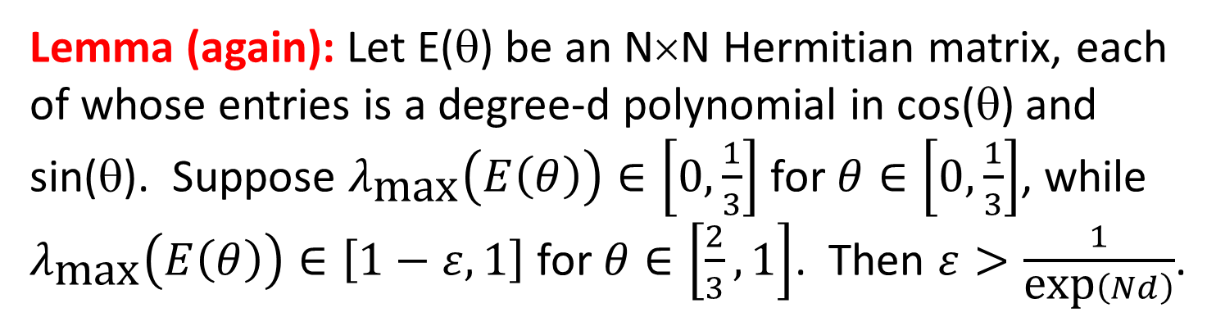
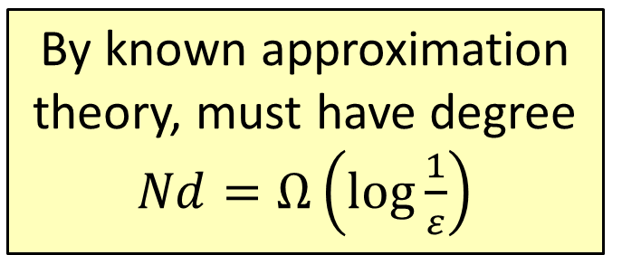
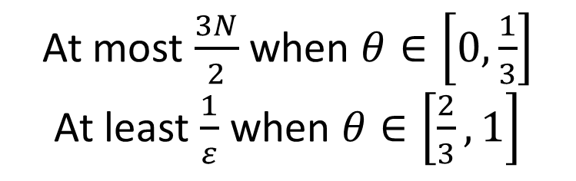
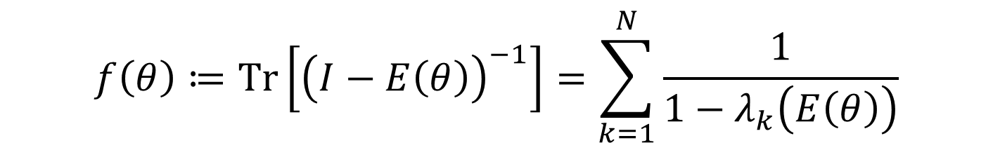
Lemma (again): Let E(θ) be an N×N Hermitian matrix, each of whose entries is a degree-d polynomial in cos(θ) and sin(θ). Suppose $λ_{\text{max}}\left(E\left(θ\right)\right)∈\left[0,\frac{1}{3}\right]$ for $θ∈\left[0,\frac{1}{3}\right]$, while $λ_{\text{max}}\left(E\left(θ\right)\right)∈\left[1−ε,1\right]$ for $θ∈\left[\frac{2}{3},1\right]$. Then $ε>\frac{1}{\text{exp}\left(Nd\right)}$.
Note: A human mathematician reading my blog (Phillip Harris) then suggested f(θ) = Det(I-E(θ)), which also works and is even simpler
Proof Idea: Consider
$$f\left(θ\right)≔\text{Tr}\left[{\left(I−E\left(θ\right)\right)}^{−1}\right]=\sum_{k=1}^{N}{\frac{1}{1−λ_{k}\left(E\left(θ\right)\right)}}$$
Suggested by GPT5-Thinking!
Rational function in cos(θ), sin(θ) of degree O(Nd)
By known approximation theory, must have degree $Nd=Ω\left(\log{\frac{1}{ε}}\right)$
At most $\frac{3N}{2}$ when $θ∈\left[0,\frac{1}{3}\right]$
At least $\frac{1}{ε}$ when $θ∈\left[\frac{2}{3},1\right]$

Slide 13
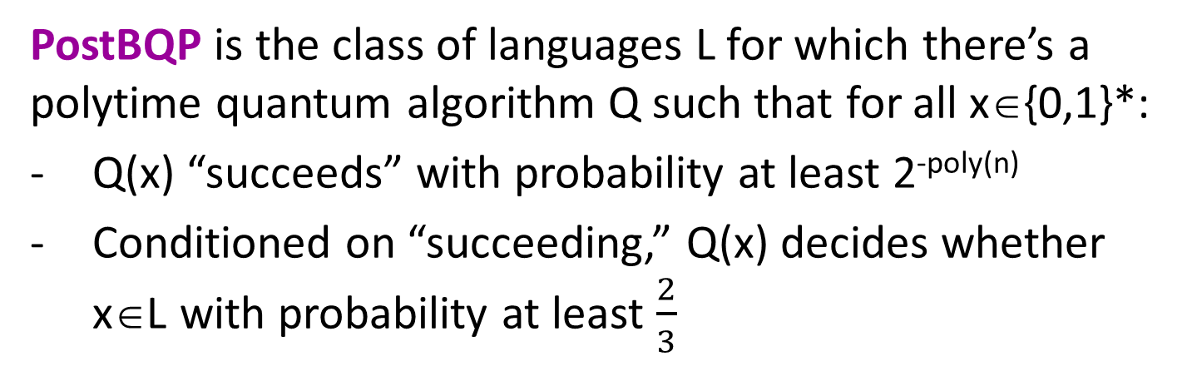
The Power of Postselection
PostBQP is the class of languages L for which there’s a polytime quantum algorithm Q such that for all x∈{0,1}*:
Q(x) “succeeds” with probability at least 2^{-poly(n)}
Conditioned on “succeeding,” Q(x) decides whether x∈L with probability at least $\frac{2}{3}$
PP is the class of languages L for which there’s a polytime algorithm A such that for all x∈{0,1}*:
If x∈L then Pr[A(x) accepts] > ½ + 2^{-poly(n)}
If x∉L then Pr[A(x) accepts] < ½ - 2^{-poly(n)}
Theorem (A. 2004): PostBQP = PP.
To prove PostBQP ⊆ PP: Almost the same as BQP ⊆ PP

Slide 14

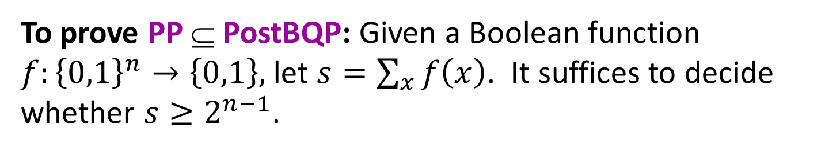



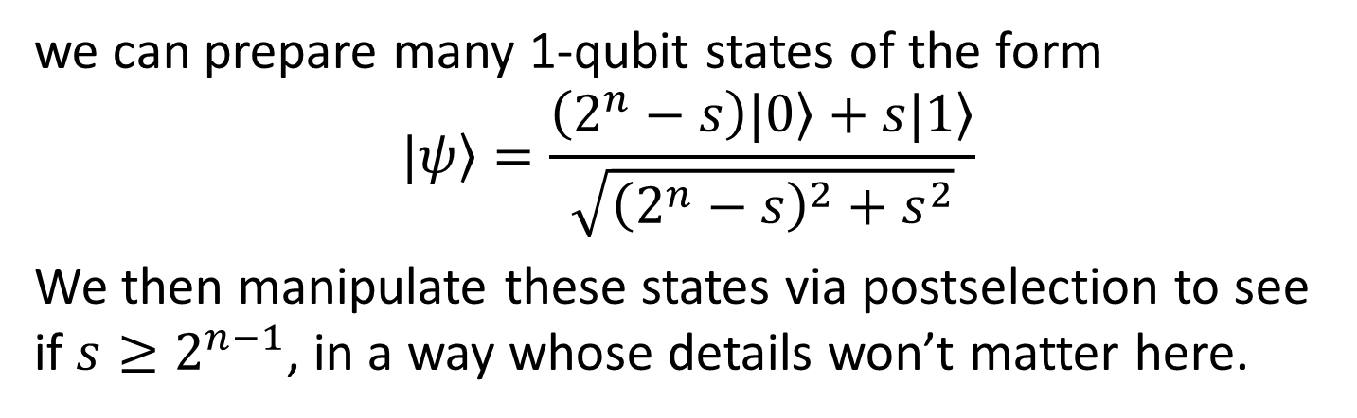

To prove PP ⊆ PostBQP: Given a Boolean function $f:{\left\{0,1\right\}}^{n}→\left\{0,1\right\},$ let $s=\sum_{x}{f\left(x\right)}$. It suffices to decide whether $s≥2^{n−1}$.
Using the circuit
|0⟩
H
H
|0⟩
$$⋮$$
$$⋮$$
$$⋮$$
$$⋮$$
$$⋮$$
f
|0⟩
H
H
|0⟩
|0⟩
|ψ⟩
we can prepare many 1-qubit states of the form
$$|\left.ψ\right\rangle =\frac{\left(2^{n}−s\right)|\left.0\right\rangle +s|\left.1\right\rangle }{\sqrt{{\left(2^{n}−s\right)}^{2}+s^{2}}}$$
We then manipulate these states via postselection to see if $s≥2^{n−1}$, in a way whose details won’t matter here.

Slide 15
Adam Bouland’s Question: Does PP ⊆ PostBQP relativize?
Certainly PP^{A} ⊆ PostBQP^{A} for all classical oracles A
But does PQP^{U} ⊆ PostBQP^{U} for all quantum oracles U?
I was able to show: PQP^{U} ⊆ PostBQP^{U} for all U closed under inverses or complex conjugation (i.e., you can also query U⁻¹ or U*), which includes all U of poly(n) dimension
With the help of GPT5Pro, A., Bouland, Docter, Nehoran have been able to show: There exists an exponentially large diagonal unitary U (not closed under inverses / conjugation…) such that PQP^{U} ⊄ PostBQP^{U}

Slide 16
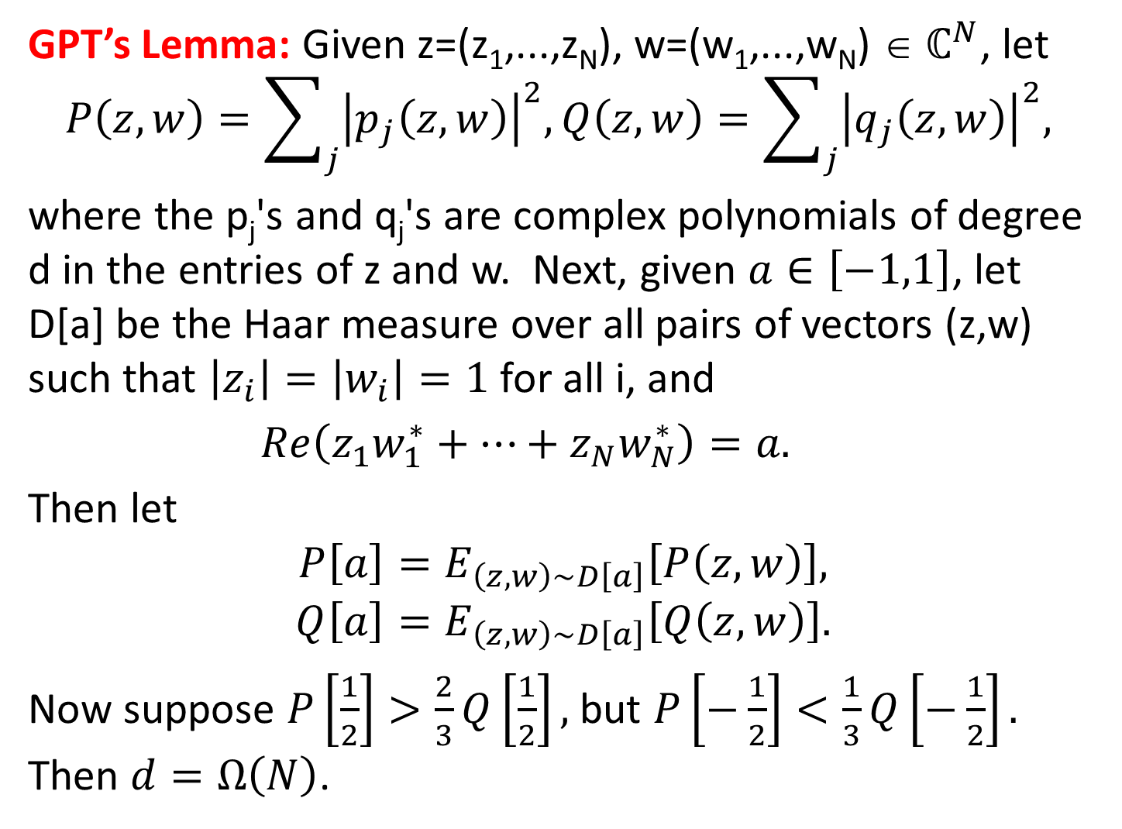
GPT’s Lemma: Given z=(z₁,...,z_{N}), w=(w₁,...,w_{N}) ∈ $ℂ^{N}$, let
$$P\left(z,w\right)=\sum_{j}{{\left|p_{j}\left(z,w\right)\right|}^{2}, Q\left(z,w\right)=\sum_{j}{{\left|q_{j}\left(z,w\right)\right|}^{2}, }}$$
where the p_{j}'s and q_{j}'s are complex polynomials of degree d in the entries of z and w. Next, given $a∈\left[−1,1\right]$, let D[a] be the Haar measure over all pairs of vectors (z,w) such that $\left|z_{i}\right|=\left|w_{i}\right|=1$ for all i, and
$Re\left(z_{1}w_{1}^{∗}+…+z_{N}w_{N}^{∗}\right)=a.$
Then let
$$P\left[a\right]=E_{\left(z,w\right)\sim D\left[a\right]}\left[P\left(z,w\right)\right],$$
$$Q\left[a\right]=E_{\left(z,w\right)\sim D\left[a\right]}\left[Q\left(z,w\right)\right].$$
Now suppose $P\left[\frac{1}{2}\right]>\frac{2}{3}Q\left[\frac{1}{2}\right],$ but $P\left[−\frac{1}{2}\right]<\frac{1}{3}Q\left[−\frac{1}{2}\right].$ Then $d=Ω\left(N\right)$.

Slide 17
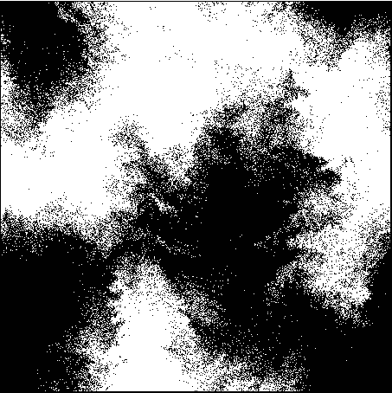
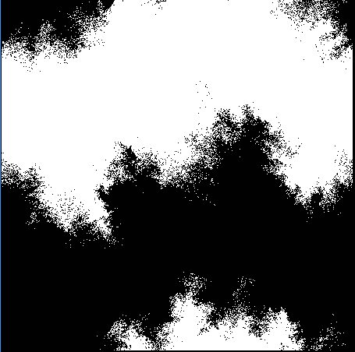
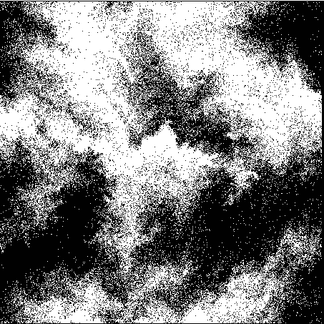
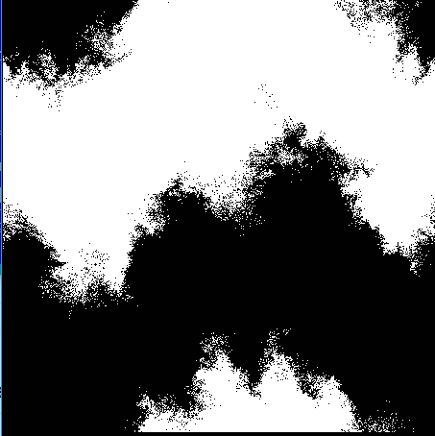

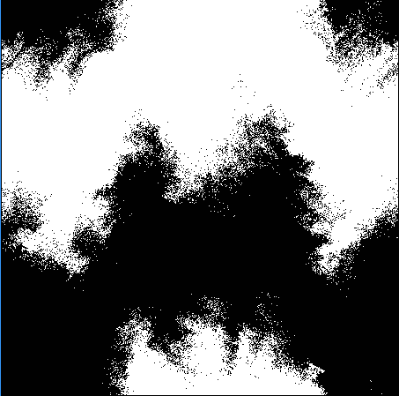
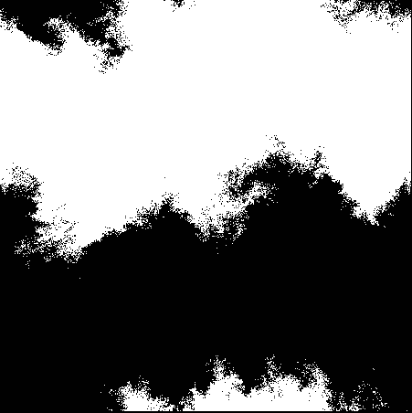

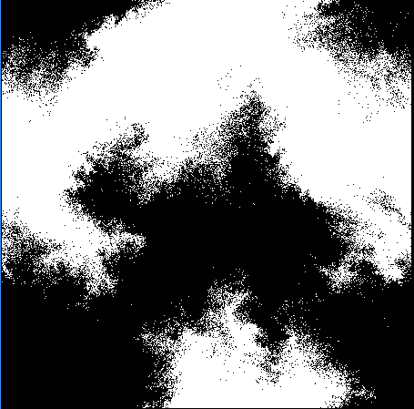
An Example In Progress
With Sean Carroll et al., we’ve been studying the rise and fall of coarse-grained entropy, in 2D lattice models of cream being stirred into coffee
GPT5Pro helped us prove:
These “shearing dynamics” eventually mix (needs some group theory, analogous to Rubik’s Cube)
Pure diffusion dynamics never produce any nontrivial coarse-grained entropy

Slide 18
Patterns
Right now, AI seems to offer maximum alpha at
proving technical lemmas that would be “standard” for someone with different expertise than yours, and
trying many possible counterexamples or potential functions (or other tasks requiring “breadth-first search”)
It will have a big impact on TCS even if that’s all it ever does! But no one should feel reassured that it will be

Slide 19
Apocaloptimistic Prognostications
The near future will be a golden age for solving TCS problems via human/AI collaboration—we won’t be cooked, we’ll be cooking!
Advice to young people: Get in on this while you can!
People with access to the latest internal models will have an advantage, but it will probably be short-lived
Will even P vs. NP fall? Dunno, but if such questions are ever solved at all, AI is likely to have played a role

Slide 20
Apocaloptimistic Prognostications II
Eventually, it’s possible that we won’t be able to do anything in TCS that AI can’t do better
If that happens, I expect we’ll have bigger things to worry about than the TCS job market. Everyone on earth will be affected.
If you’re worried about this, my advice is to think about what TCS can do for AI alignment and safety! Tons of opportunities there right now

