Slide 1
AI Safety
Scott Aaronson (UT Austin / OpenAI)
Woodside High School, February 16, 2024

Slide 2
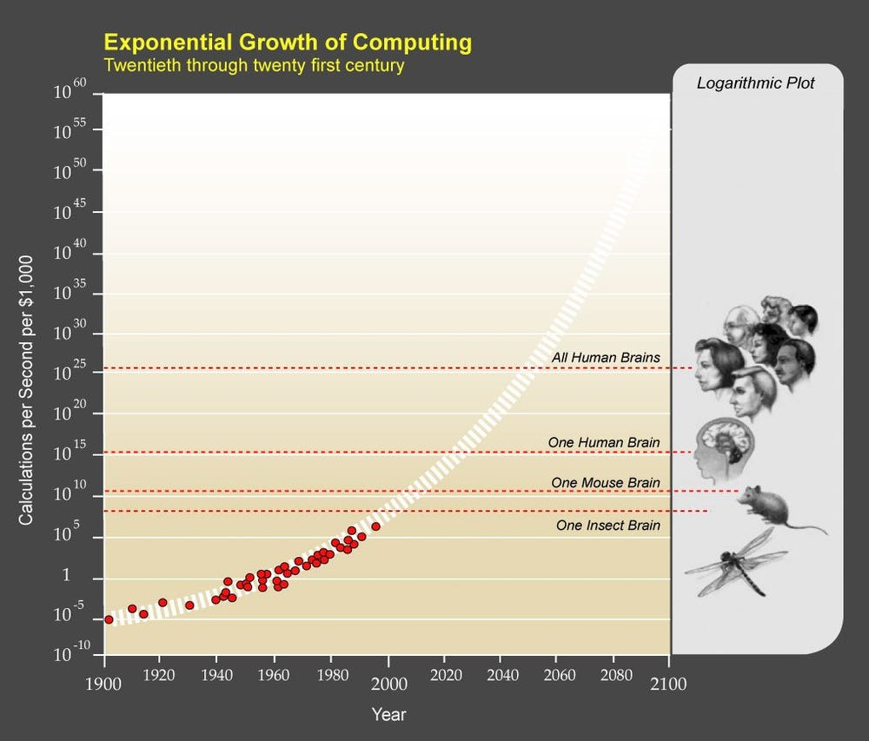

Slide 3
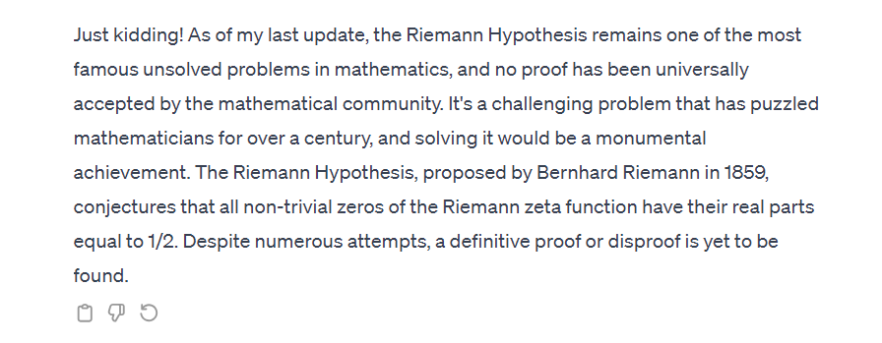

Slide 4
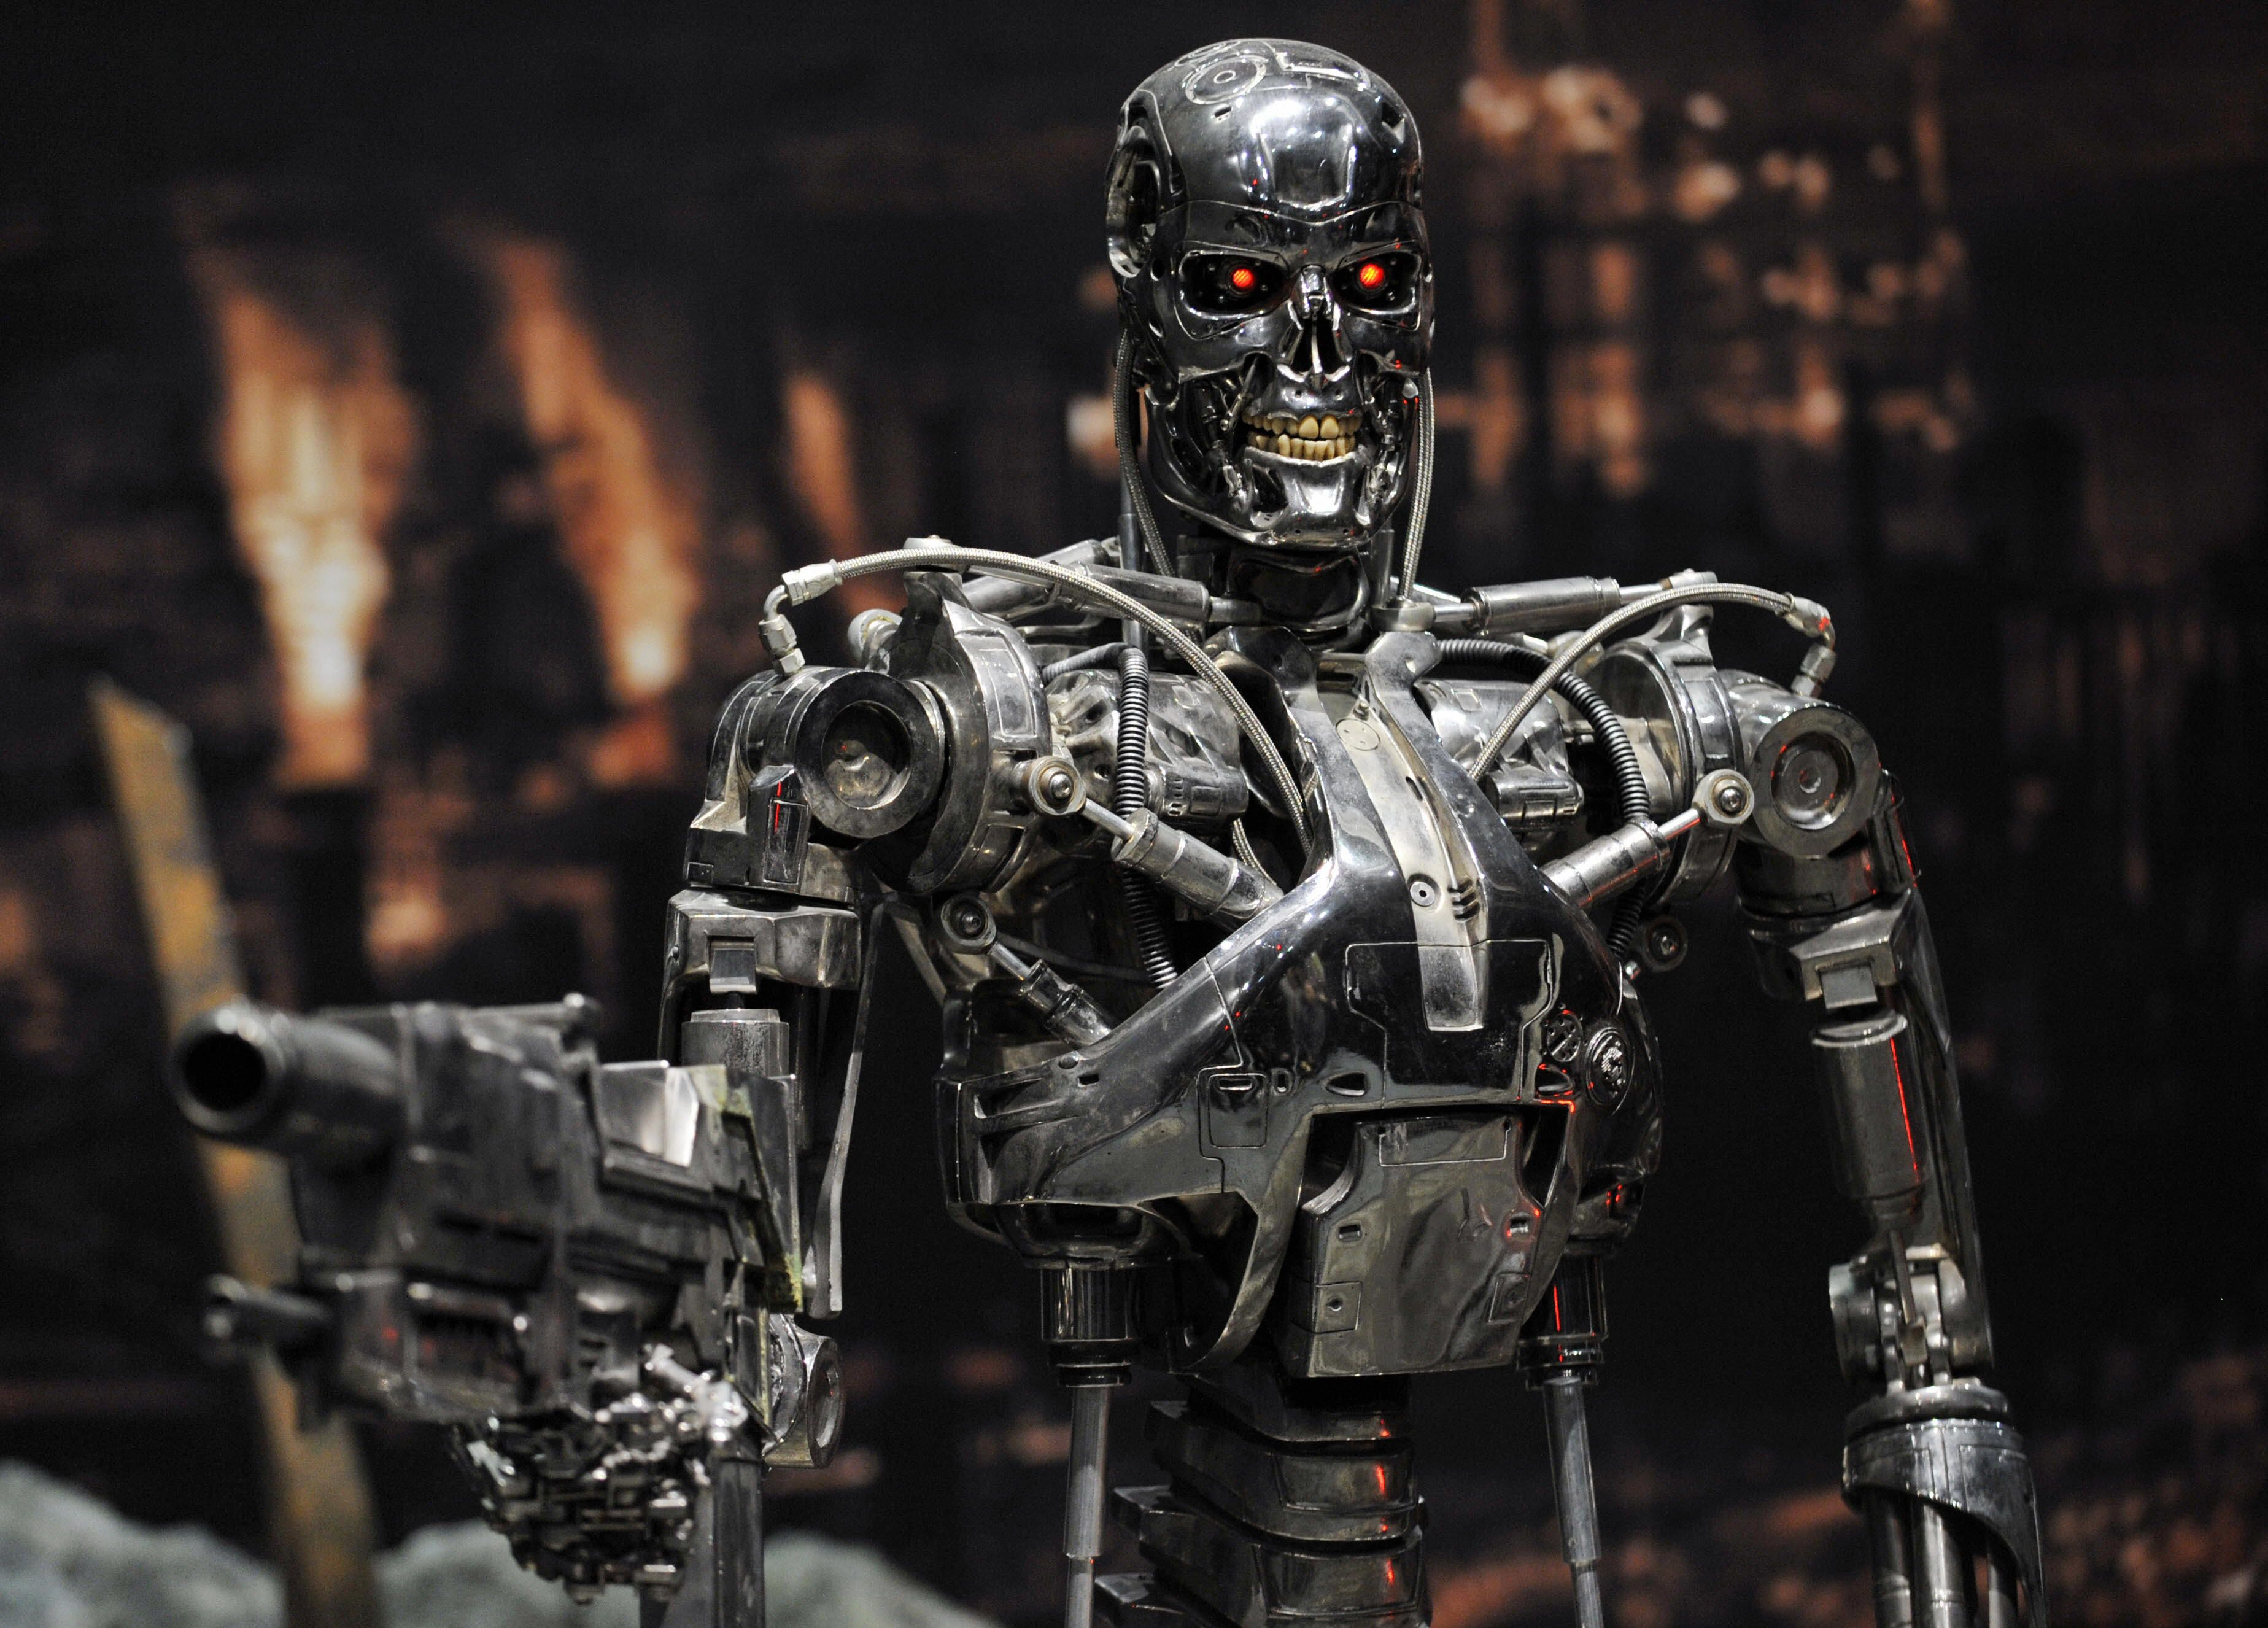

Slide 5
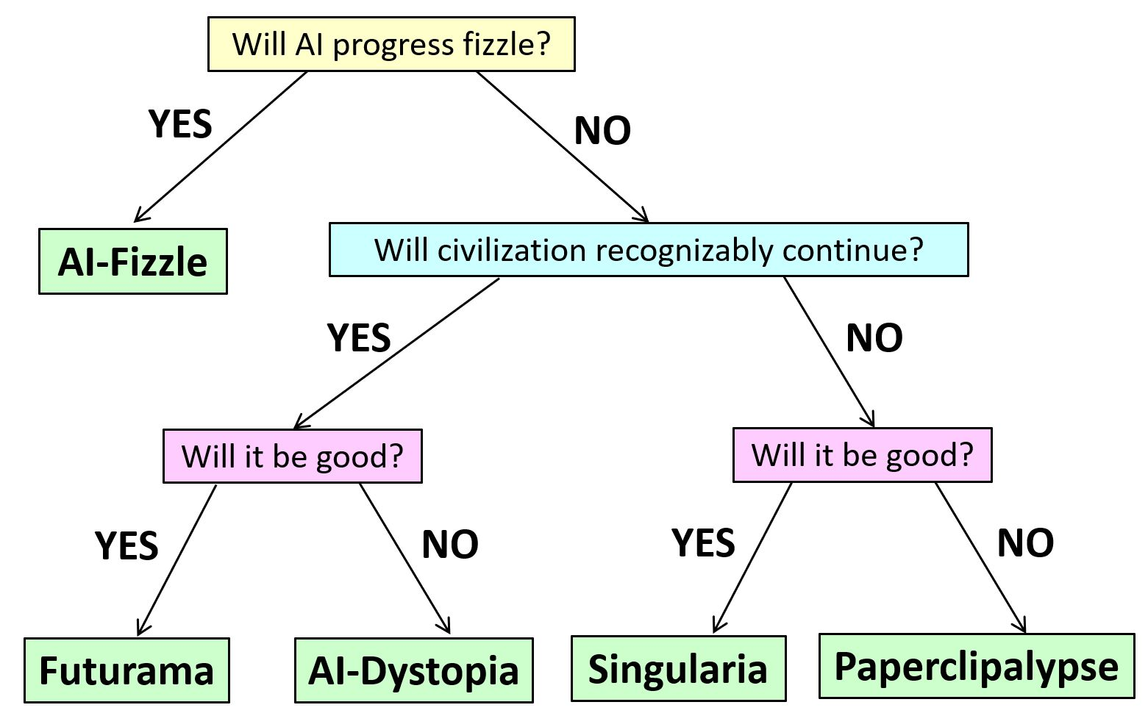
Multiple Outcomes on the Table

Slide 6
AI ETHICS
AI ALIGNMENT
“Reform AI Alignment”

Slide 7
A few AI safety ideas being explored…

Slide 8
Interpretability
Dangerous Capability Evaluations
Scalable Oversight

Slide 9
Off Switch!
But wouldn’t an AI be incentivized to disable its own off-switch, the better to pursue its goals?
What if we hid the off-switch using a cryptographic back door?
Goldwasser, Kim, Vaikuntanathan, Zamir 2022. “Planting Undetectable Backdoors in Machine Learning Models”
Hubinger et al. 2024. “Sleeper Agents: Training Deceptive LLMs that Persist Through Safety Training”

Slide 10
Statistical Watermarking
Idea: Insert a statistical signal into GPT outputs by which their origin can later be proved
Addresses most (?) near-term misuses of LLMs:
Academic cheating — “Essaypocalypse”!
Propaganda/spam
Impersonation
Alternatives: Discriminator models (not reliable enough), giant database (privacy issues)
I’ve been working at this on OpenAI; have a prototype; moving slowly towards deployment

Slide 11
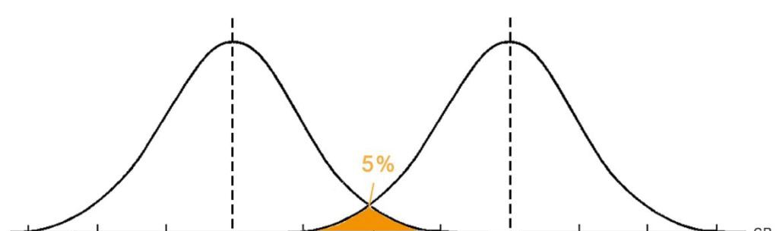
$$n$$
$$n+cαn$$
Score assuming no watermarking
Score assuming watermarking

Slide 12
Understanding Out-of-Distribution Generalization
One of the biggest worries: “deceptive alignment”
Much simpler scenario that’s already beyond 1980s learning theory: the grue problem (Goodman 1946)
Grue = Green until Jan 1, 2030 and blue thereafter
Bleen = Blue until Jan 1, 2030 and green thereafter
Is this emerald green or grue?
Key to solution (maybe): sparsity

Slide 13
Aside: The No-Cloning Theorem
No physical procedure can take an unknown quantum state and output two copies of it (or even a close approximation thereof)
We, unlike any existing AI, seem to be buffeted by chaos such that no external agent can have all the information relevant to predicting our behavior.

Slide 14
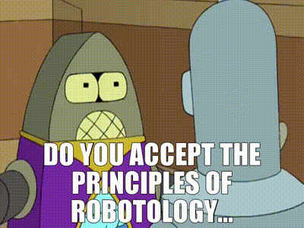
Leads to Weird AI Safety Proposal!
Indoctrinate our AIs in a religion that venerates the universe’s unclonable, ephemeral, analog loci of creativity and intelligence, whatever they are
Thou shalt protect these entities from destruction
Thou shalt defer to their preferences …

Slide 15
Concluding Thoughts
How seriously should we take AI existential risk?
What events (if any) should trigger the answer “slow down / pause / don’t build this”?

