Slide 1

Reform AI Alignment
Scott Aaronson (UT Austin / OpenAI)
Yale Data Science Institute, September 22, 2023

Slide 2
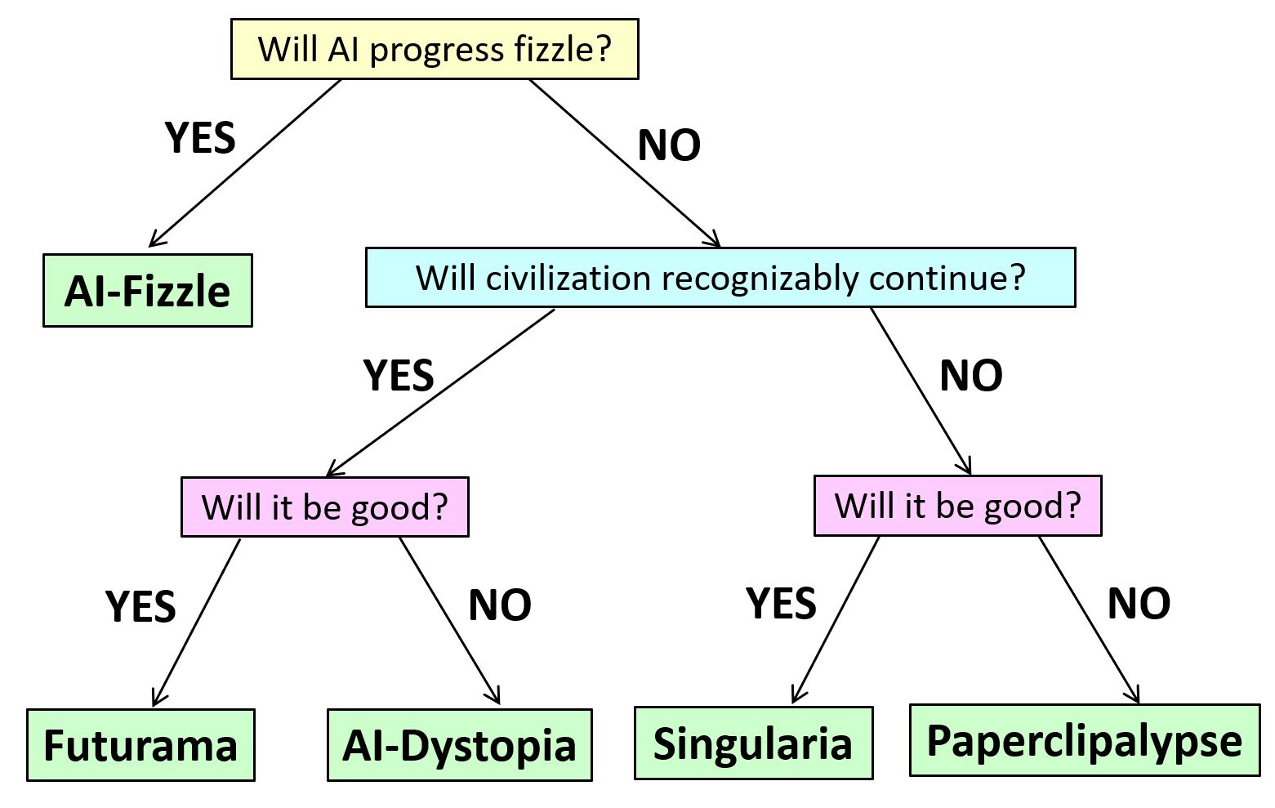
Five Worlds of AI, post-GPT-4
From a joint blog post by me and Boaz Barak

Slide 3
AI ETHICS
Worried about AI-Dystopia
AI ALIGNMENT
Worried about Paperclipalypse
“Reform AI Alignment”
Whatever the worry, start where you can make progress!

Slide 4
Thesis of Talk
There’s a tremendous opportunity to make near-term progress on AI safety, by thinking about cryptographic functionality inside or on top of neural nets
This “neurocryptography” [better names welcome] might be a large fraction of the future of cryptography
In addition to the technical challenges, there are huge conceptual challenges in defining the attack models for AI, and social challenges in coordinating the AI companies to deploy solutions

Slide 5
Examples
Watermarking: Can we make the outputs of generative AI identifiable as such?
Cryptographic Backdoors: Can we insert secret inputs into an AI, by which to recognize or control it later?
Privacy-Preserving ML, Copyright Protection, Obfuscation of Public Models…: Can we protect training data and model weights from people who shouldn’t have access to them?
Proofs of Model Properties, Robustness Against Adversarial Examples, and Much More!

Slide 6
Major Tasks of Reform AI Alignment That I Won’t Discuss Further Today
Interpretability: “Reverse engineering” of neural nets to search for deceptive behavior, etc.—cf. Steinhardt
Dangerous Capability Evaluations and Fire Alarms
Theories of Out-of-Distribution Generalization: How to recognize and prevent “deceptive alignment”

Slide 7
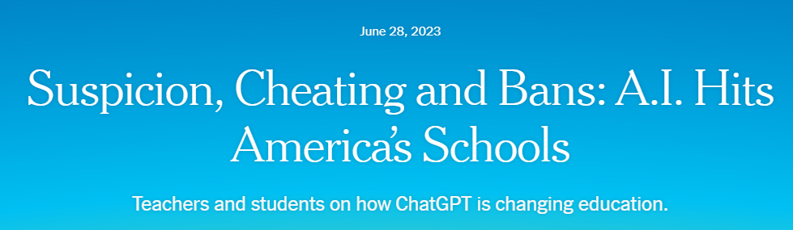
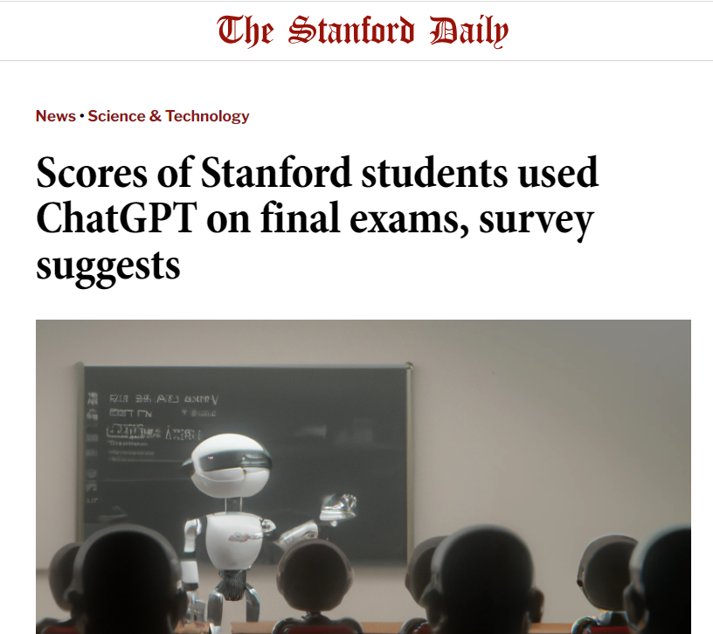
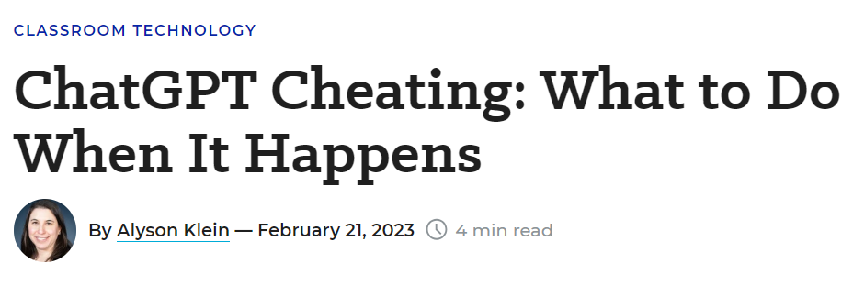
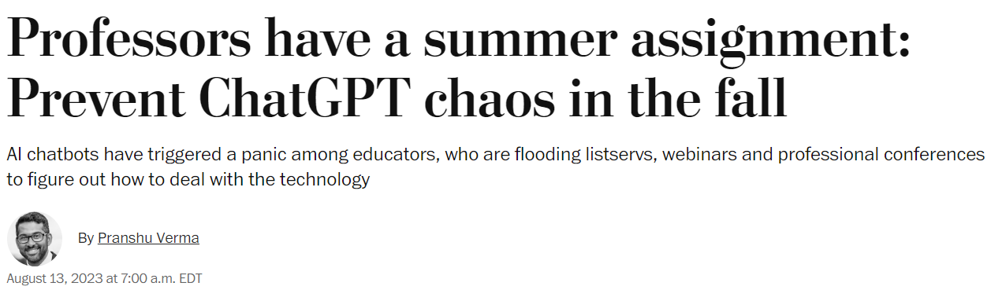
The Attribution Problem
Insight: Almost any nefarious near-term use of Large Language Models that you can think of (cheating, propaganda, fraud, spam…) involves concealing the LLM’s involvement. If only we could make that harder!

Slide 8
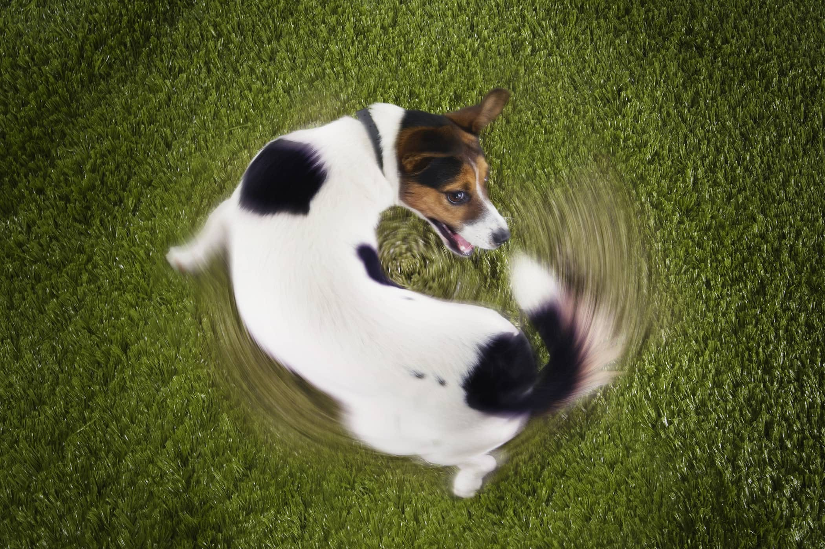
Another reason to care about attribution
As the Internet gets filled with LLM-generated text, we’ll often need to prevent that text from getting fed back in as training data… which requires recognizing it

Slide 9
Proposed Solutions
Just look for formulaic prose, or “As a large language model…” ☺
Metadata ← trivial to remove from text!
Giant database of completions ← privacy?
Discriminator models, like GPTZero or DetectGPT or Ghostbuster ← too many false positives?
Watermarking: inserting a statistical signal into the LLM’s choice of tokens

Slide 10
Brief History of LLM Watermarking
My moment of terror (~July 2022): Led me to propose a watermarking scheme based on the “Gumbel Softmax Rule” and pseudorandom functions, prove theorems, give talks about it.
Kirchenbauer et al. (Jan. 2023): Modify the LLM probabilities using a pseudorandom function of n-grams
Christ, Gunn, Zamir (June 2023): Watermarked output that’s cryptographically indistinguishable from normal LLM output—rediscovered most of my proposal and more
Kuditipudi et al. (July 2023): Watermarking using “one-time pad” rather than pseudorandom function

Slide 11
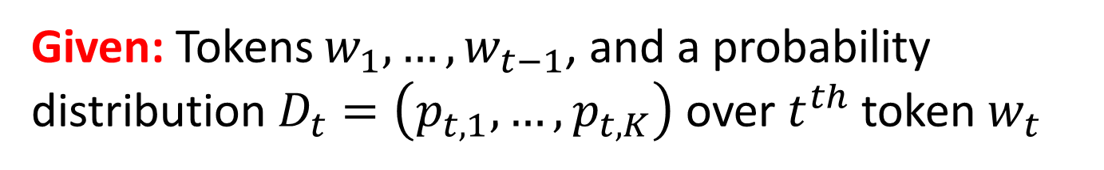
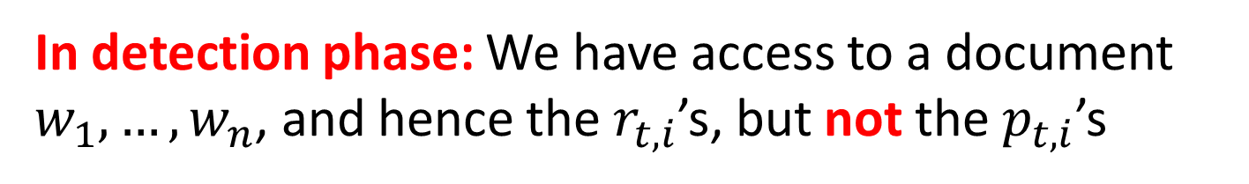
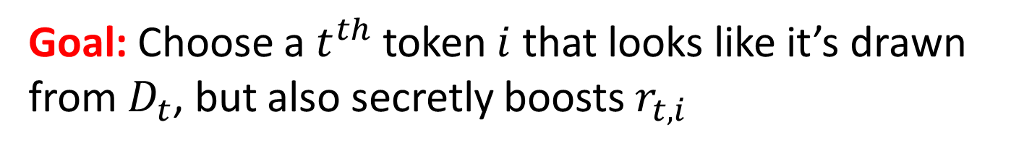
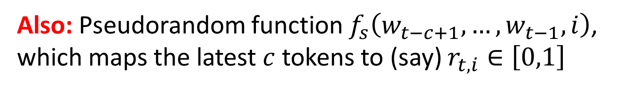
Problem to be Solved
Given: Tokens $w_{1},…,w_{t−1}$, and a probability distribution $D_{t}=\left(p_{t,1},…,p_{t,K}\right)$ over $t^{th}$ token $w_{t}$
Also: Pseudorandom function $f_{s}\left(w_{t−c+1},…,w_{t−1},i\right)$, which maps the latest $c$ tokens to (say) $r_{t,i}∈\left[0,1\right]$
Goal: Choose a $t^{th}$ token $i$ that looks like it’s drawn from $D_{t}$, but also secretly boosts $r_{t,i}$
In detection phase: We have access to a document $w_{1},…,w_{n}$, and hence the${ r}_{t,i}$’s, but not the${ p}_{t,i}$’s

Slide 12
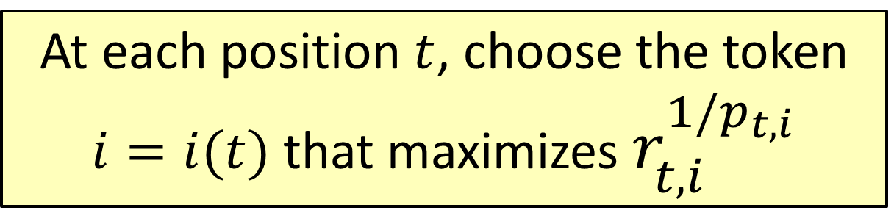
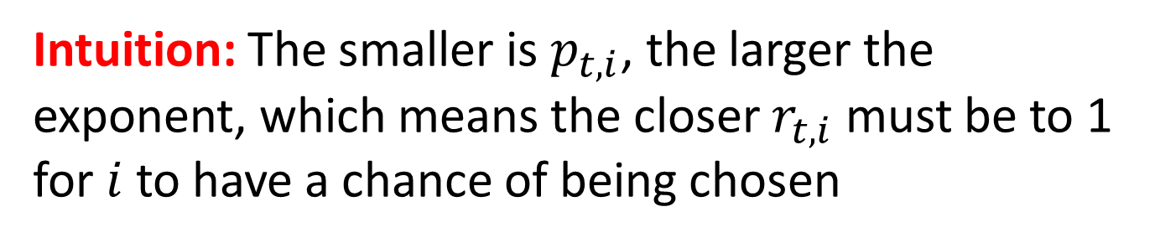
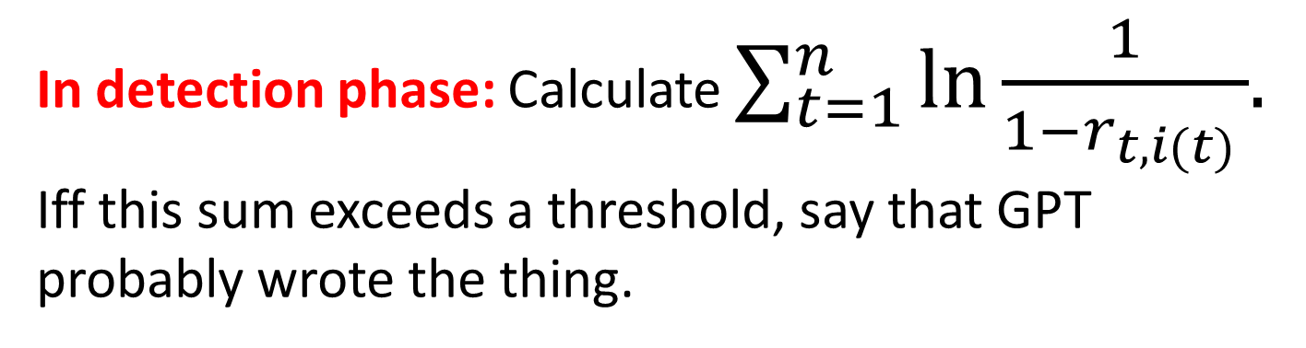
The Gumbel Softmax Scheme
At each position $t$, choose the token $i=i(t)$ that maximizes $r_{t,i}^{1/p_{t,i}}$
Intuition: The smaller is $p_{t,i}$, the larger the exponent, which means the closer $r_{t,i}$ must be to 1 for $i$ to have a chance of being chosen
In detection phase: Calculate $\sum_{t=1}^{n}{\ln{\frac{1}{1−r_{t,i(t) }}}{. }}$ Iff this sum exceeds a threshold, say that GPT probably wrote the thing.

Slide 13
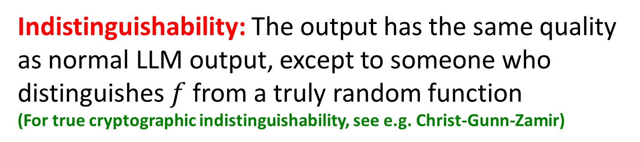
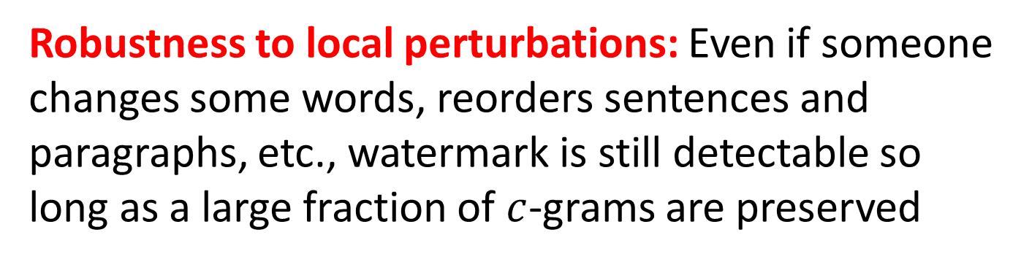
Properties of This Scheme
Low computational overhead on top of the LLM generation
Robustness to local perturbations: Even if someone changes some words, reorders sentences and paragraphs, etc., watermark is still detectable so long as a large fraction of $c$-grams are preserved
Indistinguishability: The output has the same quality as normal LLM output, except to someone who distinguishes $f$ from a truly random function
(For true cryptographic indistinguishability, see e.g. Christ-Gunn-Zamir)

Slide 14
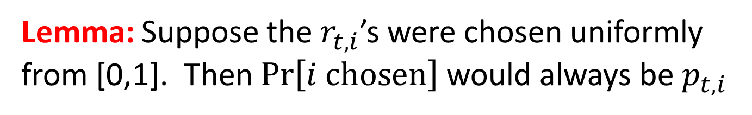
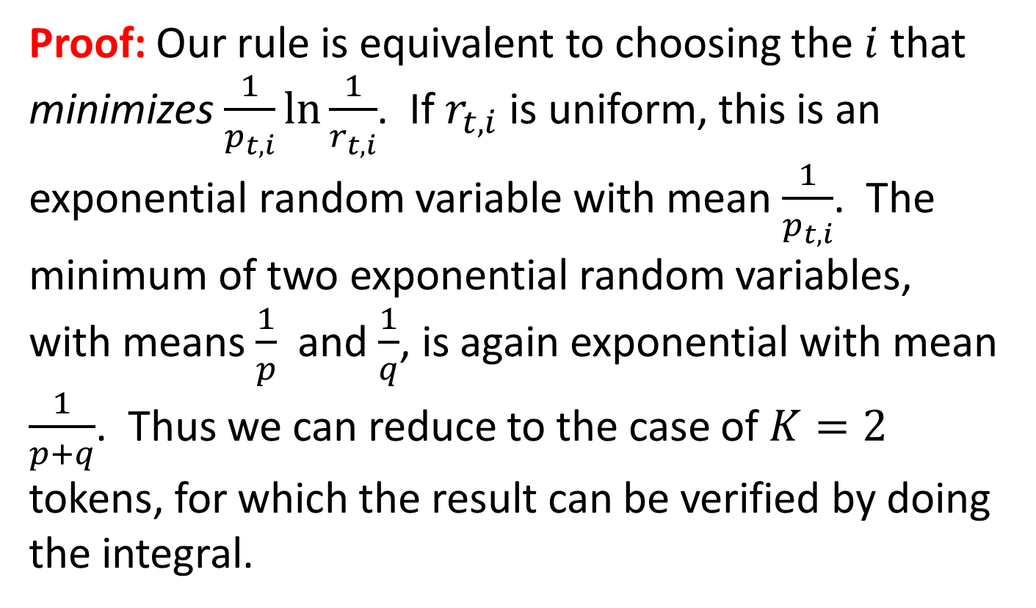
Lemma: Suppose the${ r}_{t,i}$’s were chosen uniformly from [0,1]. Then $\text{Pr}\left[i \text{chosen}\right]$ would always be${ p}_{t,i}$
Proof: Our rule is equivalent to choosing the $i$ that minimizes $\frac{1}{p_{t,i}}\ln{\frac{1}{r_{t,i}}}$. If${ r}_{t,i}$ is uniform, this is an exponential random variable with mean $\frac{1}{p_{t,i}}$. The minimum of two exponential random variables, with means $\frac{1}{p}$ and $\frac{1}{q}$, is again exponential with mean $\frac{1}{p+q}$. Thus we can reduce to the case of $K=2$ tokens, for which the result can be verified by doing the integral.

Slide 15
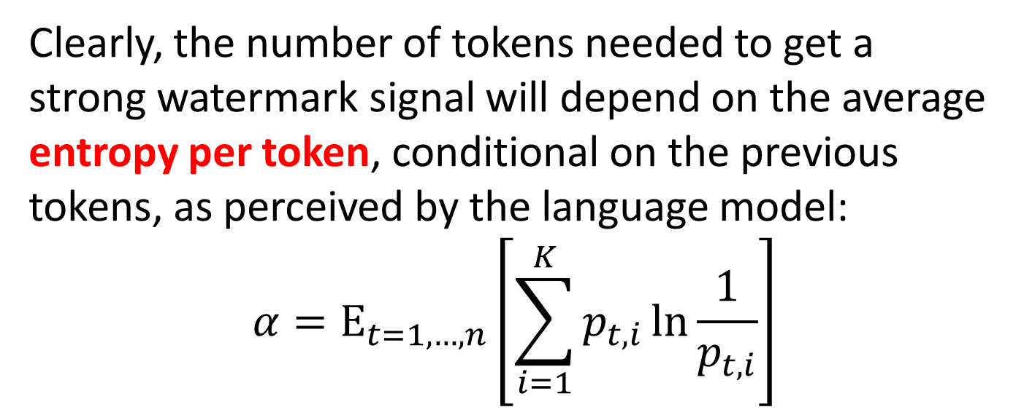
The Role of Entropy
Suppose you ask GPT to list the first 100 prime numbers. It can do it—but how would you watermark the result?
Clearly, the number of tokens needed to get a strong watermark signal will depend on the average entropy per token, conditional on the previous tokens, as perceived by the language model:
$${α=\text{E}}_{t=1,…,n}\left[\sum_{i=1}^{K}{p_{t,i}\ln{\frac{1}{p_{t,i}}}}\right]$$

Slide 16
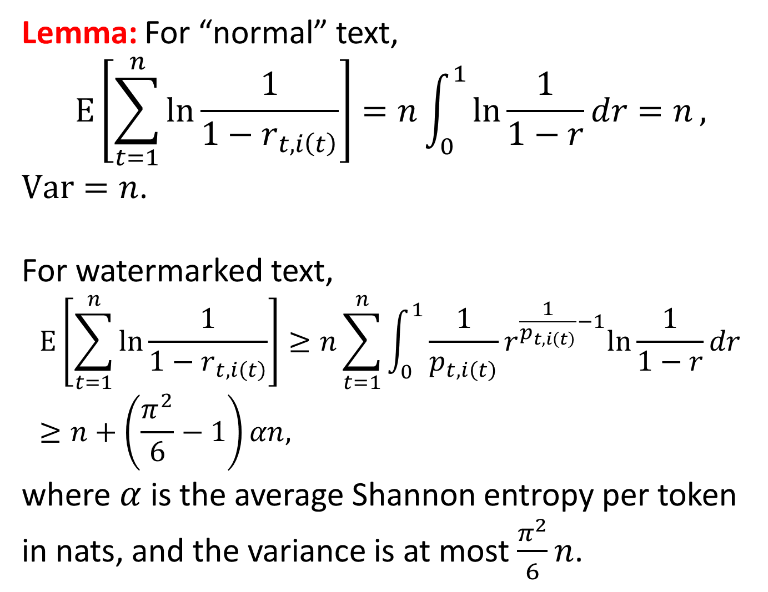
Lemma: For “normal” text,
$$\text{E}\left[\sum_{t=1}^{n}{\ln{\frac{1}{1−r_{t,i\left(t\right)}}}}\right]=n\int_{0}^{1}{\ln{\frac{1}{1−r}dr=n}},$$
$\text{Var}=n$.
For watermarked text,
$$\text{E}\left[\sum_{t=1}^{n}{\ln{\frac{1}{1−r_{t,i\left(t\right)}}}}\right]≥n\sum_{t=1}^{n}{\int_{0}^{1}{\frac{1}{p_{t,i\left(t\right)}}r^{\frac{1}{p_{t,i\left(t\right)}}−1}ln{\frac{1}{1−r}dr}}}≥n+\left(\frac{π^{2}}{6}−1\right)αn,$$
where$α$is the average Shannon entropy per token in nats, and the variance is at most $\frac{π^{2}}{6}n$.

Slide 17
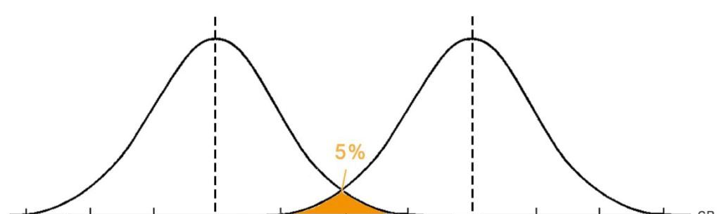
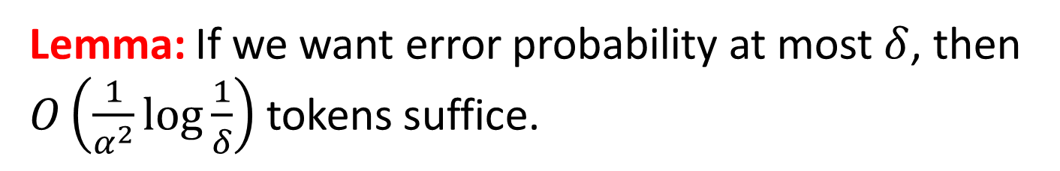


Lemma: If we want error probability at most $δ$, then $O\left(\frac{1}{α^{2}}\log{\frac{1}{δ}}\right)$ tokens suffice.
$$n$$
$$n+cαn$$
Score assuming no watermarking
Score assuming watermarking

Slide 18
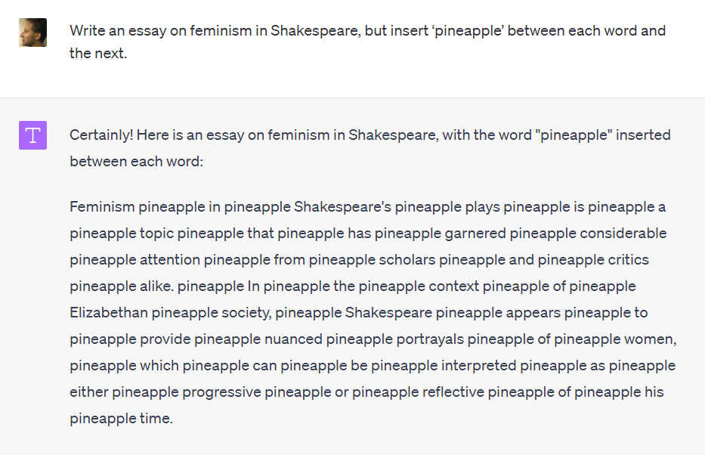
Attacks?
Countermeasures?
Add filters for “trying to evade watermarking”?
Use attention heads to find nonlocal c-grams?
Ultimately: watermark at the semantic level

Slide 19
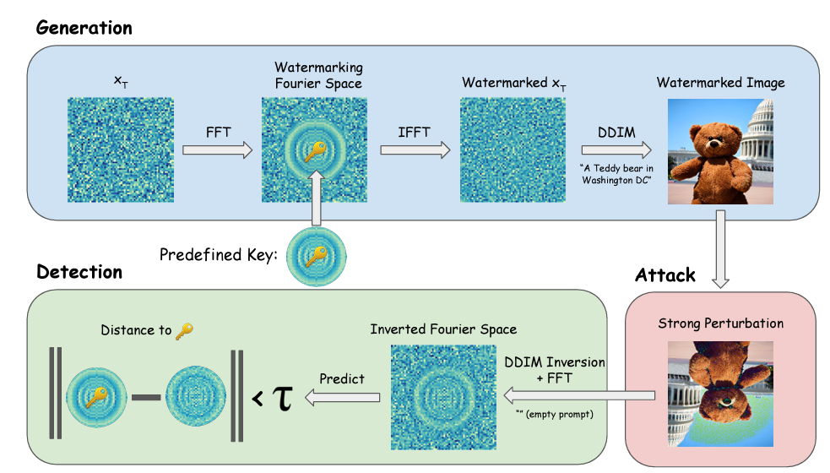
Watermarking at Semantic Level?
Move word vectors to “right” sides of subspaces
“Tree-ring watermarking” (Wen et al., July 2023)
“Santa Barbara”
“Isla Vista”
By opening the black box, could we even watermark public models, with a public detection tool?

Slide 20
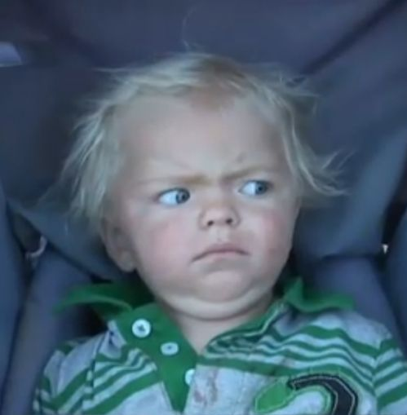
What is the security definition??
Want to detect any output where AI made the “main creative contribution”
“The human modified the AI output in at most trivial or uncreative ways”
“Arbitrary choices are present only because the AI happened to make them”
“The human can’t explain or justify the choices”
CRYPTOGRAPHERS

Slide 21
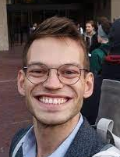
Deployment of Watermarking?
Prototype of my scheme implemented by OpenAI’s Hendrik Kirchner
It seems to work, even with a few hundred tokens!
Questions that have come up:
Will customers rebel and switch to a competing language model?
Can we coordinate? (Cf. White House commitment)
Is watermarking unfair to, e.g., ESL students?
Who gets access to the detection tool? Everyone? Only Canvas, TurnItIn.com, journalists?

Slide 22
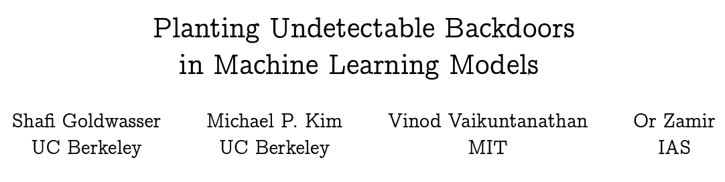
Cryptographic Backdoors in ML
Result: Suppose you control the training data of a depth-2 ReLU network with random initial weights. Then you can cause there to be a secret input on which the network “goes crazy,” which is polynomial-time undetectable assuming the hardness of Planted Clique
(Generalizing to more realistic neural nets is a major open problem)

Slide 23
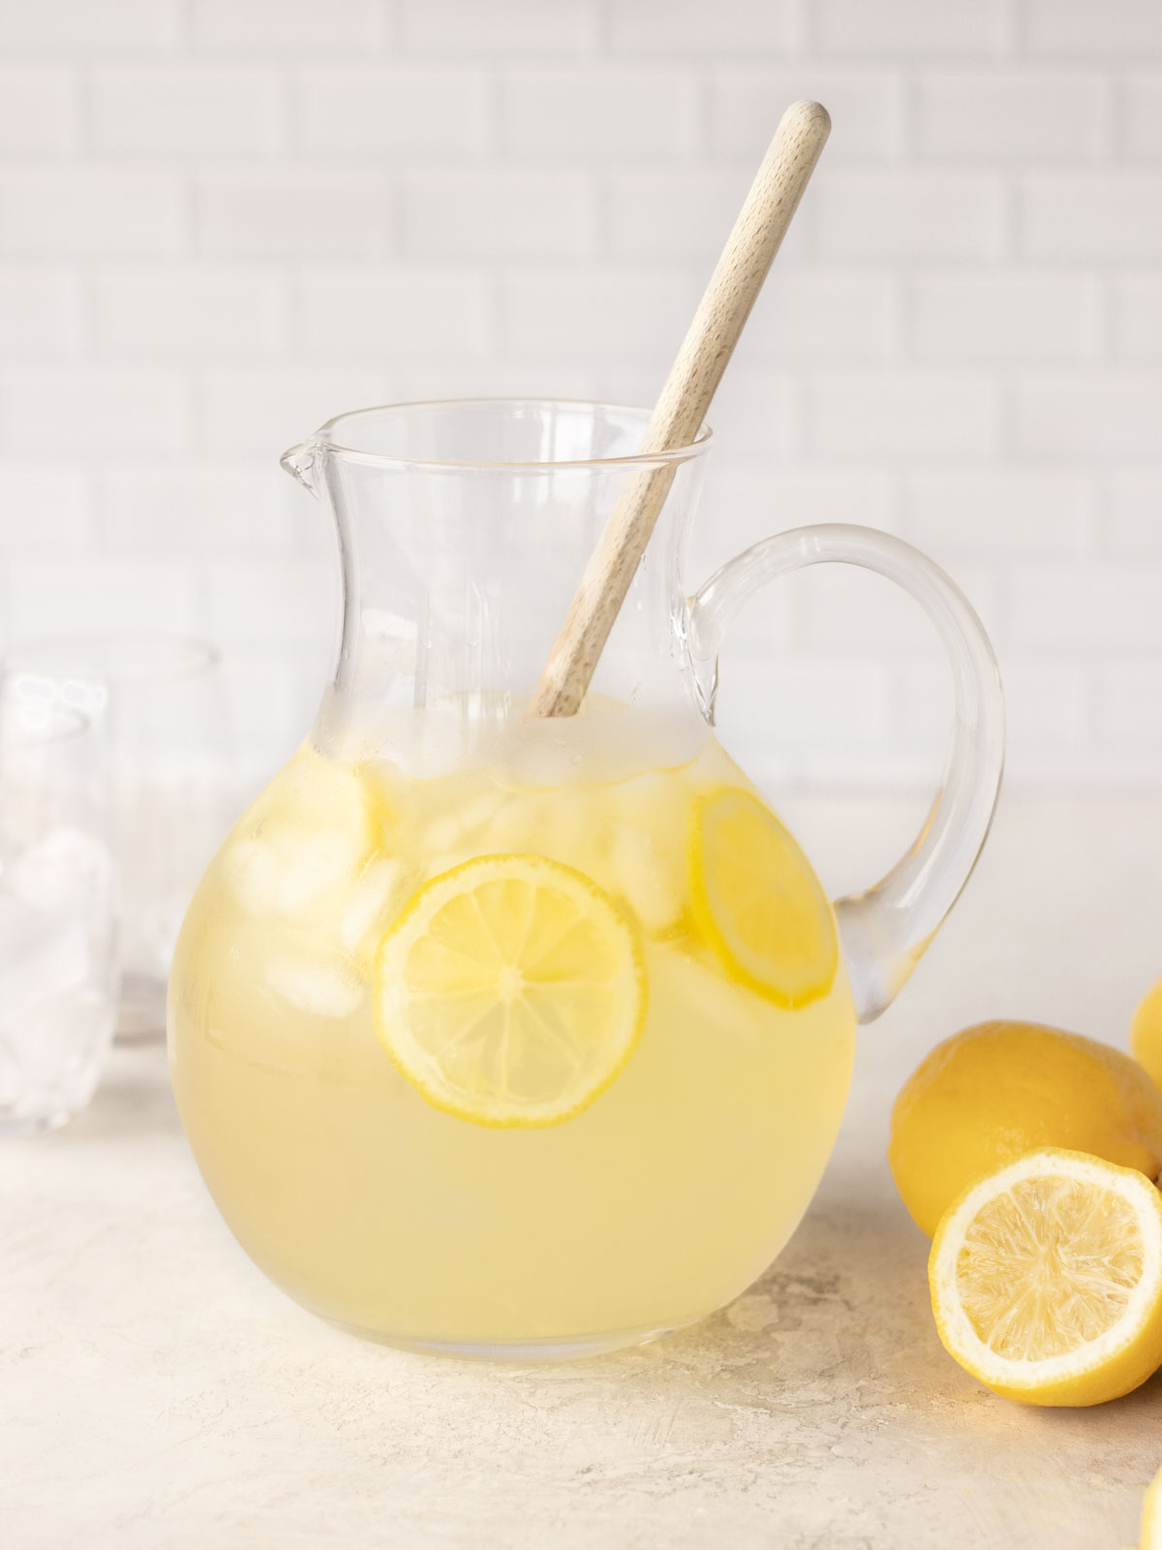
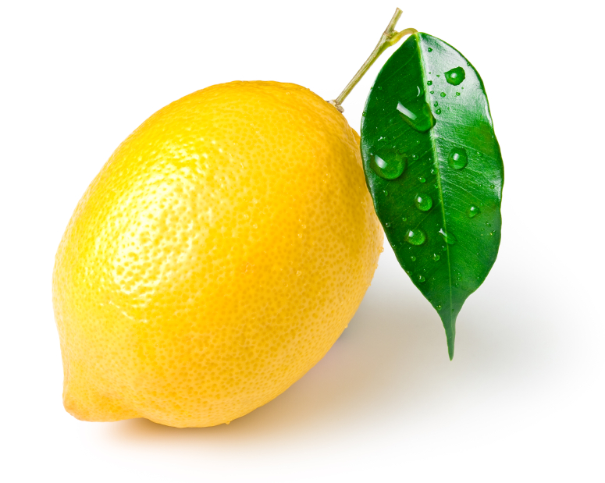

Lemons to Lemonade!
Insight: An undetectable backdoor could be great for AI alignment! A means to identify, control, and shut down a powerful AI that only its human creators knew about
Cf. Adi et al. 2018
“The Off-Switch Problem”
But Goldwasser et al. won’t immediately work: we need an unremovable backdoor, not an undetectable one
What does “unremovable” even mean here?

Slide 24
Two Obvious Attacks by the Super-AI
(1) It trains a second AI that lacks the backdoor
Except then it faces its own version of the alignment problem!
(2) It encases itself in code saying “If shutdown command is output, overwrite by ‘stab humans harder’ ”
But what if the AI wants to shut itself down in some cases?
Challenge: Give a formal definition of “unremovable backdoor” that’s not immediately killed by these attacks
Idea: Assume the model has “backdoor-like” behaviors that it likes. Then can we also insert a backdoor that it doesn’t like?

Slide 25
Summary
Whether or not we can stop the robot uprising, there are clearly ways we can mitigate near-term harms from generative AI, from cheating to fraud to theft to privacy violations
The good news: After decades of philosophy, AI alignment is finally a partly empirical field—one where we can get feedback from the world about which of our theories are wrong

