Slide 1


The Complexity of Agreement
(with new directions and applications)
Scott Aaronson
University of Texas at Austin
At: “Half a Century of Agreeing to Disagree”
Paris, France, June 11, 2026

Slide 2
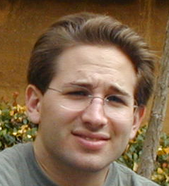
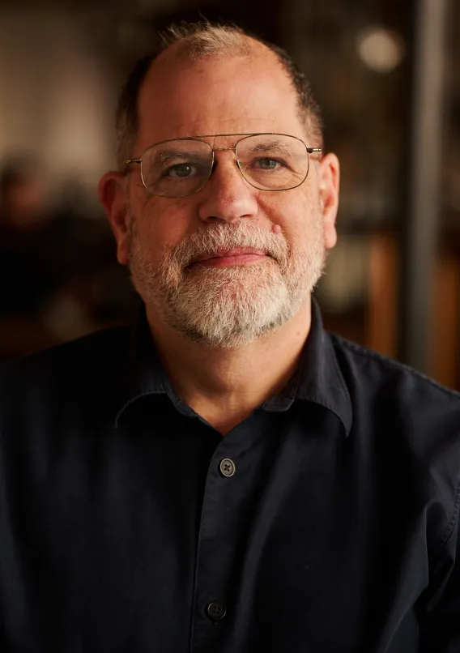
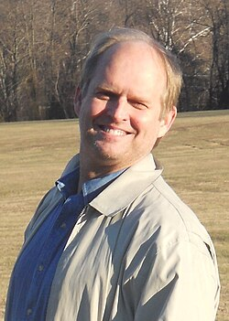
‘Twas half my life ago (2004)…
I was a 21-year-old Berkeley CS PhD student, mainly working on quantum computing (still my main thing)…
… when I came across a paper called “Are Disagreements Honest?” by Tyler Cowen and Robin Hanson … which destabilized my whole worldview

Slide 3
The paper explained something I’d never heard of: Aumann’s Agreement Theorem
“Bayesians with common priors can’t agree to disagree”
Plus, Hanson 2002:
E[p_{t+1}] = p_{t}
So, if Alice and Bob keep telling each other their current opinions, those opinions follow unbiased random walks (!)
My reaction 1: “Obviously this is wrong”
My reaction 2: “Some bad assumption is being made”

Slide 4
Hunting for the Wrong Assumption
The Common Prior Assumption itself?
Common knowledge of honesty and rationality?
Aha, maybe communication and computation cost!
Obviously if Alice and Bob had common priors and exchanged everything they knew, they’d agree!
But I conjectured that they’d basically need to share their entire life histories … meaning they’d be dead long before agreement!

Slide 5
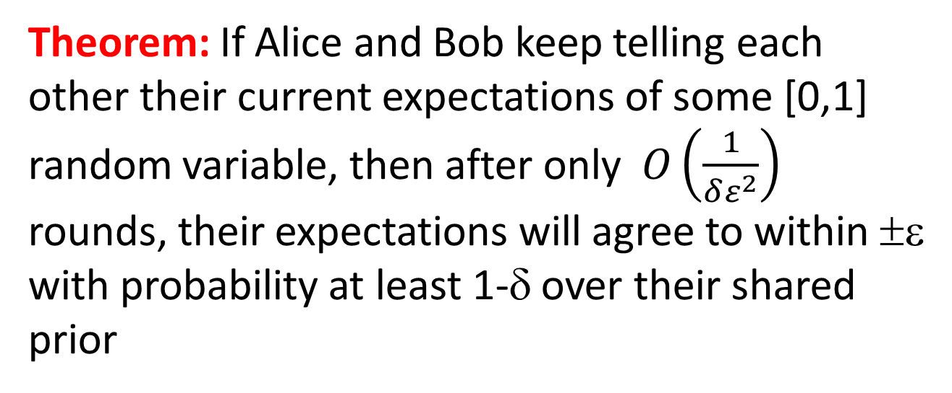
My Main Result: Conjecture Is False!
Theorem: If Alice and Bob keep telling each other their current expectations of some [0,1] random variable, then after only $O\left(\frac{1}{δε^{2}}\right)$ rounds, their expectations will agree to within ±ε with probability at least 1-δ over their shared prior
Independent of n
Moral: “Agreeing to disagree” is problematic, even for agents subject to realistic communication constraints

Slide 6

Intuition
Can also discretize the messages, by having Alice and Bob send just a couple bits indicating “is my new expectation much more than you were expecting, much less, or about the same?,” while preserving the $O\left(\frac{1}{δε^{2}}\right)$ upper bound
In the standard protocol, as long as Alice and Bob disagree by ε, their expectations E_{A} and E_{B} follow an unbiased random walk with step size ε. But since E_{A},E_{B}∈[0,1], such a walk must hit an absorbing barrier after ~1/ε² steps.
To prove: Use (E_{A})²,(E_{B})² as progress measures

Slide 7
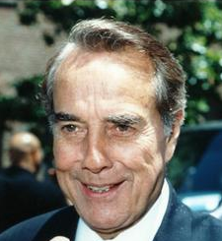

Three or More Agents
Could a weak-willed Charlie fail to bring Alice and Bob into agreement with each other?
Theorem: On a strongly-connected graph with N agents and diameter d, messages
suffice for every pair of agents to “(ε,δ)-agree”

Slide 8
Is My Bound Optimal?
Do Alice and Bob need to exchange ~1/ε² bits to agree within ε with high probability?
    Best lower bound I can show: ~log 1/ε
    Major technical open problem
    Can show: There’s a scenario where the economists’ standard protocol needs ~1/ε² bits, but a different protocol (where Alice and Bob gradually attenuate their messages) needs only ~log 1/δ bits, independent of ε

Slide 9
Approximate Agreement vs. Common Knowledge?
Econometrica reviewers of my paper in 2005:
You talk only about (ε,δ)-agreement. If you want us to accept, prove that approximate agreement implies some sort of approximate common knowledge (the original subject of Aumann’s theorem)
Still a great research problem!
Hinges on a hard question about random walks

Slide 10
Ziv Hellman’s New Extension of My Theorem!
Suppose Alice’s and Bob’s known priors are at most η apart in total variation distance. Then after they state their expectations of a [0,1] random variable O(1/(δε²)) times, they’ll agree to within ε+O(√η), except with probability δ+O(√η)
Uses a 2013 result of Ziv’s that generalizes Aumann to almost-common priors

Slide 11
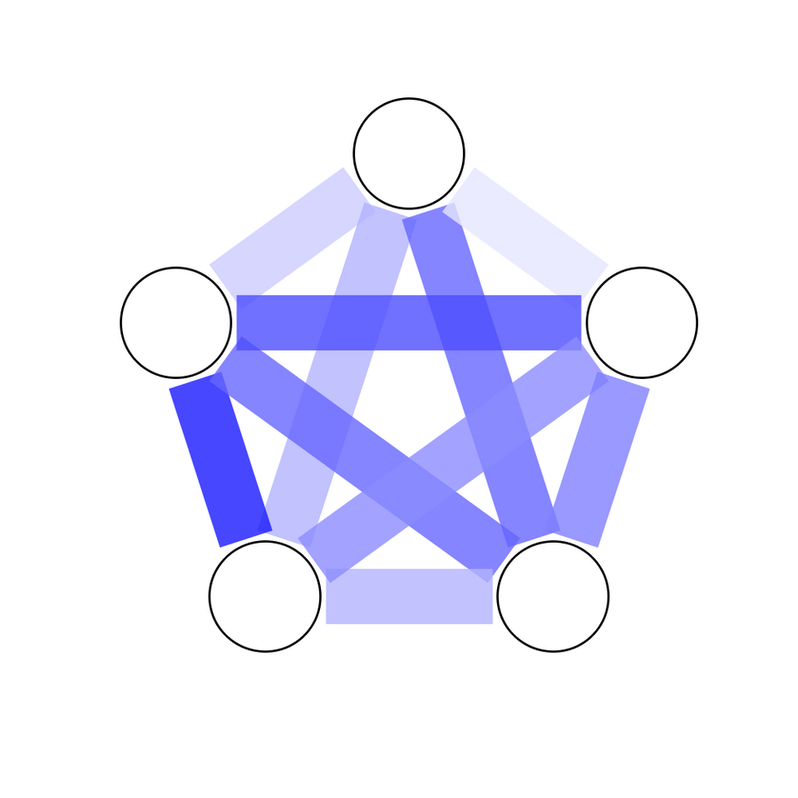
Szemerédi’s Regularity Lemma
Informally: Every n-vertex graph can be partitioned into a number of components independent of n, such that the edges between any two components “look random” with the appropriate density
Andy Drucker (my former student), 2007: This lemma immediately implies a different protocol for (ε,δ)-agreement, using a number of bits that depends only on ε and δ—albeit a wildly larger number

Slide 12
Aumann & AI Alignment
Outside a few domains like math, humans might never be capable of “Aumannian conversations,” which follow unbiased random walks and rapidly reach approximate agreement
But presumably AIs could converse this way!
Would that be good or bad from the humans’ standpoint??
For more, listen to Aran Nayebi’s talk, right after this one!

Slide 13
Computational Complexity
Fine, few messages suffice for agreement—but what if it took Alice and Bob billions of years to calculate their messages?
Turns out: Provided the agents can sample from their initial partitions, they can simulate Bayesian rationality using a number of samples independent of n (but alas, exponential in 1/ε⁶)
Meaning: By examining their messages, you couldn’t distinguish these “Bayesian wannabes” from true Bayesians with non-negligible bias

Slide 14
Computational Complexity
Problem: An agent’s expectation could lie on a “knife-edge” between two messages
Solution: Have agents “smooth” their messages by adding random noise to them
Pr[message]
0
1

