Slide 1
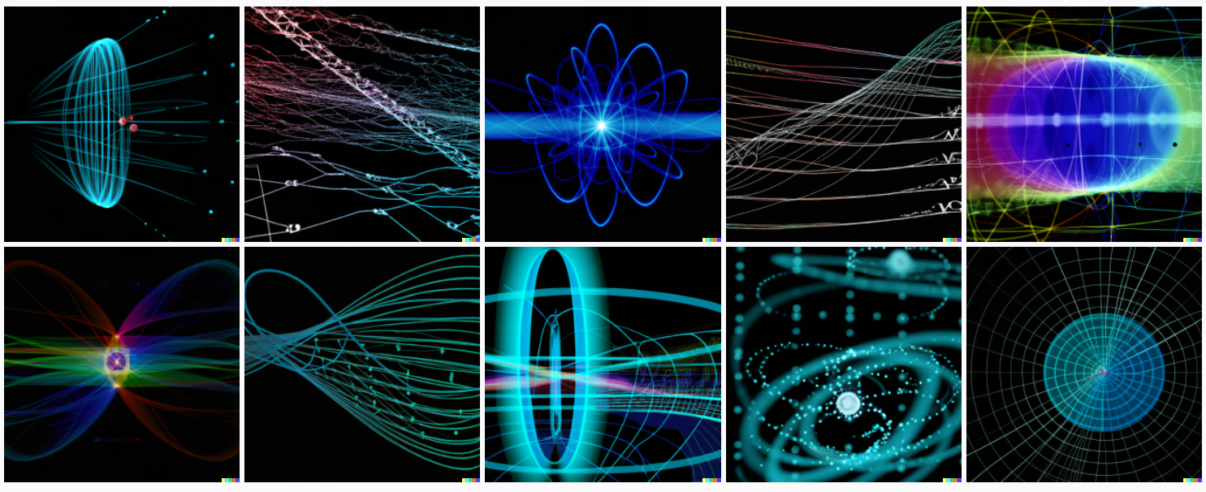
The TRUTH About Quantum Computing
Scott Aaronson (University of Texas at Austin)
Stony Brook University, NY, May 13, 2026

Slide 2
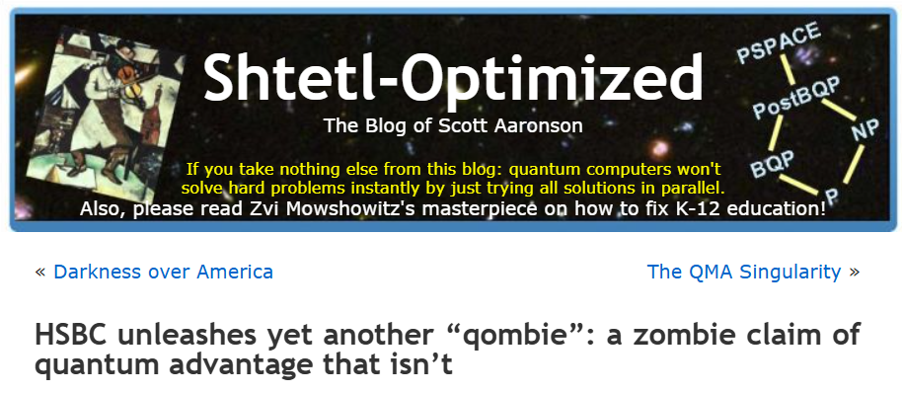
What I’ve Been Doing On My Blog For 20 Years…

Slide 3

Quantum Mechanics
“Probability theory with minus signs”

Slide 4
THE RULES: If a system can be in two distinguishable states, labeled |0⟩ and |1⟩, it can also be in a superposition, written
α|0⟩ + β|1⟩
Here α and β are complex numbers called amplitudes, which satisfy |α|²+|β|²=1. A 2-state superposition is called a qubit.
If we observe, we see |0⟩ with probability |α|² and |1⟩ with probability |β|². But if the qubit is isolated, it evolves by rules different from those of classical probability.
In the 1980s, Feynman, Deutsch, and others noticed that a system of n qubits seems to take ~2^{n} steps to simulate on a classical computer, because of the phenomenon of entanglement between the qubits. They had the amazing idea of building a quantum computer to overcome that problem

Slide 5
Popularizers Beware:
A quantum computer is NOT like a massively-parallel classical computer!
Exponentially many possible answers, but you only get to observe one of them
Any hope for a speedup rides on choreographing an interference pattern that boosts the amplitude of the right answer

Slide 6
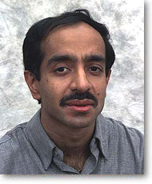
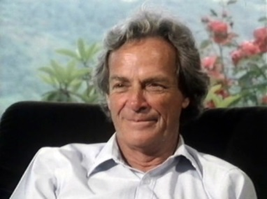


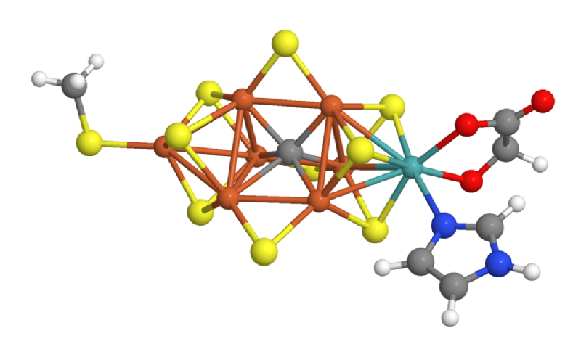
So What Are The Main Known Applications of QCs?
1. Breaking Current Public-Key Cryptography
2. Simulating Quantum Physics and Chemistry
3. Everything Else…
HHL, QAOA
And the 0th application, the one I care about most:
Disproving all the people who said QC was impossible!
Requires fault-tolerance
Looks like mostly modest speedups and not near-term, but who knows?
Still the best known “killer app.” Some near-term hope?
Post-quantum crypto is a viable response

Slide 7

The Computational Universe
NP-complete
Optimization
Bounded-Error Quantum Polynomial-Time
NP
Post-quantum crypto?
Factoring
BQP
Quantum simulation
P
Multiplying…

Slide 8
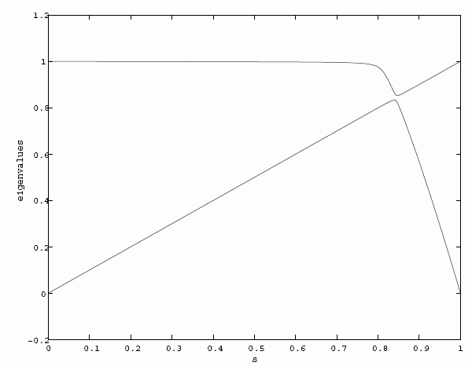
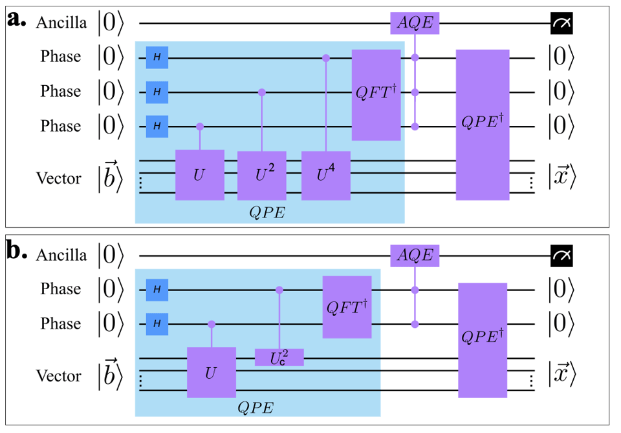
Near-Term Applications of QC to AI and Optimization: >85% Hype?
Adiabatic optimization / annealing: What’s the spectral gap?
HHL / quantum machine learning: how to measure final result?
Key question often left unasked: “Does this beat the best known classical solution in a truly fair comparison?”

Slide 9
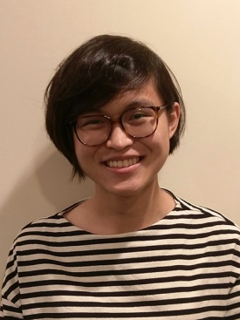
Ewin Tang’s Breakthrough (2018)
Ewin was an 18-year-old in my Intro to Quantum Information Science course at UT
For her senior thesis, she “de-quantized” the main example we’d had of a quantum algorithm thought to get exponential speedup for a real-world machine learning problem: the “Kerenidis-Prakash algorithm” for recommending products in Netflix-like systems
  I.e., gave a classical randomized algorithm that was only modestly slower
This was the opposite of what I and others expected and led to lots of followup work, underscoring the need for careful theoretical study of quantum speedups

Slide 10
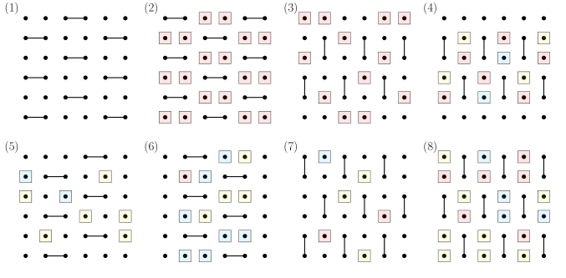
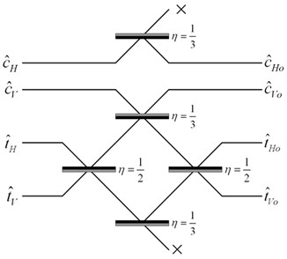
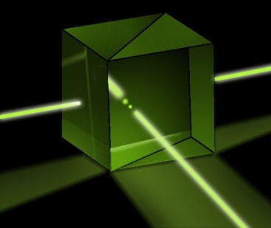
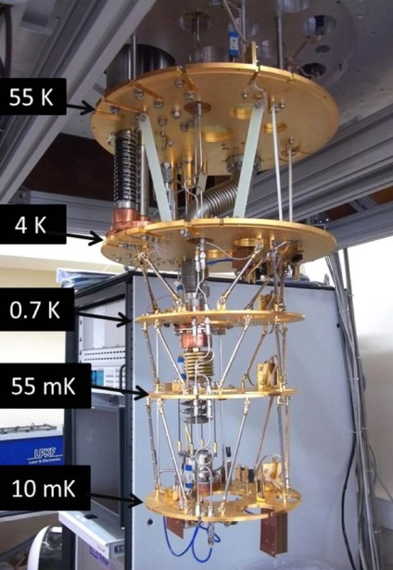
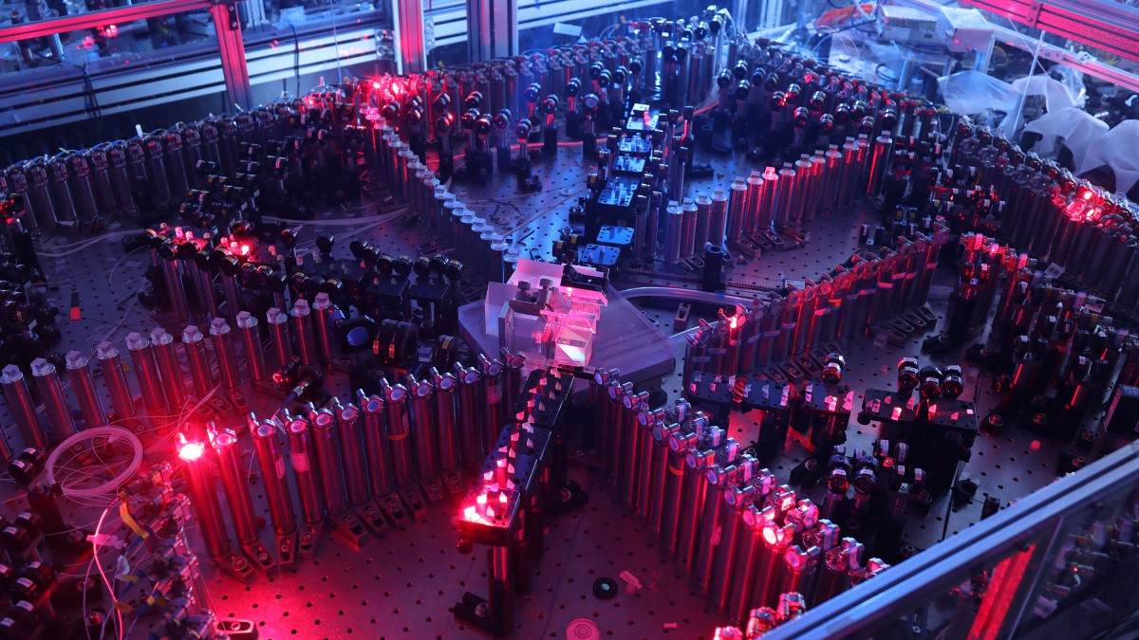
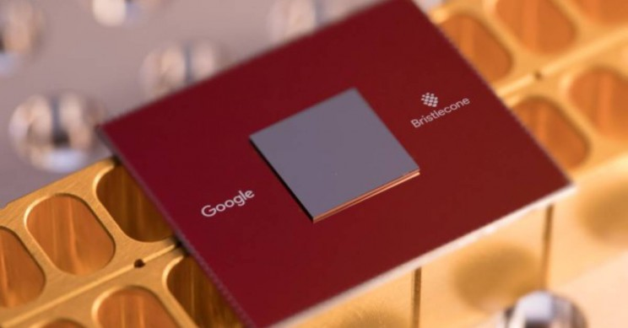
“Quantum Supremacy” Demonstrations Over the Past 5 Years
BosonSampling
(A.-Arkhipov 2011, ~100-photon experiments by USTC team 2020, Xanadu 2022, ~1000 photons by USTC 2025)
Random Circuit Sampling
(53-qubit experiment by Google team 2019; another by USTC team 2020, 103-qubit by Google 2024)

Slide 11
What Kind of Near-Term Speedup Do We Want?
Adiabatic,
Near-Term
Efficiently
Verifiable
Quantum machine learning…
OTOCs?
Fermi-Hubbard?
Peaked circuits?
Shor
Interactive protocols
BosonSampling
Random Circuit Sampling
Physics simulations
In-Principle Quantum Advantage

Slide 12
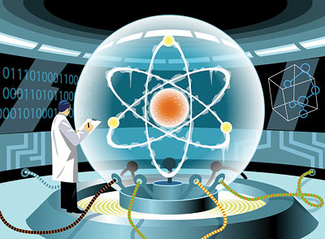
Certified Randomness from Quantum Supremacy
SEED
CHALLENGES
If a quantum computer’s outputs repeatedly, quickly pass a certain test, then under a suitable complexity assumption, we show that its responses must contain lots of entropy; they can’t be deterministic
Experimental demonstration last year by Quantinuum and JP Morgan Chase!
Led us (A.-Hung 2023) to a propose a scheme to produce public verifiably-random bits using existing QCs—useful for, e.g., proof-of-stake cryptocurrencies??

Slide 13
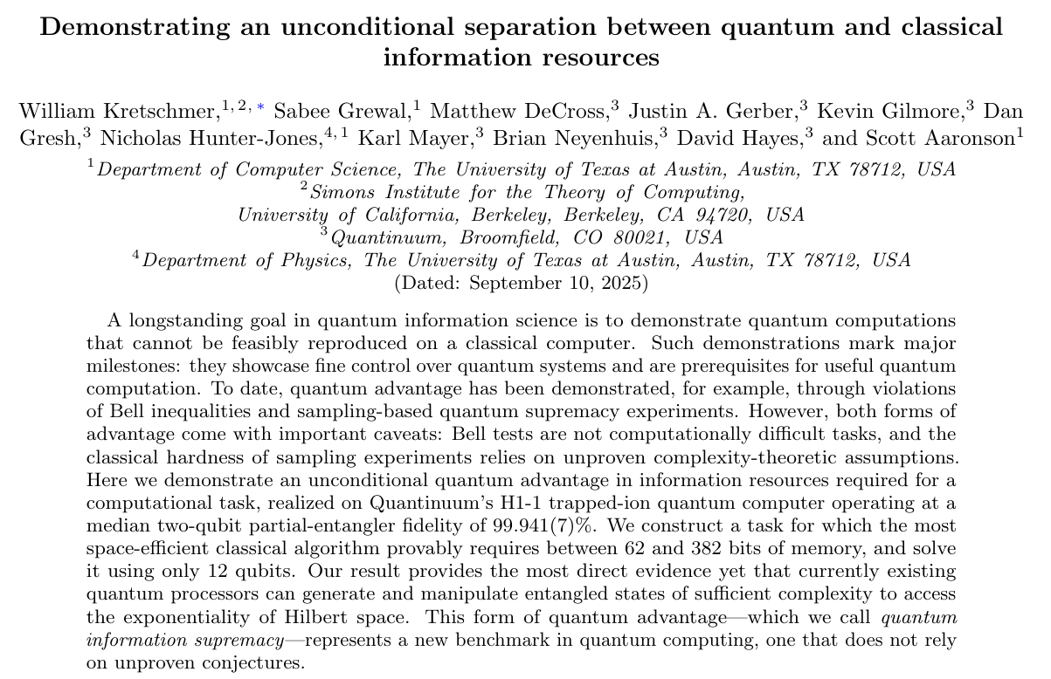
“Quantum Information Supremacy”
Zhao et al., arXiv:2604.07639 last month: Quantum information supremacy with potential applications to solving sparse linear systems, support vector machines, principal component analysis in the streaming setting

Slide 14
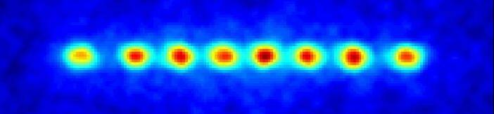
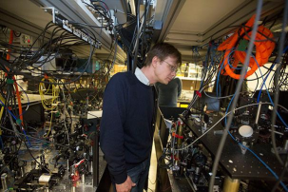
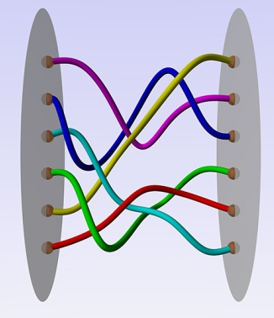
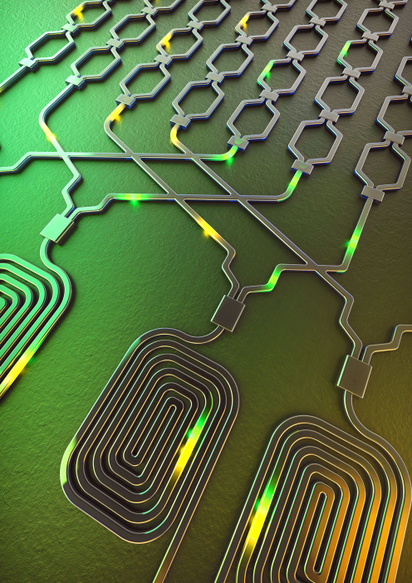
How to Build a QC…
Trapped Ions
(Quantinuum, IonQ, …)
Cold Atoms
(QuEra, Oratomic…)
Superconducting Qubits
(Google, IBM, …)
Photonics
(PsiQuantum…)
Nonabelian Anyons (Microsoft…)

Slide 15
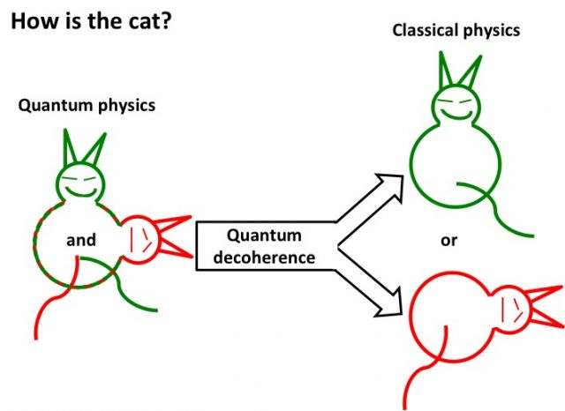
Why Is Building It So Damn Hard?
Decoherence: Unwanted interaction between the QC and its environment, prematurely “measuring” the QC
The more operations and qubits, the worse things get
In most QC researchers’ view, quantum fault-tolerance (discovered in the mid-1990s) provides the ultimate theoretical solution to decoherence
But fault-tolerance itself requires very precise physical control over the qubits—e.g. two-qubit gates with ~99.99% fidelity. This past year: 99.92% fidelity, first demos of “useful” quantum error-correction

Slide 16

Outlook
SCALABLE FAULT-TOLERANCE
COMMERCIALLY USEFUL QUANTUM ADVANTAGE
SCIENTIFICALLY INTERESTING ADVANTAGE (2026?)
ACTUALLY VERIFIED QUANTUM ADVANTAGE (2026?)
VERIFIABLE QUANTUM ADVANTAGE (2025?)
SAMPLING-BASED QUANTUM SUPREMACY (2019-2024)

Slide 17
Summary
This is an exciting time for QC. After decades of theory and experiment, we’ve finally started to see clear speedups over classical computers for specialized problems, with ~100-qubit devices, and even the beginnings of quantum error-correction
  Achieving full scalability and fault-tolerance, and threatening public-key crypto, look on the horizon
Quantum speedups are subtle and depend on structure
  Not just free exponential parallelism—”weirder than a sci-fi writer would have had the imagination to invent”

