Slide 2
Quantum Mechanics: What’s It Good For?
Scott Aaronson
Associate Professor, EECS
MIT

Slide 3
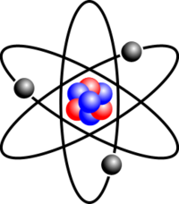
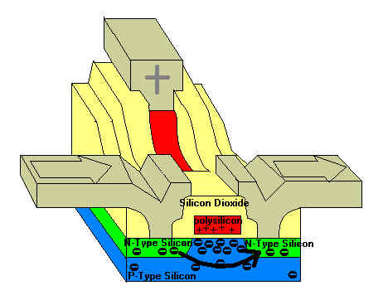
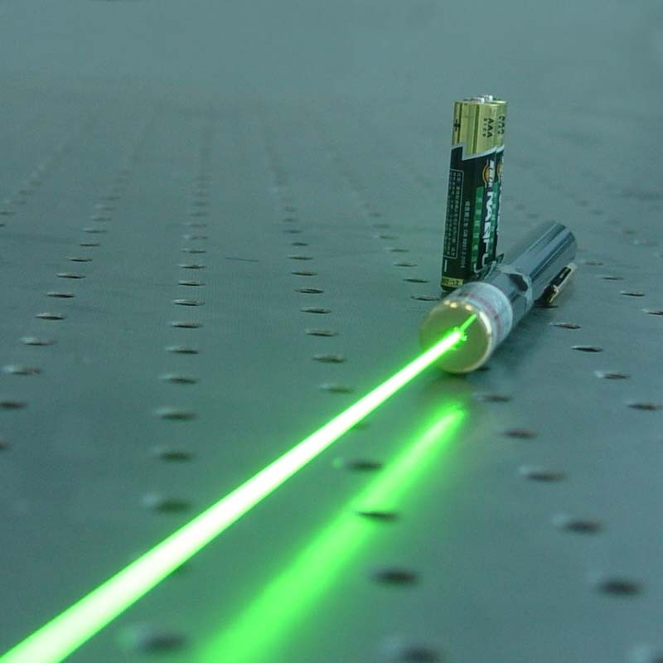
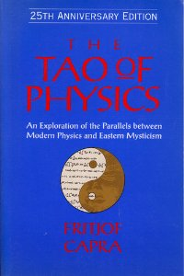
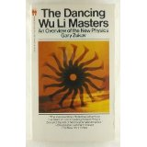
Some “Obvious” Things QM Is Good For
Keeping atoms from disintegrating
Allowing transistors and lasers to work
Helping to sell New Age books

Slide 4
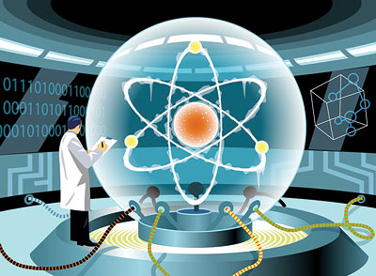
OK, but you’re here to hear about quantum computing

Slide 5
First, what is quantum mechanics?
APPLICATION LAYER
Electrodynamics
Nuclear Forces
Gravity
OS LAYER
Quantum Mechanics
Probability Theory
HARDWARE LAYER
Mathematics

Slide 6
Main Quantum Algorithms Known
Shor’s algorithm and variants
Factoring / discrete log / breaking RSA / other problems in group theory and number theory
Quantum simulation
Potentially useful for: chemistry, protein folding, nanomaterials, high-energy physics
Grover’s algorithm and variants
Can search an N-element list or evaluate a size-N game tree in ~√N steps, and get subquadratic improvements for many other problems
Quantum adiabatic algorithm
“Quantum-enhanced” version of simulated annealing. Performance on practical optimization problems remains a major open question
Other quantum algorithms
Learning properties of a linear system, with possible machine learning applications [Lloyd et al. 2008-2013]; verifying that two functions are close to each other’s Fourier transform [A. 2010]…

Slide 7
Quantum Complexity Theory
How good is the evidence for P≠BQP?
Well, if you think Factoring∉P then you have to believe that!
A.-Arkhipov 2011 gave arguably stronger evidence that QCs can solve classically hard sampling problems
PSPACE
Polynomial Space
NP-complete
SAT, Traveling Salesman…
NP
Graph Isomorphism?
Chess, Go
Factoring, Discrete Log
BQP
Bounded-Error Quantum Polynomial-Time
P
Polynomial Time
Matching, Primality…
Quantum Simulation

Slide 8
OK, what about putting quantum weirdness to work for things other than computation?

Slide 9
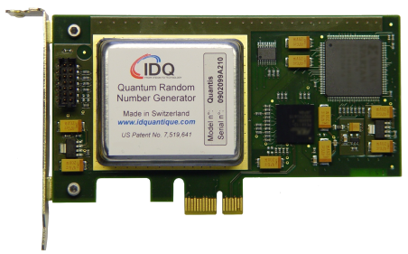
Quantum Random Number Generation
1 1 0 0 1 0 0 0 1 0 1 0 0 1 1 1 0 0 1 1 1 1 1 1 1 1 0 1 0 0 1 0 0 1 1 0 1 0 1 1 0 0 0 1 1 1 0 1 0 1 1 1 1 0 1 1 1 0 1 1 1 0 1 0 0 1 1 0 1 1 0 1 0 0 1 0 0 0 0 1 0 0 1 1 1 0 1 1 0 0 1 1 1 1 0 1 1 0 1 1
Commercially available
But why should anyone trust such a device’s output as truly random? Surprisingly, we now know how to solve that problem, using Bell inequality violations! [Colbeck 2009, Pironio et al. 2010, Vazirani and Vidick 2011]

Slide 10
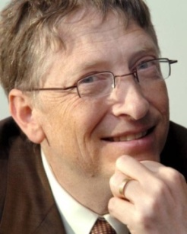
Aside: The Bell Inequality

Slide 11
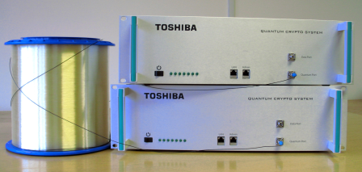
Quantum Cryptography
Again, is already commercial. And again, we now understand (in principle) how to verify untrusted devices using the Bell inequality [Mayers-Yao 1998 … Vazirani-Vidick 2012]
But requires special hardware, and existing public-key crypto is quite good. Ironically, it might take quantum computers to create the market for quantum crypto!

Slide 12
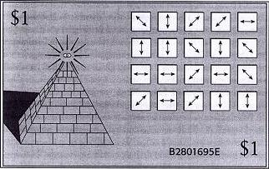
Quantum Money
Proposed by Wiesner circa 1970. In addition to a serial number, each bill would contain qubits in one of the four states |0⟩,|1⟩,|+⟩,|-⟩.
Bank remembers states on each bill, so can verify them by measuring
But counterfeiters would be physically unable to copy bills, because of the No-Cloning Theorem
Problem: Only entity able to verify bills as genuine is the bank that printed them

Slide 13
Publicly-Verifiable Quantum Money
We’d like quantum money states that can’t be copied, but that anyone can verify as legitimate—not just the bank that printed them
Will certainly require computational assumptions, in addition to quantum mechanics (why?)
A.-Christiano 2012: Publicly-verifiable quantum money based on hidden subspaces, which is secure under a plausible assumption about multivariate polynomial cryptography
A⊥
Farhi et al. paradigm:
They used knot theory to construct |ψ_{s}⟩; no formal security argument
A

Slide 14
Quantum Copy-Protected Software
Finally, a serious use for quantum computing
Goal: Quantum state |ψ_{f}⟩ that lets you compute an unknown function f, but doesn’t let you efficiently create more states with which f can be computed
Easy to achieve if f is a point function!
A.-Christiano, work in progress: Proposed scheme to quantumly copy-protect arbitrary functions f. So far, don’t know how to argue security (though can prove security of a black-box variant)

Slide 15
Conclusions
Quantum weirdness can indeed be “put to work” in surprising ways
How important will these applications be in real life? And how long until the most dramatic ones become practical? Unfortunately, we don’t know
If we’re intellectually honest, always need to ask: can a classical approach also do this? Why not? (Often the hardest part of a QC project!)
In my opinion, asking what quantum mechanics can do for us has given unprecedented insight into the theory itself—which, for me, is more than enough reason to continue studying this field
Most important application of quantum computing, in my view: Disproving the people who said it was impossible!

