Slide 1
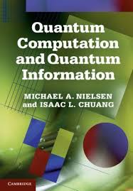

Verifiable Quantum Advantage in 2026
Scott Aaronson (University of Texas at Austin)
Quantinuum, Boulder, CO, May 11, 2026

Slide 2
Exciting times for QC…
Race to fault-tolerant QC, with Quantinuum one of the leading contenders
Hardware people now come to me with ethical conundrums (“should we be building something that breaks the current Internet?”)
Yet many QC skeptics (Gil Kalai, Leonid Levin, parts of the blockchain community) have doubled and tripled down with no updates

Slide 3

Outlook
SCALABLE FAULT-TOLERANCE
COMMERCIALLY USEFUL QUANTUM ADVANTAGE
SCIENTIFICALLY INTERESTING ADVANTAGE (2026?)
ACTUALLY VERIFIED QUANTUM ADVANTAGE (2026?)
VERIFIABLE QUANTUM ADVANTAGE (2025?)
SAMPLING-BASED QUANTUM SUPREMACY (2019-2024)

Slide 4
My Favorite Slide
Adiabatic,
Near-Term
Efficiently
Verifiable
Quantum machine learning…
ARE WE FINALLY HERE?
Shor
Interactive protocols
BosonSampling
Random Circuit Sampling
Physics simulations
In-Principle Quantum Advantage

Slide 5
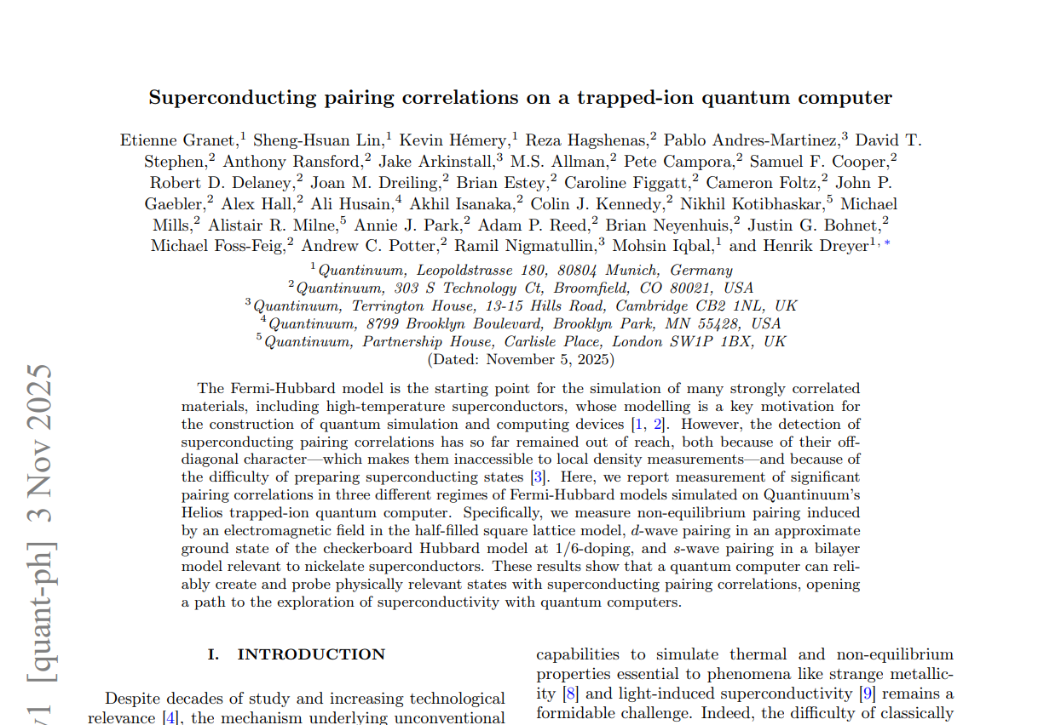
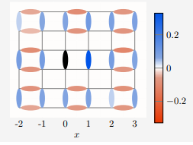
What I’m Excited About:
Quantinuum’s Fermi-Hubbard Demo
Is there quantum supremacy here or not? Maybe you can tell me! ☺

Slide 6
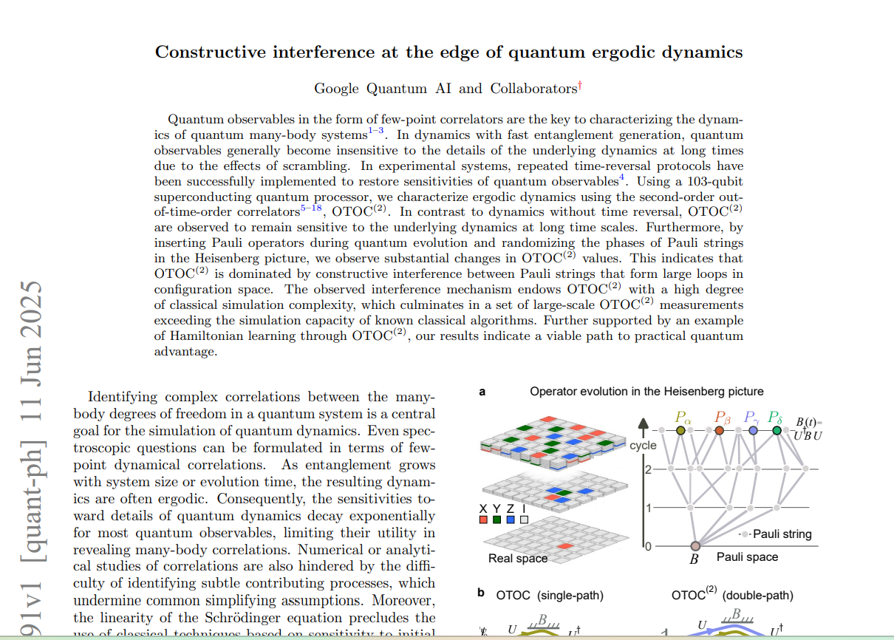
What I’m Excited About: Google’s OTOC Demo
If we want humans and not AI to discover remaining quantum algorithms, we’d better get cracking!

Slide 7
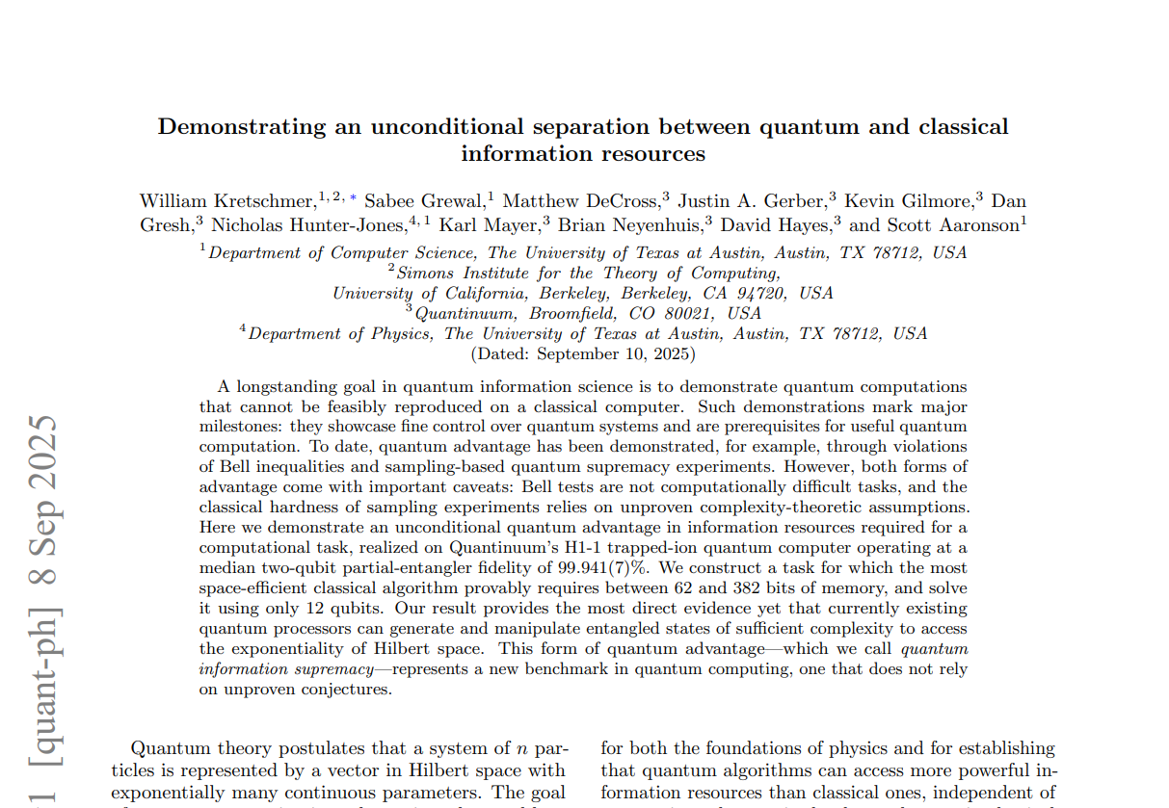
What I’m Excited About:
“Quantum Information Supremacy”
Zhao et al., arXiv:2604.07639 last month: Quantum information supremacy with potential applications to solving sparse linear systems, support vector machines, principal component analysis in the streaming setting

Slide 8
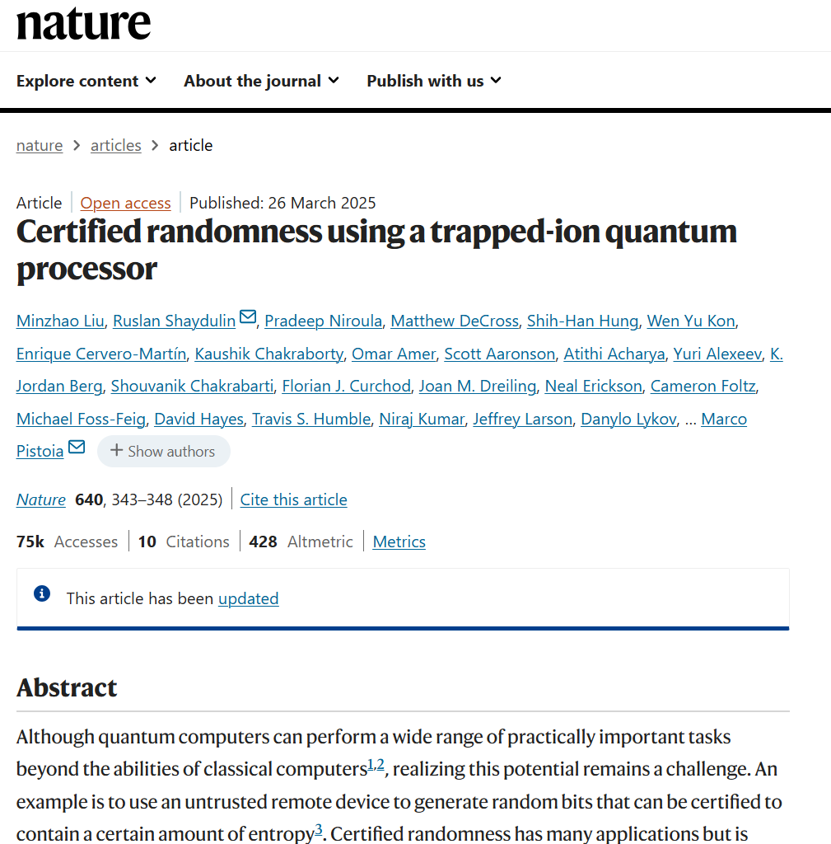
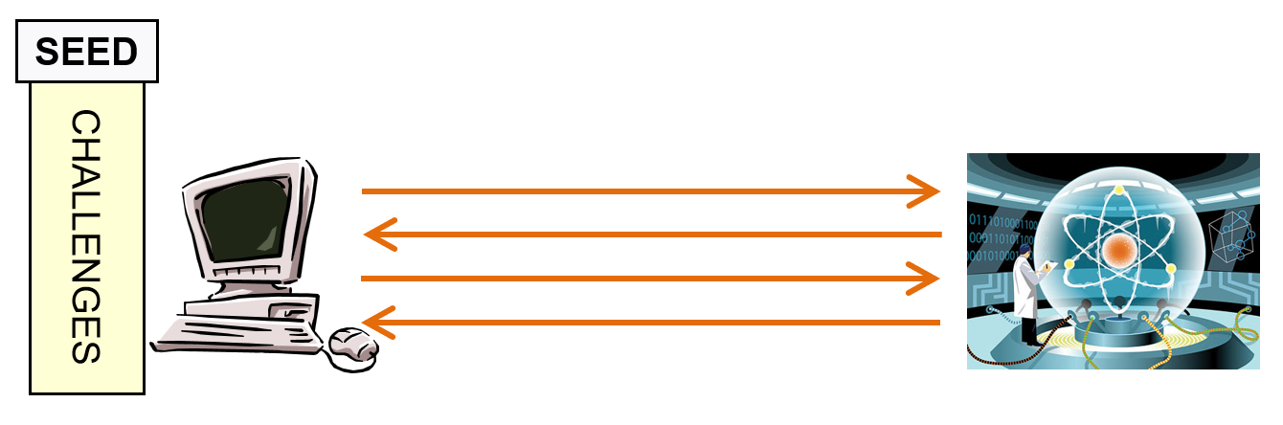
What I’m Excited About:
Experimental Certified Randomness

Slide 9
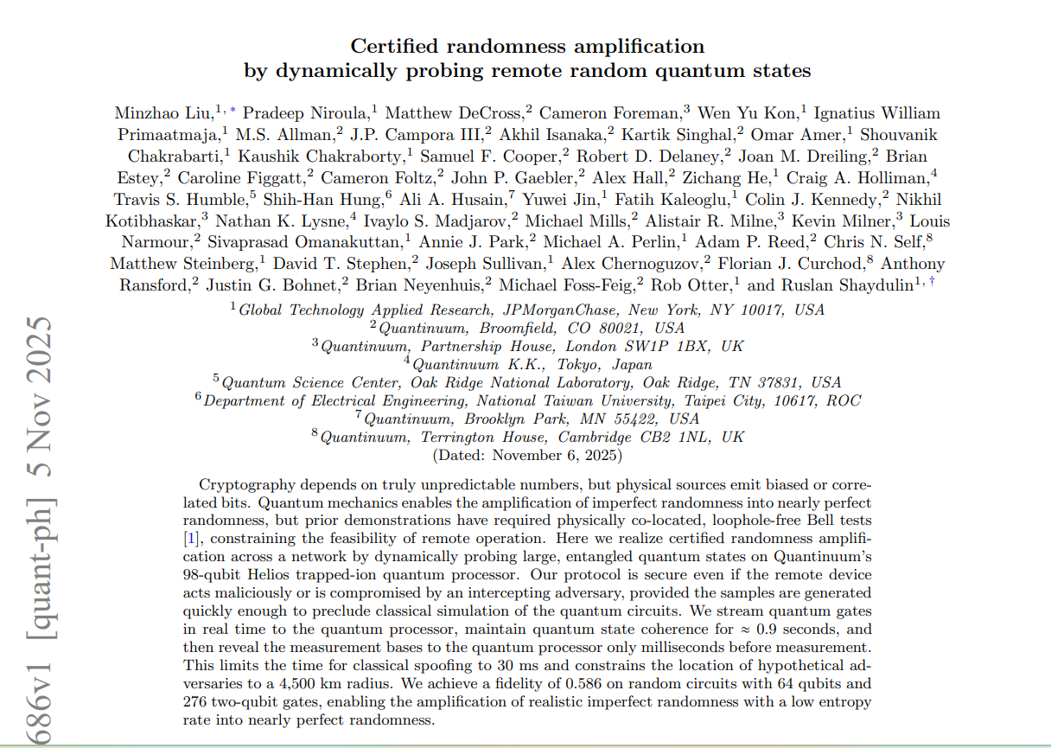

Slide 10
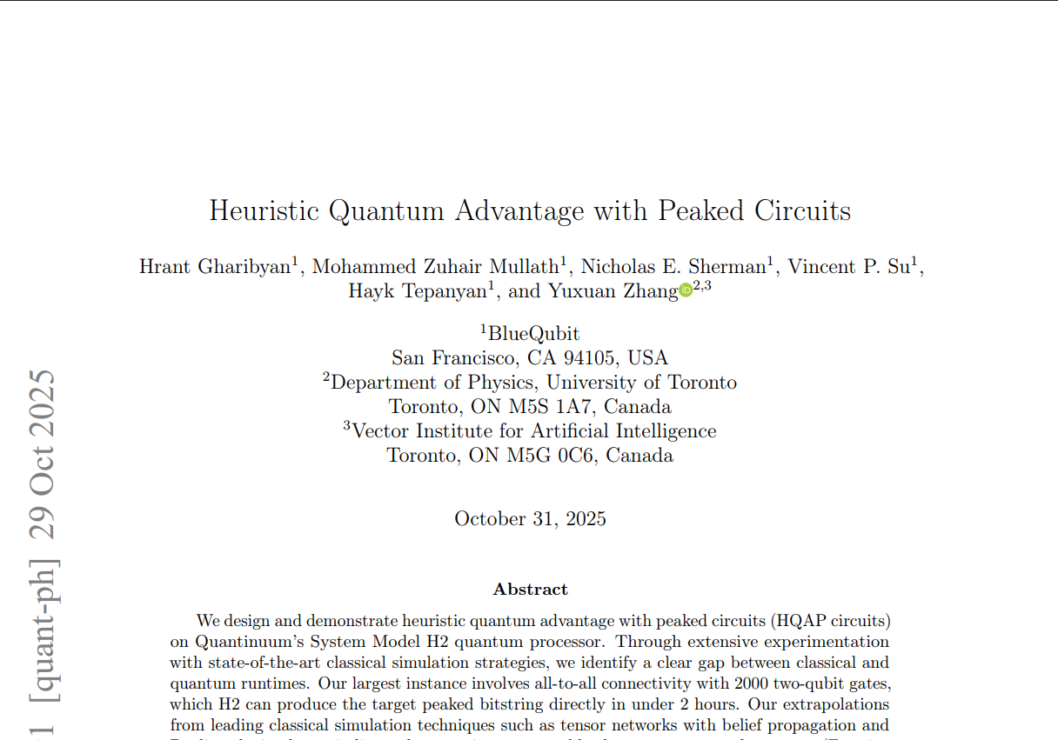
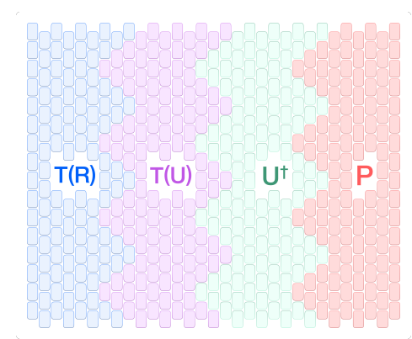
What I’m Excited About:
BlueQubit’s Obfuscated Peaked Circuit Demo
Kremer-Dupuis, arXiv:2604.21908: Bespoke classical break of some of BlueQubit’s circuits! But others are still standing

Slide 11
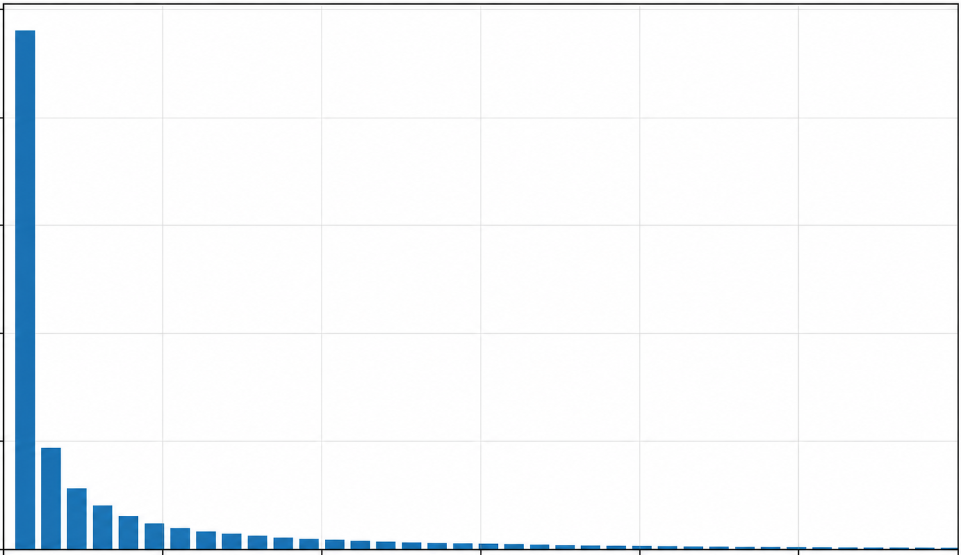
More Generally, Peaked Circuits!
A.-Zhang, arXiv:2404.14493v2
Via gradient descent, we were able to find quantum circuits that contain a highly peaked output, yet otherwise look totally random.
We still don’t understand what’s going on here!
Are these circuits really indistinguishable from random?
Why should they exist?
Can such circuits be found efficiently?

Slide 12
Conclusions
The next few years are “crunch time” for verifiable NISQ quantum advantage demos
“By default,” we’ll just continue doing OTOC measurements, condensed matter simulations, obfuscated peaked circuits, etc. until scalable fault-tolerant devices exist that can run Shor
Is something better possible? If so, could change the trajectory substantially. Basic theory questions still unresolved!

