Slide 1
On the Complexity of Manipulating Quantum Boolean Circuits
Vincent Liew

Slide 2
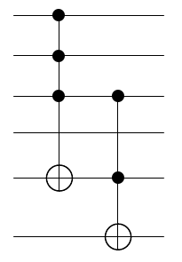
Generalized-CNOT Circuits
Generalized-CNOT gates have one target, multiple controls
We call a circuit composed of these gates is a Quantum Boolean Circuit (QBC)

Slide 3
Why Quantum Boolean Circuits?
Quantum algorithms usually have two components:
Quantum (fixed for each instance)
Uniform superposition (Hadamards)
Quantum Fourier Transform
Boolean Oracle (specific to instance of problem)
Indicator function in Grover

Slide 4
Local Transformation Rules (1)
Iwama et al. gave a set of local transformation rules for QBCs
Finitely many rules
Each rule is an identity on a bounded number of gates
Useful for heuristic optimization
Notes:
Define local transformation rules; can get from one circuit to any other circuit

Slide 5
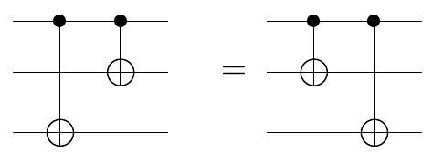
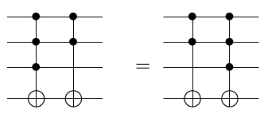
Local Transformation Rules (2)
Easy commutes:
Notes:
Talk about in general; more controls overlapping etc

Slide 6
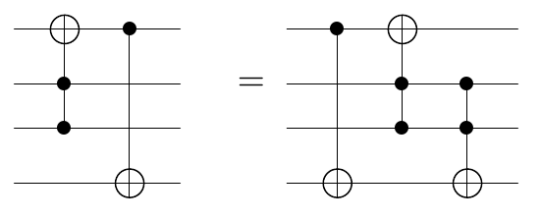
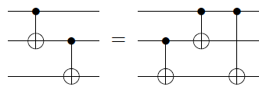
Local Transformation Rules (3)
Harder commuting:

Slide 7
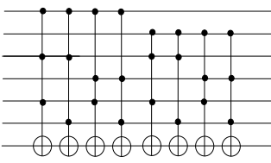
Universality via Canonical Form
Iwama et al. proved that these (with a few more) rules are universal.
Every circuit with one “work-qubit” may be transformed into canonical form.

Slide 8
TOFFLIDENTITY
Given a circuit with one-control-CNOT and Toffoli, is it the identity?
Recently proven CoNP-complete
Should require exponentially many transformations to get identity. Can we prove this?

Slide 9
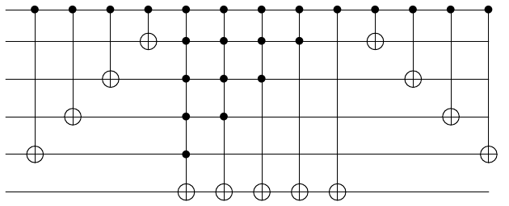
An Explicit Circuit
We have a circuit which requires exponentially many steps for Iwama’s transformation procedure:
Notes:
We can simulate many controls with a linear number of Toffoli gates.
Explicitly only one working qubit

Slide 10
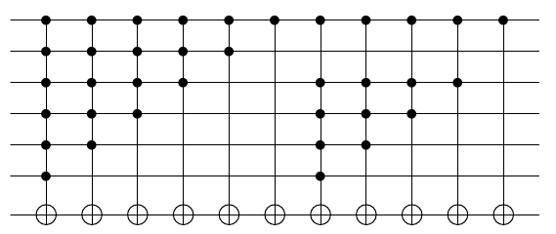
Forced to Commute
After commuting one CNOT over, the middle looks like (after rearranging):
Original Middle
“Copied” Middle

Slide 11
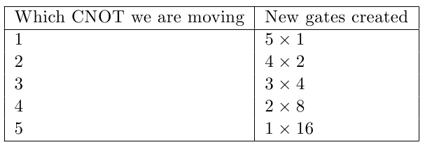
A Rough Calculation
Each CNOT we move over makes a partial “copy” of the middle section.
Assume that nothing created will cancel in the middle.

Slide 12
What Have We Learned?
Conjecture: A similar circuit family will exhibit exponentiality in general.
How do we show no polynomial series of transforms can do it?
The difficulty of deciding CoNP vs NP allowed us to predict that Iwama’s procedure might take exponentially many steps in general.

