Slide 1
Quantum Search on the Spatial Grid
Matthew Falk

Slide 2
Search Problem
Grover’s Algorithm gives a square root running time solution to this problem
When pushed onto the grid the algorithm picks up a extra logarithmic factor
Lower bound on the grid should be same as off of the grid?

Slide 3
Model
Quantum Robot walking along a two dimensional grid
Each node in the grid can be “read”
The grid is cyclic
Similar to a two dimensional Turing Machine
This takes one time step
The robot can either read a node or travel to an adjacent node
Each takes one time step
First and last node in a row or column are connected
Robot can move from to the other in one time step

Slide 4
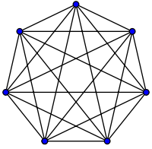
Grover’s Algorithm
Can be seen as a completely connected graph
All nodes have ability to talk to each other
Allows inversion of mean, can access all other nodes in one time step
Builds amplitude of marked state, by pulling from ALL other nodes

Slide 5
Diffuse and Disperse
First do a localized diffusion with your nearest neighbors
Then do a branch out dispersion with your group’s neighbors, sending amplitude to each group
Amplitude travels in wave like patterns towards marked node

Slide 6
Tessellation Patterns
Squares
Crosses
Corners

Slide 7
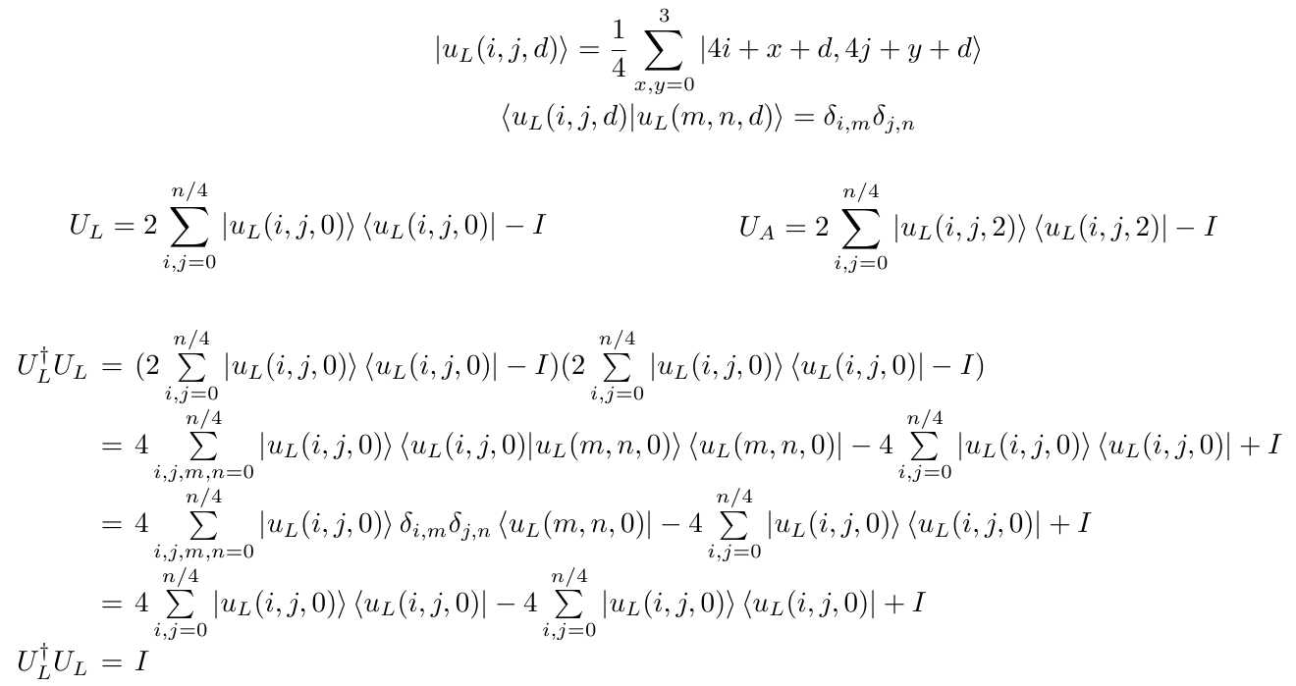
Unitary Operators

Slide 8
Algorithm
Begin by walking the robot over the grid to get equal superposition
Apply U_{w}U_{L}U_{w}U_{A} repeatedly
Measure your system
Repeat on a smaller region of the grid if incorrect measurement

Slide 9
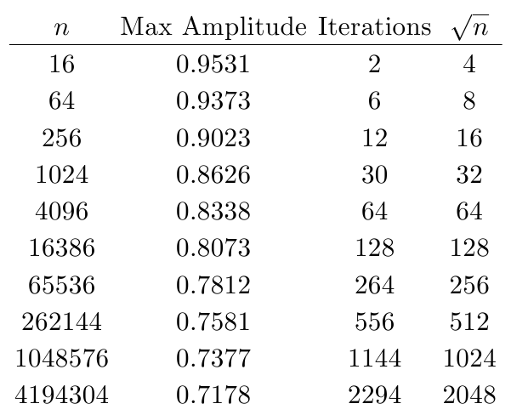
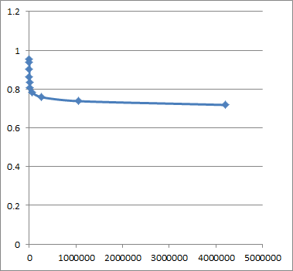
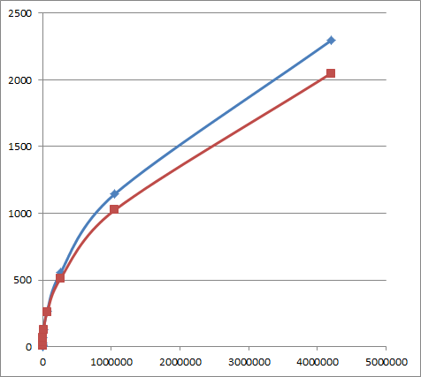
Results
Ran the simulation with a single marked element

Slide 10
Simulation
My Algorithm
Grover’s Algorithm

Slide 11
Close Up

Slide 12
Multiple Marked Items

Slide 13
New Questions
Is there an optimal tessellation and what is it?
Can we amplify the amplitude of the pyramid?
How do we prove the claim of n^{1/2}?
Are there tessellations that work equally well regardless of marked item locality?

