Slide 1
Some Limits on Non-Local Randomness Expansion
God does not play dice.
--Albert Einstein
Matt Coudron and Henry Yuen
6.845
12/12/12
Einstein, stop telling God what to do.
--Niels Bohr

Slide 2
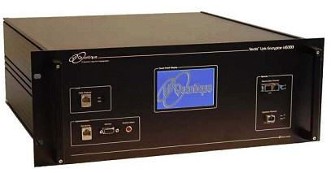
The Motivating Question
Is it possible to test randomness?

Slide 3
The Motivating Question
Is it possible to test randomness?
100010100111100…..

Slide 4
The Motivating Question
Is it possible to test randomness?
111111111111111…..

Slide 5
Non-local games offers a way…
x ϵ {0,1}
y ϵ {0,1}
a ϵ {0,1}
b ϵ {0,1}
CHSH game: a+b = x Λ y
Classical win probability: 75%
Quantum win probability: ~85%

Slide 6
Non-locality offers a way…
x ϵ {0,1}
y ϵ {0,1}
Key insight: if the devices win the CHSH game
with > 75% success probability, then their outputs
must be randomized!
a ϵ {0,1}
b ϵ {0,1}
CHSH game: a+b = x Λ y
Classical win probability: 75%
Quantum win probability: ~85%

Slide 7
Non-locality offers a way…
[Colbeck ‘10][PAM+ ‘10][VV ’11] devised protocols that not only certify randomness, but also expand it!
short random seed
1000101001
0
1
1
0
1
0
0
1
1
0
1
0
0
1
1
0
1
0
0
1
0
1
1
0
1
0
0
1
1
0
1
0
0
1
1
0
1
0
0
1
long pseudorandom input sequence
Referee feeds devices inputs and collects outputs in a streaming fashion.
01000010100….
11111010101….
.
.
.
.
.
.
.
.
Referee tests outputs, and if test passes, outputs are random!

Slide 8
Exponential certifiable randomness
Vazirani-Vidick Protocol achieves exponential certifiable randomness expansion!
n-bit seed
1000101001
0
0
0
0
0
0
0
0
0
0
0
0
Regular block: inputs are deterministic
0
1
1
0
1
0
0
1
1
0
1
0
Bell block: inputs are randomized
2^{O(n)} rounds
0
0
0
0
0
0
0
0
0
0
0
0
Regular block: inputs are deterministic
01000010100….
11111010101….
If the outputs pass the test, then they’re certified to have 2^{O(n)} bits of entropy!
.
.
.
.
.
.
.
.
Referee tests that the devices win the CHSH game ~85% of time per block.

Slide 9
And the obvious question is...
Can we do better?
Doubly exponential?
…infinite expansion?

Slide 10
Our results
Upper bounds
Nonadaptive protocols performing “AND” tests, with perfect games: doubly exponential upper bound.
Nonadaptive (no signalling) protocols performing CHSH tests: exponential upper bound
Shows VV-like protocols and analysis are essentially optimal!
Lower bounds
A simplified VV protocol that achieves better randomness rate.

Slide 11
Definitions
1000101001
Non-Adaptive
“AND” Test
Perfect Games
CHSH Tests
0
1
1
0
1
0
0
1
1
0
1
0
0
1
1
0
1
0
0
1
0
1
1
0
1
0
0
1
1
0
1
0
0
1
1
0
1
0
0
1
01000010100….
11111010101….
.
.
.
.
Test
.
.
.
.

Slide 12
Doubly Exponential Bound
Must exhibit a “cheating strategy” for Alice and Bob
Assume an “AND” test with perfect games
Outputs must be low entropy
Idea: Replay previous outputs when inputs repeat.
But, how can we be sure when inputs repeat

Slide 13
Doubly Exponential Bound
Idea: Alice and Bob both compute input matrix M
Where rows of M repeat, inputs must repeat
Replay outputs on repeated rows
M
(0, 1)
(1, 1)
(1, 0)
(0, 1)
(1, 0)
(0, 0)
(0, 1)
(1, 1)
(1, 1)
(0, 0)
(1, 0)
(0, 1)
(0, 1)
(0, 0)
(1, 1)
(1, 0)
. . .
(0, 1)
(1, 0)
(0, 0)
(1, 1)
(1, 1)
(1, 0)
(0, 0)
(0, 1)
(1, 0)
(1, 1)
(0, 0)
(0, 1)
(1, 1)
(0, 0)
(1, 0)
(1, 1)
. . .
. . .
.
.
.
.
.
.
.
.
.
.
.
.
.
.
.
.
.
.
.
.
.
.
.
.
.
.
.
.

Slide 14

Doubly Exponential Bound
Suppose that the Referee’s seed is n bits
Rows of M are 2^{n+1} bits long
There are at most $2^{2^{n+1}}$ distinct rows of M
So only need to play that many fair games
2^{n+1}
(0, 1)
(1, 1)
(1, 0)
(0, 1)
(1, 0)
(0, 0)
(0, 1)
(1, 1)
(1, 1)
(0, 0)
(1, 0)
(0, 1)
(0, 1)
(0, 0)
(1, 1)
(1, 0)
. . .
(0, 1)
(1, 0)
(0, 0)
(1, 1)
(1, 1)
(1, 0)
(0, 0)
(0, 1)
(1, 0)
(1, 1)
(0, 0)
(0, 1)
(1, 1)
(0, 0)
(1, 0)
(1, 1)
. . .
. . .
.
.
.
.
.
.
.
.
.
.
.
.
.
.
.
.
.
.
.
.
.
.
.
.
.
.
.
.

Slide 15
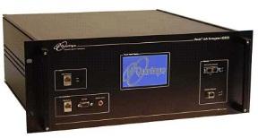
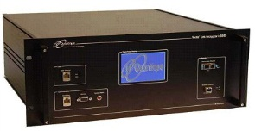
Exponential Bound
100010100
Consider CHSH tests
Many existing protocols use these
Goal: exhibit a “cheating strategy” for Alice and Bob
Require that they only play an exponential number of games honestly
0
1
1
0
1
0
0
1
1
0
1
0
0
1
1
0
1
0
0
1
1
0
1
0
0
1
1
0
1
0
0
1
1
0
1
0
0100001010
1111101010
.
.
.
.
Test
.
.
.
.

Slide 16
Exponential Bound
Idea: Imagine rows as vectors
The dimension of the vector space is only exponential (not doubly)
How can we use this?
Only play honestly on rows of M that are linearly independent of previous rows
M
(0, 1)
(1, 1)
(1, 0)
(0, 1)
(1, 0)
(0, 0)
(0, 1)
(1, 1)
(1, 1)
(0, 0)
(1, 0)
(0, 1)
(0, 1)
(0, 0)
(1, 1)
(1, 0)
. . .
(0, 1)
(1, 0)
(0, 0)
(1, 1)
(1, 1)
(1, 0)
(0, 0)
(0, 1)
(1, 0)
(1, 1)
(0, 0)
(0, 1)
(1, 1)
(0, 0)
(1, 0)
(1, 1)
. . .
. . .
.
.
.
.
.
.
.
.
.
.
.
.
.
.
.
.
.
.
.
.
.
.
.
.
.
.
.
.

Slide 17
Exponential Bound
What about linearly dependent rows?
Their inputs are linear combinations of previous inputs
X =$\sum_{\left\{i∈I\right\}}{X_{i}}$ and Y =$\sum_{\left\{i∈I\right\}}{Y_{i}}$
Want A,B s.t.
A+B = X Λ Y =$\sum_{\left\{(i,j)∈I^{2}\right\}}{X_{i}}$ Λ $Y_{j}$

Slide 18
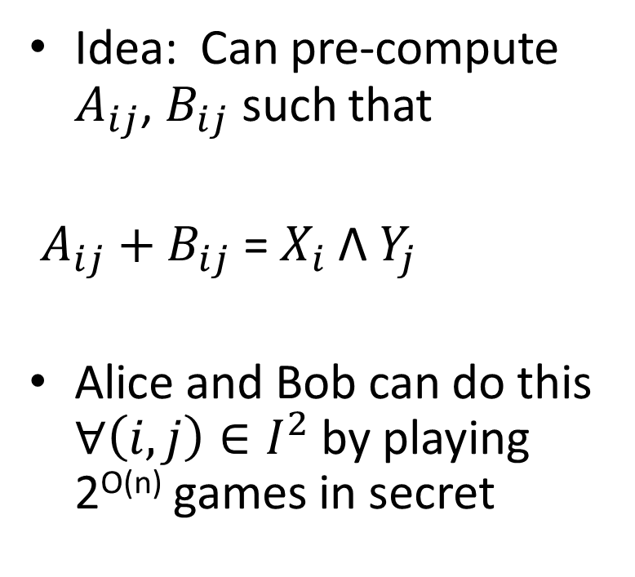
Exponential Bound
100010100
Idea: Can pre-compute $A_{ij}$, $B_{ij}$ such that
$A_{ij}+$ $B_{ij}$ = $X_{i}$Λ $Y_{j}$
Alice and Bob can do this $∀\left(i,j\right)∈I^{2}$ by playing 2^{O(n)} games in secret
0
1
1
0
1
0
0
1
1
0
1
0
0
1
1
0
1
0
0
1
1
0
1
0
0
1
1
0
1
0
0
1
1
0
1
0
0100001010
1111101010
.
.
.
.
Test
.
.
.
.

Slide 19
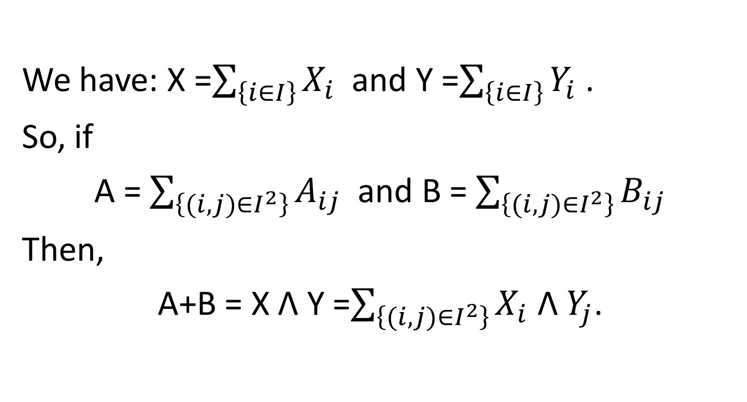
Exponential Bound
We have: X =$\sum_{\left\{i∈I\right\}}{X_{i}}$ and Y =$\sum_{\left\{i∈I\right\}}{Y_{i}}$ .
So, if
A = $\sum_{\left\{(i,j)∈I^{2}\right\}}{A_{ij}}$ and B = $\sum_{\left\{(i,j)∈I^{2}\right\}}{B_{ij}}$
Then,
A+B = X Λ Y =$\sum_{\left\{(i,j)∈I^{2}\right\}}{X_{i}}$ Λ $Y_{j}$.

Slide 20
Open Problems
100010100
Adaptive protocols
More General Tests
Other Games
0
1
1
0
1
0
0
1
1
0
1
0
0
1
1
0
1
0
0
1
1
0
1
0
0
1
1
0
1
0
0
1
1
0
1
0
0100001010
1111101010
.
.
.
.
Test
.
.
.
.

