Slide 1
QMA-complete Problems
Adam Bookatz
December 12, 2012

Slide 2
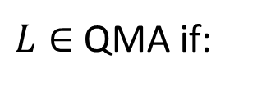

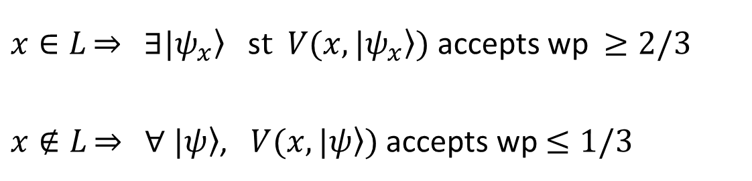
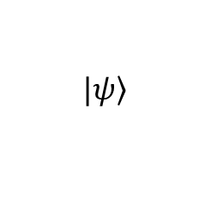
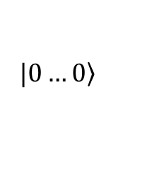
Quantum-Merlin-Arthur (QMA)
$$\left.|ψ\right\rangle$$
$$\left.|ψ\right\rangle$$
1=accept
0=reject
V
$$\left.|0…0\right\rangle$$
$x∈L\underset{⇒}{}$ $∃\left.|ψ_{x}\right\rangle$ s$t \left.V(x,|ψ_{x}\right\rangle )$ accepts wp$≥2/3$
$x∉L\underset{⇒}{}$ $∀ \left.|ψ\right\rangle$, $\left.V(x,|ψ\right\rangle )$ accepts wp$≤1/3$
$L∈$ QMA if:

Slide 3
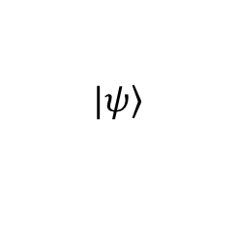
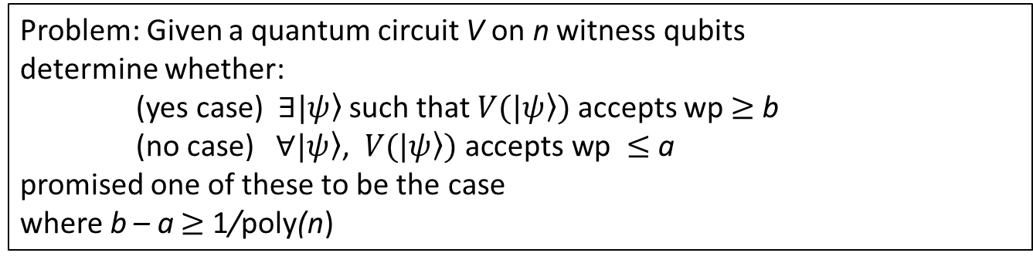
Quantum Circuit SAT (QCSAT)
Problem: Given a quantum circuit V on n witness qubits
determine whether:
(yes case) $∃\left.|ψ\right\rangle$such that $V\left.(|ψ\right\rangle )$ accepts wp $≥$ b
(no case) $∀\left.|ψ\right\rangle \text{, }V\left.(|ψ\right\rangle \text{)} \text{accepts} \text{wp} ≤$ a
promised one of these to be the case
where b – a $≥$ 1/poly(n)
$$\left.|ψ\right\rangle$$
1=accept
0=reject
V
QMA-complete (by definition)
$$\left.|0…0\right\rangle$$

Slide 4

Quantum channel property verifications
QMA-complete problems
non-identity check – Given quantum circuit, determine if it is not close to the identity (up to phase)
non-equivalence check – Given two quantum circuits, determine if they are not approximately equivalent
Given (some type of) quantum channel $Φ$, determine:
quantum clique – the largest number of inputs states that are still orthogonal after passing through $Φ$
non-isometry test – whether it does not map pure states to pure states (even with reference system present)
detecting insecure quantum encryption – whether it is not a private channel
quantum non-expander test – whether it does not send its input towards the maximally mixed state

Slide 5
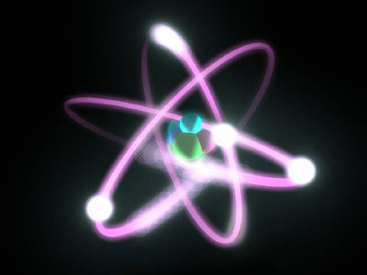
Recall…
from class that Quantum-k-SAT is QMA-complete
We will now look at more general versions
But we require a little bit of physics…

Slide 6
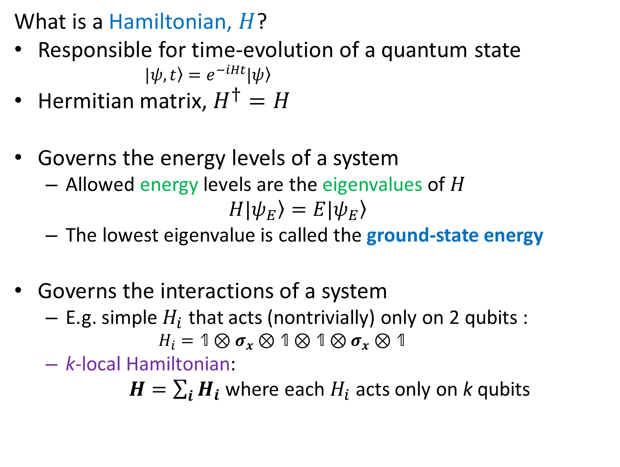
Hamiltonians
What is a Hamiltonian, $H$?
Responsible for time-evolution of a quantum state
    $\left.|ψ, t\right\rangle =e^{−iHt}\left.|ψ\right\rangle$
Hermitian matrix, $H^{†}=H$
Governs the energy levels of a system
  Allowed energy levels are the eigenvalues of $H$
  $$\left.H|ψ_{E}\right\rangle =E\left.|ψ_{E}\right\rangle$$
  The lowest eigenvalue is called the ground-state energy
Governs the interactions of a system
  E.g. simple $H_{i}$ that acts (nontrivially) only on 2 qubits :
    $$H_{i}=\text{1}⊗σ_{x}⊗\text{1}⊗\text{1}⊗σ_{x}⊗\text{1}$$
  k-local Hamiltonian:
  $H=\sum_{i}{H_{i}}$where each $H_{i}$ acts only on k qubits

Slide 7
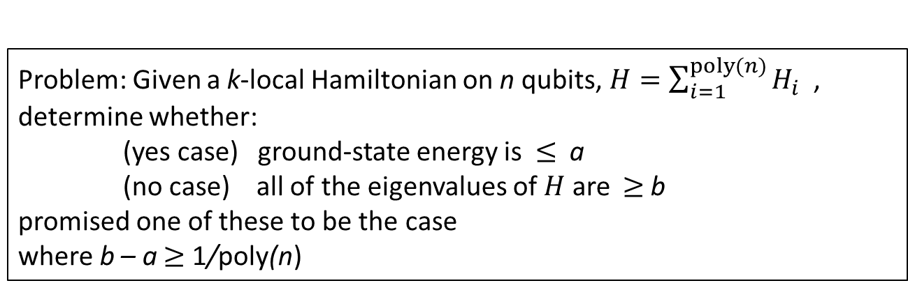

k-Local Hamiltonian
Problem: Given a k-local Hamiltonian on n qubits, $H=\sum_{i=1}^{poly(n)}{H_{i}}$ ,
determine whether:
(yes case) ground-state energy is $≤$ a
(no case) all of the eigenvalues of $H$ are $≥$b
promised one of these to be the case
where b – a $≥$ 1/poly(n)
QMA-complete for k ≥ 2 (Reduction from QCSAT)
Classical analogue: MAX-k-SAT is NP-complete for k $≥2$
  The k-local terms are like clauses involving k variables
  How many of these constraints can be satisfied?
  (in expectation value)
It is in P for k=1

Slide 8

k-Local Hamiltonian
There are a plethora of QMA-complete versions:
2 ≤ k ≤ O(log n)
Line with d=11 qudits
geometric
locality 2-local on 2-D lattice
bosons, fermions
real Hamiltonians
stochastic Hamiltonians (k ≥ 3)
many physically-relevant Hamiltonians
not just ground states: any $c^{th }$ energy level for $c=O(1)$
highest energy of a stoquastic Hamiltonian (k ≥ 3 )
Remoevd:
bounded strength Hamiltonians (k ≥ 3)
Density Functional Theory
when only considering eigenvectors that are separable over a partition

Slide 9
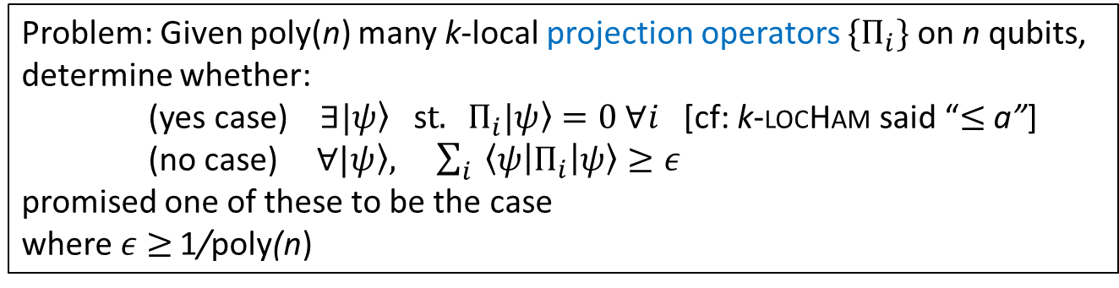
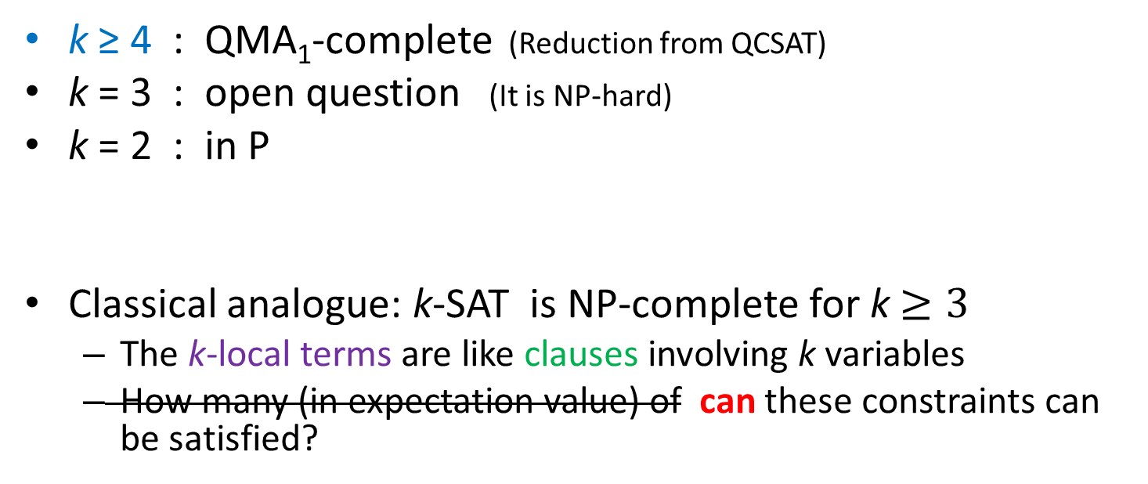
Quantum-k-SAT
Problem: Given poly(n) many k-local projection operators $\{Π_{i}\}$on n qubits,
determine whether:
(yes case) $∃\left.|ψ\right\rangle$ s$t. Π_{i}\left.|ψ\right\rangle =0 ∀i$ [cf: k-locHam said “$≤$ a”]
(no case) $∀\left.|ψ\right\rangle , \sum_{i}{ \left\langle ψ | Π_{i} | ψ\right\rangle }≥ε$
promised one of these to be the case
where $ε$ $≥$ 1/poly(n)
k ≥ 4 : QMA₁-complete (Reduction from QCSAT)
k = 3 : open question (It is NP-hard)
k = 2 : in P
Classical analogue: k-SAT is NP-complete for k $≥3$
  The k-local terms are like clauses involving k variables
  How many (in expectation value) of can these constraints can be satisfied?

Slide 10

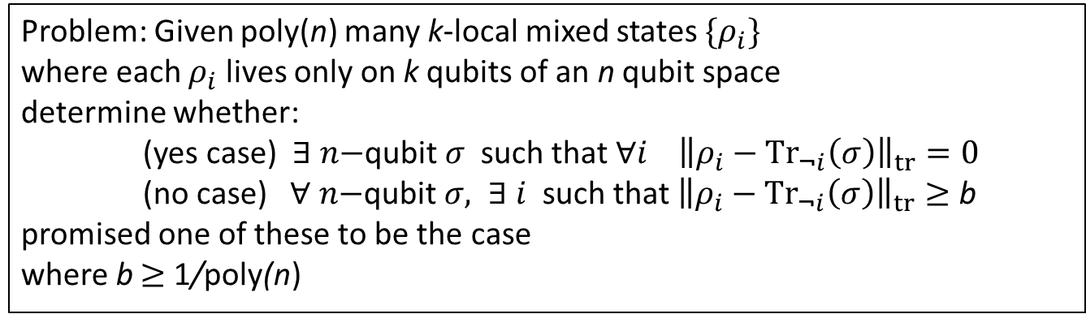



Local Consistency of Density Matrices
Problem: Given poly(n) many k-local mixed states $\{ρ_{i}\}$
where each $ρ_{i}$ lives only on k qubits of an n qubit space
determine whether:
(yes case) $∃ n\text{−}\text{qubit} σ$ such that $∀i {\left\|ρ_{i}−{Tr}_{\text{¬}i}\left(σ\right)\right\|}_{tr}=0$
(no case) $∀ n\text{−}\text{qubit} σ, ∃ i$ such that ${\left\|ρ_{i}−{Tr}_{\text{¬}i}\left(σ\right)\right\|}_{tr}≥$ b
promised one of these to be the case
where b $≥$ 1/poly(n)
$$ρ_{2}$$
$$ρ_{3}$$
QMA-complete for k ≥ 2 (Reduction from k-local Hamiltonian)
True also for bosonic and fermionic systems
$$ρ_{1}$$
$$σ$$

Slide 11
Conclusion
Not so many QMA-complete problems
Contrast: thousands of NP-complete problems
Most important problem is k-local Hamiltonian
  Most research has focused on it and its variants
There are a handful of other problems too
  Verifying properties of quantum circuits/channels
  local consistency of density matrices

Slide 12
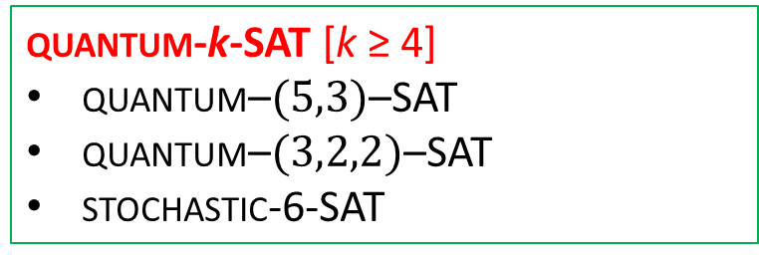
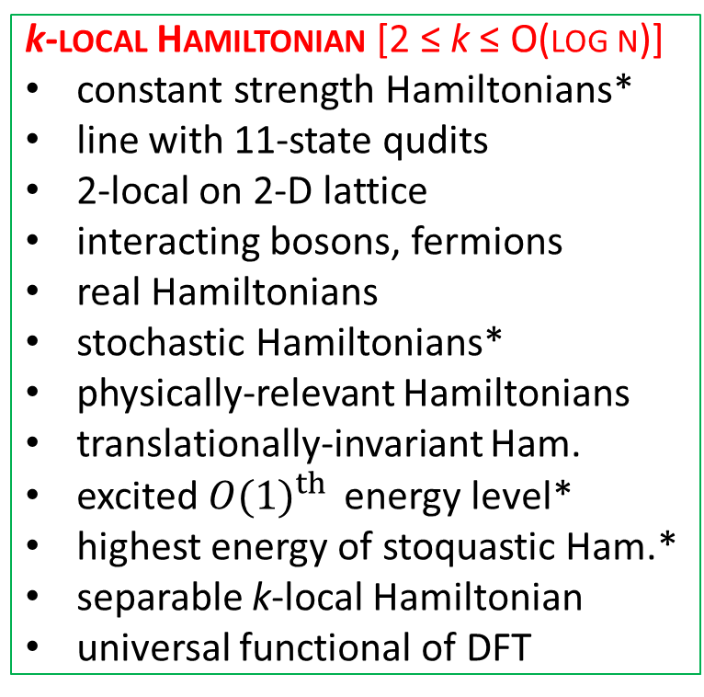
QCSAT
Channel Property Verification
non-identity check
non-equivalence check
quantum clique
non-isometry test
detect insecure q. encryption
quantum non-expander test
k-local Hamiltonian [2 ≤ k ≤ O(log n)]
constant strength Hamiltonians*
line with 11-state qudits
2-local on 2-D lattice
interacting bosons, fermions
real Hamiltonians
stochastic Hamiltonians*
physically-relevant Hamiltonians
translationally-invariant Ham.
excited ${O(1)}^{th }$ energy level*
highest energy of stoquastic Ham.*
separable k-local Hamiltonian
universal functional of DFT
k-local consistency [k ≥ 2]
bosonic, fermionic
quantum-k-SAT [k ≥ 4]
quantum–$(5,3)$–SAT
quantum–$(3,2,2)$–SAT
stochastic-6-SAT
* for k ≥ 3

Slide 13
The End

Slide 15
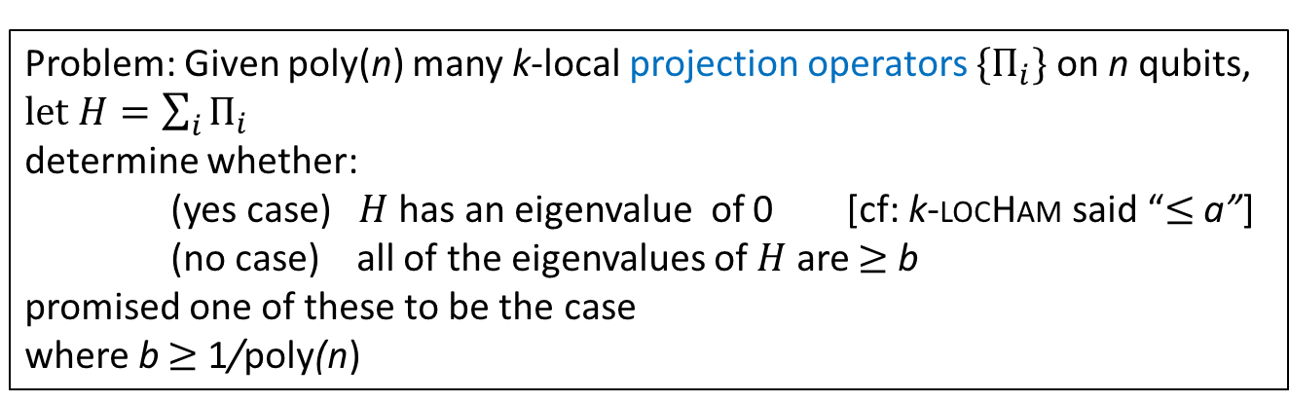
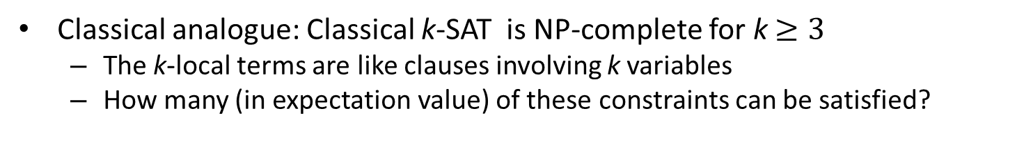
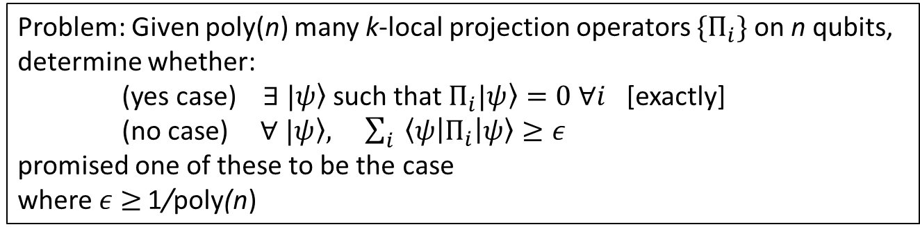
Quantum-k-SAT
Problem: Given poly(n) many k-local projection operators $\{Π_{i}\}$on n qubits, $let H=\sum_{i}{Π_{i}}$
determine whether:
(yes case) $H$has an eigenvalue of 0 [cf: k-locHam said “$≤$ a”]
(no case) all of the eigenvalues of $H$ are $≥$ b
promised one of these to be the case
where b $≥$ 1/poly(n)
Equivalently, write it more SAT-like
Problem: Given poly(n) many k-local projection operators $\{Π_{i}\}$on n qubits,
determine whether:
(yes case) $∃ \left.|ψ\right\rangle$ such that $Π_{i}\left.|ψ\right\rangle =0 ∀i$ [exactly]
(no case) $∀ \left.|ψ\right\rangle , \sum_{i}{ \left\langle ψ | Π_{i} | ψ\right\rangle }≥ε$
promised one of these to be the case
where $ε$ $≥$ 1/poly(n)
Classical analogue: Classical k-SAT is NP-complete for k $≥3$
  The k-local terms are like clauses involving k variables
  How many (in expectation value) of these constraints can be satisfied?

Slide 16
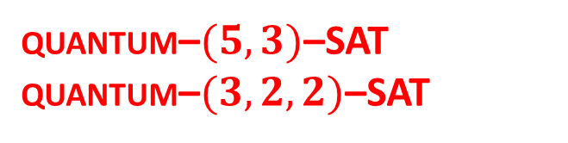

Quantum-k-SAT
k ≥ 4 : QMA₁-complete (Reduction from: QCSAT)
k = 3 : open question (it is NP-hard)
k = 2 : in P
So the current research focusses around k=3:
quantum–$(d_{1},d_{2},…,d_{k})$–SAT
  Same as quantum-k-SAT but
    Instead of the $i^{th }$qubit being a 2-state qubit
    it is now a $d_{i}$-state qudit
quantum–$(5,3)$–SAT
quantum–$(3,2,2)$–SAT
QMA₁-complete

